Slide 1
Customer Lifetime Value Analysis
Soumita Mitra

Slide 2
Objective
This is an Insurance company data and we are intended to frame a regression model that can give us a regressed prediction of Customer Lifetime Value which is our Target variable such that we can predict which of the customers out of 9134 customers are the most profitable ones to this insurance firm.
Considering the objective, we are running a multivariate regression model on Customer Lifetime Value i.e. the target variable to analyze the influence of several independent factors that affect the target variable.

Slide 3
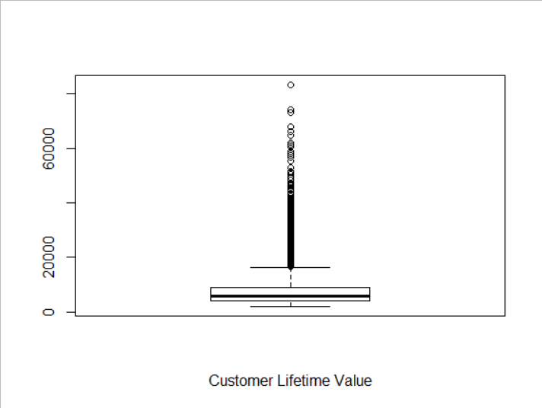
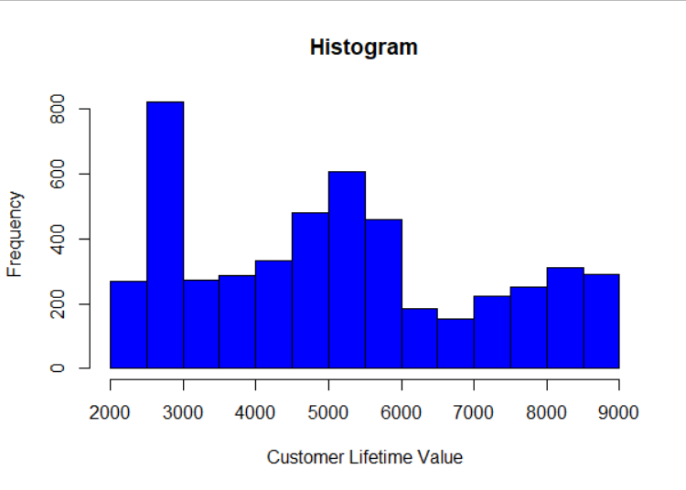
Dependent Variable
Customer Lifetime Value is the total revenue the client will derive from their entire relationship with a customer. This is the dependent variable in our dataset.
We observe that in our dataset the CLV values have large variability i.e. some of the data points are vertically distant from the others. It indicates outlier is present.
In the 2nd figure we can see that at the beginning CLV is very high but after that it is decreasing. It means the revenue that the client derive from their relationship is falling. So the distribution is not symmetric.
Box plot of CLV

Slide 4
Count of Variables and Observations
In our dataset we have 24 variables and 9134 observations.
After removing certain outliers we have 24 variables and 4941 observations.

Slide 5
Significant Variables
Factor like ‘High School or Below’ within education.
Different factors like ‘employed’ and ‘retired’ within employment status.
Gender (Male)
Income
Marital Status ‘single’
Monthly Premium Auto
Number of Open Complaints
Number of Policies

Slide 6
Insignificant Variables
Response
Coverage
Renew offer type
Location Code
Marital Status married
Months Since last Claim
Months since Policy
Inception
Policy type
Policy
Sales Channel
Total claim amount
Vehicle size
Vehicle class
Education except High School or below
Employment Status ‘medical leave’

Slide 7
Explanation of Significant Variables
Monthly premium is a significant variable. It means it affects clv. Higher the monthly premium higher will be the clv, also the revenue will be maximized.
Income have a significant impact in clv. People having a good income will take the policy rather than people with zero income. So as a result clv will increase.
Within gender the category male likely to have significant effects on clv. Male gender has greater impact than female indicating male drivers are more.
Marital status single have a significant relation with clv. The bachelors are more likely to take a policy because they are more inclined towards the planning of the life.

Slide 8
The number of open complaints have significant effect on clv. Less number of complaints means more satisfied customers resulting more customers and clv.
The number of policies have significant effect on clv. Customers with more policies are more likely to increase the clv. Thus those customers should be targeted.
Employed and retired in employment status and high school or below in education have significant relation with clv. Employed and retired customers should be targeted as they are likely to purchase the policy. Customers with higher education should be targeted as they are more likely to contribute in clv.

Slide 9
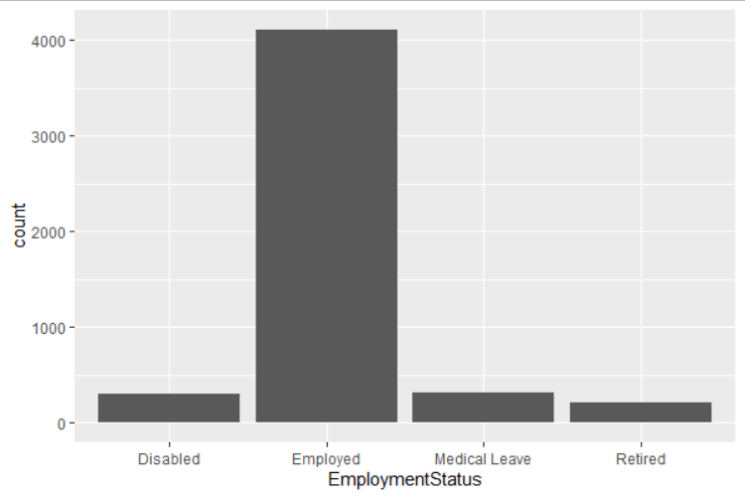
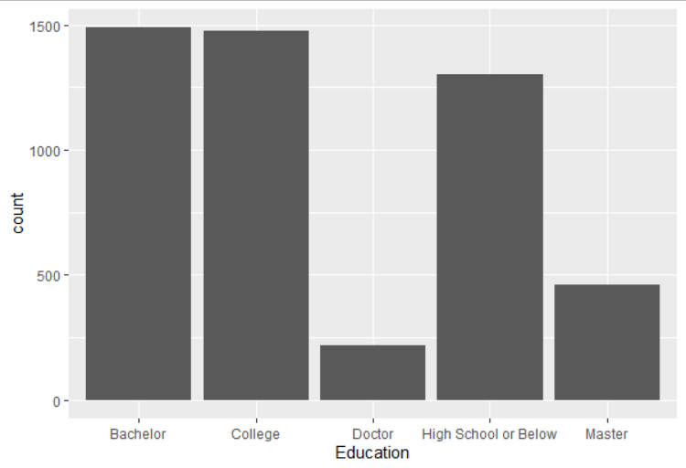
Graphical display of Significant Variable
In the 1st figure we plot employment status on x axis and the graph shows that there are higher number of employed people contributing to clv.
In the 2nd figure we plot the education on x axis. Here no of people in bachelor and college are almost same followed by the number of people in higher secondary contributing to clv.

Slide 10
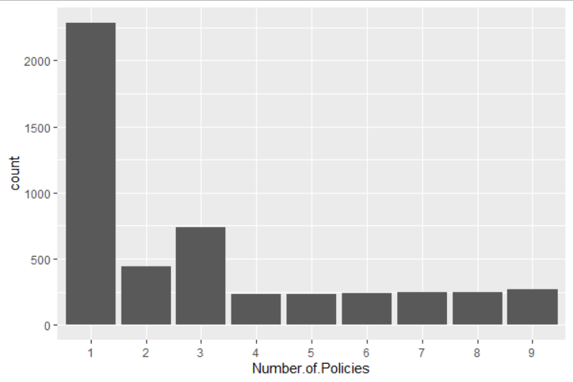
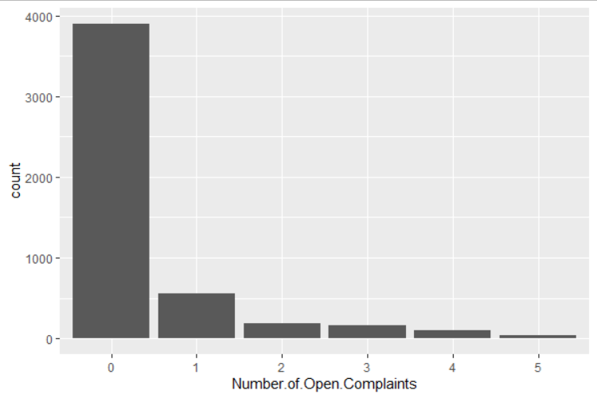
This figure shows the graphical display of policy variable. Also we can see that there are higher number of people who take lesser number of policies.
The 2nd figure shows that number of open complaints is decreasing. There are maximum amount of people who have no complaints. And it is good for the company having very few complaints.

Slide 11
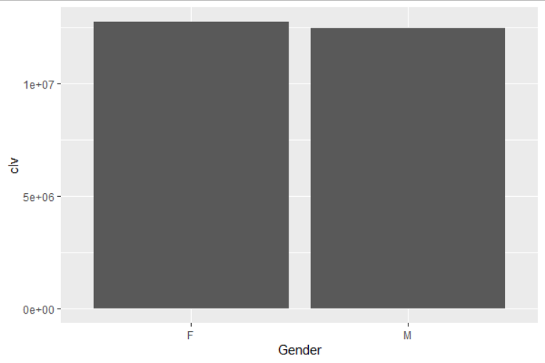
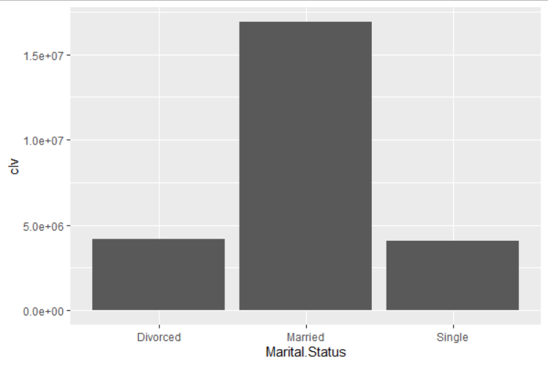
In the 1st figure we plot gender on the x axis and customer Lifetime Value on the y axis. From this bar diagram it is clearly shown that the average customer lifetime value for both male and female are almost same.
In 2nd figure we plot marital status on x axis and Customer Lifetime value on y axis. Here the average customer lifetime value for married people is high. Single or bachelor people have a slightly high average lifetime value than the divorced ones.

Slide 12
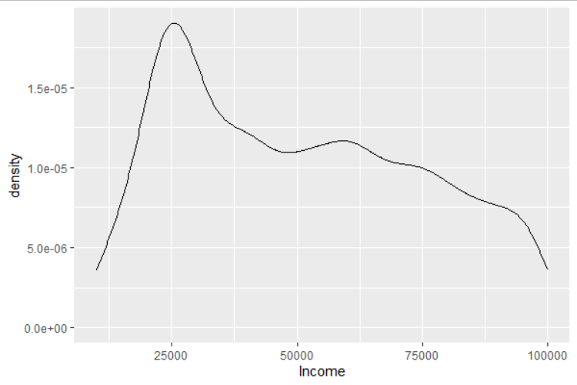
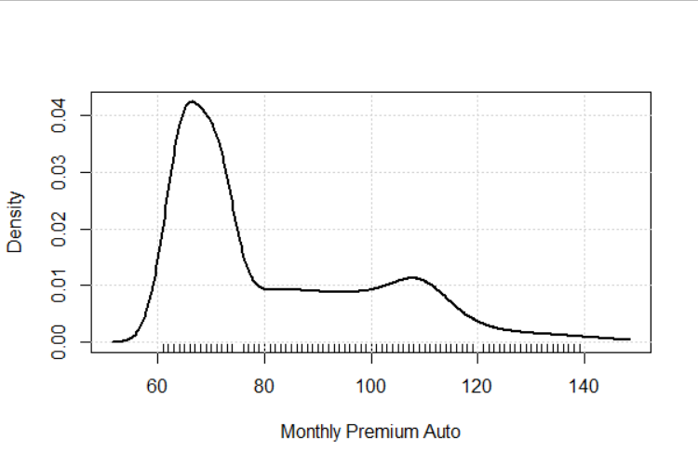
In the 1st figure we plot income on x axis and frequency density on the y axis. Here we can see a high pick around 25000. after that the income levels are falling. From this we can conclude that the distribution is not symmetric.
In the 2nd figure we plot monthly premium on the x axis and frequency density on the y axis. At the beginning it is showing a high peak after that the premium amount is falling. Also the distribution of monthly premium is not symmetric. It means lesser premium attracts more people than the higher one. Also a large no. of people gives lesser amount of premium.

Slide 13
Results Obtained
The outcomes of the data are given below:
Here R-squared is 0.9643 and adjusted R-squared is 0.9638. It indicates that all the independent variables can explain only 96% of the dependent variable.
In BP-test we have p value less than 0.05. It indicates that the variance of the residuals are changing i.e. heteroscedasticity exists in the data.
Ad-test shows p-value less than 0.05. It means that the data is not normally distributed.
In D-W test the d-statistic is close to zero and p value is greater than 0.05. It means there is no autocorrelation in this data.
MAPE tells how different are the predictions from actual. It ranges from 0 to 1, lesser the MAPE better the model. Here the value is 0.064. It means the model is really good and so are predictions.
Vif for all significant variables are less than 2. It indicates there is no multicolinearity in the dataset.

Slide 14
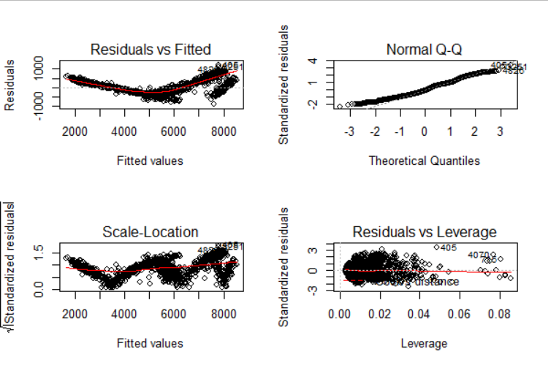
Residual Analysis
From the final model we get the following features:
The residual vs. fitted graph shows how likely the errors are distributed. Here we see that the data points are randomly scattered.
In 2nd diagram i.e. in Q-Q plot we see that errors are not following the corner line, which means they are not normally distributed.
The 3rd diagram, scale location indicates that variance of the residuals are changing.
The residual vs. leverage shows some data points have high values. Outliers might have been present in the data.

Slide 15
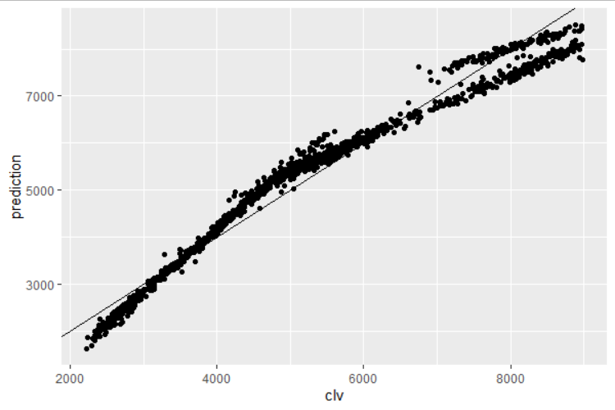
Actual vs. Predicted Plot
This figure plots actual clv values on x axis and the predicted clv values on y axis. We observe that the points are close to the fitted line implying the model is a very good fit.
It indicates that significant variables effect clv in real terms and the model is indeed a good model.

Slide 16
Variable Relationship
Positive Variables are those variables which have positive coefficient. It means if we increase 1 unit of these variables then clv will also increase. In our model such variables are:
Factors like employed in employment status
Income
Monthly Premium Auto
Number of policies
The factor high school or below in education

Slide 17
Negative variables are those variables which have negative coefficients. It means if we increase 1 unit of these variables clv will decrease. Those variables are:
Number of open complaints
Gender (male)
Marital status single

Slide 18
Business Recommendations
From the analysis I would like to convey and recommend that the
company should focus on increasing the values of the positive variables.
Since we want to maximize revenue, they have an increasing impact on
the target variable i.e. clv.
The agents should target mainly the customers who are employed or retired because mainly the employed and retired personnel’s need the insurance more and thus will contribute more to the company.
The agent should target married or single as the former is more inclined towards the work and responsibility commitments and latter a more towards the fast driving.
They should target people having either very basic or higher level of education.
The firm should focus on customers who pays higher monthly premium as it will satisfy their object.

Slide 19
Male gender has greater impact than female indicating male drivers are more. So the target audience should be male.
The company should target people having a moderate level of income. Higher the income higher is the chances of taking policy, and thus clv will increase.
Number of open complaints should be reduced as it will create an adverse effect on clv.
The firm should start increasing their policy advertisement to the customers as the no of policy affects clv.

Slide 20
Thanking You

