Slide 2
Problem Motivation
To help game developers in developing a game that reaches the most number of gamers by considering the various aspects that helps in maximum reach and making it a successful game.
Here our target developers are not EA, XBOX , Activision or Rockstar our target develops are some small game studios who wants to compete with this gaming giants and produce a good game with very less resources compared to others.

Slide 3
Examples
1.Coffee Addict Studio: Making an action,adventure game named Hazel sky written in English,Russian,German and Japanese with a very less system requirements and storage space wants to increase their sales at a low budget yet has some ambitious goals.
2.Mundfish is developing an RPG game named Atomic Heart In Q4 of 2022 in 11 languages with hyper-realistic graphics in a retro-futuristic style created with the latest visual technologies with co-op feature and many more but with a high end system requirements and less fan base.
3.Two Point Studios is developing a single player simulation game named Two point Campus with interface in 11 different languages and audio in both english and german with some basic software and hardware system requirements and with some cartoon characters targeting the kids as their audience.

Slide 4
Problem Definition
Analyze the steam catalogue dataset to determine key features that yield high number of sales,high player count even high YouTube stats (if we can conclusively determine that more activity on YouTube = more successful game) and various other factors. Analyze reviews of similar games, to try and gain information about what reviewers liked and didn’t like.Create a model that takes some number of given variables as input, and outputs predicted sales,predicted player count, etc.Using all the mined information to determine the combination of features that would maximize the success of the game.

Slide 5
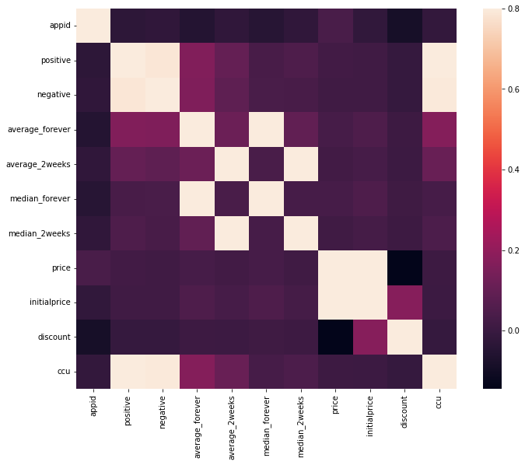

Slide 6
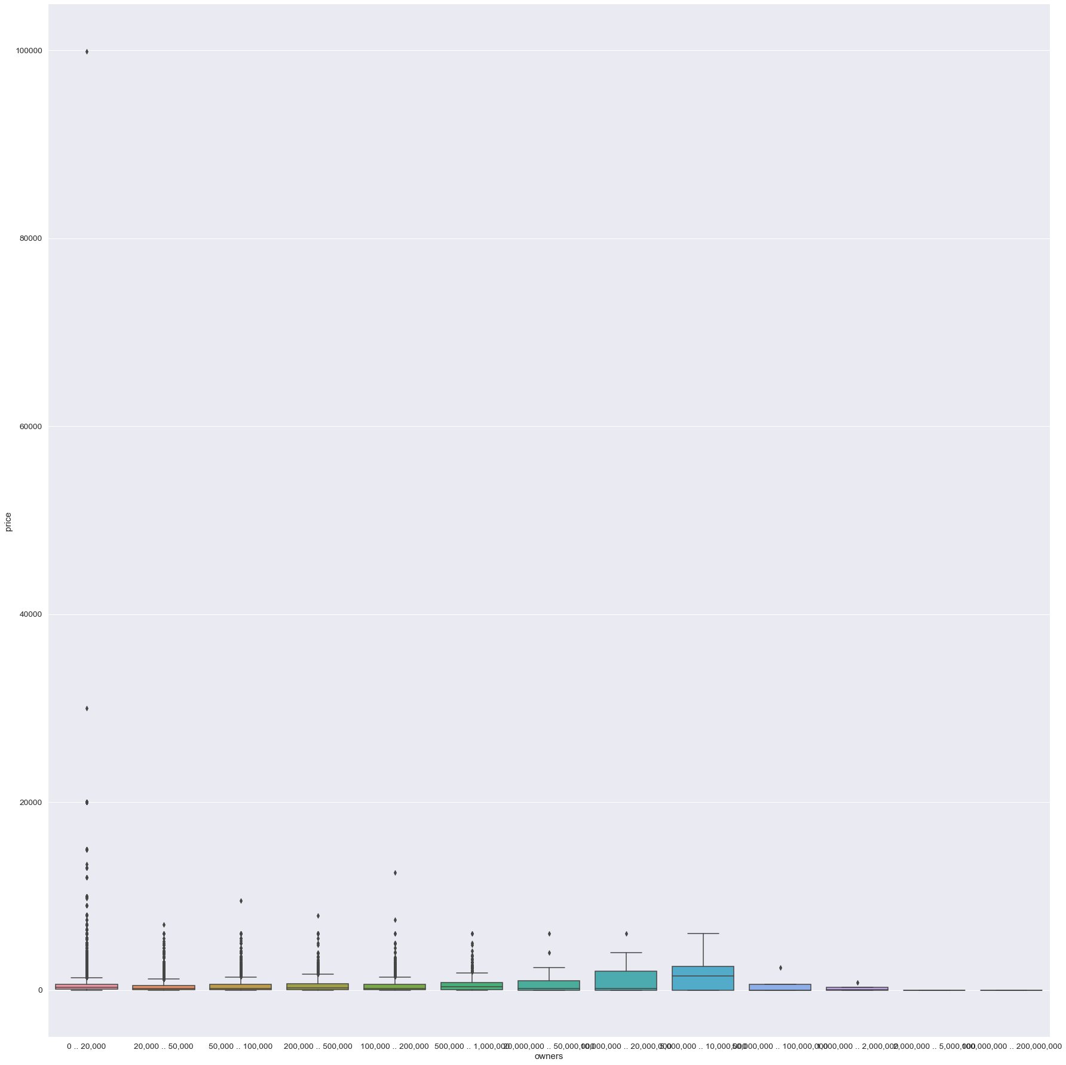
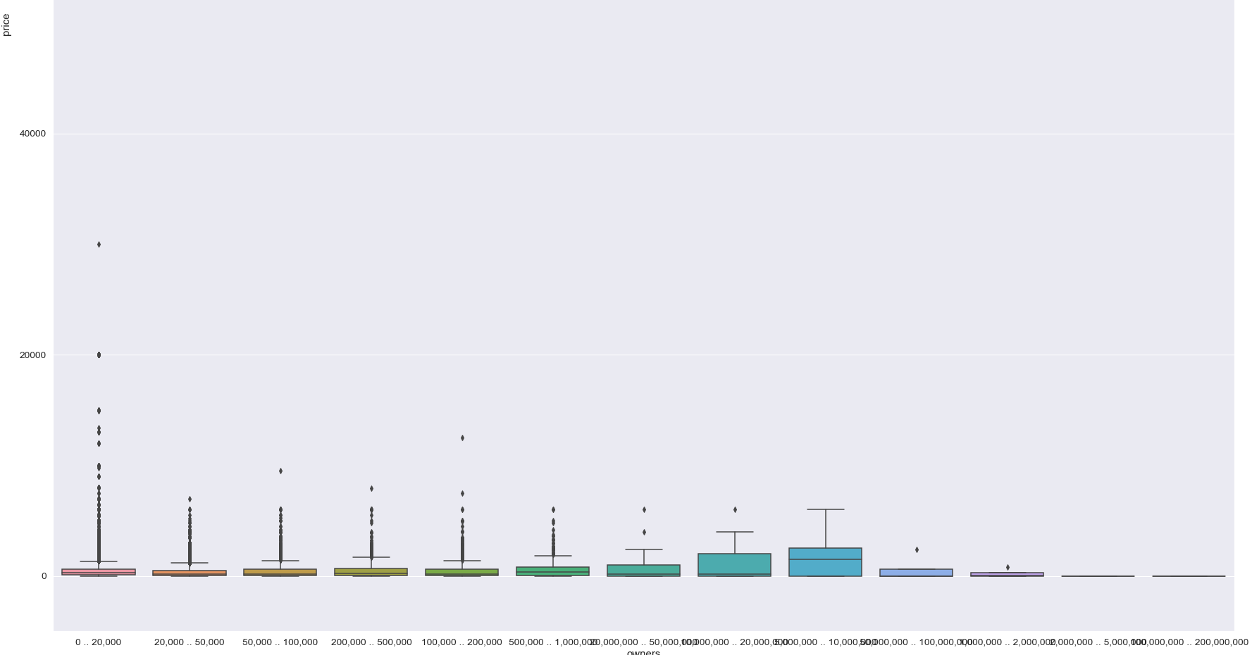

Slide 7
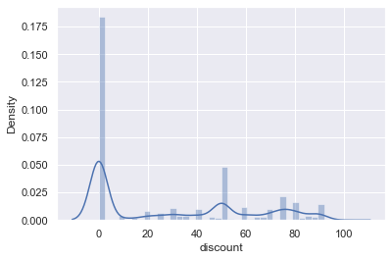

Slide 8
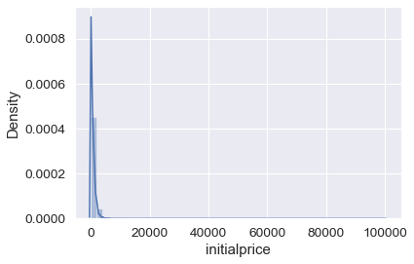

Slide 9
Future Plans
What we want to have by the end of the project:
Rules/guidelines for any game developers (association rules)
More advice, mined from game reviews (using NLP)
ML algorithm to predict success - review score, # of owners, average play time across players
Combine all these things in a dashboard presentation (maybe interactive)
Define which group members will be working on which parts

Slide 10
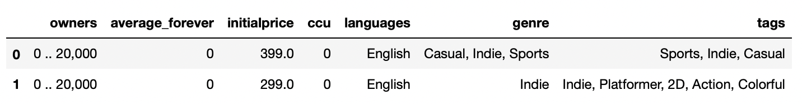
Association Rules - Current
Currently in the data cleaning and preparation phase
Must define class ranges for the numeric columns
Must add columns for each unique class or class range

Slide 11
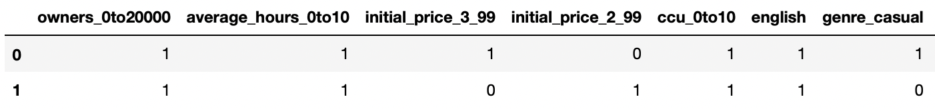
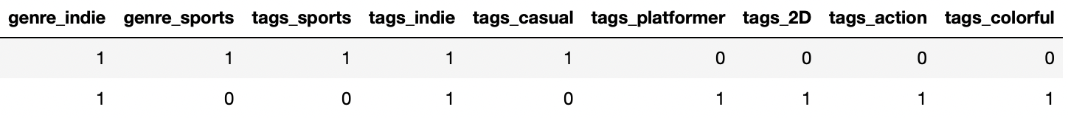
Association Rules - Current

Slide 12
Association Rules - Future
What it should look like:
The end result should be a list of rules for each game developer, specific to the goal that they are looking for
The list should include rules on what not to do as well
Things that could be added:
User review data
External data

Slide 13
Challenges/ more specific future plans
NLP with reviews
We are planning to implement some unsupervised and semi-supervised NLP models on the review texts and hope to accomplish the following:
Find general trends (words used) in all reviews and then reviews specific to particular genres. This will help us understand the most important things that a gamer focuses on, and it will help design the next product better
Apply clustering on the reviews to see if we can separate the good and the bad reviews and figure out important words that help separate good reviews from bad.
Figure out a way to classify reviews into positive and negative based on sentiment analysis. We do not have labeled data so we would be developing our own rubric or use pre-existing rubrics to do that.

Slide 14
Timeline - Association Rules
Assuming week 1 is next week
Week 1 - add user review data, and begin formatting dataset to work with apriori algorithm
Week 2 - finish formatting dataset
Week 3 - start mining rules (maybe finish), help with NLP and other areas of project
Week 4 - Finish mining rules if not done yet, help in other areas

Slide 15
Timeline - Text Analysis
Week 1 - Finish preprocessing the text column and build word clouds
Week 2 - Cluster the reviews to find patterns
Week 3 - Use semi-supervised learning approaches to perform sentiment analysis
Week 4 - Wrap up and present actionable insights

Slide 16
Data Extraction
Game Statistics and Game Reviews were fetched using REST based API requests from stream web api and stored in CSV files for later analysis
Reviews were extracted for 1000 games at a time due to restrictions on REST API
Files extracted separately were merged to a single file each for Game Statistics and Game Reviews

Slide 17
Exploratory Data Analysis – Sentiment Analysis
Data Preprocessing rules applied before performing sentiment analysis:
Remove any addresses from the reviews as those will not contribute to analyze correct sentiment
HTML tags were stripped using BeautifulSoup package
Remove any hashtags and mentions as they too don’t contribute to analyze sentiment
Punctuations were stripped off
Review text were converted to lower case to comply with next contractions and emoticons logic
Contractions in reviews were expanded to English words by creating a dictionary of possible contractions.
Emoticons were replaced with respective English text with the help of a dictionary of emoticons mentioned
Emoji package was used to handle emojis and replace them with English text

Slide 18
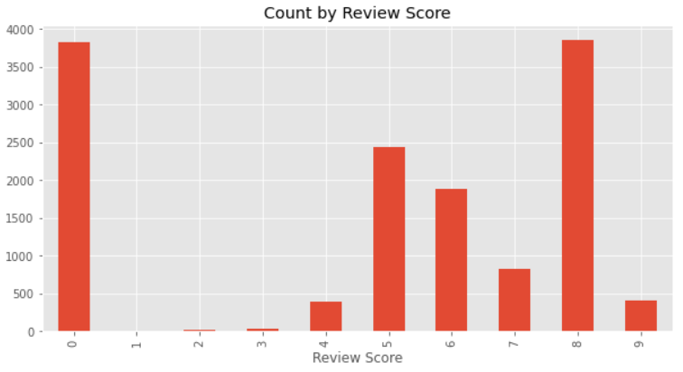
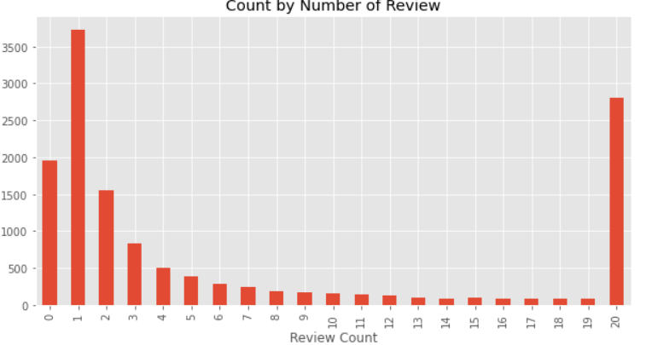
Exploratory Data Analysis – Review Existing Data
The above bar graph displays the number of apps with respected to the available review score
The above bar graph shows the distribution of the number of apps along with their review count

Slide 19
Model Selection – Sentiment Analysis
To perform Sentiment Analysis, we have used pre-trained models and check the outcome of those models.
Following models were used to perform Sentiment Analysis
VADER (Valence Aware Dictionary for Sentiment Scoring)
Roberta Model from Transformers
BERT Model from Transformers

Slide 20
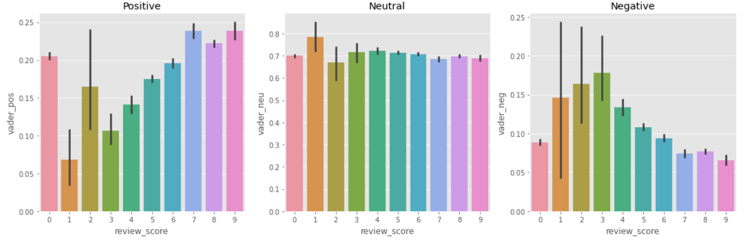
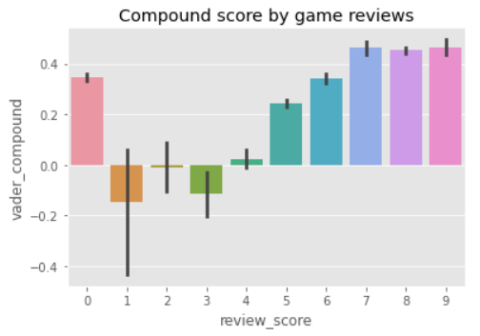
Model - VADER
Based on the graph w.r.t Vader compound score and review score it is expected that lower ratings to be in negative.
Compound score is positive for review score of 2 which doesn’t seem to be correctly calculated using vader
In case of the Positive score with review score we see it should be increasing which is apparently the case with some exception
In case of the Neutral score with review score it’s maintained which is expected since they are neutral
In case of the Negative score with review score it should go down which seems to be incorrect for review score 1 and 2

Slide 21
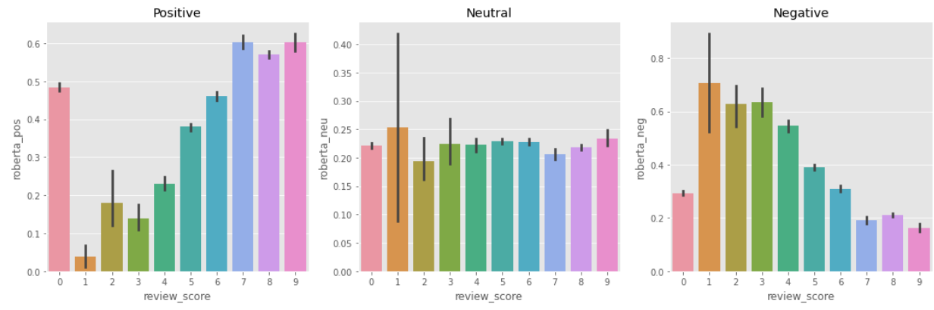
Model - Roberta
Review score 0 to be excluded since there are no reviews for those. If Review Score 0 is excluded then we see for Positive reviews the score are having and increasing trend.
For Neutral it shows a flat trend which is expected
For Negative it shows a reducing trend which is expected

Slide 22
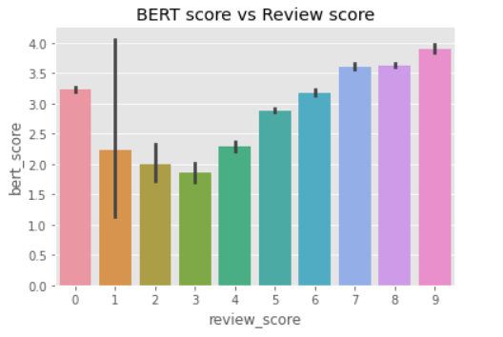
Model - BERT
BERT pretrained model used to analyze the sentiment for the game reviews.
Bert score was analyzed to validate the score, it seems that the model worked good for all rating but there are some discrepancies when ,compared with the games with review score 1

Slide 23
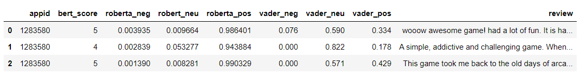
Review Analysis – Score Comparison
Based on the image below we see the first 3 reviews are all positive reviews
Based on the scores it seems that Roberta and BERT did better to identify the intensity of positive sentiment where as VADER’s intensity was less
BERT and Roberta seems to be working well to identify sentiment with different parameters
From performance standpoint VADER is much faster when compared with BERT or Roberta
VADER
Roberta
BERT

Slide 24
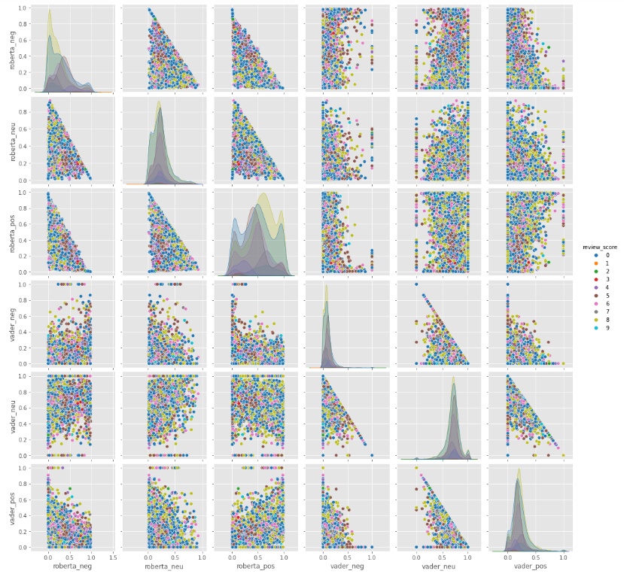
Pairwise Plot (VADER vs Roberta)
Based on the 2 model comparison it was observed that Roberta performed better than VADER which is expected. Since VADER works on individual word sentiment whereas Roberta works on a complete phrase
From the pairwise plot we see some that the VADER model is less confident and they are scattered whereas the Roberta model is more confident and less scattered.
In VADER model for example the high scores are scattered whereas in Roberta the high review score is having the higher weights.

Slide 25
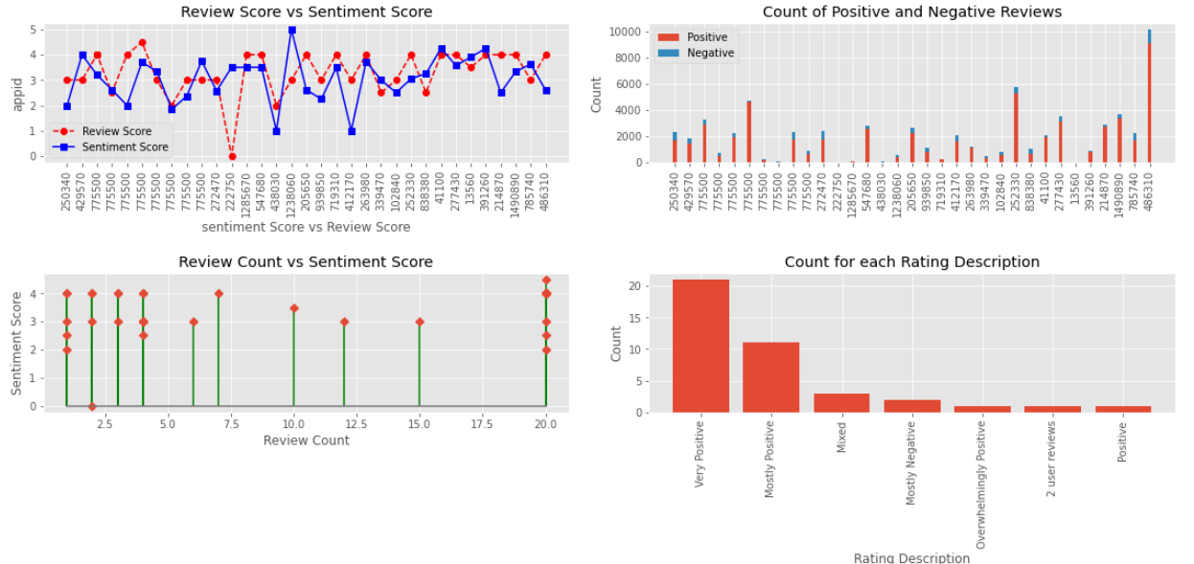
Sentiment Analysis - Dashboard

Slide 26
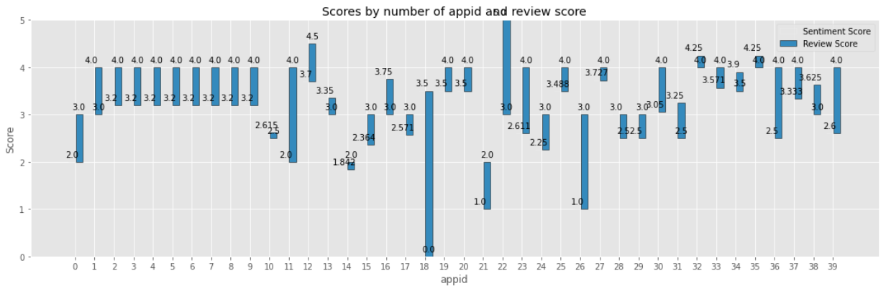
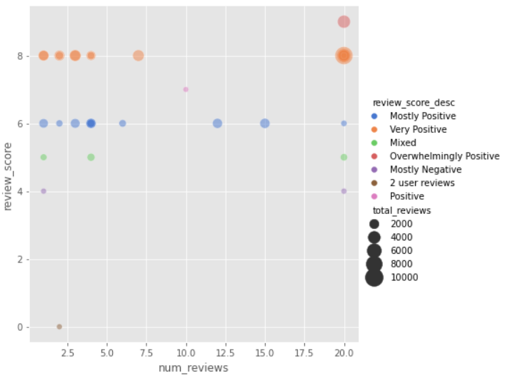
Sentiment Analysis – Dashboard(contd.)

