Slide 1
Supervision meets Self-Supervision: A Deep Multitask Network for Colorectal Cancer Histopathological Analysis
ID: 273
Aritra Marik, Soumitri Chattopadhyay, Pawan Kumar Singh
Dept. of Information Technology, Jadavpur University, Kolkata, India

Slide 2
Background
Literature Survey
Problem Description
Methodology
Results and Discussion
Conclusion
References

Slide 3
The necessity of higher efficiency in colorectal cancer histopathological (CRCH) analysis from the tissue images along with the extraction of underlying features from those images has paved the way for deep learning based methods in the literature.
Medical imaging-based histopathological analysis has been approached classically using traditional machine learning and handcrafted feature extraction, which, however, fail to capture complex underlying patterns within the image data.
Deep learning methods, particularly CNNs, have gained popularity due to their capability in recognising salient and translationally invariant image features for robust classification and investigation.

Slide 4
Colorectal Cancer Histopathology:
Kather et al. [1] proposed the first multi-class texture analysis in colorectal tissue classification.
Wang et al. [2] proposed deep learning based histopathological image classification with bilinear convolutional neural networks.
Ciompi et al. [3] highlighted the importance of stain normalization in colorectal tissue classification with convolutional networks.
Sabol et al. [4] proposed a method which had enhanced classifier performance using a fine-tuned CNN model for multi-class classification task.
Other deep learning based works include transfer learning by Ohata et al. [5] and ensemble learning strategy by Ghosh et al. [6].

Slide 5
Deep Metric Learning:
Based on (dis)similarity learning between samples and has been used for representation learning in several domains such as offline signature verification (Bromley et al. [7]), medical imaging (Annarumma et al. [8]) and face recognition (Liu et al. [9]; Schroff et al. [10]), to name a few.
Self-Supervised Learning:
SSL has gained tremendous popularity due to its capability to learn robust representations from unlabelled data. Primary directions of study include contrastive learning (Chen et al. [11]), generative/reconstruction based models (Atito et al. [12]; Deepak et al. [13]) and clustering approaches (Alwassel et al. [14]).

Slide 6
As of 2020, CRC is one of the leading causes of cancer related deaths in the world, accounting for around 11% of the cancer patients worldwide.
The early detection of CRC can increase the survival rates by around 90% which explains the need for its early detection.
An early detection and diagnosis is of paramount importance, which is however, limited due to insufficient medical practitioners available for large-scale histopathological screening.
This demands for a reliable computer-aided framework that can automatically analyse histopathological slide images and assist pathologists in quick decision-making.
To this end, we propose a novel deep learning framework that combines supervised learning with self-supervision for robust learning of histopathological features from colorectal tissue images.

Slide 7
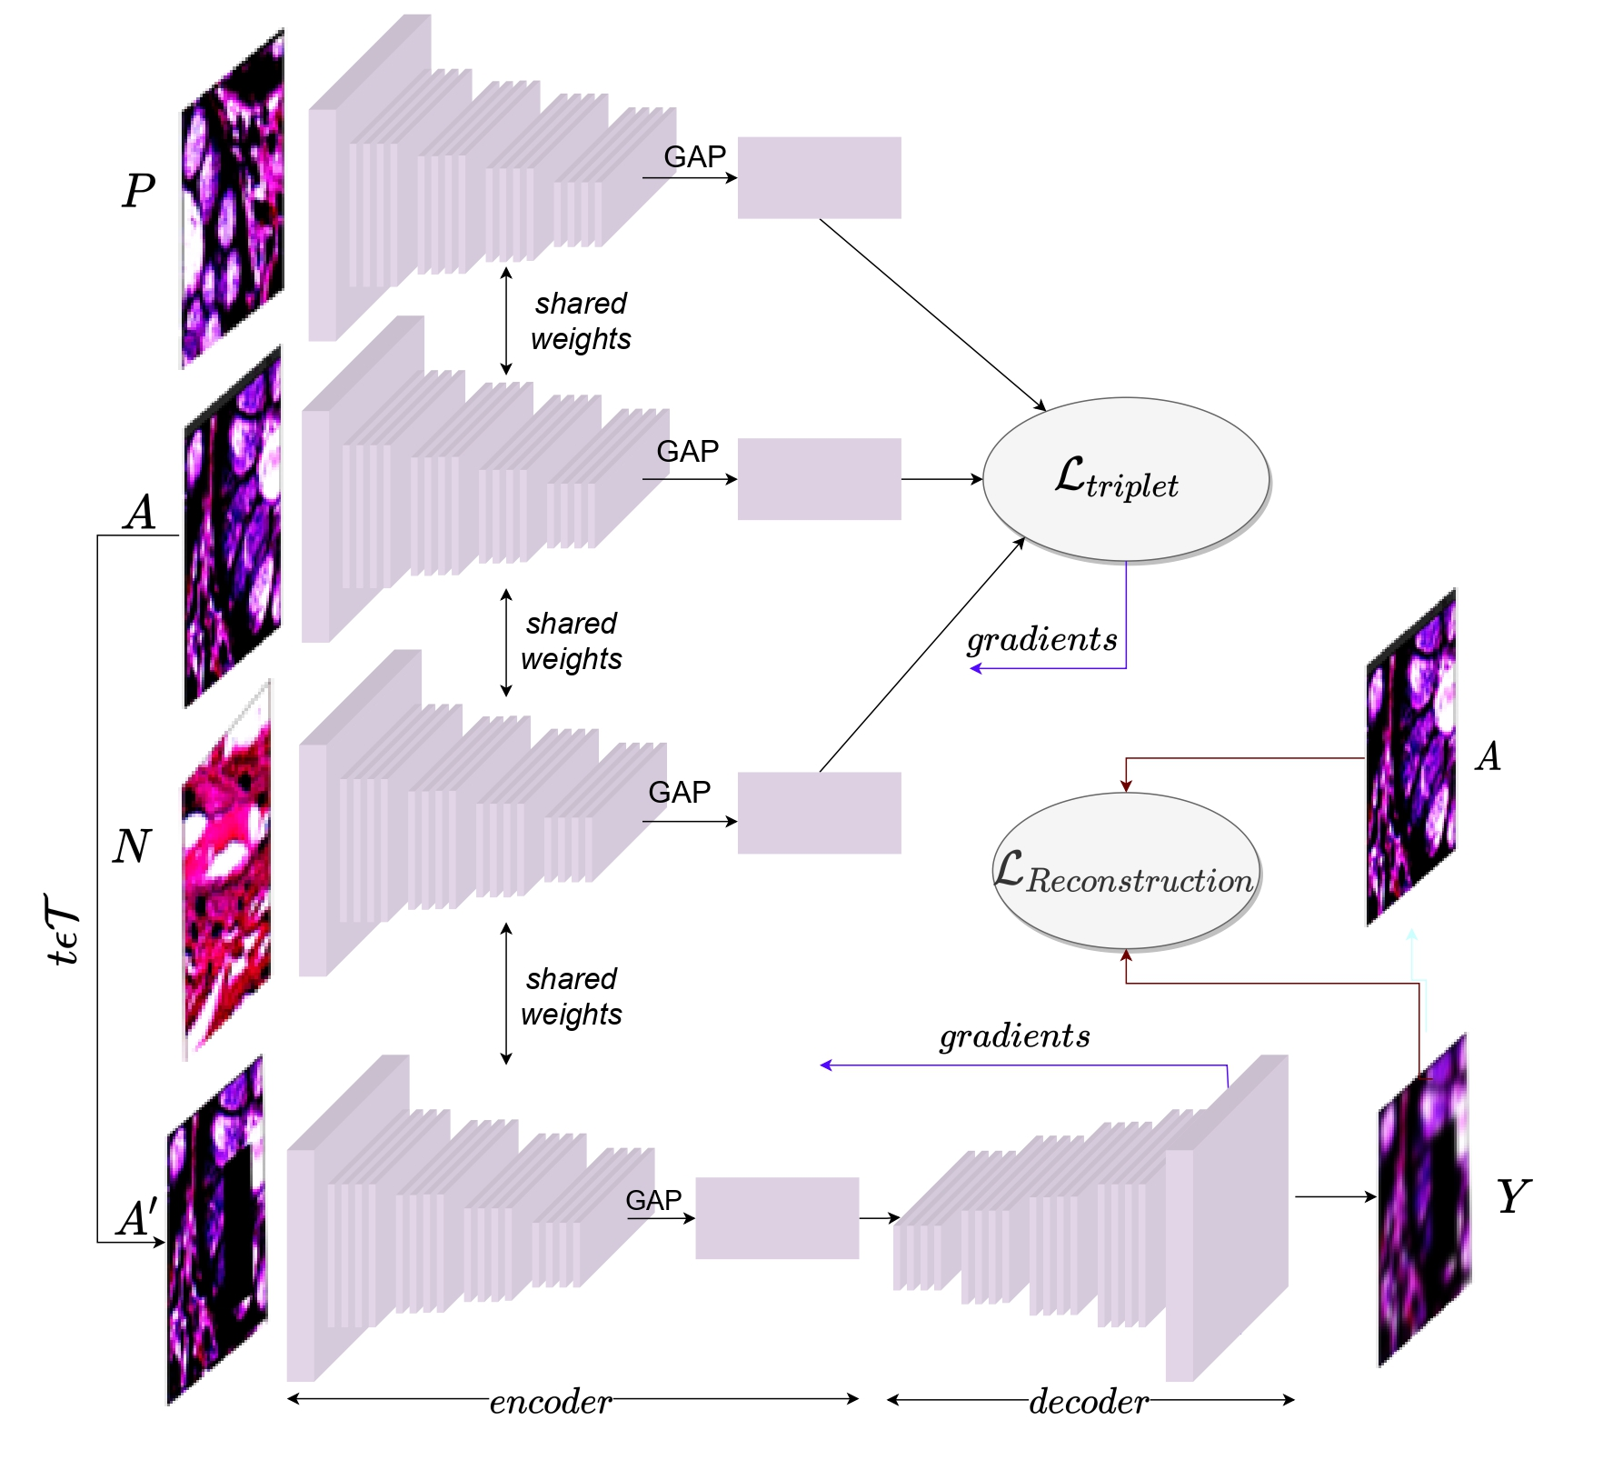
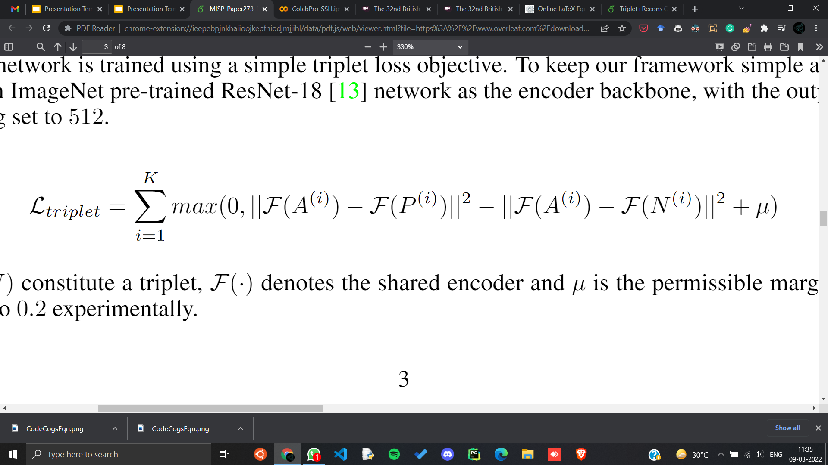
We intend to combine supervised learning with self-supervision as a pre-training paradigm for robust CRCH image analysis.
We use the metric learning framework to learn maximisation of intra-class similarities while distinguishing samples from a different class.
Specifically, metric learning is used to minimise the distance metric between intra-class or “positive” pairs and maximise the distance between inter-class or “negative” pairs.
The primary purpose is to learn discriminative embedding space, where samples from same class shall be closer while the ones from different classes shall be farther apart.

Slide 8
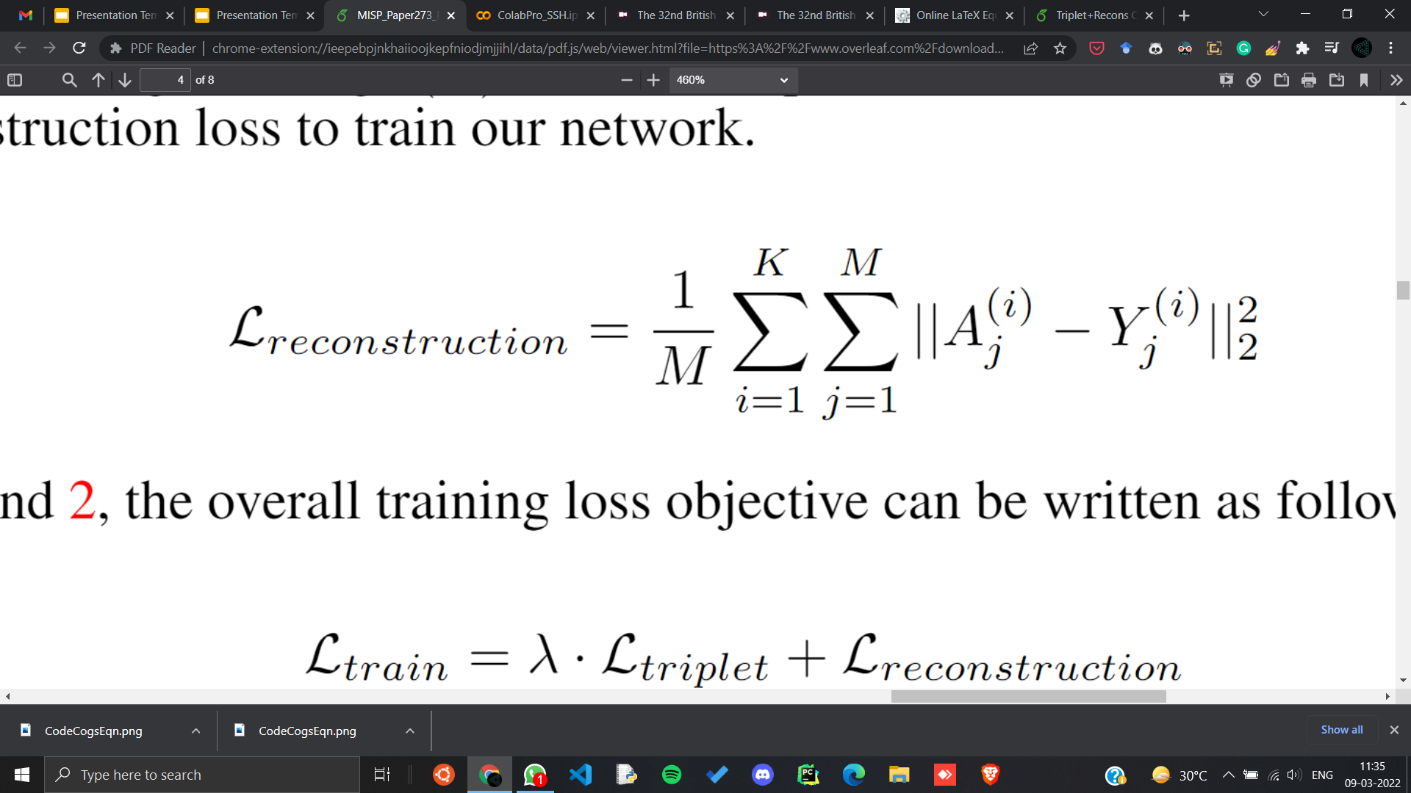
Further, we have introduced a self-supervised image reconstruction module to enhance the learning of image-level texture features.
For reconstruction, we have used the state-of-the-art U-Net decoder module (Ronneberger et al. [15]) excluding the skip connections, starting from an embedding vector into a series of unsampling layers which yield the output image dimensions.
We form a corrupted version of the ‘anchor’ image by random spatial transformations such as blurring or dropping pixels, which is then used to generate the reconstruction.
We have used mean squared error(MSE) as the reconstruction loss, employed between the output and original anchor image to train this branch.

Slide 9
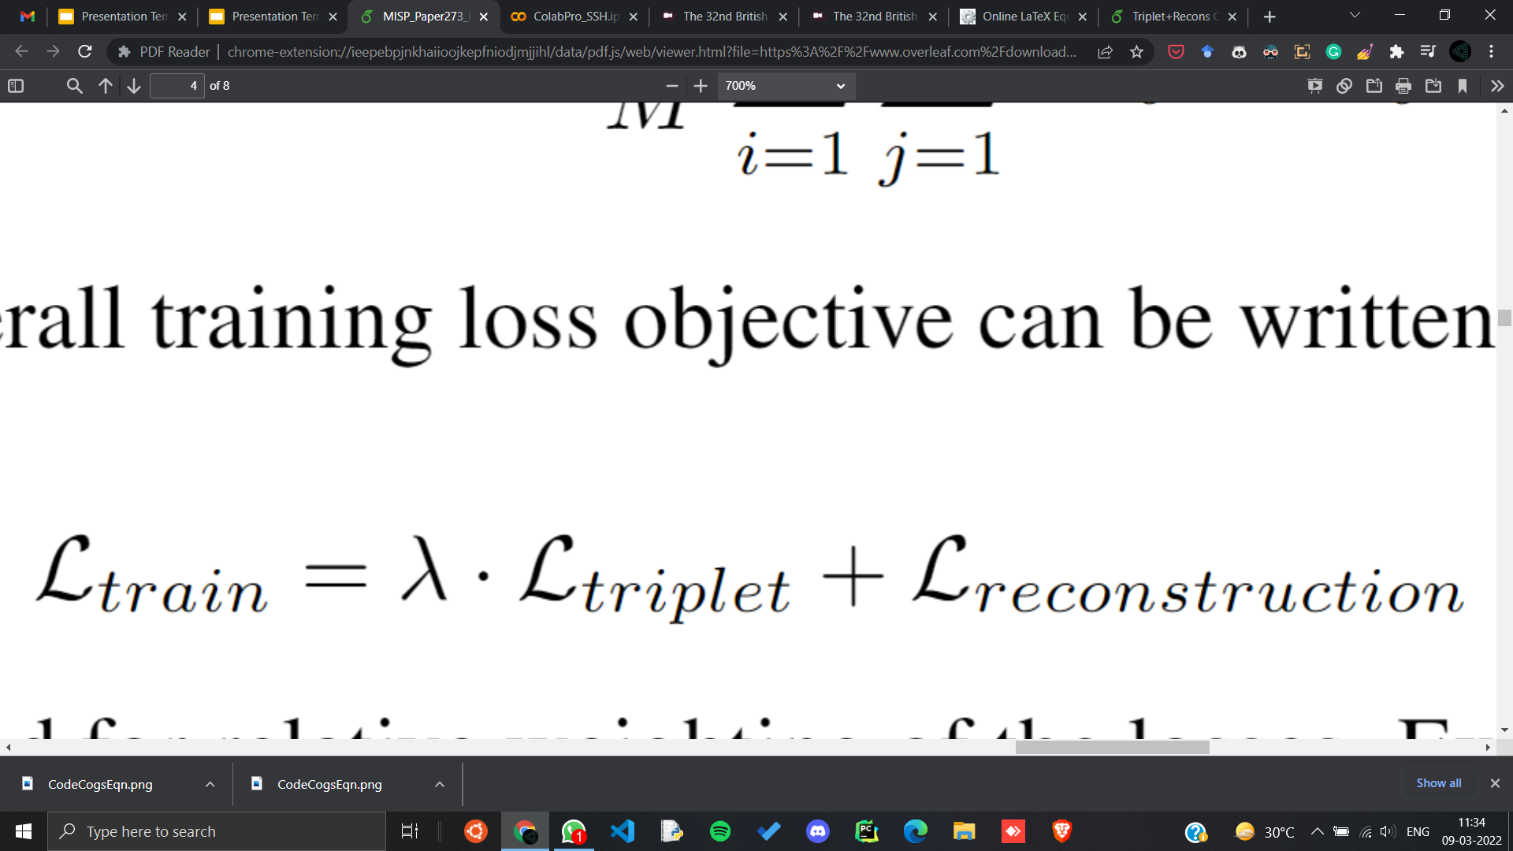
Combining the two losses, we define our training objective as:
is a hyperparameter to balance the losses.
Once the network is trained, the frozen encoder is used to extract image features, which are used to train a SVM classifier for the final classification.

Slide 10
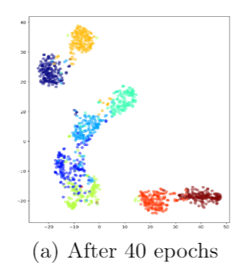
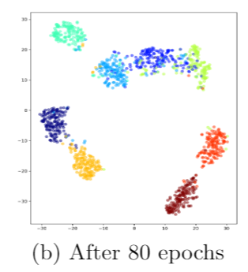
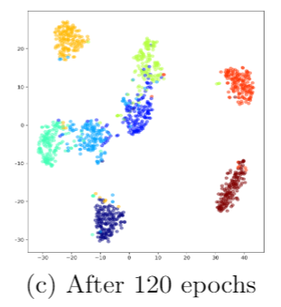
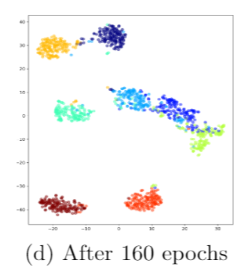
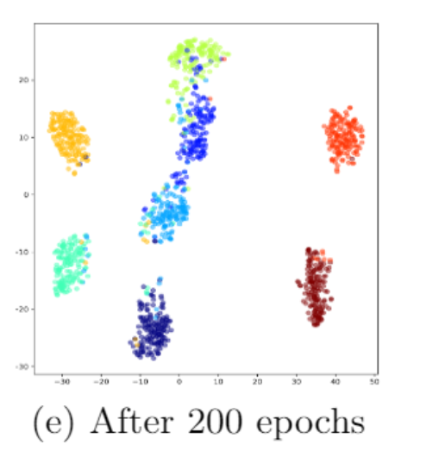
The following figures illustrates the t-distributed stochastic neighbourhood embedding (t-SNE) plots at different intervals during the training process which highlight the discriminatory learning of the embedding space obtained from the pre-training paradigm.

Slide 11
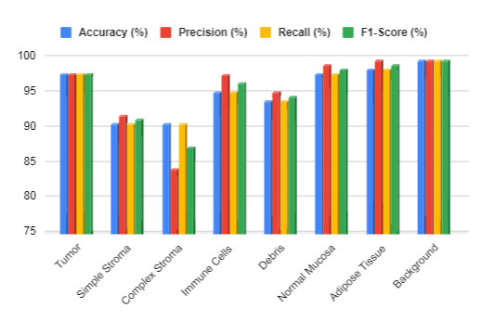
The following figure illustrates the class-wise evaluation metrics obtained from the proposed method on the CRCH dataset.

Slide 12
From the following table, which shows the comparison between out method and other state-of-the-art methods on CRCH dataset, it can be seen that our method outperforms the other ones by a significant margin.
Method | Accuracy(%) | Precision(%) | Recall(%) | F1-Score(%)
Ciompi et al. [3] | 79.66 | - | - | -
Kather et al. [1] | 87.40 | - | - | -
Ohata et al. [5] | 92.80 | - | - | 92.12
Wang et al. [2] | 92.60 | - | 92.80 | -
Sabol et al. [4] | 92.74 | 92.50 | 92.76 | 92.64
Ghosh et al. [6] | 92.83 | 92.83 | 93.11 | 92.97
Proposed method | 95.22 | 95.34 | 95.22 | 95.26

Slide 13
We have performed an ablation study to quantitatively determine the contribution of the two components of our framework, i.e. (1) a supervised metric learning model and (2) a self-supervised image reconstruction model. The results are shown in the table provided below:
Method | Accuracy(%) | Precision(%) | Recall(%) | F1-Score(%)
Triplet | 94.58 | 94.65 | 94.58 | 94.61
Reconstruction | 93.39 | 93.50 | 93.39 | 93.41
Triplet+Reconstruction (Proposed) | 95.22 | 95.34 | 95.22 | 95.26

Slide 14
In this work, we have aimed to propose a novel training strategy for robust representation learning of histopathological images.
The proposed framework leverages supervised metric learning, for the optimization of embedding space, and self-supervised image reconstruction module, for enforcing pixel-level information learning.
Thorough analysis of our framework, both qualitative and comparison with existing state-of-the-art works in literature along with suitable ablation study, prove its efficiency for image classification on CRCH dataset.
Our future work shall be focused on implementation of alternative metric learning losses along with VAE/GAN based models for reconstruction.

Slide 15
Kather, J.N., Weis, C.A., Bianconi, F., et al.: Multi-class texture analysis in colorectal cancer histology.
Wang, C., Shi, J., Zhang, Q., Ying, S.: Histopathological image classification with bilinear convolutional neural networks.
Ciompi, F., Geessink, O., Bejnordi, B.E., de Souza, G.S.e.a.: The importance of stain normalization in colorectal tissue classification with convolutional networks.
Sabol, P., Sinˇc ́ak, P., Hartono, P., Koˇcan, P., et al.: Explainable classifier for improving the accountability in decision-making for colorectal cancer diagnosis from histopathological images.
Ohata, E.F., Chagas, J.V.S.d., Bezerra, G.M., Hassan, M.M., de Albuquerque, V.H.C., Filho, P.P.R.: A novel transfer learning approach for the classification of histological images of colorectal cancer.
Ghosh, S., Bandyopadhyay, A., Sahay, S., Ghosh, R., Kundu, I., Santosh, K.: Colorectal histology tumor detection using ensemble deep neural network.
Bromley, J., Bentz, J.W., Bottou, L., Guyon, I., LeCun, Y., Moore, C., S ̈ackinger, E., Shah, R.: Signature verification using a “siamese” time delay neural network

Slide 16
Annarumma, M., Montana, G.: Deep metric learning for multi-labelled radio-graphs.
Liu, J., Deng, Y., Bai, T., Wei, Z., Huang, C.: Targeting ultimate accuracy: Face recognition via deep embedding.
Schroff, F., Kalenichenko, D., Philbin, J.: Facenet: A unified embedding for face recognition and clustering.
Chen, T., Kornblith, S., Norouzi, M., Hinton, G.: A simple framework for contrastive learning of visual representations.
Atito, S., Awais, M., Kittler, J.: Sit: Self-supervised vision transformer.
Deepak, P., Philipp, K., Jeff, D., Trevor, D., Efros, A.A.: Context encoders: Feature learning by inpainting.
Alwassel, H., Mahajan, D., Korbar, B., Torresani, L., Ghanem, B., Tran, D.: Self-supervised learning by cross-modal audio-video clustering.
Ronneberger, O., Fischer, P., Brox, T.: U-net: Convolutional networks for biomedical image segmentation.

