Slide 1
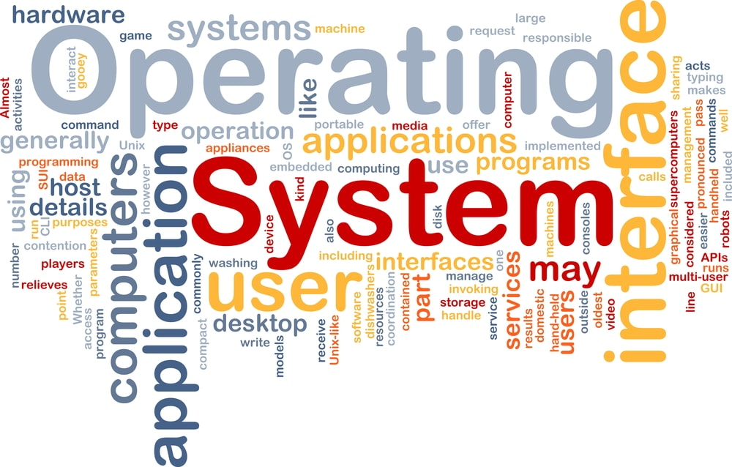
CS3.304.M21 Advanced Operating Systems Lecture # 01
Manish Shrivastava
CVIT, IIIT Hyderabad

Slide 2
Course Content
History of Operating Systems
Processes and OS Abstractions
OS APIs, Interrupts and system calls
Introduction to the Linux Kernel
Compiling the kernel
Module programming
Writing your own system calls
Overview of kernel startup and initialization
Kernel Debugging Techniques
Interrupts - PICs, APICs, exceptions (traps) and hard interrupts, IDTs
Address Spaces and Loading, Virtual Memory, Memory allocators,
Overview of memory spaces: logical segmentation, linear virtual, actual physical
Detecting BIOS-provided physical RAM map, paging, buddy system, setting up page directories (global, upper, middle), tables and PTEs
(N)UMA, nodes, zone, memory types, Setting up buddy system
Allocating contiguous pages from buddy system
Setting up slabs for small memory objects
CPU Scheduling, Threads, Process - structures, organization, initialization
Concurrent Programming, Locking, Deadlocks
Structures: thread union, thread info, stack, task, and thread struct
Creating kernel threads, using kthread, Kernel process scheduling
Scheduling processes with red-black tree, process switching, Context switches, Switching to suspended process
Linux File Systems and Disk Scheduling.

Slide 3
Reference Material
PREFERRED TEXT BOOKS:
Thomas Anderson and Michael Dahlin
Operating Systems: Principles and Practice, 2nd Edition
Recursive books (August 21, 2014),
ISBN: 0985673524
Daniel P. Bovet & Marco Cesati
Understanding the Linux Kernel (3rd edition)
O'Reilly & Associates, November 2005.
ISBN: 0596005652
REFERENCE BOOKS:
Remzi Arpaci-Dusseau and Andrea Arpaci-Dusseau
Operating Systems: Three Easy Pieces
Arpaci-Dusseau Books
August, 2018 (Version 1.00)
Jonathan Corbet; Alessandro Rubini; Greg Kroah-Hartman
Linux Device Drivers (3rd edition)
O'Reilly & Associates, February 2005.
ISBN-13: 978-0-596-00590-0
Robert Love
Linux Kernel Development (3nd Edition)
Addison-Wesley Professional, 2010.
ISBN: 0672329468
Ellen Siever, Stephen Figgins, Robert Love, and Arnold Robbins
Linux in a Nutshell, 6th Edition
O'Reilly & Associates, September 2009.
ISBN: 978-0-596-15448-6

Slide 4
Expected Outcome
Do not revisit but re-establish your basics
Go deeper
Better understand
Be more up-to-date
We will ensure that both theoretical as well as practical aspects are learnt simultaneously.
The project deliverables are expected to working code/prototype.

Slide 5
Grading Scheme
Relative Grading.
Detailed Grading Breakup (~ 46% Exams/Quiz + 54% Practical Learning):
24% Course Project
30% Assignments (6×5)
20% Mid-semester Exams (10×2)
20% Final Exam
06% Quiz/Others
Zero marks in assignment if a copying is detected
Cooperation with TA’s is expected
Zero tolerance from institute’s attendance policy

Slide 6
Lecture 01: Plan
System
Characteristics
System Concepts
System Components
Recap of historical OS efforts

Slide 7
What is an Operating System?
Abstracts the computer hardware
Hides the messy details of the underlying hardware
Present users with an easy to use resource abstraction
Manages the resources
Processors, memory, timers, disks, mice, network interfaces, printers, displays, …
Allows multiple users and programs to share the resources and coordinates the sharing
Extends or virtualizes the underlying machine

Slide 8
System
Characteristics of a system:
Components
Inter-related components
A boundary
A purpose
An environment
Interfaces
Input
Output
Constraints
input
boundary
environment
Components
interfaces
Inter-realtionship
output

Slide 9
Characteristics
Components:
A system is made up of components.
A component is either an irreducible part or aggregation of parts that make-up a system. A component is also called a sub-system.
Interrelated Components:
The components of interrelated
Dependence of one subsystem on one or more subsystems.

Slide 10
Characteristics
Boundary (Scope):
A system has a boundary, within which all of its components are contained and which establishes the limits of a separating the system from other systems.
Purpose
The overall goal of function of a system. The system’s reason for existing.

Slide 11
Characteristics
Environment
Everything external to the system that interacts with the system.
Interface
Point of contact where a system meets its environment or subsystems meet each other.
Constraint:
A limit what a system can accomplish: Capacity, speed or capabilities.

Slide 12
Characteristics
Input
Whatever a system takes from its environment in order to fulfill its purpose.
Output:
Whatever a system returns to its environment in order to fulfill its purpose.

Slide 13
Important System Concepts
Decomposition
Modularity
Coupling
Cohesion

Slide 14
Decomposition
Divide and Conquer Strategy
It deals with being able to break down a system into its components.
Decomposition results in smaller and less complex pieces that are easier to understand than larger, complex pieces.
Decomposing a system also allows to focus on one particular part of a system, making easier to think of how to modify that part independently of the entire system.

Slide 15
Modularity
Modularity refers to dividing a system up into chunks or modules of a relatively uniform size.
You can replace or add any other module (or a component) without effecting the rest of the system.
It is a design strategy in which system is composed of relatively small and autonomous routines fit together.

Slide 16
Coupling
Coupling is the extent to which subsystems are dependent on each other.
Subsystems should be as independent as possible.
If a subsystem fails and other subsystems are highly dependent on it, the others will either fail themselves or have problems in functioning.

Slide 17
Cohesion
The extent to which a system or a subsystem performs a single function.

Slide 18
Operating System (OS)
The operating part of a tool is called as operating system of that tool.
The purpose of operating system is to facilitate the operation of the underlying machine or tool.
For a machine, the OS abstracts the machine part in terms of simple services by hiding the details of the machine.
The OS can provide services to users or other subsystems.
Examples of typical operating systems:
Car operating system, Telephone operating system, TV operating system and so on.

Slide 19
Computer Operating System
A computer is also a tool that contains machine part and operating part.
The operating part of a computer is called Computer Operating System.
For a computer, the operating system abstracts the underlying hardware in terms of simple services by hiding the details of the hardware. The OS can provide services to users or other subsystems.
Examples of Computer operating systems:
WINDOWS, Macintosh, UNIX, SOLARIS, LINUX and so on.
In the rest of this course, operating system means computer operating system.

Slide 20
Computer OS components
Hardware – provides basic computing resources (CPU, memory, I/O devices).
Operating system – controls and coordinates the use of the hardware among the various application programs for the various users.
Applications programs – define the ways in which the system resources are used to solve the computing problems of the users (compilers, database systems, video games, business programs).
Users (people, machines, other computers).

Slide 21
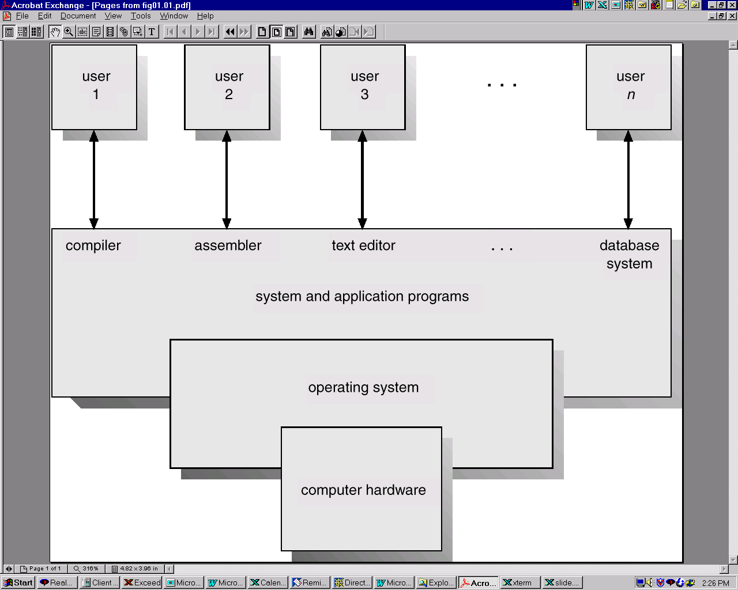
Computer OS components

Slide 22
Other OS Definitions
Resource allocator – manages and allocates resources.
Resources: CPU time, Memory Space, file storage space, I/O devices and son on.
Control program – controls the execution of user programs and operations of I/O devices .
Kernel – the one program running at all times (all else being application programs).
The two goals, efficiency and convenience are sometimes contradictory.
Much of OS theory concentrates on optimal use of resources.

Slide 23
Objectives
The main objective is to understand the operational part of any computer.
Understanding the general principles of OS design.
Focus on general-purpose, multi-user, uni-processor systems.
Emphasis on widely applicable concepts rather than any specific features of any specific OS.
Understanding problems, solutions and design choices.
Understanding the structure of specific OSs: UNIX, LINUX, WINDOWS

Slide 24
Early Systems (Serial Processing)
1940-50:
The programmer interacted directly with the computer hardware.
Display light, switches, printer, card reader.
No OS. Error is displayed through lights.
Problems:
Scheduling → Users spend lots of time at the computer.
Signup sheet was used.
Job Setup time
Loading and compiling
Mounting and Un-mounting of tapes
Setting up of card desks
Libraries of functions, linkers, loaders, debuggers, and I/O driver routines were available for all the users.

Slide 25
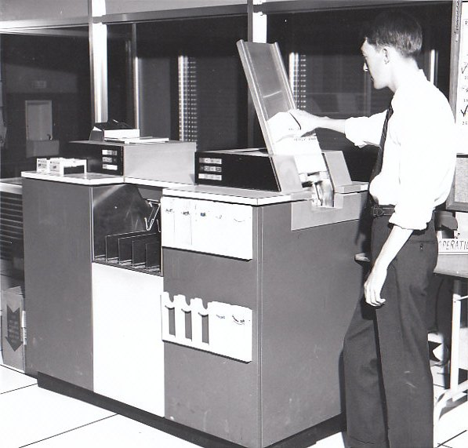
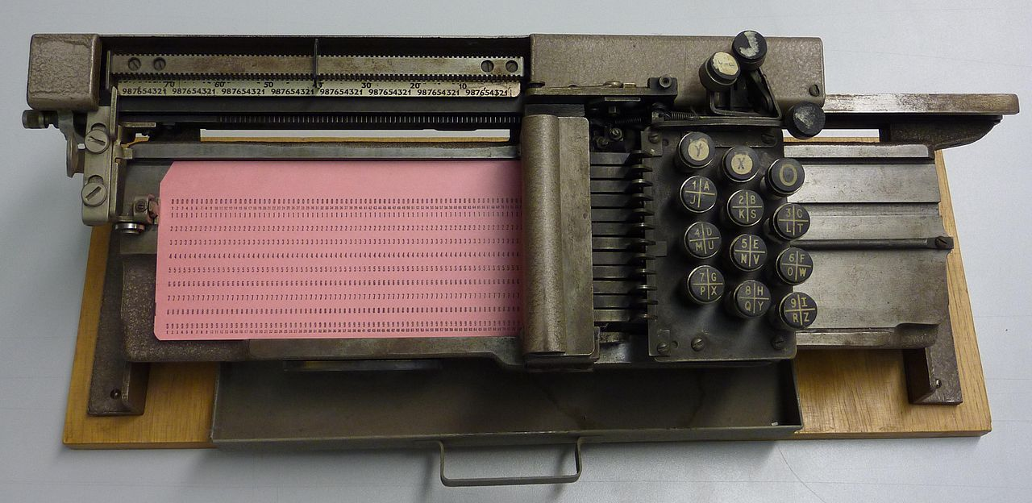
Early Systems
Early computers were (physically) large machines run from a console.
The programmer would operate the program directly from the console.
The program is loaded to the memory from panel of switches, paper tape, and from punched cards.
As time went on, additional software and hardware were developed.
Card readers, line printers, and magnetic tape became common place.
Libraries, loaders, and common functions were created.
Software reusability.
IBM029

Slide 26
Early Systems
The setup time was a real problem
CPU is idle while tapes are being mounted or the programmer was operating the console.
In the early days, few computers were available and they were expensive (millions of dollars).
operational costs: power, cooling, programmers.
Main question:
How to increase the utilization of CPU ?

Slide 27
Early Systems
The solution was two fold.
First, a professional computer operator was hired.
Once the program was finished, the operator could start next job.
The operator sets up the job, produces the dump, and starts the next job.
The set up time was reduced due to operator’s experience.
Second, jobs with similar needs were batched together and run through the computer as a group.
For example, if there is a FORTRAN job, COBOL job, and FORTRAN job, two FORTRAN jobs were batched together.
However, during transition time CPU sat idle.
Automatic job sequencing to avoid CPU idle time.
A first rudimentary OS was created
A small program called a resident monitor was developed.
The resident monitor always resided in memory.

Slide 28
Simple Batch Systems
In serial systems
Machines were very expensive
Wasting time was not acceptable.
To improve usage, the concept of batch OS was developed.
The main idea is the use of software known as monitor.
The user no longer has access to machine.
The user submits the job (tape) to the operator.
The operator batches the jobs together sequentially, places entire batch as an input device for use by the computer.

Slide 29
Features of Batch System
The batch OS is simply a program.
It relies on the ability of the processor to fetch instructions from various portions of main memory to seize and relinquish control.
Hardware features:
Memory protection: While the user program is running, it must not alter the memory area containing the monitor.
If such is the case the processor hardware should detect the error and transfer control to monitor.
Timer: A timer is used to prevent the single job from monopolizing the system

Slide 30
Features of Batch System
Hardware Features
Privileged instructions
Contains instructions that are only executed by monitor.
I/O instructions
If a program encounters them the control shifts through monitor.
Interrupts: It gives OS more flexibility.
Relinquishing control and regain control
With batch OS the machine time alters between execution of user programs and execution of monitor.
Two overheads
Machine time is consumed by the monitor.
Memory is consumed by the monitor.
Still, they improved the performance over serial systems.

Slide 31
Problem with Batch System
CPU is idle
Speed of mechanical devices is very slower than those of electronic devices.
CPU works in a microsecond range
Thousands of instructions/second
A card reader may read 1200 cards per minute (20 cards per second)
CPU speed has increased at a faster rate.
Tape technology improved the performance little-bit.
Main perceived problem
Turn-around time: upto two days
CPU often underutilized
Most of the time was spent reading and writing from tape.

Slide 32
Multi-programmed Batched Systems (1960s) (or Multi tasking)
If CPU is executing a job and requires a tape to be mounted
In a non multi-programmed system
CPU sits idle.
In a Multi-programmed system
CPU takes up another job.
Multiprogramming is the first instance when the OS started taking decisions.
Job scheduling is done by OS.
Having several programs in the memory requires memory management.

Slide 33
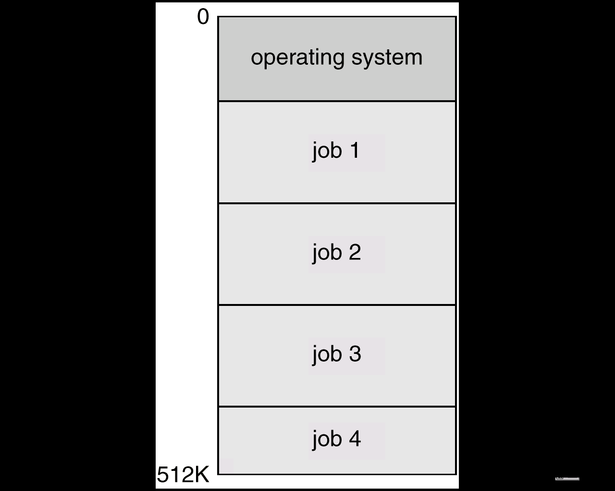
Multi-programmed Batched Systems (1960s) (or Multi tasking)
A single user can not keep either CPU or I/O busy.
Multiprogramming increases CPU utilization by organizing jobs such that the CPU always has one to execute.
The OS keeps several jobs in memory at a time and CPU is multiplexed among them

Slide 34
OS Requirements (60s)
OS Research in 60s
MULTICS at MIT
Atlas (spooling, demand paging) at Manchester Univ.
Multiprogramming
Memory allocation and protection
I/O operations were responsibility of OS.
Interactive systems
Scheduling issues
Swapping and virtual memory.
Users wanted permanent files
Hierarchical directory systems.
Increased in size and complexity were not well understood
IBM: OS/360

Slide 35
UNIX (early 1970s)
Originally developed at Bell labs for the PDP-7
Ken Thomson
Dennis Ritchie
Smaller & Simpler
Process spawn and control
Each command creates a new process
Simple inter-process communication
Command interpreter not built in: runs as a user process
Files were streams of bytes.
Hierarchical file system
Advantages
Written in a high-level language
Distributed in source form
Powerful OS primitives on an inexpensive platform

Slide 36
Personal Computers (1980s)
Originally
Single user
Simplified OSs
No memory protection
MS-DOS
Now run sophisticated OSs
Windows NT, Linux

Slide 37
Networks of workstations ( 1990s)
High-speed network connections
Local & world-wide
Client-server systems
File systems
Remote windowing systems
Support a variety of node OSs
Unix, Windows XP, OS/2

Slide 38
Future
Distributed systems
Network is invisible
Micro-kernel and extensible OSs
Supports multiple OS flavors
E.g., Mach, Amoeba, WINDOWS XP
Embedded services and network computers
Computer runs a very thin OS (Java Virtual machine).
Notes:
up vote81down voteaccepted
Monolithic kernel is a single large process running entirely in a single address space. It is a single static binary file. All kernel services exist and execute in the kernel address space. The kernel can invoke functions directly. Examples of monolithic kernel based OSs: Unix, Linux.
In microkernels, the kernel is broken down into separate processes, known as servers. Some of the servers run in kernel space and some run in user-space. All servers are kept separate and run in different address spaces. Servers invoke "services" from each other by sending messages via IPC (Interprocess Communication). This separation has the advantage that if one server fails, other servers can still work efficiently. Examples of microkernel based OSs: Mac OS X and Windows NT.

Slide 39
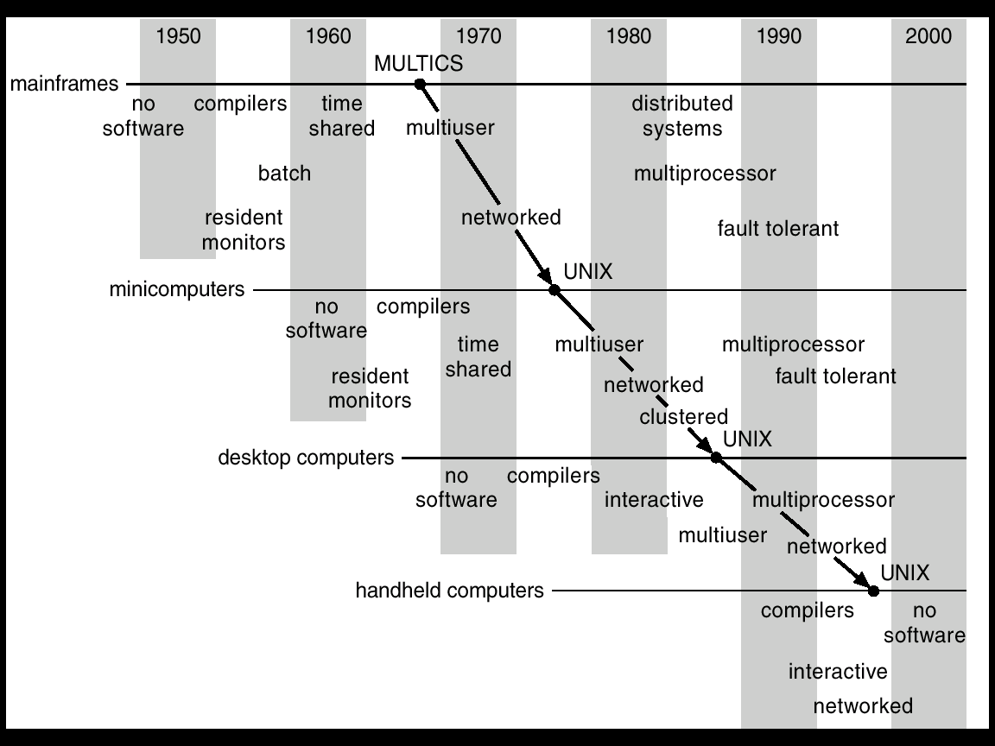
Migration of Operating-System Concepts and Features

Slide 40
Multiprocessor Systems
Multiprocessor systems with more than one CPU in close communication.
Tightly coupled system – processors share memory and a clock; communication usually takes place through the shared memory.
Advantages of multiprocessor system:
Increased throughput: more processors more work
Economical: more computing in same box
Increased reliability
Graceful degradation & Fault tolerance: failure of one processor will not halt the system. Service is proportional to the level of surviving hardware.

Slide 41
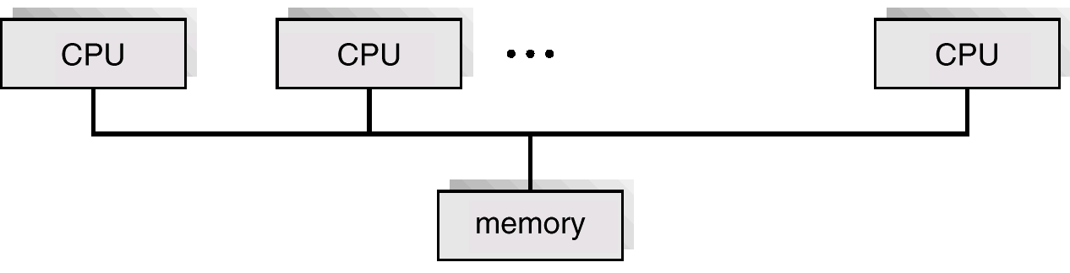
Parallel Systems
Symmetric multiprocessing (SMP)
Each processor runs and identical copy of the operating system.
Many processes can run at once without performance deterioration.
Most modern operating systems support SMP
Asymmetric multiprocessing
Each processor is assigned a specific task; master processor schedules and allocated work to slave processors.
More common in extremely large systems
SMP Architecture

Slide 42
Distributed Systems
Distribute the computation among several physical processors.
Loosely coupled system
each processor has its own local memory;
processors communicate with one another through various communications lines such as high-speed buses or telephone lines.
Advantages of distributed systems
Resources Sharing
Computation speed up/load sharing
Reliability
Communications

Slide 43
Real-Time Systems
Often used as a control device in a dedicated application such as controlling scientific experiments, medical imaging systems, industrial control systems, and some display systems.
Well-defined fixed-time constraints.
A process must complete within the defined constraints or system will fail.
Real-Time systems may be either hard or soft real-time.

Slide 44
Real-Time Systems
Hard real-time:
Guarantees that critical tasks complete within time.
All the delays in the system are bounded.
Secondary storage limited or absent, data stored in short term memory, or read-only memory (ROM)
Conflicts with time-sharing systems, not supported by general-purpose operating systems.
Soft real-time
Critical time tasks gets priority over other tasks, and retails that priority until it completes.
Limited utility in industrial control of robotics
Useful in applications (multimedia, virtual reality) requiring advanced operating-system features.

Slide 45
Concept of Virtual Computer
Multilevel implementation
also called layered
Resources
Hardware: provided to the OS
Logical ( virtual): created by the OS
Resource management
transformation
multiplexing
time and space

Slide 46
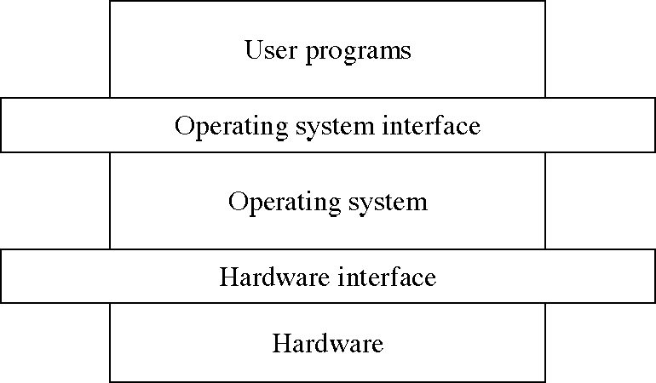
Levels in a computer system

Slide 47
Design: Two-level Implementation
Two-level implementation
Lower level is a problem-specific language
Upper level solves the problem at hand
Lower level is reusable
In operating systems
mechanism: lower level of basic functions, does not change
policy: upper level policy decisions, easy to change and experiment

Slide 48
Operating System Functions
Resource manager
manage hardware and software resources
Virtual machine manager
implement a virtual machine for processes to run in
a nicer environment than the bare hardware

Slide 49
Hardware Resources
Processor: execute instructions
Memory: store programs and data
Input/output (I/O)controllers: transfer to and from devices
Disk devices: long-term storage
Other devices: conversion between internal and external data representations

Slide 50
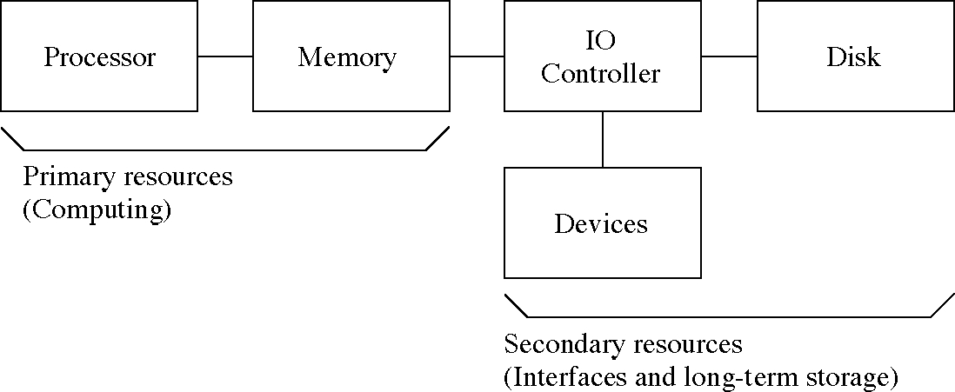
Hardware Resources

Slide 51
Resource Management Functions
Transforming physical resources to logical resources
Making the resources easier to use
Multiplexing one physical resource to several logical resources
Creating multiple, logical copies of resources
Scheduling physical and logical resources
Deciding who gets to use the resources

Slide 52
Types of Multiplexing
Time multiplexing
time-sharing
scheduling a serially-reusable resource among several users
Space multiplexing
space-sharing
dividing a multiple-use resource up among several users

Slide 53
Virtual Computers
Processor virtualized to processes
mainly time-multiplexing
Memory virtualized to address spaces
space and time multiplexing
Disks virtualized to files
space-multiplexing
transforming

Slide 54
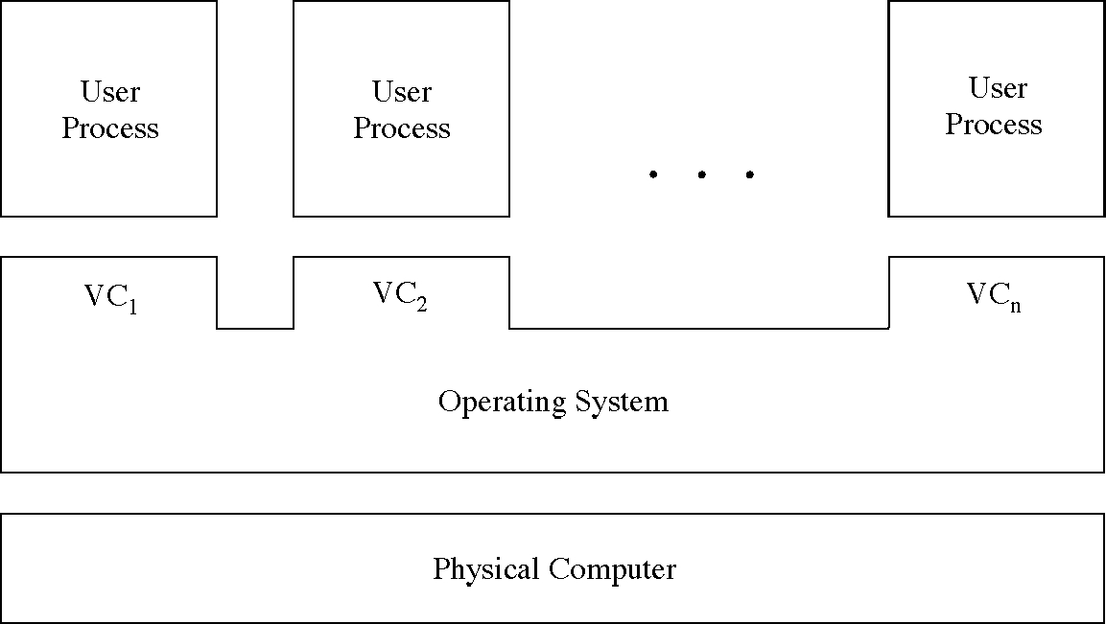
Multiple Virtual Computers

Slide 55
Do we need an OS?
Not always
Some programs run “stand-alone”
But they are very useful
Reusable functions
Easier to use than the bare hardware

Slide 56
System Structures I

Slide 57
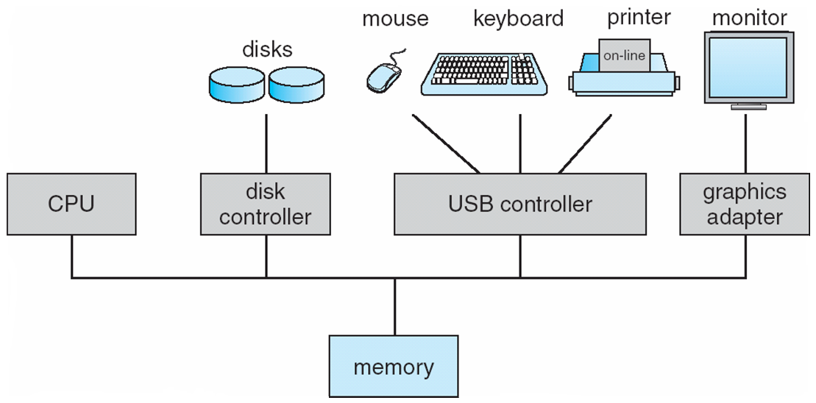
Computer System Organization
Computer-system operation
One or more CPUs, device controllers connect through common bus providing access to shared memory
Concurrent execution of CPUs and devices competing for memory cycles

Slide 58
Computer-Components
Computer consists of processor, memory, and I/O components, with one or more modules of each type. These modules are connected through interconnection network.
I/O devices and the CPU can execute concurrently.
Each device controller is in-charge of a particular device type.
Each device controller has a local buffer.
CPU moves data from/to main memory to/from local buffers
I/O is from the device to local buffer of controller.
Device controller informs CPU that it has finished its operation by causing an interrupt.

Slide 59
I/O Hardware
I/O devices can be categorized as storage, communications, user-interface, and others
Devices connect with the computer via ports, e.g. a serial or parallel port.
A common set of wires connecting multiple devices is termed a bus.
Buses include rigid protocols for the types of messages that can be sent across the bus and the procedures for resolving contention issues.
Bus types commonly found in a modern PC:
The PCI bus connects high-speed high-bandwidth devices to the memory subsystem ( and the CPU. )
The expansion bus connects slower low-bandwidth devices, which typically deliver data one character at a time ( with buffering. )
The SCSI bus connects a number of SCSI devices to a common SCSI controller.
A daisy-chain bus, is when a string of devices is connected to each other like beads on a chain, and only one of the devices is directly connected to the host.
Notes:
Peripheral Component Interconnect
Small Computer System Interface (SCSI)

Slide 60
Thank You

