Slide 1
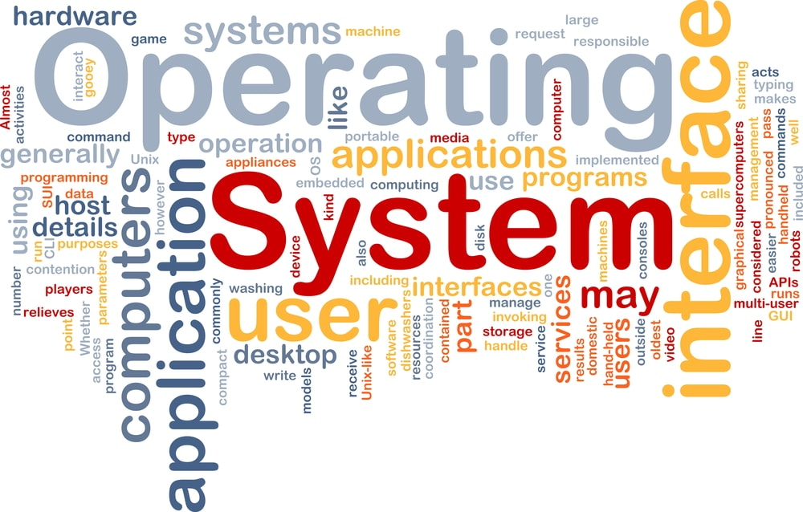
CS3.304.M21 Advanced Operating Systems Lecture # 03
Manish Shrivastava
LTRC, IIIT Hyderabad

Slide 2
Objectives
The main objective is to understand the operational part of any computer.
Understanding the general principles of OS design.
Focus on general-purpose, multi-user, uni-processor systems.
Emphasis on widely applicable concepts rather than any specific features of any specific OS.
Understanding problems, solutions and design choices.
Understanding the structure of specific OSs: UNIX, LINUX, WINDOWS

Slide 3
Early Systems (Serial Processing)
1940-50:
The programmer interacted directly with the computer hardware.
Display light, switches, printer, card reader.
No OS. Error is displayed through lights.
Problems:
Scheduling → Users spend lots of time at the computer.
Signup sheet was used.
Job Setup time
Loading and compiling
Mounting and Un-mounting of tapes
Setting up of card desks
Libraries of functions, linkers, loaders, debuggers, and I/O driver routines were available for all the users.

Slide 4
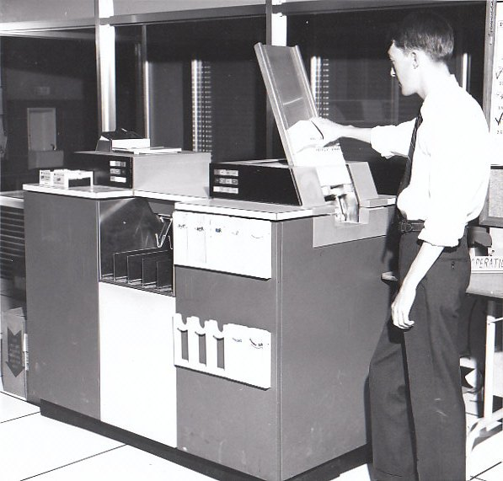
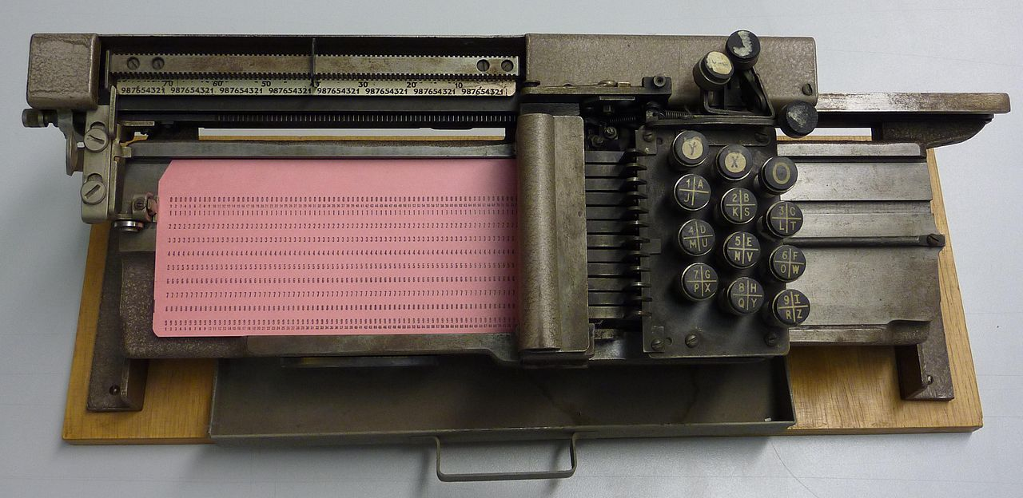
Early Systems
Early computers were (physically) large machines run from a console.
The programmer would operate the program directly from the console.
The program is loaded to the memory from panel of switches, paper tape, and from punched cards.
As time went on, additional software and hardware were developed.
Card readers, line printers, and magnetic tape became common place.
Libraries, loaders, and common functions were created.
Software reusability.
IBM029

Slide 5
Early Systems
The setup time was a real problem
CPU is idle while tapes are being mounted or the programmer was operating the console.
In the early days, few computers were available and they were expensive (millions of dollars).
operational costs: power, cooling, programmers.
Main question:
How to increase the utilization of CPU ?

Slide 6
Early Systems
The solution was two fold.
First, a professional computer operator was hired.
Once the program was finished, the operator could start next job.
The operator sets up the job, produces the dump, and starts the next job.
The set up time was reduced due to operator’s experience.
Second, jobs with similar needs were batched together and run through the computer as a group.
For example, if there is a FORTRAN job, COBOL job, and FORTRAN job, two FORTRAN jobs were batched together.
However, during transition time CPU sat idle.
Automatic job sequencing to avoid CPU idle time.
A first rudimentary OS was created
A small program called a resident monitor was developed.
The resident monitor always resided in memory.

Slide 7
Simple Batch Systems
In serial systems
Machines were very expensive
Wasting time was not acceptable.
To improve usage, the concept of batch OS was developed.
The main idea is the use of software known as monitor.
The user no longer has access to machine.
The user submits the job (tape) to the operator.
The operator batches the jobs together sequentially, places entire batch as an input device for use by the computer.

Slide 8
Features of Batch System
The batch OS is simply a program.
It relies on the ability of the processor to fetch instructions from various portions of main memory to seize and relinquish control.
Hardware features:
Memory protection: While the user program is running, it must not alter the memory area containing the monitor.
If such is the case the processor hardware should detect the error and transfer control to monitor.
Timer: A timer is used to prevent the single job from monopolizing the system

Slide 9
Features of Batch System
Hardware Features
Privileged instructions
Contains instructions that are only executed by monitor.
I/O instructions
If a program encounters them the control shifts through monitor.
Interrupts: It gives OS more flexibility.
Relinquishing control and regain control
With batch OS the machine time alters between execution of user programs and execution of monitor.
Two overheads
Machine time is consumed by the monitor.
Memory is consumed by the monitor.
Still, they improved the performance over serial systems.

Slide 10
Problem with Batch System
CPU is idle
Speed of mechanical devices is very slower than those of electronic devices.
CPU works in a microsecond range
Thousands of instructions/second
A card reader may read 1200 cards per minute (20 cards per second)
CPU speed has increased at a faster rate.
Tape technology improved the performance little-bit.
Main perceived problem
Turn-around time: upto two days
CPU often underutilized
Most of the time was spent reading and writing from tape.

Slide 11
Multi-programmed Batched Systems (1960s) (or Multi tasking)
If CPU is executing a job and requires a tape to be mounted
In a non multi-programmed system
CPU sits idle.
In a Multi-programmed system
CPU takes up another job.
Multiprogramming is the first instance when the OS started taking decisions.
Job scheduling is done by OS.
Having several programs in the memory requires memory management.

Slide 12
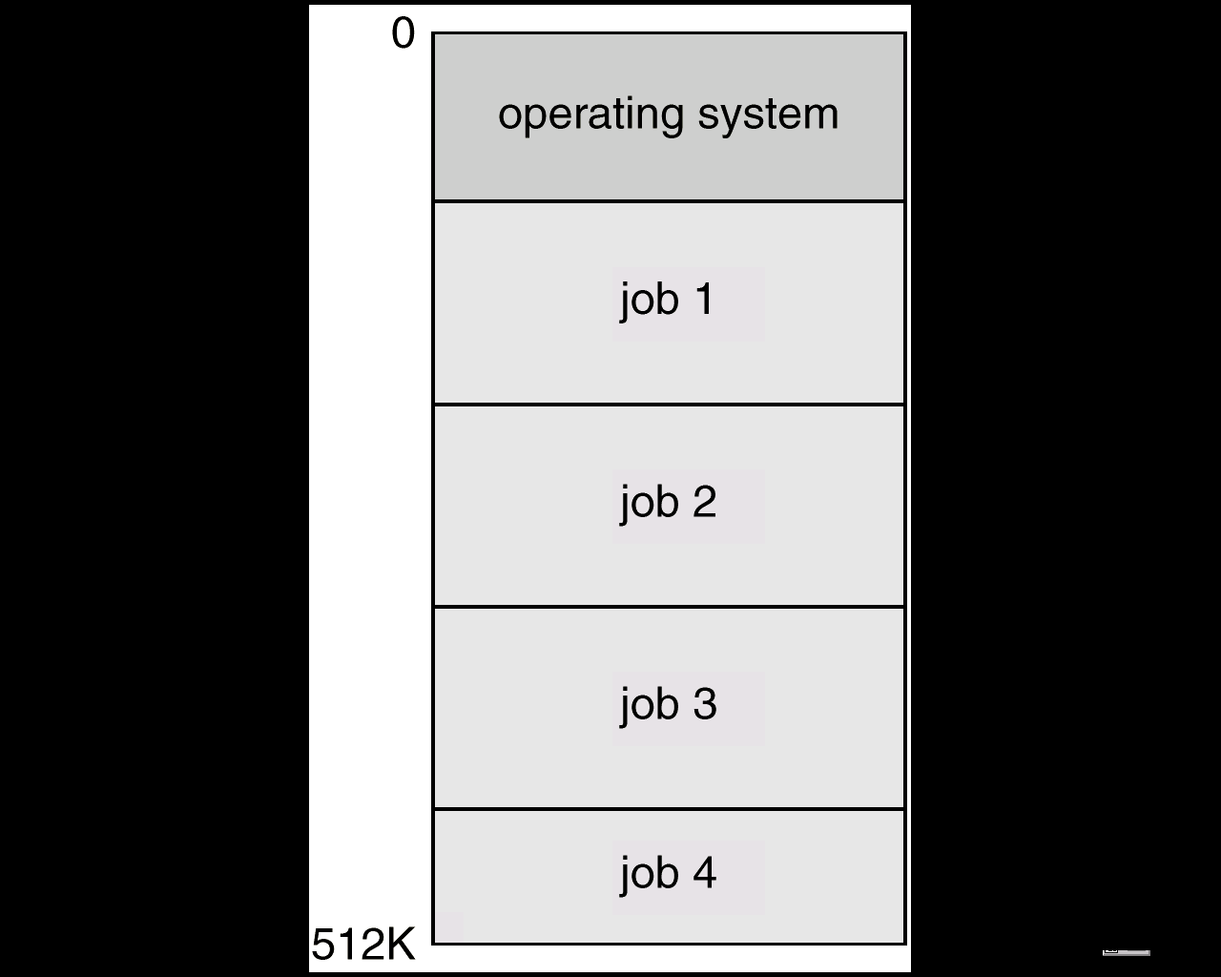
Multi-programmed Batched Systems (1960s) (or Multi tasking)
A single user can not keep either CPU or I/O busy.
Multiprogramming increases CPU utilization by organizing jobs such that the CPU always has one to execute.
The OS keeps several jobs in memory at a time and CPU is multiplexed among them

Slide 13
OS Requirements (60s)
OS Research in 60s
MULTICS at MIT
Atlas (spooling, demand paging) at Manchester Univ.
Multiprogramming
Memory allocation and protection
I/O operations were responsibility of OS.
Interactive systems
Scheduling issues
Swapping and virtual memory.
Users wanted permanent files
Hierarchical directory systems.
Increased in size and complexity were not well understood
IBM: OS/360

Slide 14
UNIX (early 1970s)
Originally developed at Bell labs for the PDP-7
Ken Thomson
Dennis Ritchie
Smaller & Simpler
Process spawn and control
Each command creates a new process
Simple inter-process communication
Command interpreter not built in: runs as a user process
Files were streams of bytes.
Hierarchical file system
Advantages
Written in a high-level language
Distributed in source form
Powerful OS primitives on an inexpensive platform

Slide 15
Personal Computers (1980s)
Originally
Single user
Simplified OSs
No memory protection
MS-DOS
Now run sophisticated OSs
Windows NT, Linux

Slide 16
Networks of workstations ( 1990s)
High-speed network connections
Local & world-wide
Client-server systems
File systems
Remote windowing systems
Support a variety of node OSs
Unix, Windows XP, OS/2

Slide 17
Future
Distributed systems
Network is invisible
Micro-kernel and extensible OSs
Supports multiple OS flavors
E.g., Mach, Amoeba, WINDOWS XP
Embedded services and network computers
Computer runs a very thin OS (Java Virtual machine).
Notes:
up vote81down voteaccepted
Monolithic kernel is a single large process running entirely in a single address space. It is a single static binary file. All kernel services exist and execute in the kernel address space. The kernel can invoke functions directly. Examples of monolithic kernel based OSs: Unix, Linux.
In microkernels, the kernel is broken down into separate processes, known as servers. Some of the servers run in kernel space and some run in user-space. All servers are kept separate and run in different address spaces. Servers invoke "services" from each other by sending messages via IPC (Interprocess Communication). This separation has the advantage that if one server fails, other servers can still work efficiently. Examples of microkernel based OSs: Mac OS X and Windows NT.

Slide 18
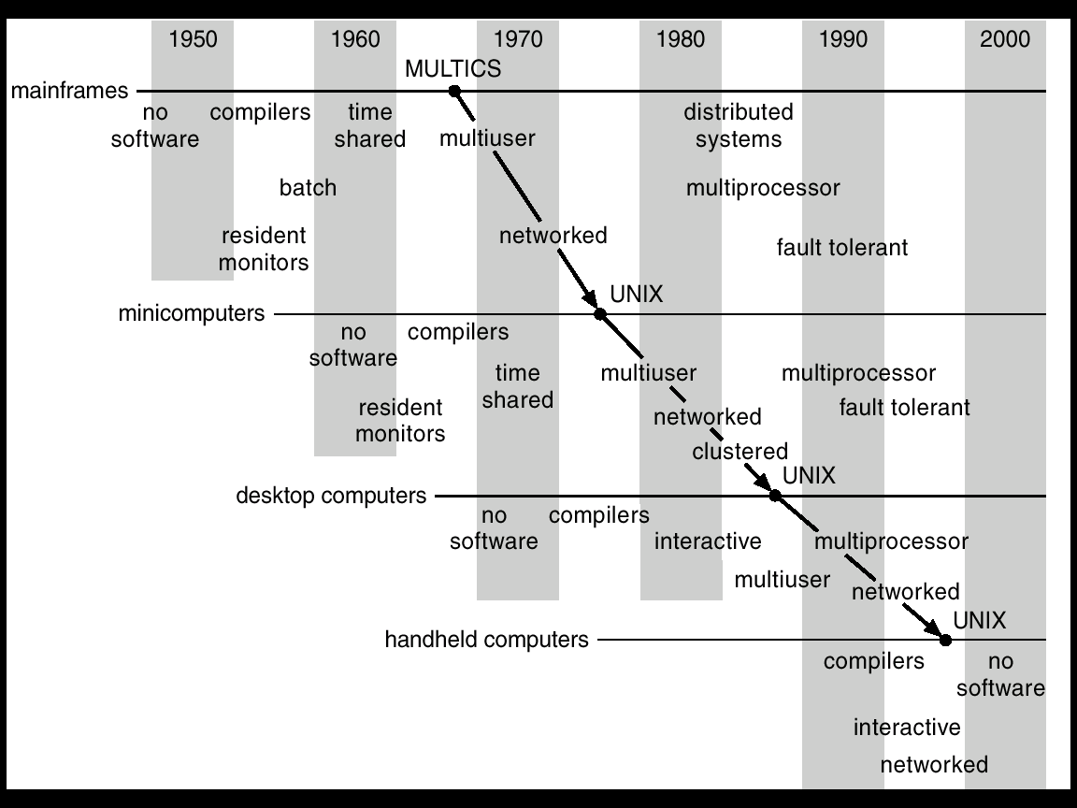
Migration of Operating-System Concepts and Features

Slide 19
Multiprocessor Systems
Multiprocessor systems with more than one CPU in close communication.
Tightly coupled system – processors share memory and a clock; communication usually takes place through the shared memory.
Advantages of multiprocessor system:
Increased throughput: more processors more work
Economical: more computing in same box
Increased reliability
Graceful degradation & Fault tolerance: failure of one processor will not halt the system. Service is proportional to the level of surviving hardware.

Slide 20
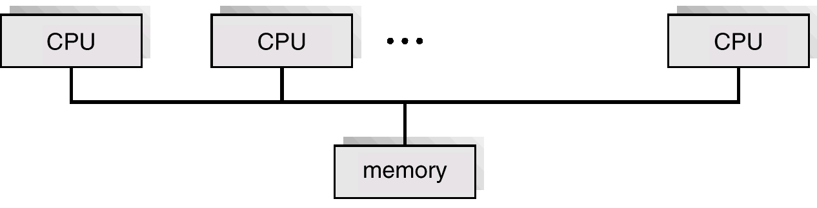
Parallel Systems
Symmetric multiprocessing (SMP)
Each processor runs and identical copy of the operating system.
Many processes can run at once without performance deterioration.
Most modern operating systems support SMP
Asymmetric multiprocessing
Each processor is assigned a specific task; master processor schedules and allocated work to slave processors.
More common in extremely large systems
SMP Architecture

Slide 21
Distributed Systems
Distribute the computation among several physical processors.
Loosely coupled system
each processor has its own local memory;
processors communicate with one another through various communications lines such as high-speed buses or telephone lines.
Advantages of distributed systems
Resources Sharing
Computation speed up/load sharing
Reliability
Communications

Slide 22
Real-Time Systems
Often used as a control device in a dedicated application such as controlling scientific experiments, medical imaging systems, industrial control systems, and some display systems.
Well-defined fixed-time constraints.
A process must complete within the defined constraints or system will fail.
Real-Time systems may be either hard or soft real-time.

Slide 23
Real-Time Systems
Hard real-time:
Guarantees that critical tasks complete within time.
All the delays in the system are bounded.
Secondary storage limited or absent, data stored in short term memory, or read-only memory (ROM)
Conflicts with time-sharing systems, not supported by general-purpose operating systems.
Soft real-time
Critical time tasks gets priority over other tasks, and retails that priority until it completes.
Limited utility in industrial control of robotics
Useful in applications (multimedia, virtual reality) requiring advanced operating-system features.

Slide 24
Concept of Virtual Computer
Multilevel implementation
also called layered
Resources
Hardware: provided to the OS
Logical ( virtual): created by the OS
Resource management
transformation
multiplexing
time and space

Slide 25
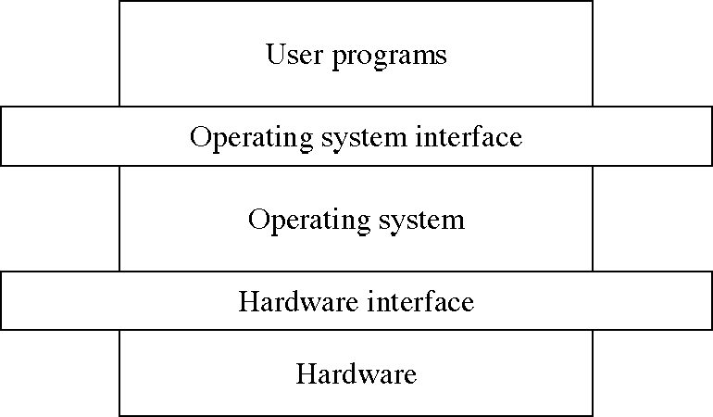
Levels in a computer system

Slide 26
Design: Two-level Implementation
Two-level implementation
Lower level is a problem-specific language
Upper level solves the problem at hand
Lower level is reusable
In operating systems
mechanism: lower level of basic functions, does not change
policy: upper level policy decisions, easy to change and experiment

Slide 27
Operating System Functions
Resource manager
manage hardware and software resources
Virtual machine manager
implement a virtual machine for processes to run in
a nicer environment than the bare hardware

Slide 28
Hardware Resources
Processor: execute instructions
Memory: store programs and data
Input/output (I/O)controllers: transfer to and from devices
Disk devices: long-term storage
Other devices: conversion between internal and external data representations

Slide 29
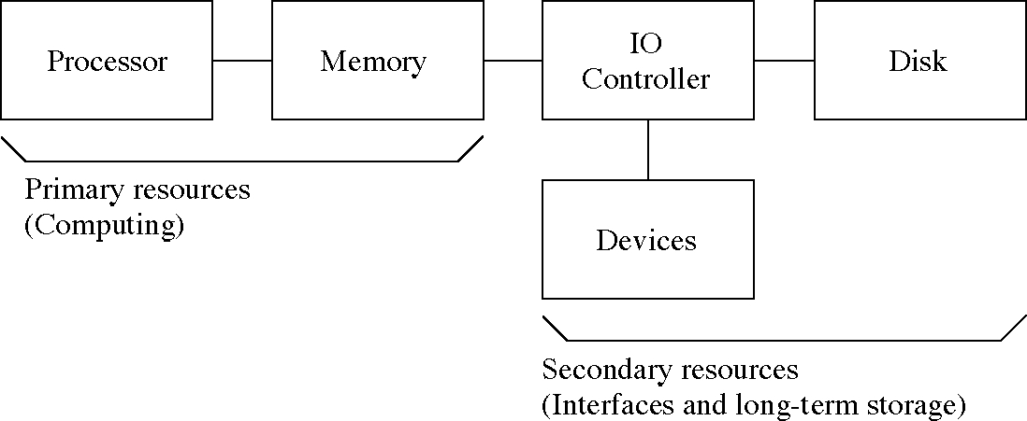
Hardware Resources

Slide 30
Resource Management Functions
Transforming physical resources to logical resources
Making the resources easier to use
Multiplexing one physical resource to several logical resources
Creating multiple, logical copies of resources
Scheduling physical and logical resources
Deciding who gets to use the resources

Slide 31
Types of Multiplexing
Time multiplexing
time-sharing
scheduling a serially-reusable resource among several users
Space multiplexing
space-sharing
dividing a multiple-use resource up among several users

Slide 32
Virtual Computers
Processor virtualized to processes
mainly time-multiplexing
Memory virtualized to address spaces
space and time multiplexing
Disks virtualized to files
space-multiplexing
transforming

Slide 33
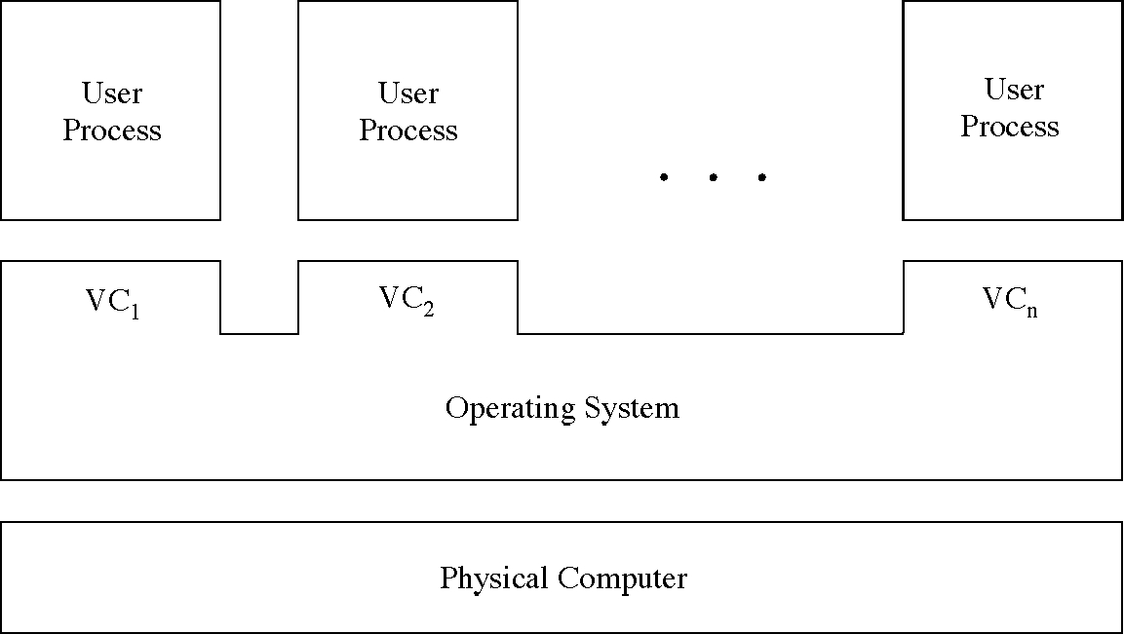
Multiple Virtual Computers

Slide 34
Do we need an OS?
Not always
Some programs run “stand-alone”
But they are very useful
Reusable functions
Easier to use than the bare hardware

Slide 35
System Structures I

Slide 36
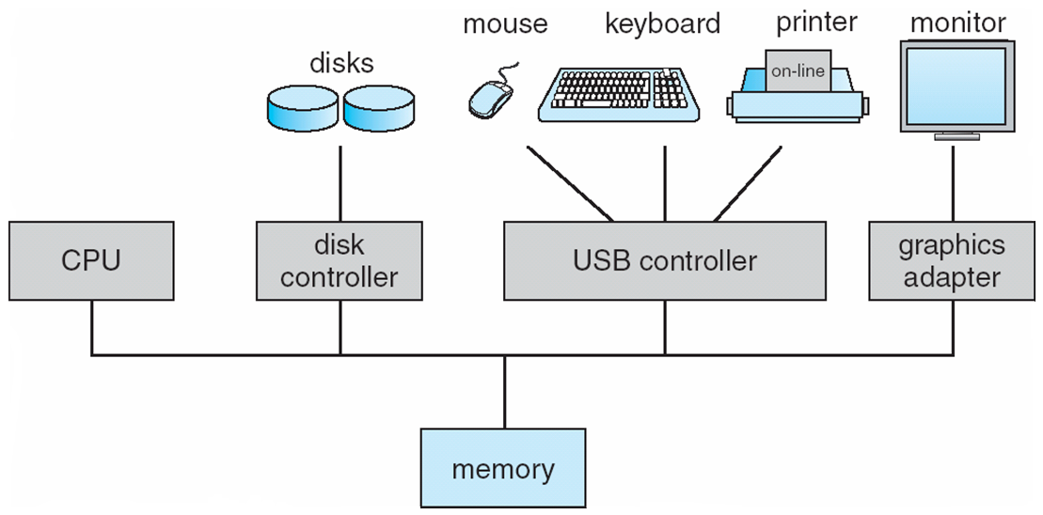
Computer System Organization
Computer-system operation
One or more CPUs, device controllers connect through common bus providing access to shared memory
Concurrent execution of CPUs and devices competing for memory cycles

Slide 37
Computer-Components
Computer consists of processor, memory, and I/O components, with one or more modules of each type. These modules are connected through interconnection network.
I/O devices and the CPU can execute concurrently.
Each device controller is in-charge of a particular device type.
Each device controller has a local buffer.
CPU moves data from/to main memory to/from local buffers
I/O is from the device to local buffer of controller.
Device controller informs CPU that it has finished its operation by causing an interrupt.

Slide 38
I/O Hardware
I/O devices can be categorized as storage, communications, user-interface, and others
Devices connect with the computer via ports, e.g. a serial or parallel port.
A common set of wires connecting multiple devices is termed a bus.
Buses include rigid protocols for the types of messages that can be sent across the bus and the procedures for resolving contention issues.
Bus types commonly found in a modern PC:
The PCI bus connects high-speed high-bandwidth devices to the memory subsystem ( and the CPU. )
The expansion bus connects slower low-bandwidth devices, which typically deliver data one character at a time ( with buffering. )
The SCSI bus connects a number of SCSI devices to a common SCSI controller.
A daisy-chain bus, is when a string of devices is connected to each other like beads on a chain, and only one of the devices is directly connected to the host.
Notes:
Peripheral Component Interconnect
Small Computer System Interface (SCSI)

Slide 39
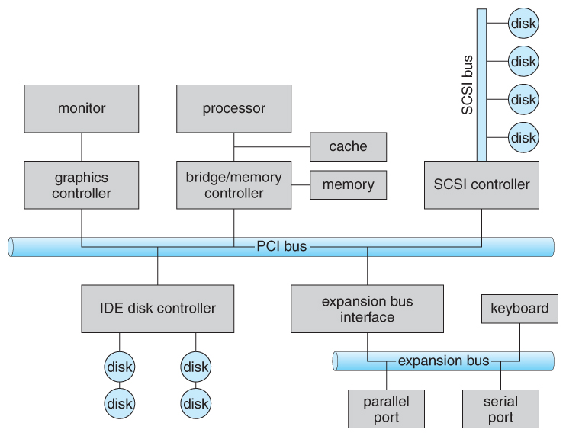
PC Bus Structure

Slide 40
Registers
One way of communicating with devices is through registers associated with each port. Registers may be one to four bytes in size, and may typically include ( a subset of ) the following four:
The data-in register is read by the host to get input from the device.
The data-out register is written by the host to send output.
The status register has bits read by the host to ascertain the status of the device, such as idle, ready for input, busy, error, transaction complete, etc.
The control register has bits written by the host to issue commands or to change settings of the device such as parity checking, word length, or full- versus half-duplex operation.

Slide 41
Memory Mapped I/O
Another technique for communicating with devices is memory-mapped I/O.
In this case a certain portion of the processor's address space is mapped to the device, and communications occur by reading and writing directly to/from those memory areas.
Memory-mapped I/O is suitable for devices which must move large quantities of data quickly, such as graphics cards.
Memory-mapped I/O can be used either alone or more often in combination with traditional registers. For example, graphics cards still use registers for control information such as setting the video mode.
A potential problem exists with memory-mapped I/O, if a process is allowed to write directly to the address space used by a memory-mapped I/O device.

Slide 42
Polling
One simple means of device handshaking involves polling:
The host repeatedly checks the busy bit on the device until it becomes clear.
The host writes a byte of data into the data-out register, and sets the write bit in the command register ( in either order. )
The host sets the command ready bit in the command register to notify the device of the pending command.
When the device controller sees the command-ready bit set, it first sets the busy bit.
Then the device controller reads the command register, sees the write bit set, reads the byte of data from the data-out register, and outputs the byte of data.
The device controller then clears the error bit in the status register, the command-ready bit, and finally clears the busy bit, signaling the completion of the operation.
Polling can be very fast and efficient, if both the device and the controller are fast and if there is significant data to transfer. It becomes inefficient, however, if the host must wait a long time in the busy loop waiting for the device, or if frequent checks need to be made for data that is infrequently there.

Slide 43
Architecture of a Simple Computer
Processor: Controls the operation of the computer and performs data processing functions. It is called CPU.
Main memory: Stores data and programs; it is volatile
I/O modules: Moves data between the computer and external environment.
System bus: mechanism of communication among processors, main memory, and I/O modules.

Slide 44
Simple Computer
Operation: Processor controls everything.
MAR: Memory address register: which specifies the address in memory for the next read or write.
MBR: Memory buffer register: which contains the data to be written into memory or which receives data read from memory.
I/O AR: Address of I/O device
I/O BR: Exchange of data between I/O and computer.

Slide 45
Simple Computer
Processor Registers: Within the processor there is a set of registers that provide a level of memory that is faster and smaller than main memory.
User visible registers: Available to programmer
Data registers: Can be used by the programmer.
Address Registers: Contains Main memory address of data and instructions.
Index register: Index to base value
Segment pointer: It contains a reference to a particular segment.
Stack pointer: Points top of the stack.
Control and status registers: These are employed to control the operation of the processor. Differ from machine to machine.
MAR, MBR,I/O AR, and I/O BR
Program Counter (PC): Contains the address of the instruction to be fetched.
Instruction Register (IR): Contains the instruction most recently fetched.
Program Status Word (PSW): It is a register or a set of registers.

Slide 46
Simple Computer
PSW (Program Status word): It is a register or a set of registers.
Sign: contains sign bit of last arithmetic operation
Zero: it is set if the result of arithmetic operation is zero
Carry: It is set if there is a carry or borrow.
Equal: If the compare result is equality
Overflow: It is set if the result is overflow.
Interrupt enable/disable: Used to disable or enable interrupts.
Supervisor: Indicates whether the processor is executing in supervisor or user mode.
Instruction execution:
Program execution is the main function of the computer.
Instruction fetch and execute
Start
Fetch the next instruction
Execute the next instruction
Halt

Slide 47
Simple Computer
Fetching: Bringing the instructions from the main memory.
PC: Contains the address of the next instruction to be fetched.
Incremented unless told otherwise
Execute:
The processor interprets the instructions and performs the required action.
Processor-memory: Transfer data from the memory
Processor-I/O- transfer data from peripheral device from the memory.
Data processing: Arithmetic and logic operations
Control: The instructions may specify the sequence of the next instruction to be fetched.

Slide 48
Interrupt Processing
To improve the performance, interrupts are provided.
With interrupts, the processor can be engaged in executing other processes while an I/O operation is in progress.
Interrupt cycle is added to the instruction cycle.
Start
Fetch cycle
Fetch the next instruction
Execute cycle
Interrupts
Disabled
Execute the next instruction
Halt
Interrupts enables
Check for interrupt
Process Interrupt.
Interrupt cycle

Slide 49
Common Functions of Interrupts
Interrupt transfers control to the interrupt service routine generally, through the interrupt vector, which contains the addresses of all the service routines.
Interrupt architecture must save the address of the interrupted instruction.
Incoming interrupts are disabled while another interrupt is being processed to prevent a lost interrupt.
A trap is a software-generated interrupt caused either by an error or a user request.
An operating system is interrupt driven.

Slide 50
I/O Controller Interrupting
To start I/O operation, CPU loads the appropriate registers within the device controller
The device controller examines the contents of these registers to determine what action to take.
If it s a read operation the controller transfers the data into local buffer.
Then it informs the CPU through interrupt.
The operating system preserves the state of the CPU by storing registers and the program counter.

Slide 51
Interrupt Handling
Interrupt handler: The CPU hardware has a wire called interrupt request line; that CPU senses after executing every instruction.
When a CPU senses a signal, it saves the PC, and PSW on a stack and jump to the interrupt handler routine at a fixed address in memory.
Interrupt vector: It contains the memory addresses of specialized interrupt handlers.

Slide 52
Interrupt Handling
Interrupts allow devices to notify the CPU when they have data to transfer or when an operation is complete, allowing the CPU to perform other duties when no I/O transfers need its immediate attention.
The CPU has an interrupt-request line that is sensed after every instruction.
A device's controller raises an interrupt by asserting a signal on the interrupt request line.
The CPU then performs a state save, and transfers control to the interrupt handler routine at a fixed address in memory. ( The CPU catches the interrupt and dispatches the interrupt handler. )
The interrupt handler determines the cause of the interrupt, performs the necessary processing, performs a state restore, and executes a return from interrupt instruction to return control to the CPU. ( The interrupt handler clears the interrupt by servicing the device. )
( Note that the state restored does not need to be the same state as the one that was saved when the interrupt went off. )

Slide 53
I/O Structure
Synchronous I/O: After I/O starts, control returns to user program only upon I/O completion.
Wait instruction idles the CPU until the next interrupt
At most one I/O request is outstanding at a time, no simultaneous I/O processing.
Asynchronous I/O: After I/O starts, control returns to user program without waiting for I/O completion.
non-blocking I/O: the I/O request returns immediately, whether the requested I/O operation has ( completely ) occurred or not
Device-status table contains entry for each I/O device indicating its type, address, and state.
Operating system indexes into I/O device-status table to determine device status and to modify table entry.

Slide 54
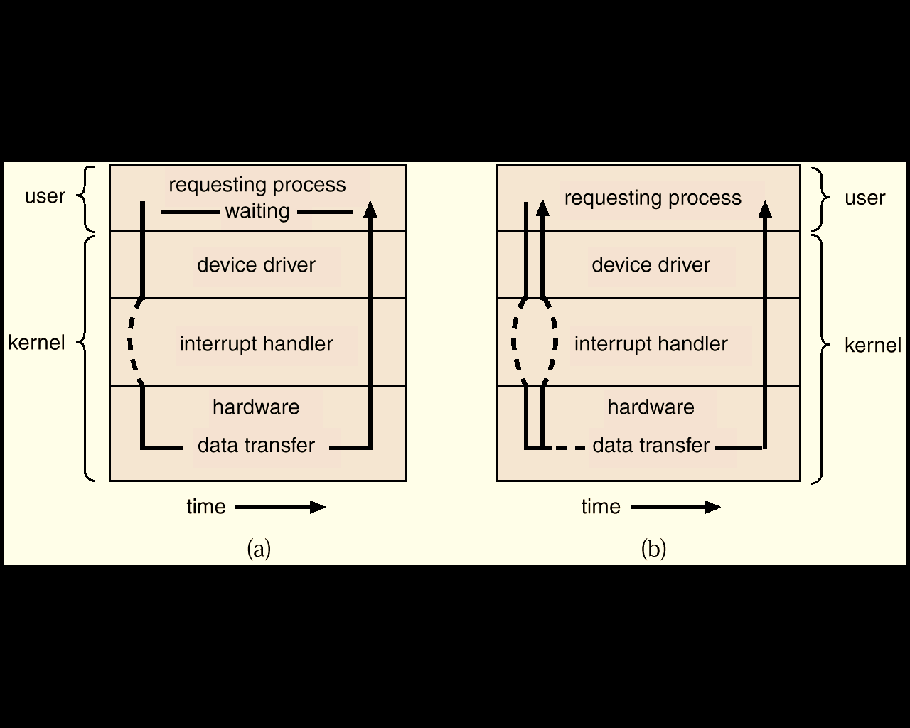
Two I/O Methods
Synchronous
Asynchronous

Slide 55
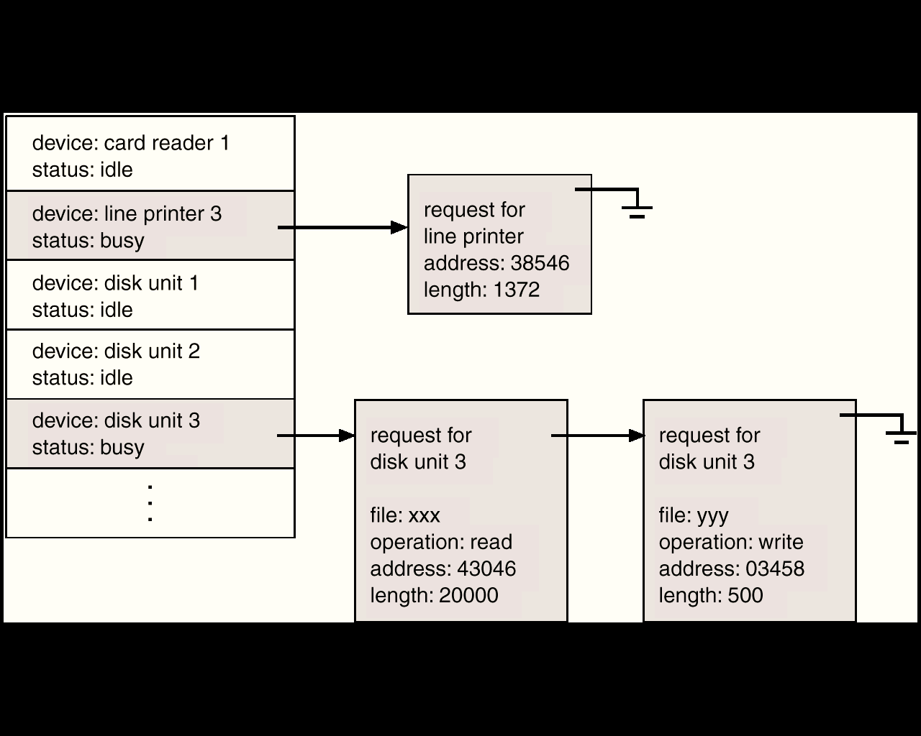
Device-Status Table

Slide 56
I/O communication techniques
Two kinds of data transfer
Program data transfer: CPU checks the I/O status
The I/O module does not interrupt the processor.
Processor is responsible for extracting the data from main memory and shifting data out of main memory.
It is a time-consuming process that keeps the processor busy unnecessarily.
Interrupt driven data transfer: when I/O is ready it interrupts the CPU
In Interrupt driven data transfer, the I/O module will interrupt the processor to request service when it is ready to exchange data with the processor.

Slide 57
Modern Computer
The above description is adequate for simple interrupt-driven I/O, but there are three needs in modern computing which complicate the picture:
The need to defer interrupt handling during critical processing,
The need to determine which interrupt handler to invoke, without having to poll all devices to see which one needs attention, and
The need for multi-level interrupts, so the system can differentiate between high- and low-priority interrupts for proper response.

Slide 58
Interrupt Controller
These issues are handled in modern computer architectures with interrupt-controller hardware.
Most CPUs now have two interrupt-request lines: One that is non-maskable for critical error conditions and one that is maskable, that the CPU can temporarily ignore during critical processing.
The interrupt mechanism accepts an address, which is usually one of a small set of numbers for an offset into a table called the interrupt vector. This table holds the addresses of routines prepared to process specific interrupts.
The number of possible interrupt handlers still exceeds the range of defined interrupt numbers, so multiple handlers can be interrupt chained. Effectively the addresses held in the interrupt vectors are the head pointers for linked-lists of interrupt handlers.
Modern interrupt hardware also supports interrupt priority levels, allowing systems to mask off only lower-priority interrupts while servicing a high-priority interrupt, or conversely to allow a high-priority signal to interrupt the processing of a low-priority one.

Slide 59
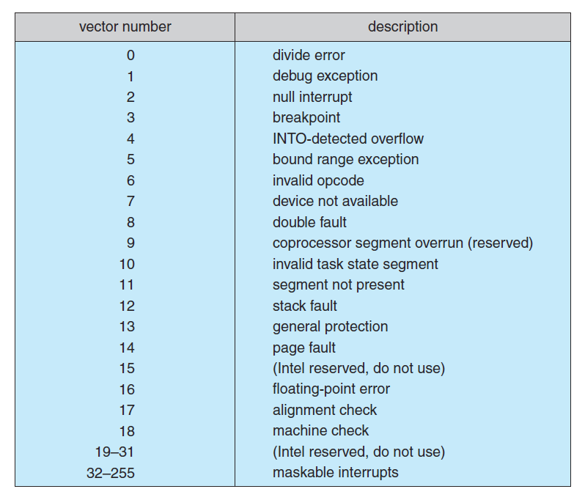
Interrupt Vector Table

Slide 60
Interrupt Controller
At boot time the system determines which devices are present, and loads the appropriate handler addresses into the interrupt table.
During operation, devices signal errors or the completion of commands via interrupts.
Exceptions, such as dividing by zero, invalid memory accesses, or attempts to access kernel mode instructions can be signaled via interrupts.
Time slicing and context switches can also be implemented using the interrupt mechanism.
The scheduler sets a hardware timer before transferring control over to a user process.
When the timer raises the interrupt request line, the CPU performs a state-save, and transfers control over to the proper interrupt handler, which in turn runs the scheduler.
The scheduler does a state-restore of a different process before resetting the timer and issuing the return-from-interrupt instruction.

Slide 61
Some Interrupts
A similar example involves the paging system for virtual memory –
A page fault causes an interrupt, which in turn issues an I/O request and a context switch, moving the interrupted process into the wait queue and selecting a different process to run. When the I/O request has completed then the device interrupts, and the interrupt handler moves the process from the wait queue into the ready queue.
Some OSs (Solaris OS) use a multi-threaded kernel and priority threads to assign different threads to different interrupt handlers. This allows for the "simultaneous" handling of multiple interrupts, and the assurance that high-priority interrupts will take precedence over low-priority ones and over user processes.

Slide 62
Some Interrupts
System calls are implemented via software interrupts, a.k.a. traps. When a (library) program needs work performed in kernel mode, it sets command information and possibly data addresses in certain registers, and then raises a software interrupt.
The completion of a disk read operation involves two interrupts:
A high-priority interrupt acknowledges the device completion, and issues the next disk request so that the hardware does not sit idle.
A lower-priority interrupt transfers the data from the kernel memory space to the user space, and then transfers the process from the waiting queue to the ready queue.

Slide 63
Direct Memory Access
For devices that transfer large quantities of data (such as disk controllers), it is wasteful to tie up the CPU transferring data in and out of registers one byte at a time
Instead this work can be off-loaded to a special processor, known as the Direct Memory Access, DMA, Controller.
The host issues a command to the DMA controller, indicating the details of transfer operation. The DMA interrupts the CPU when the transfer is complete.
A simple DMA controller is a standard component in modern PCs, and many bus-mastering I/O cards contain their own DMA hardware.
Handshaking between DMA controllers and their devices is accomplished through two wires called the DMA-request and DMA-acknowledge wires.
While the DMA transfer is going on the CPU does not have access to the PCI bus (including main memory), but it does have access to its internal registers and primary and secondary caches.

Slide 64
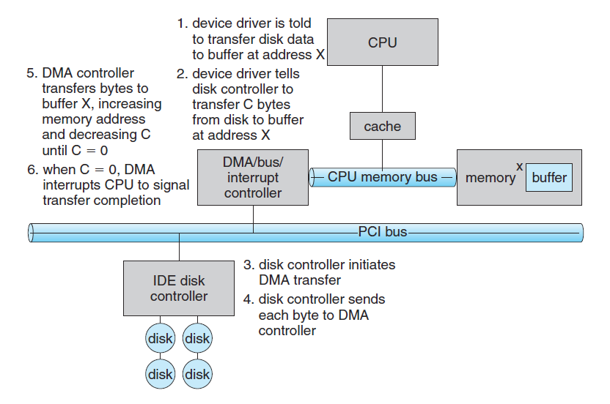
Direct Memory Access

Slide 65
Direct Memory Access
DMA can be done in terms of either physical addresses or virtual addresses that are mapped to physical addresses. The latter approach is known as Direct Virtual Memory Access, DVMA, and allows direct data transfer from one memory-mapped device to another without using the main memory chips.
Direct DMA access by user processes can speed up operations, but is generally forbidden by modern systems for security and protection reasons.

Slide 66
Storage Structure
Main memory – only large storage media that the CPU can access directly
Random access
Typically volatile
Secondary storage – extension of main memory that provides large nonvolatile storage capacity
Magnetic disks – rigid metal or glass platters covered with magnetic recording material
Disk surface is logically divided into tracks, which are subdivided into sectors
The disk controller determines the logical interaction between the device and the computer

Slide 67
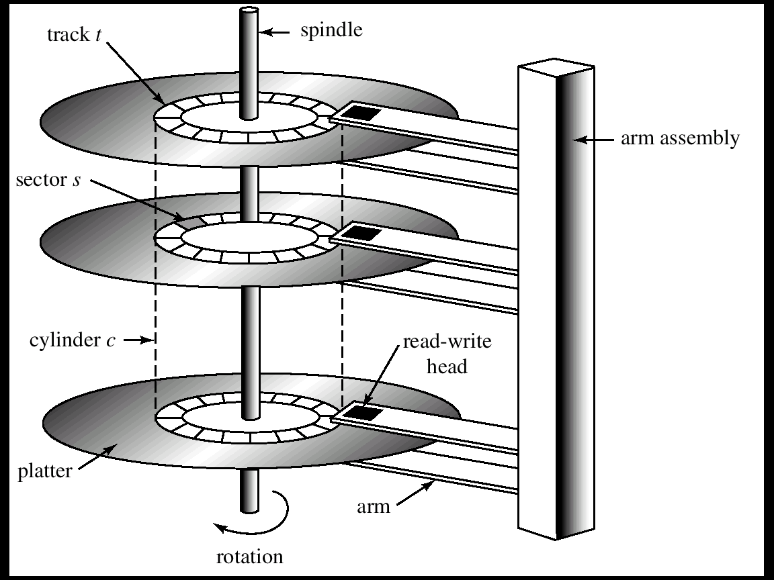
Moving-Head Disk Mechanism

Slide 68
Storage Hierarchy
Storage systems organized in hierarchy
Speed
Cost
Volatility
Caching – copying information into faster storage system; main memory can be viewed as a cache for secondary storage

Slide 69
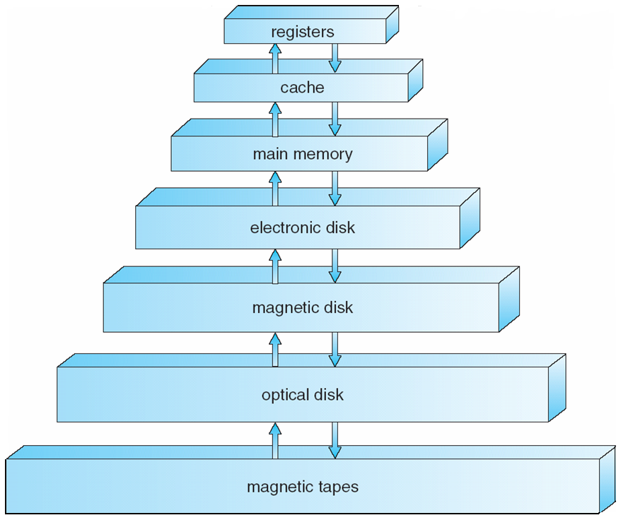
Storage-Device Hierarchy

Slide 70
Caching
Important principle, performed at many levels in a computer (in hardware, operating system, software)
Information in use copied from slower to faster storage temporarily
Faster storage (cache) checked first to determine if information is there
If it is, information used directly from the cache (fast)
If not, data copied to cache and used there
Cache smaller than storage being cached
Cache management important design problem
Cache size and replacement policy

Slide 71
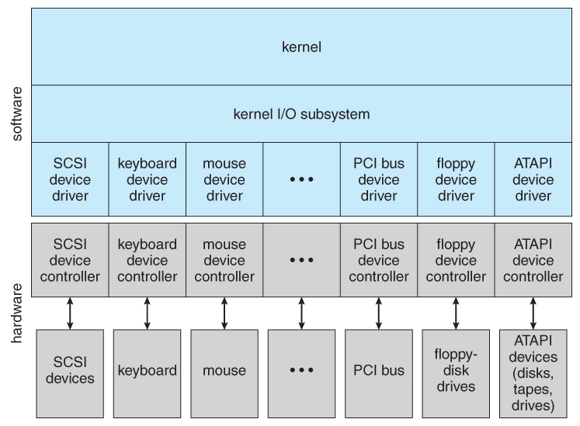
Application I/O Interface

Slide 72
Application I/O Interface
Block and Character Devices
Block : HDD Filesystems etc
Character : Any guesses ??
Network Devices
Socket Interfaces
Clocks and Timers
PIT: Programmable interrupt Timer

Slide 73
Types of I/O
Blocking or non-blocking I/O
With blocking I/O a process is moved to the wait queue when an I/O request is made, and moved back to the ready queue when the request completes
With non-blocking I/O the I/O request returns immediately, whether the requested I/O operation has ( completely ) occurred or not
Asynchronous I/O, in which the I/O request returns immediately allowing the process to continue on with other tasks, and then the process is notified when data becomes available

Slide 74
Kernel I/O handling
I/O Scheduling
Buffering
Caching
Spooling and Device Reservation
SPOOL : Simultaneous Peripheral Operations On-Line
Error Handling
I/O Protection
Notes:
Spooling:
Acronym of “Simultaneous Peripheral Operation On-Line”.
Its a process of placing data in temporary working area for another program to process.
E.g: Print spooling and Mail spools etc.
When there is a resource (like printer) to be accessed by two or more processes(or devices), there spooling comes handy to schedule the tasks. Data from each process is put on the spool (print queue) and processed in FIFO(first in first out) manner.
With spooling all process can access the resource without waiting.
After writing the data on spool, process can perform other tasks. And printing process operates seperately.
Without spooling, process would be tied up until the printing finished.
Spooling is useful for the devices which have differing data access rate. Used mainly when processes share some resource and needed to have synchronization.
Buffering:
Preloading data into a reserved area of memory (the buffer).
It temporarily stores input or output data in an attempt to better match the speeds of two devices such as a fast CPU and a slow disk drive.
Buffer may be used in between when moving data between two processes within a computer. Data is stored in buffer as it is retrieved from one processes or just before it is sent to another process.
With spooling, the disk is used as a very large buffer. Usually complete jobs are queued on disk to be completed later.
It is mostly used for input, output, and sometimes temporary storage of data either when transfer of data takes place or data that may be modified in a non-sequential manner.
Caching:
Caching transparently stores data in component called Cache, so that future request for that data can be served faster.
A special high-speed storage mechanism. It can be either a reserved section of main memory or an independent high-speed storage device.
The data that is stored within a cache might be values that have been computed earlier or duplicates of original values that are stored elsewhere.
E.g: Memory Caching, Disk Caching, Web Caching(used in browser), Database Caching etc.
A cache’s sole purpose is to reduce accesses to the underlying slower storage.

Slide 75
I/O request and hardware
Users request data using file names, which must ultimately be mapped to specific blocks of data from a specific device managed by a specific device driver.
DOS uses the colon separator to specify a particular device ( e.g. C:, LPT:, etc. )
UNIX uses a mount table to map filename prefixes ( e.g. /usr ) to specific mounted devices.
UNIX uses special device files, usually located in /dev, to represent and access physical devices directly.
Each device file has a major and minor number associated with it, stored and displayed where the file size would normally go.
The major number is an index into a table of device drivers, and indicates which device driver handles this device. ( E.g. the disk drive handler. )
The minor number is a parameter passed to the device driver, and indicates which specific device is to be accessed, out of the many which may be handled by a particular device driver. ( e.g. a particular disk drive or partition. )
A series of lookup tables and mappings makes the access of different devices flexible, and somewhat transparent to users.
Notes:
Where multiple entries in the mount table match different prefixes of the filename the one that matches the longest prefix is chosen. ( e.g. /usr/home instead of /usr where both exist in the mount table and both match the desired file. )

Slide 76
Unix Streams
The streams mechanism in UNIX provides a bi-directional pipeline between a user process and a device driver, onto which additional modules can be added.
The user process interacts with the stream head.
The device driver interacts with the device end.
Zero or more stream modules can be pushed onto the stream, using ioctl( ). These modules may filter and/or modify the data as it passes through the stream.
Each module has a read queue and a write queue.
Flow control can be optionally supported, in which case each module will buffer data until the adjacent module is ready to receive it
Streams I/O is asynchronous, except for the interface between the user process and the stream head.
The device driver must respond to interrupts from its device - If the adjacent module is not prepared to accept data and the device driver's buffers are all full, then data is typically dropped.
Streams are widely used in UNIX, and are the preferred approach for device drivers.

Slide 77
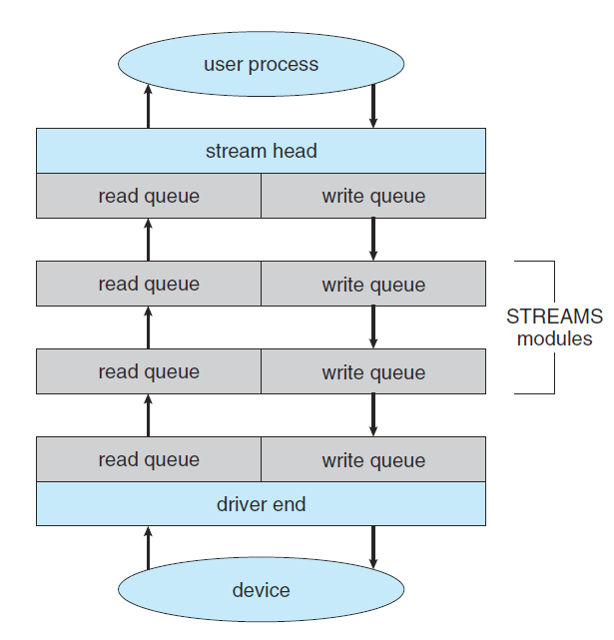
Unix Streams

Slide 78
OS Services
OS Services
User Functions: (G/C)UI, Program execution, I/O, FS manipulation
Process Communication, Error Detection, Resource allocation accounting, protection and security
User level Services
GUI/CLI

Slide 79
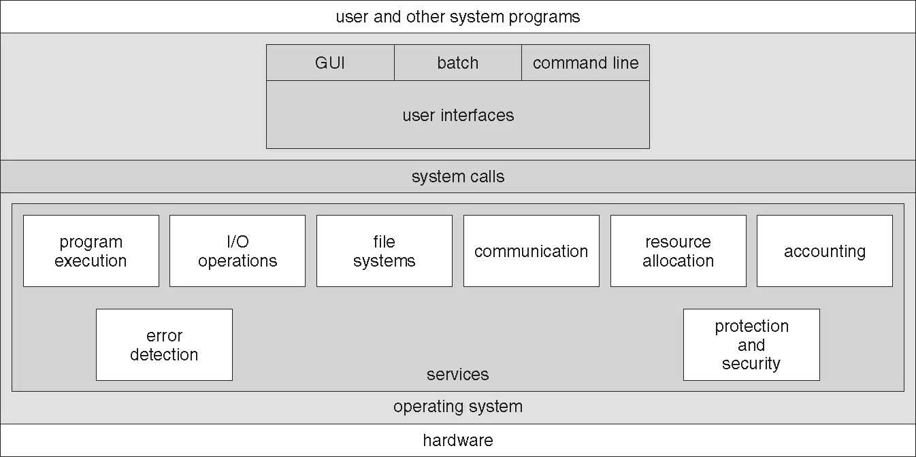
A View of Operating System Services

Slide 80
System Calls
The system calls are the instruction set of the OS virtual processor.
Programming interface to the services provided by the OS.
Typically written in a high-level language (C or C++).
Mostly accessed by programs via a high-level Application Program Interface (API) rather than direct system call use.
Three most common APIs are Win32 API for Windows, *POSIX API for POSIX-based systems (including virtually all versions of UNIX, Linux, and Mac OS X), and Java API for the Java virtual machine (JVM).
*Portable Operating System Interface (POSIX)

Slide 81
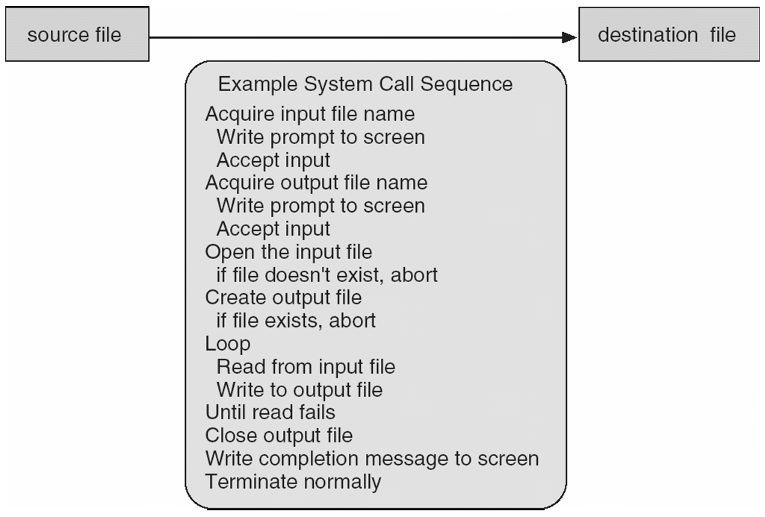
Example of System Calls
System call sequence to copy the contents of one file to another file

Slide 82
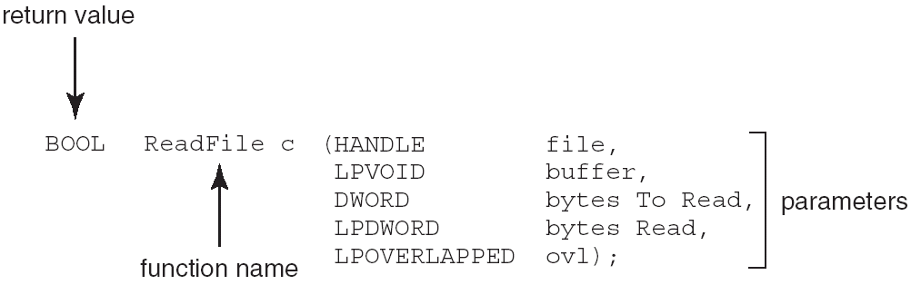
Example of Standard API
Consider the ReadFile() function in the Win32 API—a function for reading from a file
A description of the parameters passed to ReadFile()
HANDLE file—the file to be read
LPVOID buffer—a buffer where the data will be read into and written from
DWORD bytesToRead—the number of bytes to be read into the buffer
LPDWORD bytesRead—the number of bytes read during the last read
LPOVERLAPPED ovl—indicates if overlapped I/O is being used
Notes:
Overlapped I/O is an asynchronous I/O extension of the Windows APIs, which was introduced in Windows NT.

Slide 83
System Call Implementation
Typically, a number associated with each system call
System-call interface maintains a table indexed according to these numbers
The system call interface invokes intended system call in OS kernel and returns status of the system call and any return values
The caller need know nothing about how the system call is implemented
Just needs to obey API and understand what OS will do as a result call
Most details of OS interface hidden from programmer by API
Managed by run-time support library (set of functions built into libraries included with compiler)

Slide 84
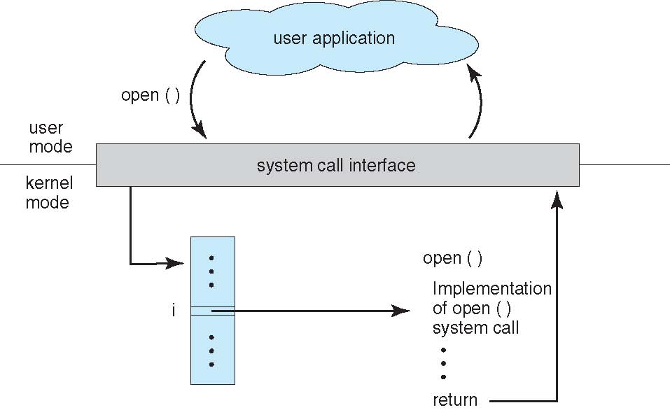
API – System Call – OS Relationship

Slide 85
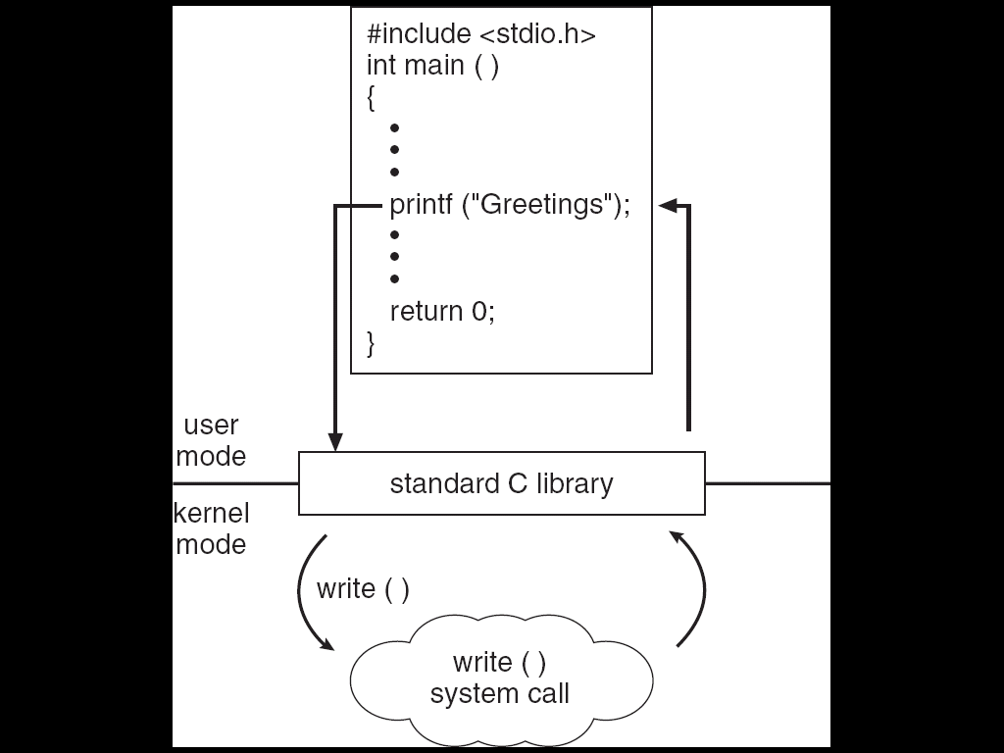
Standard C Library Example
C program invoking printf() library call, which calls write() system call

Slide 86
System Call Parameter Passing
Often, more information is required than simply identity of desired system call
Exact type and amount of information vary according to OS and call
Three general methods used to pass parameters to the OS
Simplest: pass the parameters in registers
In some cases, may be more parameters than registers
Parameters stored in a block, or table, in memory, and address of block passed as a parameter in a register
This approach taken by Linux and Solaris
Parameters placed, or pushed, onto the stack by the program and popped off the stack by the operating system
Block and stack methods do not limit the number or length of parameters being passed

Slide 87
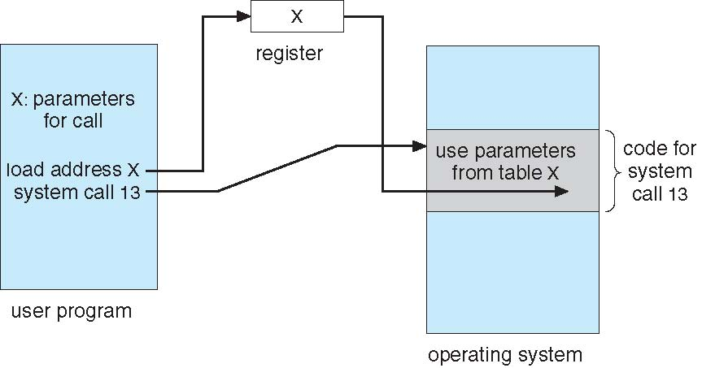
Parameter Passing via Table

Slide 88
Types of System Calls
Process control
end, abort
load, execute
create process, terminate process
get process attributes, set process attributes
wait for time
wait event, signal event
allocate and free memory
File management
create file, delete file
open, close file
read, write, reposition
get and set file attributes

Slide 89
Types of System Calls
Device management
request device, release device
read, write, reposition
get device attributes, set device attributes
logically attach or detach devices
Information maintenance
get time or date, set time or date
get system data, set system data
get and set process, file, or device attributes
Communications
create, delete communication connection
send, receive messages
transfer status information
attach and detach remote devices

Slide 90
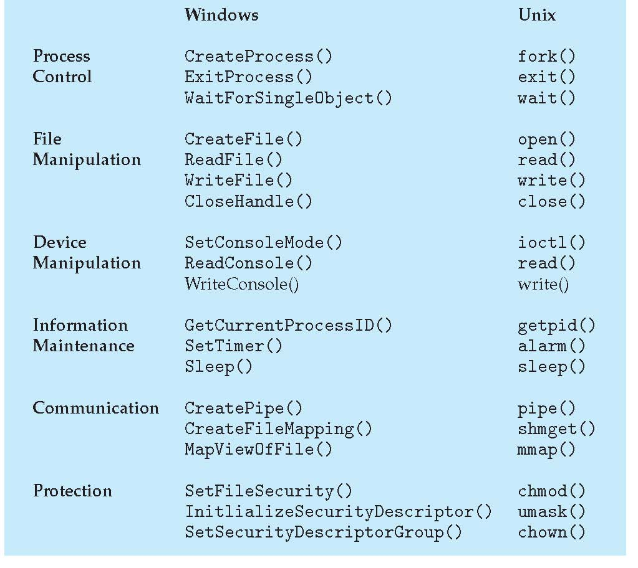
Examples of Windows and Unix System Calls

Slide 91
Types of System Calls: Process Control Example: MS-DOS
Single-tasking
Shell invoked when system booted
Simple method to run program
No process created
Single memory space
Loads program into memory, overwriting all but the kernel
Program exit -> shell reloaded

Slide 92
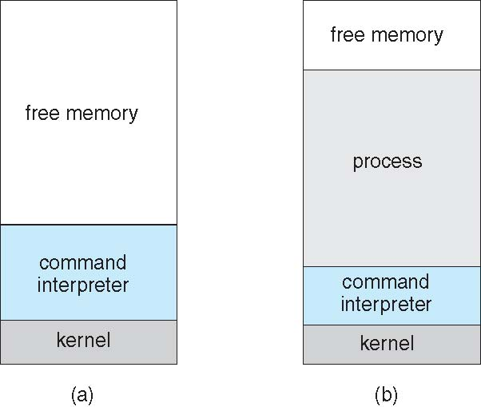
MS-DOS execution

Slide 93
Thank You

Slide 94
Outline
System Structures I
Interrupt Handling
I/O Structure
System Structures II
System Calls

