Slide 1
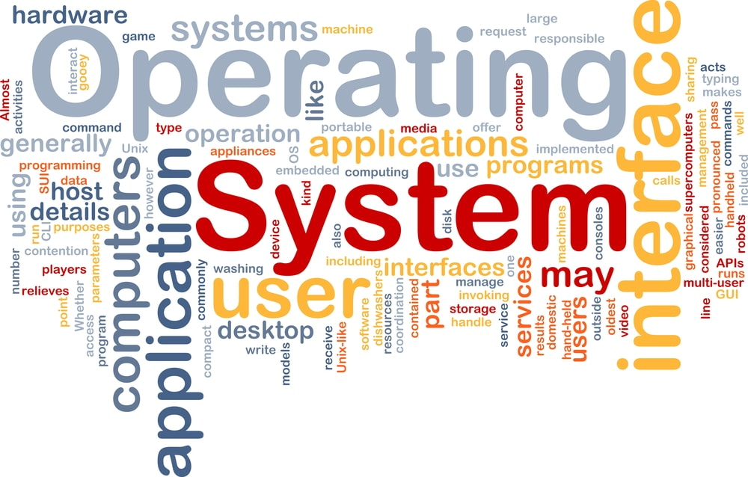
CS3.304.M21 Advanced Operating Systems Lecture # 04
Manish Shrivastava
LTRC, IIIT Hyderabad

Slide 2
Architecture of a Simple Computer
Processor: Controls the operation of the computer and performs data processing functions. It is called CPU.
Main memory: Stores data and programs; it is volatile
I/O modules: Moves data between the computer and external environment.
System bus: mechanism of communication among processors, main memory, and I/O modules.

Slide 3
Simple Computer
Operation: Processor controls everything.
MAR: Memory address register: which specifies the address in memory for the next read or write.
MBR: Memory buffer register: which contains the data to be written into memory or which receives data read from memory.
I/O AR: Address of I/O device
I/O BR: Exchange of data between I/O and computer.

Slide 4
Simple Computer
Processor Registers: Within the processor there is a set of registers that provide a level of memory that is faster and smaller than main memory.
User visible registers: Available to programmer
Data registers: Can be used by the programmer.
Address Registers: Contains Main memory address of data and instructions.
Index register: Index to base value
Segment pointer: It contains a reference to a particular segment.
Stack pointer: Points top of the stack.
Control and status registers: These are employed to control the operation of the processor. Differ from machine to machine.
MAR, MBR,I/O AR, and I/O BR
Program Counter (PC): Contains the address of the instruction to be fetched.
Instruction Register (IR): Contains the instruction most recently fetched.
Program Status Word (PSW): It is a register or a set of registers.

Slide 5
Simple Computer
PSW (Program Status word): It is a register or a set of registers.
Sign: contains sign bit of last arithmetic operation
Zero: it is set if the result of arithmetic operation is zero
Carry: It is set if there is a carry or borrow.
Equal: If the compare result is equality
Overflow: It is set if the result is overflow.
Interrupt enable/disable: Used to disable or enable interrupts.
Supervisor: Indicates whether the processor is executing in supervisor or user mode.
Instruction execution:
Program execution is the main function of the computer.
Instruction fetch and execute
Start
Fetch the next instruction
Execute the next instruction
Halt

Slide 6
Simple Computer
Fetching: Bringing the instructions from the main memory.
PC: Contains the address of the next instruction to be fetched.
Incremented unless told otherwise
Execute:
The processor interprets the instructions and performs the required action.
Processor-memory: Transfer data from the memory
Processor-I/O- transfer data from peripheral device from the memory.
Data processing: Arithmetic and logic operations
Control: The instructions may specify the sequence of the next instruction to be fetched.

Slide 7
Interrupt Processing
To improve the performance, interrupts are provided.
With interrupts, the processor can be engaged in executing other processes while an I/O operation is in progress.
Interrupt cycle is added to the instruction cycle.
Start
Fetch cycle
Fetch the next instruction
Execute cycle
Interrupts
Disabled
Execute the next instruction
Halt
Interrupts enables
Check for interrupt
Process Interrupt.
Interrupt cycle

Slide 8
Common Functions of Interrupts
Interrupt transfers control to the interrupt service routine generally, through the interrupt vector, which contains the addresses of all the service routines.
Interrupt architecture must save the address of the interrupted instruction.
Incoming interrupts are disabled while another interrupt is being processed to prevent a lost interrupt.
A trap is a software-generated interrupt caused either by an error or a user request.
An operating system is interrupt driven.

Slide 9
I/O Controller Interrupting
To start I/O operation, CPU loads the appropriate registers within the device controller
The device controller examines the contents of these registers to determine what action to take.
If it s a read operation the controller transfers the data into local buffer.
Then it informs the CPU through interrupt.
The operating system preserves the state of the CPU by storing registers and the program counter.

Slide 10
Interrupt Handling
Interrupt handler: The CPU hardware has a wire called interrupt request line; that CPU senses after executing every instruction.
When a CPU senses a signal, it saves the PC, and PSW on a stack and jump to the interrupt handler routine at a fixed address in memory.
Interrupt vector: It contains the memory addresses of specialized interrupt handlers.

Slide 11
Interrupt Handling
Interrupts allow devices to notify the CPU when they have data to transfer or when an operation is complete, allowing the CPU to perform other duties when no I/O transfers need its immediate attention.
The CPU has an interrupt-request line that is sensed after every instruction.
A device's controller raises an interrupt by asserting a signal on the interrupt request line.
The CPU then performs a state save, and transfers control to the interrupt handler routine at a fixed address in memory. ( The CPU catches the interrupt and dispatches the interrupt handler. )
The interrupt handler determines the cause of the interrupt, performs the necessary processing, performs a state restore, and executes a return from interrupt instruction to return control to the CPU. ( The interrupt handler clears the interrupt by servicing the device. )
( Note that the state restored does not need to be the same state as the one that was saved when the interrupt went off. )

Slide 12
I/O Structure
Synchronous I/O: After I/O starts, control returns to user program only upon I/O completion.
Wait instruction idles the CPU until the next interrupt
At most one I/O request is outstanding at a time, no simultaneous I/O processing.
Asynchronous I/O: After I/O starts, control returns to user program without waiting for I/O completion.
non-blocking I/O: the I/O request returns immediately, whether the requested I/O operation has ( completely ) occurred or not
Device-status table contains entry for each I/O device indicating its type, address, and state.
Operating system indexes into I/O device-status table to determine device status and to modify table entry.

Slide 13
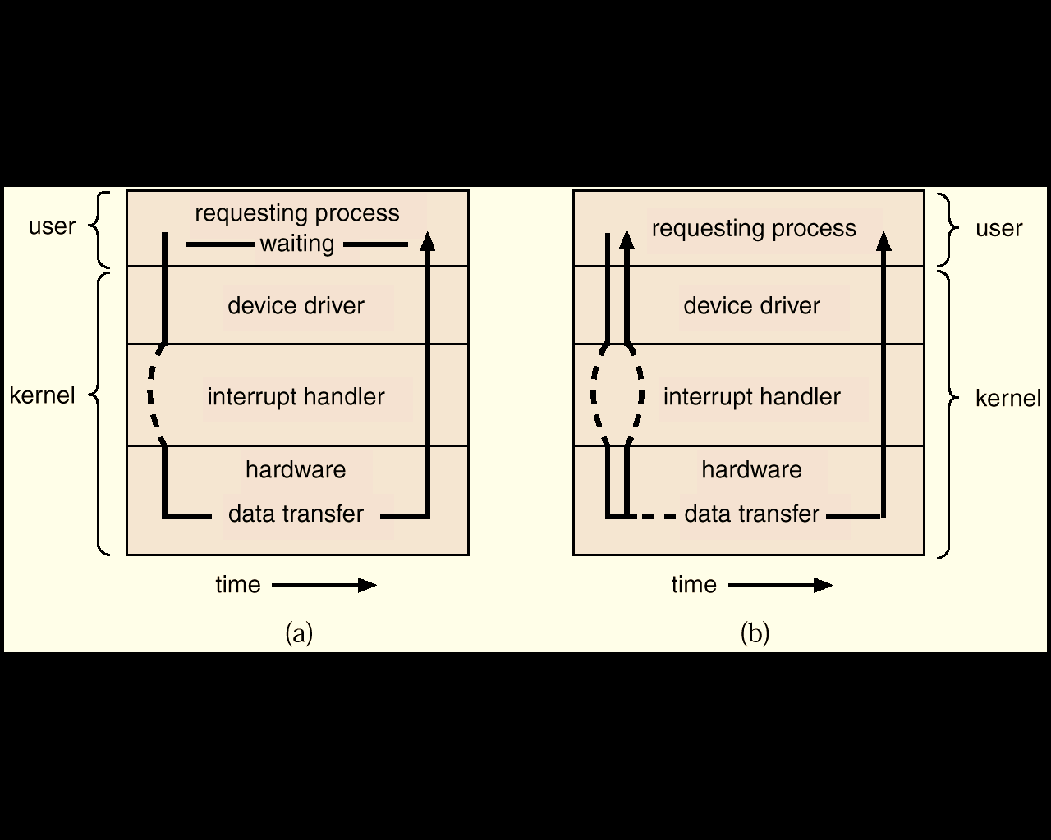
Two I/O Methods
Synchronous
Asynchronous

Slide 14
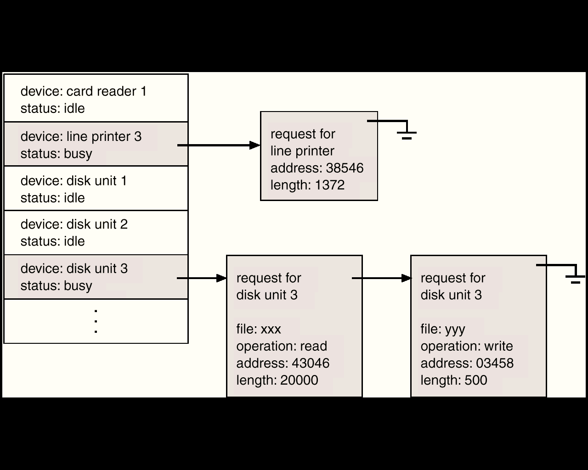
Device-Status Table

Slide 15
I/O communication techniques
Two kinds of data transfer
Program data transfer: CPU checks the I/O status
The I/O module does not interrupt the processor.
Processor is responsible for extracting the data from main memory and shifting data out of main memory.
It is a time-consuming process that keeps the processor busy unnecessarily.
Interrupt driven data transfer: when I/O is ready it interrupts the CPU
In Interrupt driven data transfer, the I/O module will interrupt the processor to request service when it is ready to exchange data with the processor.

Slide 16
Modern Computer
The above description is adequate for simple interrupt-driven I/O, but there are three needs in modern computing which complicate the picture:
The need to defer interrupt handling during critical processing,
The need to determine which interrupt handler to invoke, without having to poll all devices to see which one needs attention, and
The need for multi-level interrupts, so the system can differentiate between high- and low-priority interrupts for proper response.

Slide 17
Interrupt Controller
These issues are handled in modern computer architectures with interrupt-controller hardware.
Most CPUs now have two interrupt-request lines: One that is non-maskable for critical error conditions and one that is maskable, that the CPU can temporarily ignore during critical processing.
The interrupt mechanism accepts an address, which is usually one of a small set of numbers for an offset into a table called the interrupt vector. This table holds the addresses of routines prepared to process specific interrupts.
The number of possible interrupt handlers still exceeds the range of defined interrupt numbers, so multiple handlers can be interrupt chained. Effectively the addresses held in the interrupt vectors are the head pointers for linked-lists of interrupt handlers.
Modern interrupt hardware also supports interrupt priority levels, allowing systems to mask off only lower-priority interrupts while servicing a high-priority interrupt, or conversely to allow a high-priority signal to interrupt the processing of a low-priority one.

Slide 18
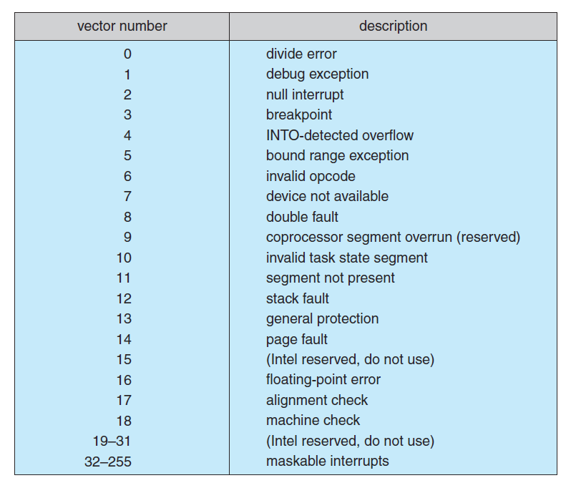
Interrupt Vector Table

Slide 19
Interrupt Controller
At boot time the system determines which devices are present, and loads the appropriate handler addresses into the interrupt table.
During operation, devices signal errors or the completion of commands via interrupts.
Exceptions, such as dividing by zero, invalid memory accesses, or attempts to access kernel mode instructions can be signaled via interrupts.
Time slicing and context switches can also be implemented using the interrupt mechanism.
The scheduler sets a hardware timer before transferring control over to a user process.
When the timer raises the interrupt request line, the CPU performs a state-save, and transfers control over to the proper interrupt handler, which in turn runs the scheduler.
The scheduler does a state-restore of a different process before resetting the timer and issuing the return-from-interrupt instruction.

Slide 20
Some Interrupts
A similar example involves the paging system for virtual memory –
A page fault causes an interrupt, which in turn issues an I/O request and a context switch, moving the interrupted process into the wait queue and selecting a different process to run. When the I/O request has completed then the device interrupts, and the interrupt handler moves the process from the wait queue into the ready queue.
Some OSs (Solaris OS) use a multi-threaded kernel and priority threads to assign different threads to different interrupt handlers. This allows for the "simultaneous" handling of multiple interrupts, and the assurance that high-priority interrupts will take precedence over low-priority ones and over user processes.

Slide 21
Some Interrupts
System calls are implemented via software interrupts, a.k.a. traps. When a (library) program needs work performed in kernel mode, it sets command information and possibly data addresses in certain registers, and then raises a software interrupt.
The completion of a disk read operation involves two interrupts:
A high-priority interrupt acknowledges the device completion, and issues the next disk request so that the hardware does not sit idle.
A lower-priority interrupt transfers the data from the kernel memory space to the user space, and then transfers the process from the waiting queue to the ready queue.

Slide 22
Direct Memory Access
For devices that transfer large quantities of data (such as disk controllers), it is wasteful to tie up the CPU transferring data in and out of registers one byte at a time
Instead this work can be off-loaded to a special processor, known as the Direct Memory Access, DMA, Controller.
The host issues a command to the DMA controller, indicating the details of transfer operation. The DMA interrupts the CPU when the transfer is complete.
A simple DMA controller is a standard component in modern PCs, and many bus-mastering I/O cards contain their own DMA hardware.
Handshaking between DMA controllers and their devices is accomplished through two wires called the DMA-request and DMA-acknowledge wires.
While the DMA transfer is going on the CPU does not have access to the PCI bus (including main memory), but it does have access to its internal registers and primary and secondary caches.

Slide 23
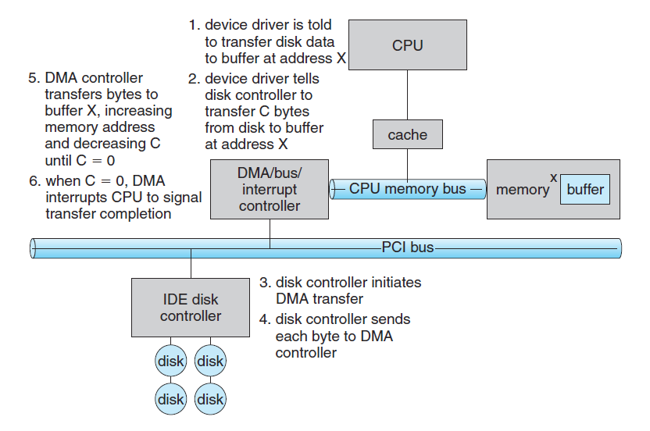
Direct Memory Access

Slide 24
Direct Memory Access
DMA can be done in terms of either physical addresses or virtual addresses that are mapped to physical addresses. The latter approach is known as Direct Virtual Memory Access, DVMA, and allows direct data transfer from one memory-mapped device to another without using the main memory chips.
Direct DMA access by user processes can speed up operations, but is generally forbidden by modern systems for security and protection reasons.

Slide 25
Storage Structure
Main memory – only large storage media that the CPU can access directly
Random access
Typically volatile
Secondary storage – extension of main memory that provides large nonvolatile storage capacity
Magnetic disks – rigid metal or glass platters covered with magnetic recording material
Disk surface is logically divided into tracks, which are subdivided into sectors
The disk controller determines the logical interaction between the device and the computer

Slide 26
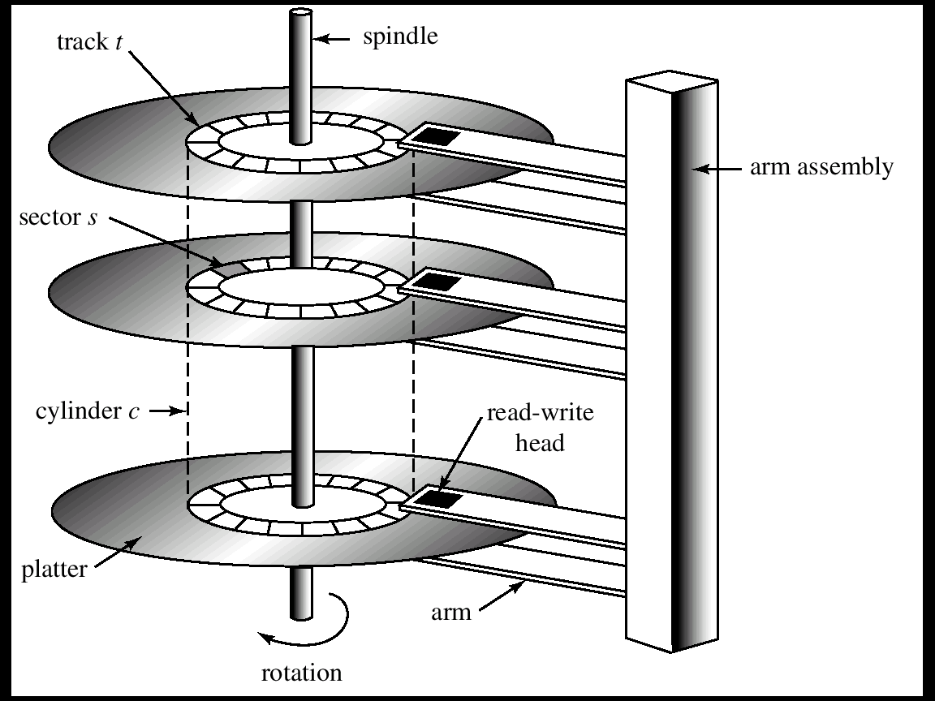
Moving-Head Disk Mechanism

Slide 27
Storage Hierarchy
Storage systems organized in hierarchy
Speed
Cost
Volatility
Caching – copying information into faster storage system; main memory can be viewed as a cache for secondary storage

Slide 28
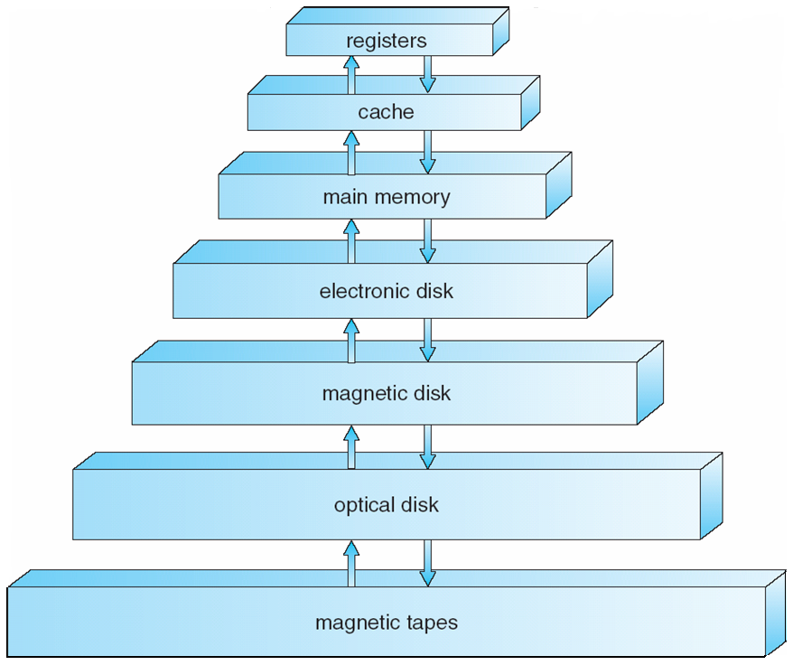
Storage-Device Hierarchy

Slide 29
Caching
Important principle, performed at many levels in a computer (in hardware, operating system, software)
Information in use copied from slower to faster storage temporarily
Faster storage (cache) checked first to determine if information is there
If it is, information used directly from the cache (fast)
If not, data copied to cache and used there
Cache smaller than storage being cached
Cache management important design problem
Cache size and replacement policy

Slide 30
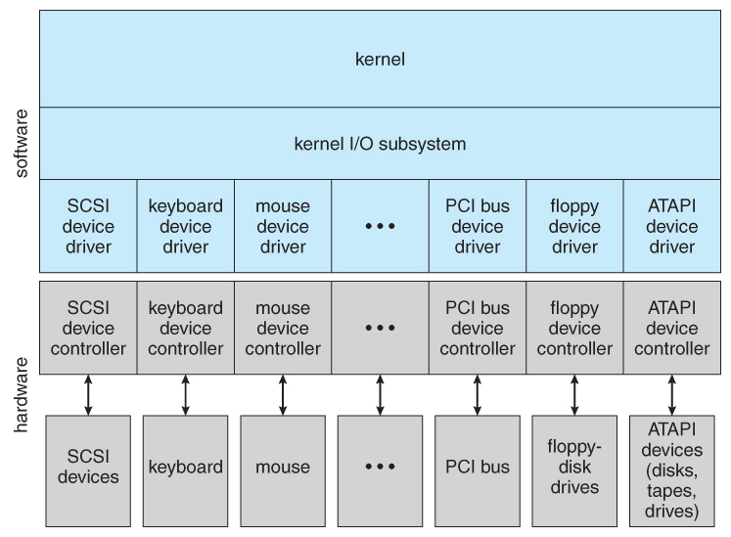
Application I/O Interface

Slide 31
Application I/O Interface
Block and Character Devices
Block : HDD Filesystems etc
Character : Any guesses ??
Network Devices
Socket Interfaces
Clocks and Timers
PIT: Programmable interrupt Timer

Slide 32
Types of I/O
Blocking or non-blocking I/O
With blocking I/O a process is moved to the wait queue when an I/O request is made, and moved back to the ready queue when the request completes
With non-blocking I/O the I/O request returns immediately, whether the requested I/O operation has ( completely ) occurred or not
Asynchronous I/O, in which the I/O request returns immediately allowing the process to continue on with other tasks, and then the process is notified when data becomes available

Slide 33
Kernel I/O handling
I/O Scheduling
Buffering
Caching
Spooling and Device Reservation
SPOOL : Simultaneous Peripheral Operations On-Line
Error Handling
I/O Protection
Notes:
Spooling:
Acronym of “Simultaneous Peripheral Operation On-Line”.
Its a process of placing data in temporary working area for another program to process.
E.g: Print spooling and Mail spools etc.
When there is a resource (like printer) to be accessed by two or more processes(or devices), there spooling comes handy to schedule the tasks. Data from each process is put on the spool (print queue) and processed in FIFO(first in first out) manner.
With spooling all process can access the resource without waiting.
After writing the data on spool, process can perform other tasks. And printing process operates seperately.
Without spooling, process would be tied up until the printing finished.
Spooling is useful for the devices which have differing data access rate. Used mainly when processes share some resource and needed to have synchronization.
Buffering:
Preloading data into a reserved area of memory (the buffer).
It temporarily stores input or output data in an attempt to better match the speeds of two devices such as a fast CPU and a slow disk drive.
Buffer may be used in between when moving data between two processes within a computer. Data is stored in buffer as it is retrieved from one processes or just before it is sent to another process.
With spooling, the disk is used as a very large buffer. Usually complete jobs are queued on disk to be completed later.
It is mostly used for input, output, and sometimes temporary storage of data either when transfer of data takes place or data that may be modified in a non-sequential manner.
Caching:
Caching transparently stores data in component called Cache, so that future request for that data can be served faster.
A special high-speed storage mechanism. It can be either a reserved section of main memory or an independent high-speed storage device.
The data that is stored within a cache might be values that have been computed earlier or duplicates of original values that are stored elsewhere.
E.g: Memory Caching, Disk Caching, Web Caching(used in browser), Database Caching etc.
A cache’s sole purpose is to reduce accesses to the underlying slower storage.

Slide 34
I/O request and hardware
Users request data using file names, which must ultimately be mapped to specific blocks of data from a specific device managed by a specific device driver.
DOS uses the colon separator to specify a particular device ( e.g. C:, LPT:, etc. )
UNIX uses a mount table to map filename prefixes ( e.g. /usr ) to specific mounted devices.
UNIX uses special device files, usually located in /dev, to represent and access physical devices directly.
Each device file has a major and minor number associated with it, stored and displayed where the file size would normally go.
The major number is an index into a table of device drivers, and indicates which device driver handles this device. ( E.g. the disk drive handler. )
The minor number is a parameter passed to the device driver, and indicates which specific device is to be accessed, out of the many which may be handled by a particular device driver. ( e.g. a particular disk drive or partition. )
A series of lookup tables and mappings makes the access of different devices flexible, and somewhat transparent to users.
Notes:
Where multiple entries in the mount table match different prefixes of the filename the one that matches the longest prefix is chosen. ( e.g. /usr/home instead of /usr where both exist in the mount table and both match the desired file. )

Slide 35
Unix Streams
The streams mechanism in UNIX provides a bi-directional pipeline between a user process and a device driver, onto which additional modules can be added.
The user process interacts with the stream head.
The device driver interacts with the device end.
Zero or more stream modules can be pushed onto the stream, using ioctl( ). These modules may filter and/or modify the data as it passes through the stream.
Each module has a read queue and a write queue.
Flow control can be optionally supported, in which case each module will buffer data until the adjacent module is ready to receive it
Streams I/O is asynchronous, except for the interface between the user process and the stream head.
The device driver must respond to interrupts from its device - If the adjacent module is not prepared to accept data and the device driver's buffers are all full, then data is typically dropped.
Streams are widely used in UNIX, and are the preferred approach for device drivers.

Slide 36
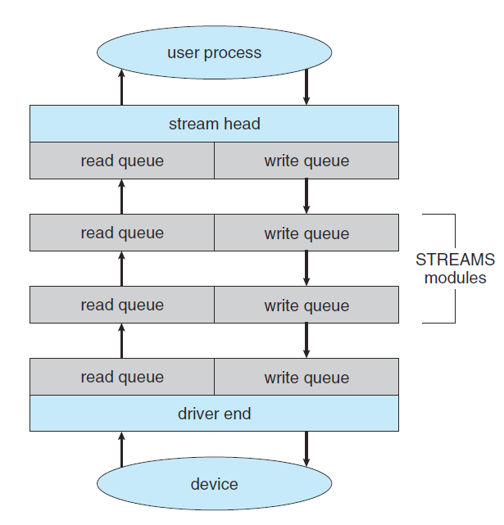
Unix Streams

Slide 37
OS Services
OS Services
User Functions: (G/C)UI, Program execution, I/O, FS manipulation
Process Communication, Error Detection, Resource allocation accounting, protection and security
User level Services
GUI/CLI

Slide 38
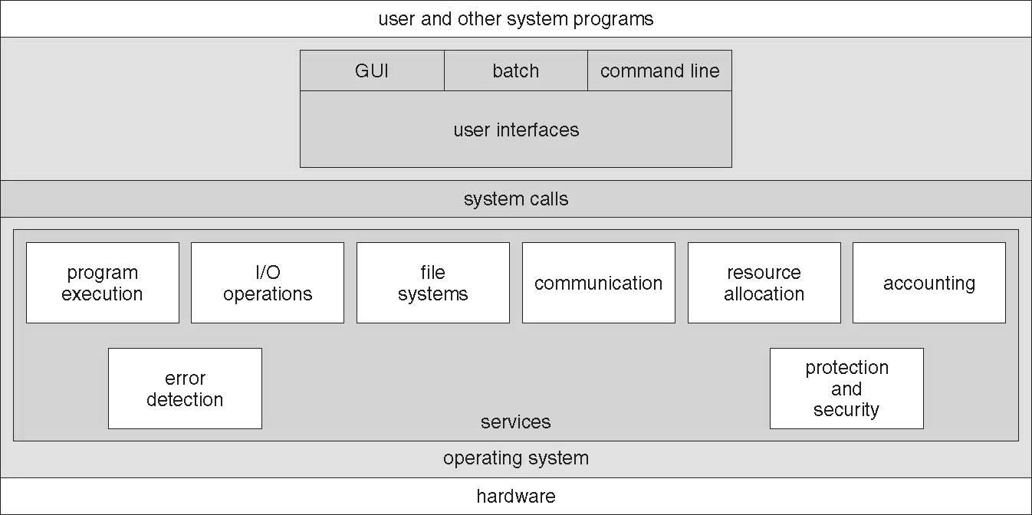
A View of Operating System Services

Slide 39
System Calls
The system calls are the instruction set of the OS virtual processor.
Programming interface to the services provided by the OS.
Typically written in a high-level language (C or C++).
Mostly accessed by programs via a high-level Application Program Interface (API) rather than direct system call use.
Three most common APIs are Win32 API for Windows, *POSIX API for POSIX-based systems (including virtually all versions of UNIX, Linux, and Mac OS X), and Java API for the Java virtual machine (JVM).
*Portable Operating System Interface (POSIX)

Slide 40
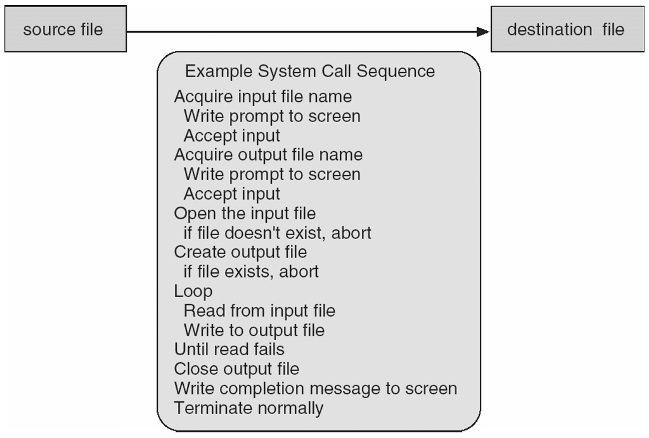
Example of System Calls
System call sequence to copy the contents of one file to another file

Slide 41
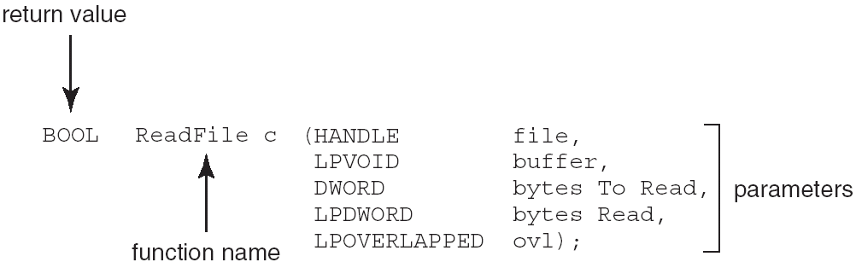
Example of Standard API
Consider the ReadFile() function in the Win32 API—a function for reading from a file
A description of the parameters passed to ReadFile()
HANDLE file—the file to be read
LPVOID buffer—a buffer where the data will be read into and written from
DWORD bytesToRead—the number of bytes to be read into the buffer
LPDWORD bytesRead—the number of bytes read during the last read
LPOVERLAPPED ovl—indicates if overlapped I/O is being used
Notes:
Overlapped I/O is an asynchronous I/O extension of the Windows APIs, which was introduced in Windows NT.

Slide 42
System Call Implementation
Typically, a number associated with each system call
System-call interface maintains a table indexed according to these numbers
The system call interface invokes intended system call in OS kernel and returns status of the system call and any return values
The caller need know nothing about how the system call is implemented
Just needs to obey API and understand what OS will do as a result call
Most details of OS interface hidden from programmer by API
Managed by run-time support library (set of functions built into libraries included with compiler)

Slide 43
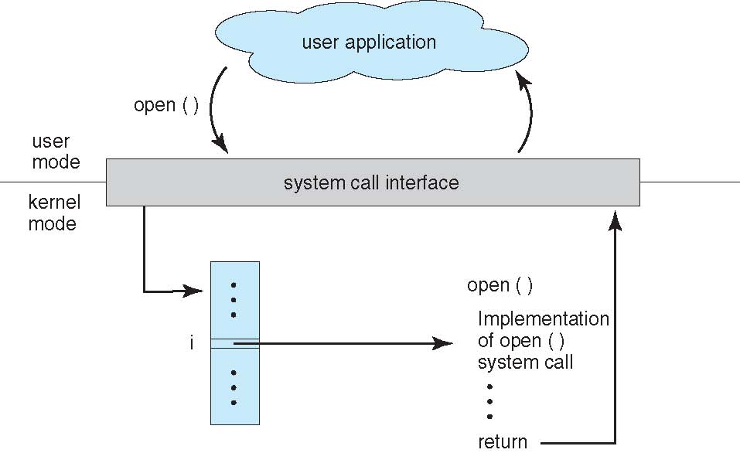
API – System Call – OS Relationship

Slide 44
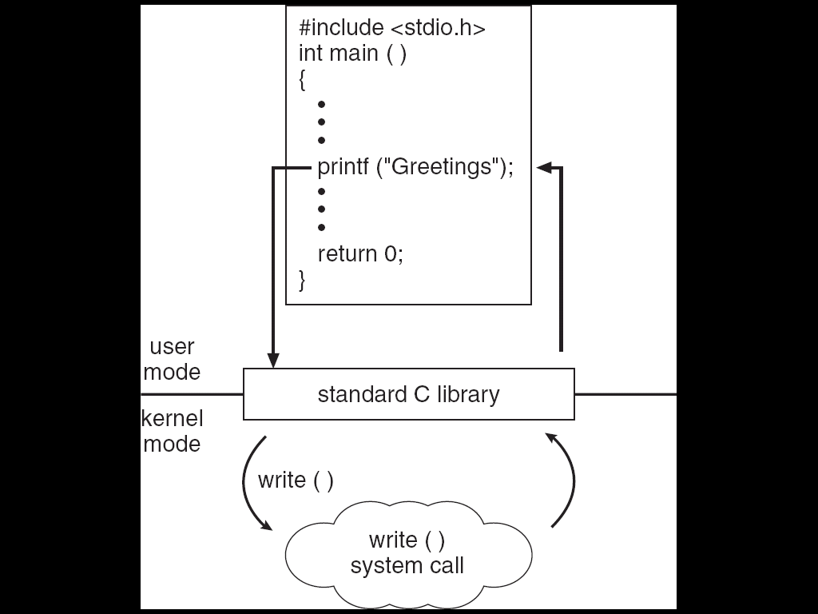
Standard C Library Example
C program invoking printf() library call, which calls write() system call

Slide 45
System Call Parameter Passing
Often, more information is required than simply identity of desired system call
Exact type and amount of information vary according to OS and call
Three general methods used to pass parameters to the OS
Simplest: pass the parameters in registers
In some cases, may be more parameters than registers
Parameters stored in a block, or table, in memory, and address of block passed as a parameter in a register
This approach taken by Linux and Solaris
Parameters placed, or pushed, onto the stack by the program and popped off the stack by the operating system
Block and stack methods do not limit the number or length of parameters being passed

Slide 46
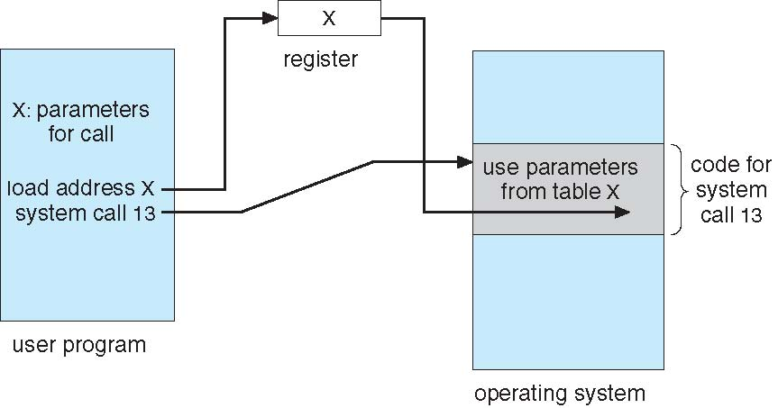
Parameter Passing via Table

Slide 47
Types of System Calls
Process control
end, abort
load, execute
create process, terminate process
get process attributes, set process attributes
wait for time
wait event, signal event
allocate and free memory
File management
create file, delete file
open, close file
read, write, reposition
get and set file attributes

Slide 48
Types of System Calls
Device management
request device, release device
read, write, reposition
get device attributes, set device attributes
logically attach or detach devices
Information maintenance
get time or date, set time or date
get system data, set system data
get and set process, file, or device attributes
Communications
create, delete communication connection
send, receive messages
transfer status information
attach and detach remote devices

Slide 49
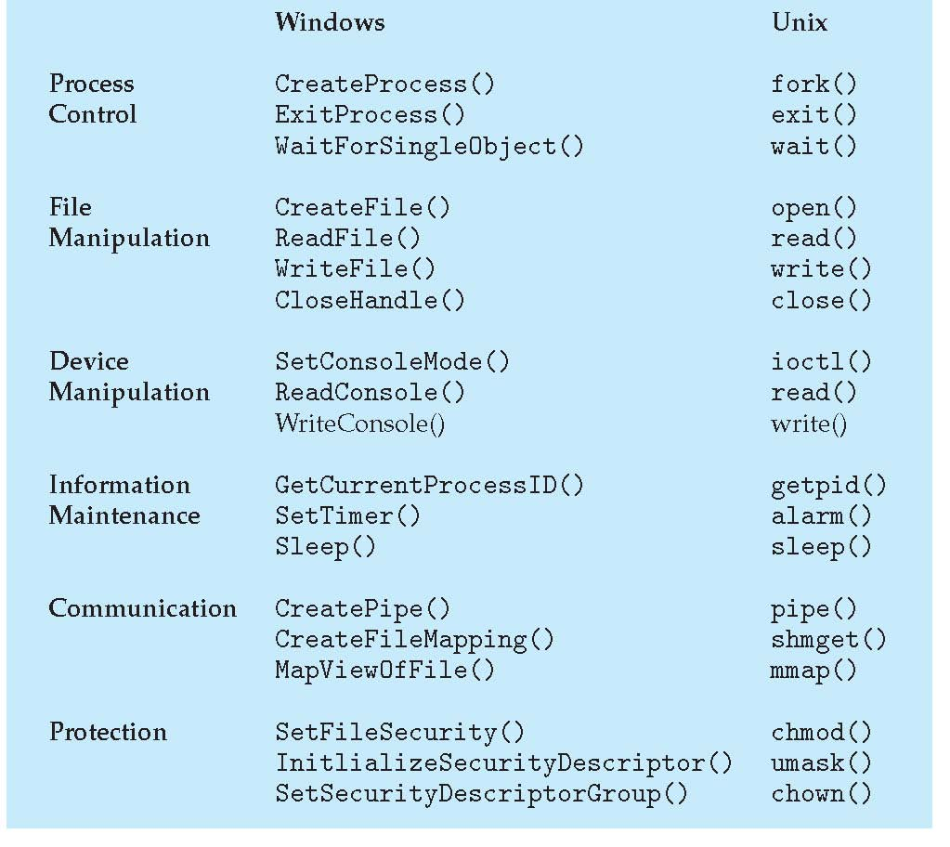
Examples of Windows and Unix System Calls

Slide 50
Types of System Calls: Process Control Example: MS-DOS
Single-tasking
Shell invoked when system booted
Simple method to run program
No process created
Single memory space
Loads program into memory, overwriting all but the kernel
Program exit -> shell reloaded

Slide 51
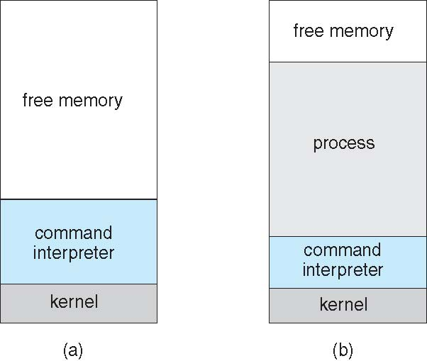
MS-DOS execution

Slide 52
System Calls
The system calls are the instruction set of the OS virtual processor.
Programming interface to the services provided by the OS.
Typically written in a high-level language (C or C++).
Mostly accessed by programs via a high-level Application Program Interface (API) rather than direct system call use.
Three most common APIs are Win32 API for Windows, *POSIX API for POSIX-based systems (including virtually all versions of UNIX, Linux, and Mac OS X), and Java API for the Java virtual machine (JVM).
*Portable Operating System Interface (POSIX)

Slide 53
Example of System Calls
System call sequence to copy the contents of one file to another file

Slide 54
Example of Standard API
Consider the ReadFile() function in the Win32 API—a function for reading from a file
A description of the parameters passed to ReadFile()
HANDLE file—the file to be read
LPVOID buffer—a buffer where the data will be read into and written from
DWORD bytesToRead—the number of bytes to be read into the buffer
LPDWORD bytesRead—the number of bytes read during the last read
LPOVERLAPPED ovl—indicates if overlapped I/O is being used
Notes:
Overlapped I/O is an asynchronous I/O extension of the Windows APIs, which was introduced in Windows NT.

Slide 55
System Call Implementation
Typically, a number associated with each system call
System-call interface maintains a table indexed according to these numbers
The system call interface invokes intended system call in OS kernel and returns status of the system call and any return values
The caller need know nothing about how the system call is implemented
Just needs to obey API and understand what OS will do as a result call
Most details of OS interface hidden from programmer by API
Managed by run-time support library (set of functions built into libraries included with compiler)

Slide 56
API – System Call – OS Relationship

Slide 57
Standard C Library Example
C program invoking printf() library call, which calls write() system call

Slide 58
System Call Parameter Passing
Often, more information is required than simply identity of desired system call
Exact type and amount of information vary according to OS and call
Three general methods used to pass parameters to the OS
Simplest: pass the parameters in registers
In some cases, may be more parameters than registers
Parameters stored in a block, or table, in memory, and address of block passed as a parameter in a register
This approach taken by Linux and Solaris
Parameters placed, or pushed, onto the stack by the program and popped off the stack by the operating system
Block and stack methods do not limit the number or length of parameters being passed

Slide 59
Parameter Passing via Table

Slide 60
Types of System Calls
Process control
end, abort
load, execute
create process, terminate process
get process attributes, set process attributes
wait for time
wait event, signal event
allocate and free memory
File management
create file, delete file
open, close file
read, write, reposition
get and set file attributes

Slide 61
Types of System Calls
Device management
request device, release device
read, write, reposition
get device attributes, set device attributes
logically attach or detach devices
Information maintenance
get time or date, set time or date
get system data, set system data
get and set process, file, or device attributes
Communications
create, delete communication connection
send, receive messages
transfer status information
attach and detach remote devices

Slide 62
Examples of Windows and Unix System Calls

Slide 63
Types of System Calls: Process Control Example: MS-DOS
Single-tasking
Shell invoked when system booted
Simple method to run program
No process created
Single memory space
Loads program into memory, overwriting all but the kernel
Program exit -> shell reloaded

Slide 64
MS-DOS execution

Slide 65
Process Control Example: FreeBSD
Unix variant
Multitasking
User login -> invoke user’s choice of shell
Shell executes fork() system call to create process
Executes exec() to load program into process
Shell waits for process to terminate or continues with user commands
Process exits with code of 0 – no error or > 0 – error code

Slide 66
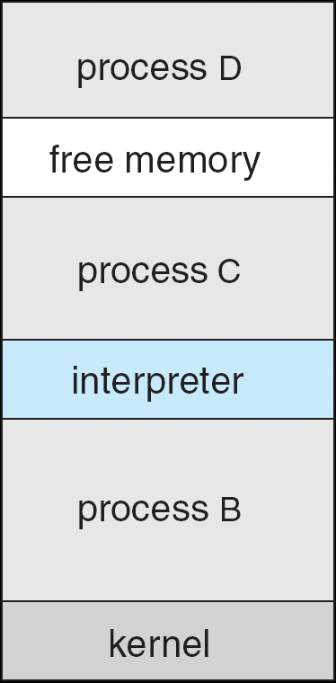
FreeBSD Running Multiple Programs

Slide 67
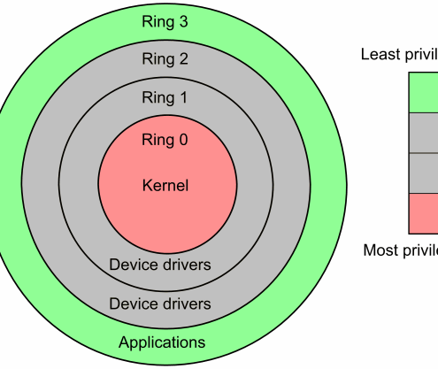
Linux system calls
Operating systems offer processes running in User Mode a set of interfaces to interact with hardware devices such as
the CPU
disks
printers.
Unix systems implement most interfaces between User Mode processes and hardware devices by means of system calls issued to the kernel.

Slide 68
POSIX APIs vs. System Calls
An application programmer interface (API) is a function definition that specifies how to obtain a given service.
A system call is an explicit request to the kernel made via a software interrupt.

Slide 69
From a Wrapper Routine to a System Call
Unix systems include several libraries of functions that provide APIs to programmers.
Some of the APIs defined by the libc standard C library refer to wrapper routines (routines whose only purpose is to issue a system call).
Usually, each system call has a corresponding wrapper routine, which defines the API that application programs should employ.

Slide 70
APIs and System Calls
An API does not necessarily correspond to a specific system call.
First of all, the API could offer its services directly in User Mode. (For something abstract such as math functions, there may be no reason to make system calls.)
Second, a single API function could make several system calls.
Moreover, several API functions could make the same system call, but wrap extra functionality around it.

Slide 71
Example of Different APIs Issuing the Same System Call
In Linux, the malloc( ), calloc( ), and free( ) APIs are implemented in the libc library.
The code in this library keeps track of the allocation and deallocation requests and uses the brk( ) system call to enlarge or shrink the process heap.
Linux defines a set of seven macros called _syscall0 through _syscall6.
Example: _syscall3(int,write,int,fd,const char *,buf,unsigned int,count)

Slide 72
The Return Value of a Wrapper Routine
Most wrapper routines return an integer value, whose meaning depends on the corresponding system call.
A return value of -1 usually indicates that the kernel was unable to satisfy the process request.
A failure in the system call handler may be caused by
invalid parameters
a lack of available resources
hardware problems, and so on.
The specific error code is contained in the errno variable, which is defined in the libc library.

Slide 73
Execution Flow of a System Call
When a User Mode process invokes a system call, the CPU switches to Kernel Mode and starts the execution of a kernel function.
As we will see in the next section, in the 80x86 architecture a Linux system call can be invoked in two different ways.
The net result of both methods, however, is a jump to an assembly language function called the system call handler.

Slide 74
System Call Number
Because the kernel implements many different system calls, the User Mode process must pass a parameter called the system call number to identify the required system call.
The eax register is used by Linux for this purpose.
Additional parameters are usually passed when invoking a system call.

Slide 75
The Return Value of a System Call
All system calls return an integer value.
The conventions for these return values are different from those for wrapper routines. In the kernel:
positive or 0 values denote a successful termination of the system call
negative values denote an error condition
In the latter case, the value is the negation of the error code that must be returned to the application program in the errno variable.
The errno variable is not set or used by the kernel. Instead, the wrapper routines handle the task of setting this variable after a return from a system call.

Slide 76
Operations Performed by a System Call
The system call handler, which has a structure similar to that of the other exception handlers, performs the following operations:
*Saves the contents of most registers in the Kernel Mode stack.
Handles the system call by invoking a corresponding C function called the system call service routine.
*Exits from the handler:
the registers are loaded with the values saved in the Kernel Mode stack
the CPU is switched back from Kernel Mode to User Mode.
*This operation is common to all system calls and is coded in assembly language.

Slide 77
Naming Rules of System Call Service Routines
The name of the service routine associated with the xyz( ) system call is usually sys_xyz( ); there are, however, a few exceptions to this rule.

Slide 78
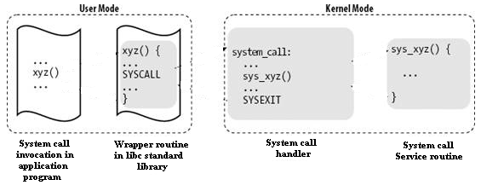
Control Flow Diagram of a System Call
The arrows denote the execution flow between the functions.
The terms "SYSCALL" and "SYSEXIT" are placeholders for the actual assembly language instructions that switch the CPU, respectively, from User Mode to Kernel Mode and from Kernel Mode to User Mode.

Slide 79
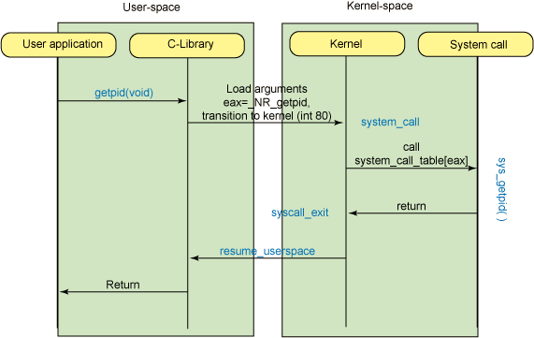
Control Flow Diagram of a System Call

Slide 80
Process Related System Calls
The UNIX system provides several system calls to
create and end program,
to send and receive software interrupts,
to allocate memory, and to do other useful jobs for a process.
Four system calls are provided for creating a process, ending a process, and waiting for a process to complete.
These system calls are fork(), the "exec" family, wait(), and exit().

Slide 81
exec() system calls
The UNIX system calls that transform a executable binary file into a process are the "exec" family of system calls. The prototypes for these calls are:
int execl(file_name, arg0 [, arg1, ..., argn], NULL)
char *file_name, *arg0, *arg1, ..., *argn;
int execv(file_name, argv)
char *file_name, *argv[];
int execle(file_name, arg0 [, arg1, ..., argn], NULL, envp)
char *file_name, *arg0, *arg1, ..., *argn, *envp[];
int execve(file_name, argv, envp)
char *file_name, *argv[], *envp[];
int execlp(file_name, arg0 [, arg1, ..., argn], NULL)
char *file_name, *arg0, *arg1, ..., *argn;
int execvp(file_name, argv)
char *file_name, *argv[];

Slide 82
exec() system calls (Cont’d)
Unlike the other system calls and subroutines, a successful exec system call does not return. Instead, control is given to the executable binary file named as the first argument.
When that file is made into a process, that process replaces the process that executed the exec system call -- a new process is not created.

Slide 83
exec() system calls (Cont’d)
Letters added to the end of exec indicate the type of arguments:
l argn is specified as a list of arguments.
v argv is specified as a vector (array of character pointers).
e environment is specified as an array of character pointers.
p user's PATH is searched for command, and command can be a shell program

Slide 84
fork() system call
To create a new process, you must use the fork() system call.
The prototype for
the fork() system call is:
int fork()
fork() causes the UNIX system to create a new process, called the "child process", with a new process ID. The contents of the child process are identical to the contents of the parent process.

Slide 85
fork() system call (Cont’d)
The new process inherits several characteristics of the old process. Among the characteristics inherited are:
The environment.
All signal settings.
The set user ID and set group ID status.
The time left until an alarm clock signal.
The current working directory and the root directory.
The file creation mask as established with umask().
fork() returns zero in the child process and non-zero (the child's process ID) in the parent process.

Slide 86
wait() system call
You can control the execution of child processes by calling wait() in the parent.
wait() forces the parent to suspend execution until the child is finished.
wait() returns the process ID of a child process that finished.
If the child finishes before the parent gets around to calling wait(), then when wait() is called by the parent, it will return immediately with the child's process ID.

Slide 87
wait() system call (Cont’d)
The prototype for the wait() system call is:
int wait(status)
int *status;
“status” is a pointer to an integer where the UNIX system stores the value returned by the child process. wait() returns the process ID of the process that ended.

Slide 88
exit() system call
The exit() system call ends a process and returns a value to it parent.
The prototype for the exit() system call is:
void exit(status)
int status;
where status is an integer between 0 and 255. This number is returned to the parent via wait() as the exit status of the process.
By convention, when a process exits with a status of zero that means it didn't encounter any problems; when a process exit with a non-zero status that means it did have problems.

Slide 89
Software Interrupt
The UNIX system provides a facility for sending and receiving software interrupts, also called SIGNALS.
Signals are sent to a process when a predefined condition happens.
The number of signals available is system dependent.
The signal name is defined in /usr/include/sys/signal.h as a manifest constant.

Slide 90
Signal
Programs can respond to signals three different ways.
Ignore the signal. This means that the program will never be informed of the signal no matter how many times it occurs. The only exception to this is the SIGKILL signal which can neither be ignored nor caught.
A signal can be set to its default state, which means that the process will be ended when it receives that signal. In addition, if the process receives any of SIGQUIT, SIGILL, SIGIOT, SIGEMT, SIGFPE, SIGBUS, SIGSEGV, or SIGSYS, the UNIX system will produce a core image (core dump), if possible, in the directory where the process was executing when it received the program-ending signal.
Catch the signal. When the signal occurs, the UNIX system will transfer control to a previously defined subroutine where it can respond to the signal as is appropriate for the program.

Slide 91
Signal
Related system calls
signal
kill
alarm

Slide 92
signal() system call
You define how you want to respond to a signal with the signal() system call. The prototype is:
#include <sys/signal.h>
int (* signal ( signal_name, function ))
int signal_name;
int (* function)();

Slide 93
kill() system call
The UNIX system sends a signal to a process when something happens, such as typing the interrupt key on a terminal, or attempting to execute an illegal instruction. Signals are also sent to a process with the kill() system call. Its prototype is:
int kill (process_id, signal_name )
int process_it, signal_name;

Slide 94
alarm() system call
Every process has an alarm clock stored in its system-data segment. When the alarm goes off, signal SIGALRM is sent to the calling process. A child inherits its parent's alarm clock value, but the actual clock isn't shared.
The alarm clock remains set across an exec. The prototype for alarm() is:
unsigned int alarm(seconds)
unsigned int seconds;
Check
timesup.c

Slide 95
Examples : File Creation
/* creat.c */
#include <stdio.h>
#include <sys/types.h> /* defines types used by sys/stat.h */
#include <sys/stat.h> /* defines S_IREAD & S_IWRITE */
int main() {
int fd;
fd = creat("datafile.dat", S_IREAD | S_IWRITE);
if (fd == -1)
printf("Error in opening datafile.dat\n");
else {
printf("datafile.dat opened for read/write access\n");
printf("datafile.dat is currently empty\n");
}
close(fd);
exit (0);
}

Slide 96
Stat.h
#define S_IRWXU 0000700 /* -rwx------ */
#define S_IREAD 0000400 /* read permission, owner */
#define S_IRUSR S_IREAD
#define S_IWRITE 0000200 /* write permission, owner */
#define S_IWUSR S_IWRITE
#define S_IEXEC 0000100 /* execute/search permission, owner */
#define S_IXUSR S_IEXEC
#define S_IRWXG 0000070 /* ----rwx--- */
#define S_IRGRP 0000040 /* read permission, group */
#define S_IWGRP 0000020 /* write " " */
#define S_IXGRP 0000010 /* execute/search " " */
#define S_IRWXO 0000007 /* -------rwx */
#define S_IROTH 0000004 /* read permission, other */
#define S_IWOTH 0000002 /* write " " */
#define S_IXOTH 0000001 /* execute/search " " */

Slide 97
File Open
/* open.c */
#include <fcntl.h> /* defines options flags */
#include <sys/types.h> /* defines types used by sys/stat.h */
#include <sys/stat.h> /* defines S_IREAD & S_IWRITE */
static char message[] = "Hello, world";
int main() {
int fd; char buffer[80];
fd = open("datafile.dat",O_RDWR | O_CREAT | O_EXCL, S_IREAD | S_IWRITE);
if (fd != -1) {
printf("datafile.dat opened for read/write access\n");
write(fd, message, sizeof(message));
lseek(fd, 0L, 0); /* go back to the beginning of the file */
if (read(fd, buffer, sizeof(message)) == sizeof(message))
printf("\"%s\" was written to datafile.dat\n", buffer);
else
printf("*** error reading datafile.dat ***\n");
close (fd);
} else printf("*** datafile.dat already exists ***\n");
exit (0);
}

