Slide 1
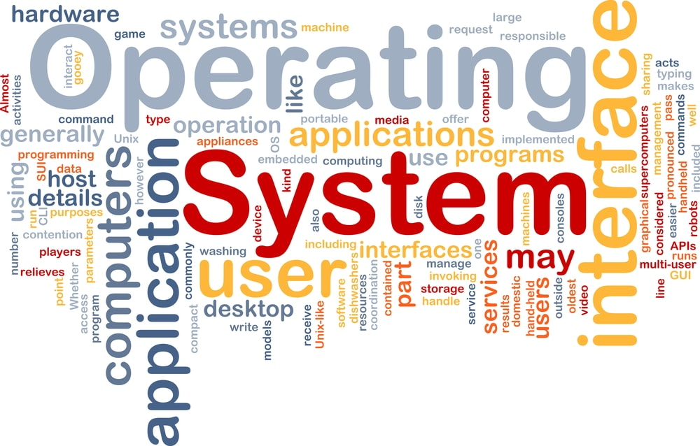
CS3.304.M21 Advanced Operating Systems Lecture # 05
Manish Shrivastava
CVIT, IIIT Hyderabad

Slide 2
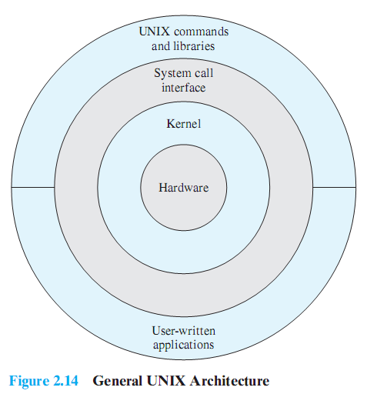
Description of UNIX
Notes:
This figure provides a general description of the classic UNIX architecture.
The underlying hardware is surrounded by the OS software.
The OS is often called the system kernel, or simply the kernel, to emphasize its isolation from the user and applications.
It is the UNIX kernel that we will be concerned with in our use of UNIX as an example in this book.
UNIX also comes equipped with a number of user services and interfaces that are considered part of the system.
These can be grouped into the shell, other interface software, and the components of the C compiler (compiler, assembler, loader).
The layer outside of this consists of user applications and the user interface to the C compiler.

Slide 3
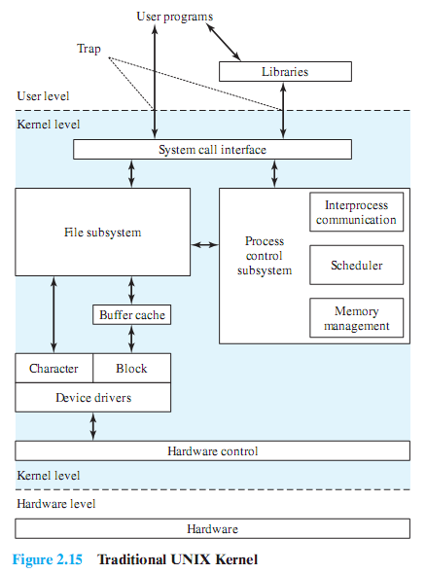
Traditional UNIX Kernel
Notes:
User programs can invoke OS services either directly or through library programs.
The system call interface is the boundary with the user and allows higher-level software to gain access to specific kernel functions.
At the other end, the OS contains primitive routines that interact directly with the hardware.
Between these two interfaces, the system is divided into two main parts, one concerned with process control and the other concerned with file management and I/O.
The process control subsystem is responsible for memory management, the scheduling and dispatching of processes, and the synchronization and interprocess communication of processes.
The file system exchanges data between memory and external devices either as a stream of characters or in blocks. To achieve this, a variety of device drivers are used.
For block-oriented transfers, a disk cache approach is used: a system buffer in main memory is interposed between the user address space and the external device.

Slide 4
The Linux Kernel

Slide 5
Monolithic?
What is a monolithic program?
What is a Monolithic Kernel?

Slide 6
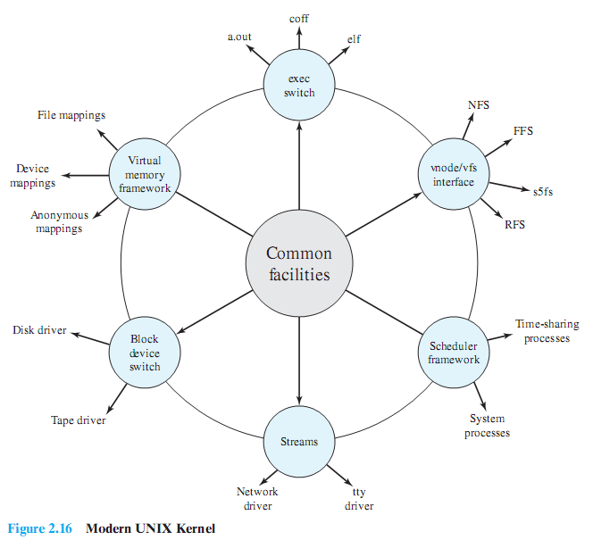
System V Release 4 (SVR4)
Notes:
Almost a complete rewrite of the System V kernel and produced a clean, if complex, implementation.
New features in the release include real-time processing support, process scheduling classes, dynamically allocated data structures, virtual memory management, virtual file system, and a preemptive kernel.
It incorporates most of the important features ever developed on any UNIX system and does so in an integrated, commercially viable fashion.

Slide 7
Modular Monolithic Kernel
Although monolithic, the kernel is structures as a collection of modules
Loadable modules
An object file which can be linked and unlinked at run time
Characteristics:
Dynamic Linking
Stackable modules
Notes:
Although Linux does not use a microkernel approach, it achieves many of the potential advantages of this approach by means of its particular modular architecture.
Linux is structured as a collection of modules, a number of which can be automatically loaded and unloaded on demand.
These relatively independent blocks are referred to as loadable modules.
In essence, a module is an object file whose code can be linked to and unlinked from the kernel at runtime.
The Linux loadable modules have two important characteristics:
Dynamic linking: A kernel module can be loaded and linked into the kernel while the kernel is already in memory and executing.
A module can also be unlinked and removed from memory at any time.
Saves kernel memory.
Stackable modules: The modules are arranged in a hierarchy.
Individual modules serve as libraries when they are referenced by client modules higher up in the hierarchy, and as clients when they reference modules further down.

Slide 8
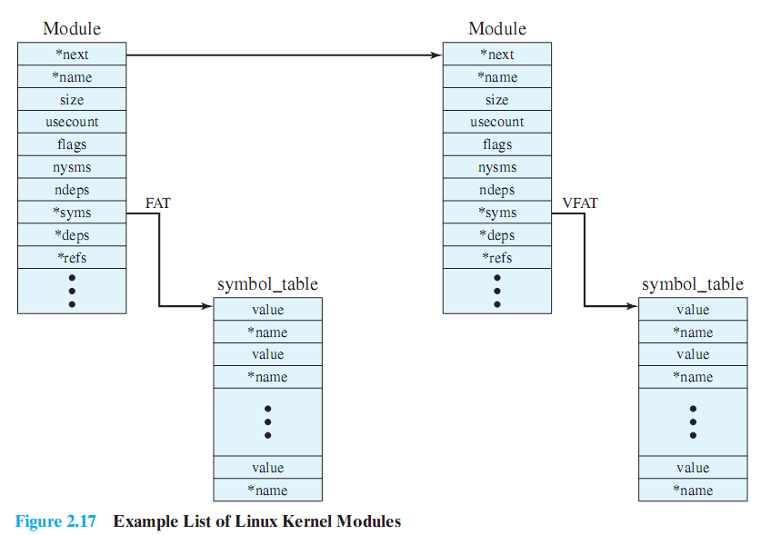
Linux Kernel Modules
Notes:
Figure 2.17 is an example that illustrates the structures used by Linux to manage modules.
It shows that the VFAT module was loaded after the FAT module and that the VFAT module is dependent on the FAT module.
The figure shows the list of kernel modules after only two modules have been loaded:
FAT and VFAT.
Each module is defined by two tables,
The module table and
the symbol table.
The module table includes the following elements:
*next: Pointer to the following module. All modules are organized into a linked list.
The list begins with a pseudomodule (not shown in Figure 2.17).
*name: Pointer to module name.
size:Module size in memory pages.
usecount:Module usage counter.
The counter is incremented when an operation involving the module’s functions is started and decremented when the operation terminates.
flags:Module flags.
nsyms: Number of exported symbols.
ndeps: Number of referenced modules
*syms: Pointer to this module’s symbol table.
*deps: Pointer to list of modules the are referenced by this module.
*refs: Pointer to list of modules that use this module.
The symbol table defines those symbols controlled by this module that are used elsewhere.

Slide 9
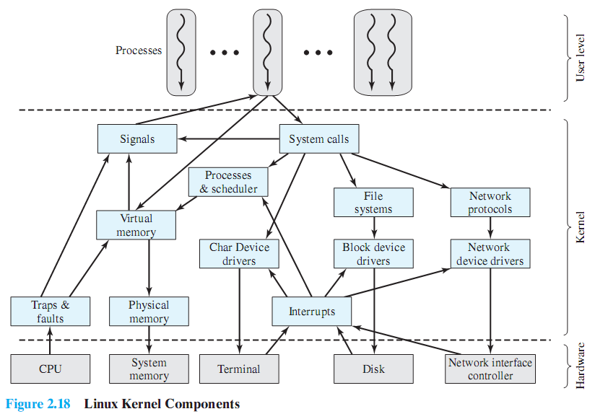
Linux Kernel Components
Notes:
This figure shows the main components of the Linux kernel as implemented on an IA-64 architecture (e.g., Intel Itanium).
It shows several processes running on top of the kernel.
Each box indicates a separate process, while each squiggly line with an arrowhead represents a thread of execution.
The kernel itself consists of an interacting collection of components, with arrows indicating the main interactions.
The underlying hardware is also depicted as a set of components with arrows indicating which kernel components use or control which hardware components.
All of the kernel components, of course, execute on the processor but, for simplicity, these relationships are not shown.

Slide 10
Design Goals
Three goals
Modularity
Simplicity
Portability
Numerous standard utilities
Eliminate need to write special code
Used in combination for specific tasks
Numerous functions
IEEE POSIX (Portable Operating System Interface) specifications conformity
Programs’ portability

Slide 11
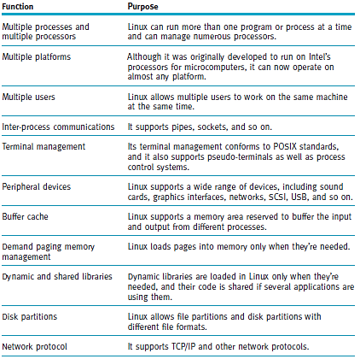
(table 15.2)
Select system functions supported by Linux.
© Cengage Learning 2014

Slide 12
(table 15.2) (cont’d.)
Select system functions supported by Linux.
© Cengage Learning 2014

Slide 13
Process?
What is a process?
Is kernel a process?

Slide 14
Process?
What is a process?
Is kernel a process?
No!
Init is just the first process; it does not manage any processes or threads. It does create some, using the kernel syscalls fork() and exec.
It is a Process Manager without being a process

Slide 15
Kernel vs. Application Coding
Two major differences:
The core kernel has no standard libraries
The core kernel must be a monolithic, statically linked library
No standard libraries:
No libc (malloc, pthreads, string handling, etc.)
Partly because of chicken/egg situation
Also, standard libraries can be too slow
No dynamic loading of shared libraries for the core kernel

Slide 16
Two Big Problems
A totally static kernel would be enormous
About 20 million lines of code in 2015
Most of this is hardware drivers that are never used on any given platform
Programmers rely on “library” functions for efficiency and correctness
E.g., things like data structures, sleeping routines, etc.
What libraries to use? (hint: not glibc)
Kernel code has to be entirely self-contained
Also, chicken+egg problem, as glibc functions may in turn invoke the kernel via system calls

Slide 17
First Solution: Loadable Kernel Modules
Kernel modules are kernel code that can be loaded dynamically:
Can be loaded/unloaded whenever
Runs in kernel mode
Can access exported kernel variables and functions
Can export variables and functions to kernel or other modules

Slide 18
Kernel and Kernel Modules
Often, if you want to add something to the kernel you need to rebuild the kernel and reboot.
A “loadable kernel module” (LKM) is an object file that extends the base kernel.
Exist in most OSes
Including Windows, FreeBSD, Mac OS X, etc.
Modules get added and removed as needed
To save memory, add functionality, etc.

Slide 19
Why Kernel Modules
Linux is a monolithic kernel. All functionality is compiled into the same static binary that is loaded into memory on boot.
Without modules, the entire kernel would need to be loaded into memory to boot a node. Problems?
Waste of memory (embedded systems)
Slower boot time
Larger trusted computing base (TCB), more room for bugs

Slide 20
What are Kernel Modules used for?
What pieces of code do we think might not be needed on every system that the kernel boots on?
Device Drivers
Architecture-specific code
Lines of code (just .c files) for:
Device Drivers: 1,583,159
Everything else: 1,003,777
(Includes all of the architectures that we’re not using!)

Slide 21
What are Kernel Modules used for?
Beyond space savings, what else might modules be useful for?
“Out-of-tree” functionality that is not accepted into “mainline” kernel
Allowing users to load custom functionality at runtime
Configuring/patching a running system without requiring a reboot

Slide 22
Modular?
What does it mean to be modular (exactly)?
How is that beneficial?
How would a Modular kernel differ from a Monolithic one?

Slide 23
Linux Kernel Modules
In general must be licensed under a free license.
Doing otherwise will taint the whole kernel.
A tainted kernel sees little support.
Might be a copyright problem if you redistribute.
The Linux kernel changes pretty rapidly, including APIs etc.
This can make it a real chore to keep LKMs up to date.
Also makes a tutorial a bit of a pain.

Slide 24
Module Implementation
Must define:
An initialization function called on load
An exit function called on unload
The init function must be self contained!
Must unwind actions if initialization cannot complete successfully
E.g. if you kmalloc() space but don’t free it, that physical memory is now lost (until system restart)
You can also pass parameters to modules at load time.

Slide 25
Creating a module
All modules need to define functions that are to be run when:
The module is loaded into the kernel
The module is removed from the kernel
We just write C code (see next slide)
We need to compile it as a kernel module.
We invoke the kernel’s makefile.
sudo make –C /lib/modules/xxx/build M=$PWD modules
This makes (as root) using the makefile in the path specified.
I think it makes all C files in the directory you started in
Creates .ko (rather than .o) file
Xxx is some kernel version/directory

Slide 26
Simple module
#include <linux/init.h>
#include <linux/module.h>
#include <linux/kernel.h>
MODULE_LICENSE("Dual BSD/GPL");
static int hello_init(void) {
printk("<1> Hello World!\n");
return 0;
}
static void hello_exit(void) {
printk("<1> Bye world!\n");
}
module_init(hello_init);
module_exit(hello_exit);
MODULE_LICENSE
Required.
Short list of allowed licenses.
Printk()
Kernel print.
Prints message to console and to log.
<1> indicates high priority message, so it gets logged.
Module_init()
Tells system what module to call when we first load the module.
TIMTOWTDI
Module_exit()
Same but called when module released.

Slide 27
Modules: Listing, loading and removing
From the command line:
lsmod
List modules.
insmod
Insert module into kernel
Adds to list of available modules
Causes function specified by module_init() to be called.
rmmod
Removes module from kernel

Slide 28
lsmod
Module Size Used by memory 10888 0 hello 9600 0 binfmt_misc 18572 1 bridge 63776 0 stp 11140 1 bridge bnep 22912 2 video 29844 0

Slide 29
insmod
Very (very) simple
insmod xxxxx.ko
Says to insert the module into the kernel

Slide 30
Other (better) way to load a module
Modprobe is a smarter version of insmod.
Actually it’s a smarter version of insmod, lsmod and rmmod…
It can use short names/aliases for modules
It will first install any dependent modules
We’ll use insmod for the most part
But be aware of modprobe
[3]

Slide 31
So?
#include <linux/init.h>
#include <linux/module.h>
#include <linux/kernel.h>
MODULE_LICENSE("Dual BSD/GPL");
static int hello_init(void) {
printk("<1> Hello World!\n");
return 0;
}
static void hello_exit(void) {
printk("<1> Bye world!\n");
}
module_init(hello_init);
module_exit(hello_exit);
When insmod, log file gets a “Hello World!”
When rmmod, that message prints to log (and console…)
It’s not the name, it’s the module_init().

Slide 32
Modules?
There are a number of different reasons one might have a module
But the main one is to create a device driver
It’s not realistic for Linux to have a device driver for all possible hardware in memory all at once.
Would be too much code, requiring too much memory.
So we have devices as modules
Loaded as needed.

Slide 33
Device driver (Thanks Wikipedia!)
A device driver is a computer program allowing higher-level computer programs to interact with a hardware device.
A driver typically communicates with the device through the computer bus or communications subsystem to which the hardware connects.
When a calling program invokes a routine in the driver, the driver issues commands to the device.
Drivers are hardware-dependent and operating-system-specific.

Slide 34
Devices in Linux (1/2)
There are special files called “device files” in Linux.
A user can interact with it much like a normal file.
But they generally provide access to a physical device.
They are generally found in /dev and /sys
/dev/fb is the frame buffer
/dev/ttyS0 is one of the serial ports
Not all devices files correspond to physical devices.
Pseudo-devices.
Provide various functions to the programmer
/dev/null
Accepts and discards all input; produces no output.
/dev/zero
Produces a continuous stream of NULL (zero value) bytes.
etc.
crw-rw---- 1 root dialout 4, 64 Jun 20 13:01 ttyS0

Slide 35
Devices in Linux (2/2)
Pretty clearly you need a way to connect the device file to the actual device
Or pseudo device for that matter
We want to be able to “fake” this by writing functions that handle the file I/O.
So we need to associate functions with all the things we can do with a file.
Open, close.
Read, write.
Today we’ll talk about all that…

Slide 36
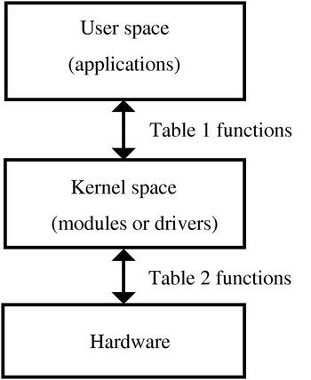
Kernel vs. User space
User Space
End-user programs. They use the kernel to interface to the hardware.
Kernel Space
Provides a standard (and hopefully multi-user secure) method of using and sharing the hardware.
Private function member might be a good analogy.
[1]

Slide 37
What is a “device”?
Linux devices are accessed from user space in exactly the same way files are accessed.
They are generally found in /dev and /sys
To link normal files with a kernel module, each device has a “major number”
Each device also has a “minor number” which can be used by the device to distinguish what job it is doing.
% ls -l /dev/fd0 /dev/fd0u1680
brwxrwxrwx 1 root floppy 2, 0 Jul 5 2000 /dev/fd0
brw-rw---- 1 root floppy 2, 44 Jul 5 2000 /dev/fd0u1680
Two floppy devices. They are actually both the same bit of hardware using the same driver
(major number is 2), but one is 1.68MB the other 1.44.

Slide 38
Creating a device
mknod /dev/memory c 60 0
Creates a device named /dev/memory
Major number 60
Minor number 0
Minor numbers are passed to the driver to distinguish different hardware with the same driver.
Or, potentially, the same hardware with different parameters (as the floppy example)

Slide 39
Second Solution: Kernel “Libraries”
Kernel libraries re-implement a lot of the functionality programmers expect in user space
Are statically compiled into the kernel
Automatically available just by including relevant header
Built to be kernel-safe (sleeping, waiting, locking, etc. is done properly)
Features:
Utilities: kmalloc, kthreads, string parsing, etc.
Containers: hash tables, binary trees etc.
Algorithms: sorting, compression
Mostly found under /lib and /include/linux

Slide 40
Kernel “Libraries”
Mostly found under /lib and /include/linux
Many kernel “libraries” have clear analogues to user space libraries:
- malloc/free vs kmalloc/kfree
- pthread_create vs kthread_create
- sleep/usleep/nanosleep (user) vs msleep (kernel)
Some, however, are a bit different:
- e.g., linked list implementation

Slide 41
Example: Linked Lists
See also:
/include/linux/list.h
/include/linux/types.h
Moral of the story:
Always search for functionality before writing it yourself.

Slide 42
Notes:
One important note is that module stuff is written in kernel space.
That means you can’t do a lot of things you might want to!
File I/O is a really bad idea
Talking to memory-mapped I/O devices requires effort
Still have virtual memory
Things like malloc don’t quite work
Thus kmalloc, kprint, etc.
Can be an unpleasant place to live…

Slide 43
Linux Boot Process – Simple Walkthrough
Manish Shrivastava

Slide 44
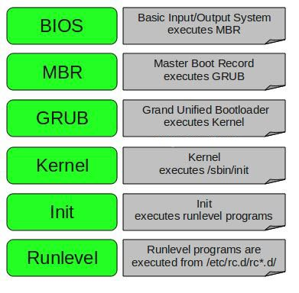
Overview

Slide 45
The BIOS

Slide 46
The BIOS
Basic Input Output System
Has two responsibilities:
POST - Power On Self Test
Load and execute the bootloader.
“hardcoded” to look at the first sector of a bootable device.

Slide 47
The MBR

Slide 48
The MBR
The term used to refer to a partitioning scheme or sector 0 of a storage device.
Split into 3 sections
Bootloader | Partition Table | Boot Signature
446 bytes | 64 bytes | 2 bytes
BIOS loads the bootloader code into RAM and executes it.

Slide 49
The Bootloader

Slide 50
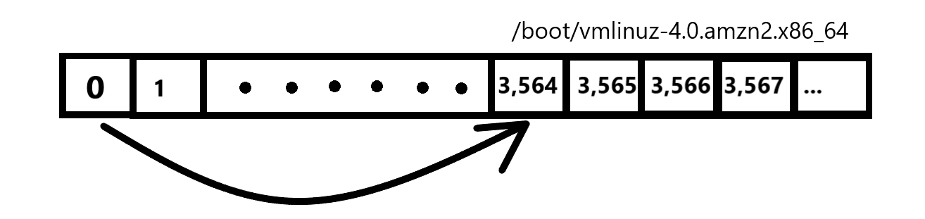
The Bootloader
Responsible for loading the operating system into memory.
LILO (Linux Loader) was the default for a long time
It works by pointing to the first sector where the kernel is stored (simplified).
Has limited functionality due to the 446 bytes available in MBR

Slide 51
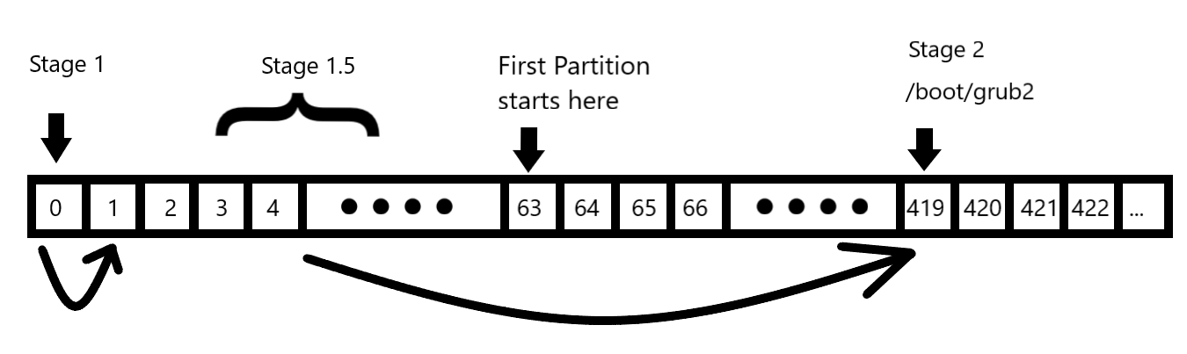
The Bootloader - GRUB
GRUB replaced LILO as the default Linux bootloader (we’ll focus on version 2 but version 1 is similar).
Split into 3 stages.

Slide 52
The Bootloader - GRUB
Stage 1 loads Stage 1.5
Stage 1.5 loads the grub kernel and filesystem modules needed to locate Stage 2 ( /boot/grub2 )
Stage 2 parses /boot/grub2/grub.cfg and displays GRUB Menu
When a (Linux) OS is selected, corresponding kernel image along with the appropriate initramfs images are loaded into memory.
If Windows is selected, GRUB chainloads the Windows Bootloader.

Slide 53
The Chicken-and-Egg problem

Slide 54
The Chicken-and-Egg Problem
The kernel needs to mount the root filesystem which can have one or more properties:
NFS
RAID
LVM
Encryption
The necessary modules are stored in /lib/modules
In order to access them, the filesystem must be mounted.

Slide 55
The Chicken-and-Egg Problem
Solution?

Slide 56
Initial Ram Disk (initrd)
A temporary filesystem that has all the stuff needed to mount the root filesystem.
Initial Ram Disk (initrd) is an image of a block device.
Grub makes it available as a special block device in memory (/dev/ram)
The kernel mounts this device and uses it as it’s root filesystem.
Kernel must be compiled with the drivers needed to mount initrd.

Slide 57
Initrd vs Initramfs

Slide 58
initrd vs initramfs
Initrd is made available as a block device that is mounted in memory.
Initramfs is an archive that contains the directory structure of a typical filesystem.
Archive is extracted to created a tmpfs (temporary filesystem)
Mounted in memory to create initramfs
Initramfs introduced in Linux Kernel v2.6.13

Slide 59
The Kernel

Slide 60
The Kernel
Initializes and configures memory and various hardware.
Extract initramfs into a tempfs and mount it in memory
Mount the root filesystem as read-only.
Start the first program.

Slide 61
SysV Init

Slide 62
SysV-Init
The first program started by the kernel, thus has a PID of 1.
A daemon that runs throughout the lifetime of the system until it shuts down. Manages all other daemons and programs.
Program is located at “/sbin/init”

Slide 63
The rc.sysinit script
Located at “/etc/rc.d/rc.sysinit”, this is the first script that is executed by init and it will perform the following tasks:
Set the system’s hostname
Unmount initramfs
Sets kernel parameters as defined in /etc/sysctl.conf.
Start devfs
Mount procfs and sysfs
Dumps the current contents of the kernel ring buffer into /var/log/dmesg
Process /etc/fstab (mounting and running fsck)
Enable RAID and LVM
After the rc.sysinit script is executed, the relevant runlevel scripts are executed.

Slide 64
Runlevels
A runlevel describes the state of a system with regards to the services and functionality that is available.
There are a total of 7 runlevels which are defined as follows:
0: Halt or shutdown the system
1: Single user mode
2: Multi-user mode, without networking
3: Full multi user mode, with networking
4: Officially not defined; Unused
5: Full multi user with NFS and graphics (typical for desktops)
6: Reboot
Default runlevel is configured in the config file /etc/inittab
Notes:
Discuss use cases of the different runlevels.
Runlevel 3 – cloud environment where you only have access to the terminal.
Runlevel 5 – GUI environment.
You can troll someone by changing the default runlevel to 0, 1 or 6.

Slide 65
Runlevel Scripts
Runlevel scripts are responsible for starting and stopping services that will provide the functionality for the respective runlevel.
Located under “/etc/rc.d”:
$ ls -l /etc/rc.d total 60 drwxr-xr-x 2 root root 4096 Aug 26 09:19 init.d -rwxr-xr-x 1 root root 2617 Aug 17 2017 rc drwxr-xr-x 2 root root 4096 Aug 26 09:19 rc0.d drwxr-xr-x 2 root root 4096 Aug 26 09:19 rc1.d drwxr-xr-x 2 root root 4096 Aug 26 09:19 rc2.d drwxr-xr-x 2 root root 4096 Aug 26 09:19 rc3.d drwxr-xr-x 2 root root 4096 Aug 26 09:19 rc4.d drwxr-xr-x 2 root root 4096 Aug 26 09:19 rc5.d drwxr-xr-x 2 root root 4096 Aug 26 09:19 rc6.d -rwxr-xr-x 1 root root 220 Jul 2 06:56 rc.local -rwxr-xr-x 1 root root 20108 Aug 17 2017 rc.sysinit

Slide 66
Runlevel Scripts
Naming convention of the scripts is as follows:
Starts with “S” or “K”. “S” scripts are used to start the service and “K” scripts are used to stop the service.
Followed by a number that specifies the order in which the scripts are to be executed.
Ends with the name of the service.
Notes:
For example, you will notice that the “network” Start script is set to start before the “ssh” service script since a system will need to have network access before the SSH service can start. Consequently, the network Kill script is set to execute AFTER the ssh service Kill script.

Slide 67
rc.local sript
After the runlevel scripts have been executed, the last script to run is the /etc/rc.d/rc.local script.
You can add custom Bash commands you want to be executed at boot.
The login prompt will show up after the rc.local script has been executed.

Slide 68
SysV-Init Important Commands
$ service httpd start
$ service httpd status
$ chkconfig httpd on
$ runlevel
$ telinit 3
$ sed -i “s/^id:.*:initdefault:/id:3:initdefault/” /etc/inittab

Slide 69
SystemD Boot Process

Slide 70
SystemD
SystemD is a system and service manager that was designed to replace SysV-Init which has the following limitations:
Services are started sequentially.
Longer boot times.
No easy and straightforward way to monitor running services.
Dependencies have to be handled manually.
Notes:
- Services are started sequentially even services that do not depend on each other.
- Longer boot times (most because of the point mentioned above)
- No easy and straightforward way to monitor running services.
- Dependencies have to be handled manually so you need very good knowledge of the dependencies involved when you want to modify the runlevel scripts to add a new service.

Slide 71
SystemD Units
Every resource that is managed by SystemD is called a unit.
A unit is a plain-text file that stores information about any one of the following:
a service
a socket
a device
a mount point,
an automount point
a swap file or partition
a start-up target
a watched file system path
a timer controlled and supervised by systemd
a resource management slice or a group of externally created processes.

Slide 72
SystemD Target Units
Runlevels were replaced by “target” units,
Target files are used to group together units that are needed for that specific target (services, sockets, devices, etc.)
SysV-Init Runlevel | SystemD Start-up Target
0: Halt or shutdown the system | poweroff.target
1: Single User mode | rescue.target
2: Multi-user mode, without networking | multi-user.target
3: Full multi user mode, with Networking | multi-user.target
4: Undefined | multi-user.target
5: Full multi-user mode with networking and graphical desktop. | graphical.target
6: Reboot | reboot.target

Slide 73
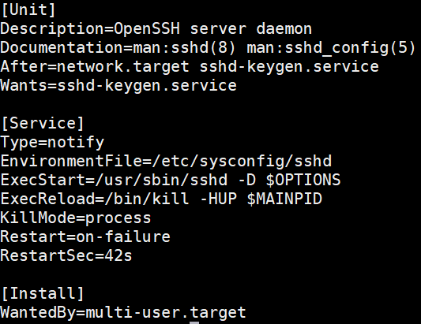
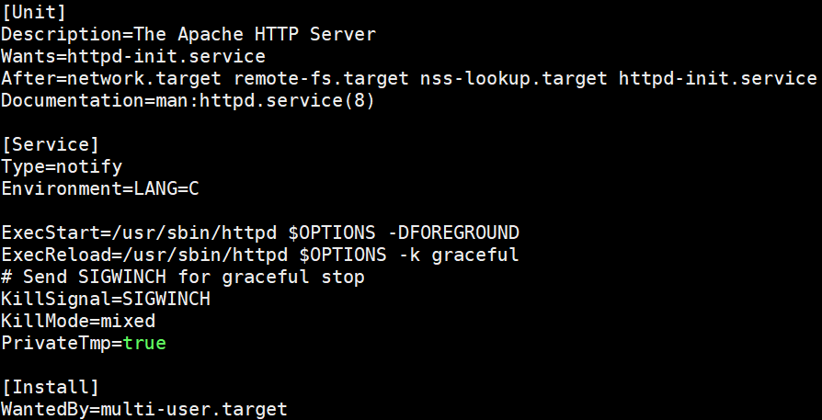
SystemD Service Units
Runlevel Scripts were replaced by systemd unit files (mostly service unit files)
A service unit file will define how that service is started and stopped.

Slide 74
SystemD Dependencies
There are 3 main ways of defining the dependencies of unit (target or service):
“Wants=” statements inside the unit files.
“Requires=” statements inside the unit files.
Special “.wants” directories associated with each target unit file found under the directory /etc/systemd/system
When you enable a service using systemctl, systemd creates a symbolic link in the default target’s “.wants” directory that points to the service unit file.

Slide 75
SystemD Boot Process
When a system boots into a specific target, all the dependent units are activated (services, mounts, sockets, etc.)
All the tasks that are performed by the rc.sysinit script are replaced by “sysinit.target”.
basic.target, multi-user.target, graphical.target and rescue.target all have sysinit.target as one of their dependencies.
By default, rc.local script will not run by default unless if you make it executable:
chmod +x /etc/rc.d/rc.local

