Slide 1
Processes and Communication
Manish Shrivastava

Slide 2
Process Creation
A system call is used to create process.
Assigns unique id
Space
PCB is initialized.
The creating process is called parent process.
Parent process creates children processes, which, in turn create other processes, forming a tree of processes.
In UNIX pagedaemon, swapper, and init children are root process. Users are children of init process.
A process needs certain resources to accomplish its task.
CPU time, memory, files, I/O devices.

Slide 3
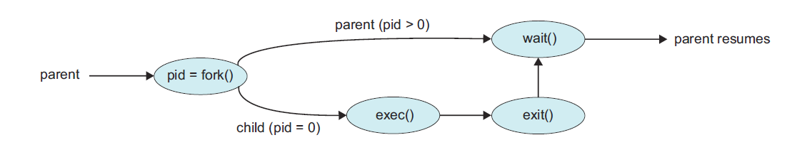
Process Creation
When a process creates a new process,
Resource sharing possibilities.
Parent and children share all resources.
Children share subset of parent’s resources.
Parent and child share no resources.
Execution possibilities
Parent and children execute concurrently.
Parent waits until children terminate.
Address space
Child duplicate of parent.
Child has a program loaded into it.

Slide 4
Process Creation
UNIX examples
fork system call creates new process
exec system call used after a fork to replace the process’ memory space with a new program.
The new process is a copy of the original process.
The exec system call is used after a fork by one of the two processes to replace the process memory space with a new program.
WINDOWS NT supports both models:
Parent address space can be duplicated or
parent can specify the name of a program for the OS to load into the address space of the new process.

Slide 5
Process Concept
Early OS: One program at a time with complete control.
Modern OS: allow multiple programs to be loaded in to memory and to be executed concurrently.
This requires firm control over execution of programs.
The notion of process emerged to control the execution of programs.
A process
Unit of work
Program in execution
OS consists of a collection of processes
OS processes executes system code.
User processes executes user code.
By switching CPU between processes, the OS can make the computer more productive.

Slide 6
Process Concept
Process (task or job) includes the current activity.–
a program in execution;
process execution must progress in sequential fashion.
The components of a process are
The program to be executed
The data on which the program will execute
The resources required by the program– such as memory and file (s)
The status of execution: a) Program counter b) Stack
Multiple processes can be associated with the same program.
For CPU, all processes are similar
Batch Jobs and user programs/tasks
Word file, Internet browser
System call
Scheduler
….

Slide 7
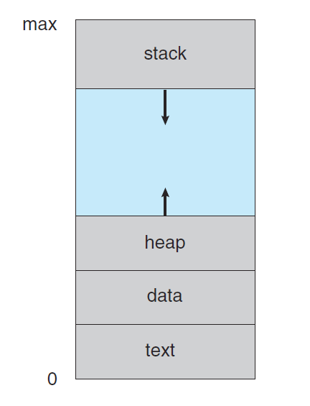
Process Concept
Process in Memory
Process memory

Slide 8
Process Concept
Example: User level context
MAX
(b, *p) - main
(a) - foo
stack
…
int aa;
char buf[1000];
void foo() {
int a;
…
}
main() {
int b;
char *p;
p = new char[1000];
foo();
}
heap (p)
(char[1000])
data (aa, buf)
text (code)
0
Process memory

Slide 9
Process State
As a process executes, it changes state
Each process can be in one of
new: The process is being created.
running: Instructions are being executed.
waiting: The process is waiting for some event to occur.
ready: The process is waiting to be assigned to a process.
terminated: The process has finished execution.
The names may differ between OSs.

Slide 10
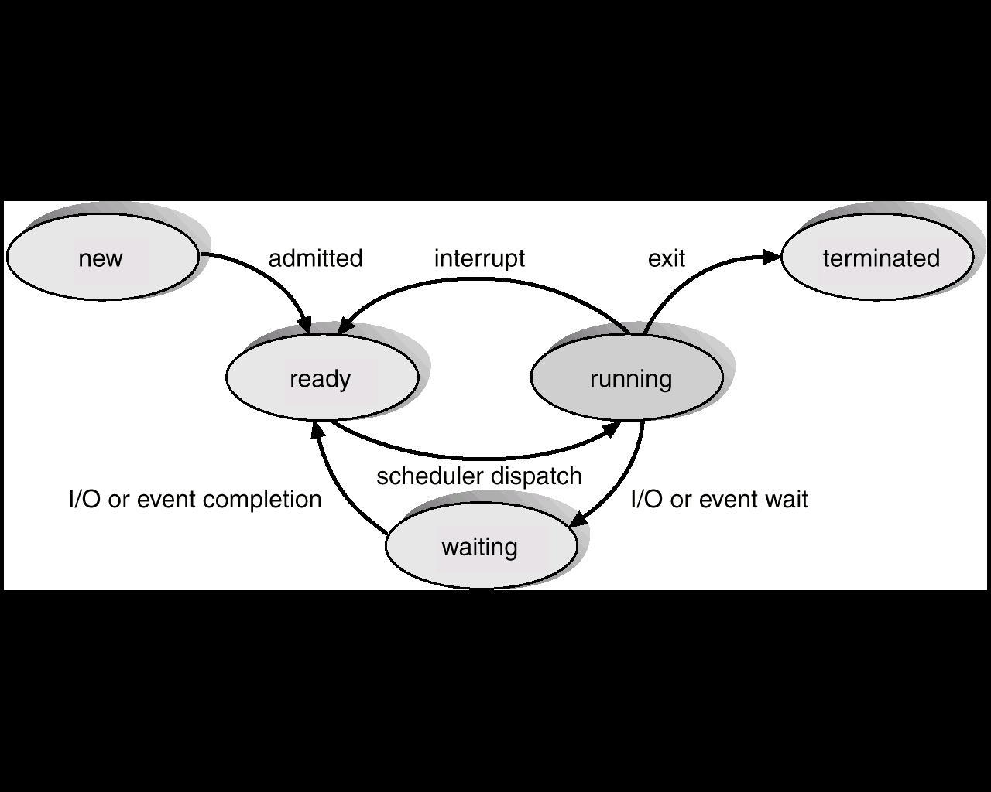
Process State

Slide 11
State Change
Null → New : a new process is created to execute the program
New batch job, log on
Created by OS to provide the service
New → ready: OS will move a process from prepared to ready state when it is prepared to take additional process.
Ready → Running: when it is a time to select a new process to run, the OS selects one of the process in the ready state.
Running → terminated: The currently running process is terminated by the OS if the process indicates that it has completed, or if it aborts.

Slide 12
State Change
Running → Ready: The process has reached the maximum allowable time or interrupt.
Running → Waiting: A process is put in the waiting state, if it requests something for which it must wait.
Example: System call request.
Waiting → Ready: A process in the waiting state is moved to the ready state, when the event for which it has been waiting occurs.
Ready → Terminated: If a parent terminates, child process should be terminated
Waiting → Terminated: If a parent terminates, child process should be terminated

Slide 13
Process Context
Contains all states necessary to run a program
Is the user level context sufficient?
Only if the system runs through one program at a time
The system typically needs to switch back and forth between programs.
P1
P2
R0 = 1
R0 = 2
R2 = R0 + 1
R2 = R0
R2 in P1 is wrong. How to make It correct?
Save R0 in P1 before switching
Restore R0 in P1 when switching from P2 to P1.
Registers should be a part of process context: the register context!

Slide 14
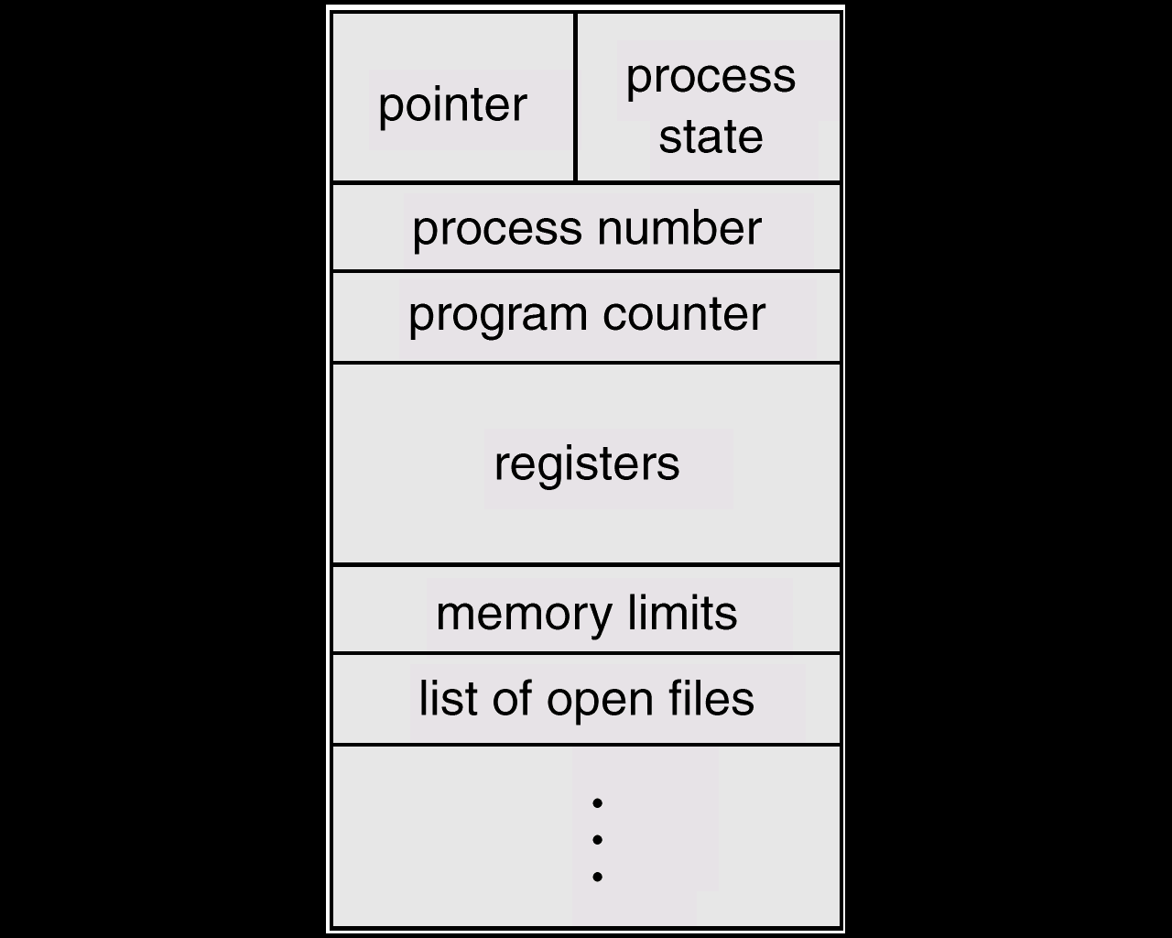
Process Control Block (PCB)

Slide 15
Process Control Block (PCB)
Information associated with each process.
Process state: new, ready, running,…
Program Counter (PC): address of the next instruction to execute
CPU registers: data registers, stacks, condition-code information, etc.
CPU scheduling information: process priorities, pointers to scheduling queues, etc.

Slide 16
Process Control Block (PCB)
Memory-management information: locations including value of base and limit registers, page tables and other virtual memory information.
Accounting information: the amount of CPU and real time used, time limits, account numbers, job or process numbers etc.
I/O status information: List of I/O devices allocated to this process, a list of open files, and so on

Slide 17
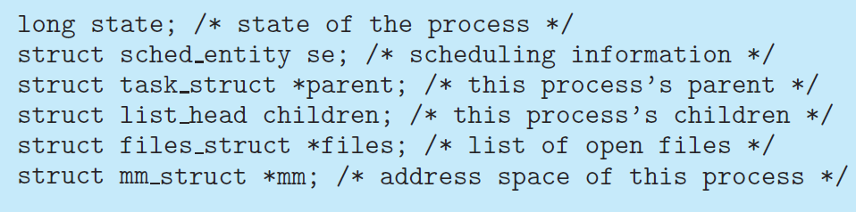
Process Control Block (PCB)
The process control block in the Linux operating system is represented by the C structure task struct, which is found in the <linux/sched.h> include file in the kernel source-code directory.

Slide 18
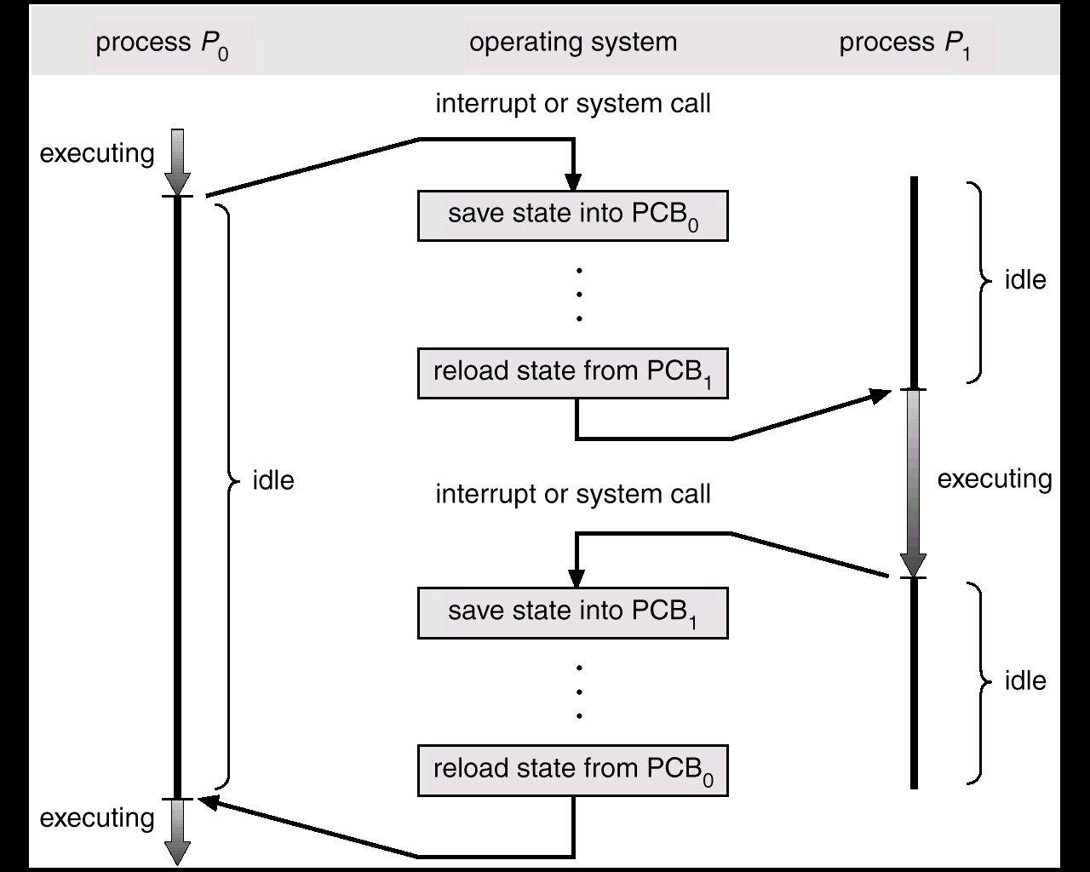
CPU Switch From Process to Process

Slide 19
Inter-process Communication (IPC)
IPC facility provides a mechanism to allow processes to communicate and synchronize their actions.
Processes can communicate through
Shared Memory
Message Passing.
Both schemes may exist in OS.
The Shared-memory method requires communication processes to share some variables.
The responsibility for providing communication rests with the programmer.
The OS only provides shared memory.
Example: producer-consumer problem.

Slide 20
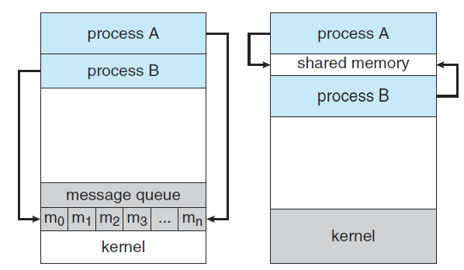
Communication Models
Message Passing
Shared Memory

Slide 21
Producer-Consumer Problem: Shared memory
Producer process produces information that is consumed by a consumer process.
unbounded-buffer places no practical limit on the size of the buffer.
Producer can produce any number of items.
Consumer may have to wait
bounded-buffer assumes that there is a fixed buffer size.
Consumer or producer may have to wait

Slide 22
Shared Memory
Shared memory is memory that may be simultaneously accessed by multiple programs.
Life cycle of Shared Memory
Create Memory Block
Attach to number of process simultaneously
Read & Write
Detach Memory block
Free Memory block

Slide 23
Common chunk of read/write memory
MAX
Shared Memory
(unique key)
Create
ptr
ptr
Attach
0
Attach
Proc. 1
Proc. 2
ptr
ptr
ptr
Proc. 3
Proc. 4
Proc. 5

Slide 24
Example
Shmget System Call
The shmget system call is used to create shared memory segment
Shmt System Call
Attaches block to process
int shmget (key_t key, int size, int shmflg);
Arguments:
key_t key: key for creating or accessing shared memory
•
•
int size: size in bytes of shared memory segment to create. Use 0 for
accessing an existing segment.
•
int shmflg: segment creation condition and access permission.

Slide 25
Communicating Among Separate Processes
Define the structure of a shared memory
segment as follows:
//Status of memory block
#define NOT_READY (­1)
#define FILLED (0)
#define TAKEN (1)
struct Memory {
int status; // used for Synchronization
int data[4]; // data to share
};

Slide 26
Communicating Among Separate Processes
Prepare for a shared memory
The “Server”
void main(int argc, char *argv[])
{
key_t ShmKEY;
int ShmID, i;
struct Memory *ShmPTR;
ShmKEY = ftok(“./”, ‘x’);
ShmID = shmget(ShmKEY, sizeof(struct Memory),
IPC_CREAT | 0666);
ShmPTR = (struct Memory *) shmat(ShmID, NULL, 0);
18

Slide 27
Communicating Among Separate Processes
shared memory not ready
ShmPTR­>status = NOT_READY;
filling in data
for (i = 0; i < 4; i++)
ShmPTR­ > data[i] = atoi(argv[i]);
ShmPTR­>status = FILLED;
while (ShmPTR­>status != TAKEN)
sleep(1); /* sleep for 1 second */
shmdt((void *) ShmPTR);
shmctl(ShmID, IPC_RMID, NULL);
exit(0);
}
wait until the data is taken
detach and remove shared memory

Slide 28
Communicating Among Separate Processes
void main(void)
The “Client”
{
key_t ShmKEY;
prepare for shared memory
int ShmID;
struct Memory *ShmPTR;
ShmKEY=ftok(“./”, ‘x’);
ShmID = shmget(ShmKEY, sizeof(struct Memory), 0666);
ShmPTR = (struct Memory *) shmat(ShmID, NULL, 0);
while (ShmPTR­>status != FILLED)
;
printf(“%d %d %d %d\n”, ShmPTR­>data[0],
ShmPTR­>data[1], ShmPTR­>data[2], ShmPTR­>data[3]);
ShmPTR­>status = TAKEN;
shmdt((void *) ShmPTR);
exit(0);
20
}

Slide 29
Communicating Among Separate Processes
If you did not remove your shared memory
segments (e.g., program crashes before the
execution of
shmctl()
), they will be in the
system forever. This will degrade the system
performance.
Use the
Ipcs
command to check if you have
shared memory segments left in the system.
Use the
ipcrm
command to remove your
shared memory segments.

Slide 30
Inter-process Communication (IPC): Message Passing System
Message system – processes communicate with each other without resorting to shared variables.
If P and Q want to communicate, a communication link exists between them.
OS provides this facility.

Slide 31
IPC
IPC facility provides two operations:
send(message) – message size fixed or variable
receive(message)
If P and Q wish to communicate, they need to:
establish a communication link between them
exchange messages via send/receive
Implementation of communication link
physical (e.g., shared memory, hardware bus)
logical (e.g., logical properties)
We are concerned with logical link.

Slide 32
Implementation Questions
How are links established?
Can a link be associated with more than two processes?
How many links can there be between every pair of communicating processes?
What is the capacity of a link?
Is the size of a message that the link can accommodate fixed or variable?
Is a link unidirectional or bi-directional?

Slide 33
Fixed and variable message size
Fixed size message
Good for OS designer
Complex for programmer
Variable size messages
Complex for the OS designer
Good for programmer

Slide 34
Methods to implement a link
Direct or Indirect communication
Synchronous or asynchronous communication
Automatic or explicit buffering

Slide 35
Direct Communication
Symmetric: Processes must name each other explicitly:
send (P, message) – send a message to process P
receive(Q, message) – receive a message from process Q.
Asymmetric: Only sender names the recipient, the recipient is not required to name the sender.
The send and receive primitives are as follows.
Send (P, message)– send a message to process P.
Receive(id, message)– receive a message from any process.
Properties of communication link
Links are established automatically.
A link is associated with exactly one pair of communicating processes.
Between each pair there exists exactly one link.
The link may be unidirectional, but is usually bi-directional
Disadvantages: Changing the identifier of a process may necessitate examining all other process definitions. Any such hard-coding techniques, where identifiers must be explicitly stated, are less desirable.
Notes:
The variable id is set to the name of the process with which communication has taken place.

Slide 36
Indirect Communication
The messages are sent and received from mailboxes (also referred to as ports).
A mailbox is an object
Process can place messages
Process can remove messages.
Two processes can communicate only if they have a shared mailbox.
Operations
create a new mailbox
send and receive messages through mailbox
destroy a mailbox
Primitives are defined as:
send(A, message) – send a message to mailbox A
receive(A, message) – receive a message from mailbox A

Slide 37
Indirect Communication
Mailbox sharing
P₁ , P₂ , and P₃ share mailbox A.
P₁ , sends; P₂ and P₃ receive.
Who gets a message ?
Solutions
Allow a link to be associated with at most two processes.
Allow only one process at a time to execute a receive operation.
Allow the system to select arbitrarily the receiver. Sender is notified who the receiver was.
A mailbox may be owned either by a process or by the operating system.
If the mailbox is part of the address space of the process,
We distinguish between the owner (which can only receive messages through this mailbox) and the user (which can only send messages to the mailbox).
Since each mailbox has a unique owner, there can be no confusion about which process should receive a message sent to this mailbox.
When a process that owns a mailbox terminates, the mailbox disappears.

Slide 38
Indirect Communication
Properties of a link:
A link is established if they have a shared mailbox
A link may be associated with more than two boxes.
Between a pair of processes there may be number of links
A link may be either unidirectional or bi-directional.
OS owned mailboxes:
OS provides a facility
To create a mailbox
Send and receive messages through mailbox
To destroy a mail box.
The process that creates mailbox is a owner of that mailbox
The ownership and send and receive privileges can be passed to other processes through system calls.

Slide 39
Synchronous v/s asynchronous
Message passing may be either blocking or non-blocking.
Blocking is considered synchronous
Non-blocking is considered asynchronous
send and receive primitives may be either blocking or non-blocking.
Blocking send: The sending process is blocked until the message is received by the receiving process or by the mailbox.
Non-blocking send: The sending process sends the message and resumes operation.
Blocking receive: The receiver blocks until a message is available.
Non-blocking receive: The receiver receives either a valid message or a null.

Slide 40
Reference
Beej's Guide to Unix IPC: http://beej.us/guide/bgipc/output/html/multipage/index.html

Slide 41
Thank You

