Slide 1

E-Commerce Performance & Customer Insights
Data Analytics Internship Project — A comprehensive deep-dive into revenue performance, delivery efficiency, and customer satisfaction drivers.
E-COMMERCE
By Soumojit Maitra

Slide 2

Project Objectives
Revenue Performance
Delivery Efficiency
Analyze revenue performance and uncover key business trends across product categories and time periods.
Evaluate end-to-end delivery performance, identify bottlenecks, and measure the rate of late deliveries.
Customer Satisfaction
Understand the key drivers behind customer satisfaction scores and their relationship to operational metrics.

Slide 3

Dataset Overview
Integrated Multi-Table Dataset
Data Architecture
A unified master dataset was engineered by joining multiple relational tables to enable end-to-end analysis across the entire customer journey.
Orders & order items
Customer profiles
Product catalog
Payment records
Review & rating data
Raw Tables
Analysis Ready
Data Integration
The master dataset enabled seamless cross-functional analysis, connecting logistics, finance, and customer experience in a single view.

Slide 4
Key Performance Indicators
$16.64M
98,666
$168.64
~12
Total Revenue
Total Orders
Avg Order Value
Avg Delivery Days
Cumulative revenue generated across all orders in the dataset period.
Total number of orders processed and fulfilled across all regions.
Average revenue generated per individual customer order.
Average number of days from order placement to customer delivery.
~8%
4.0
Late Delivery Rate
Avg Customer Rating
Percentage of orders that were delivered past the estimated delivery date.
Average review score out of 5 submitted by customers post-delivery.

Slide 5
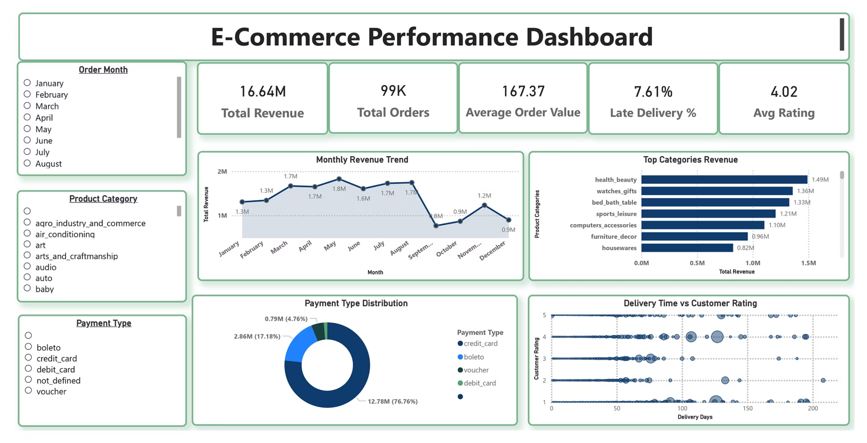
Dashboard Overview

Slide 6
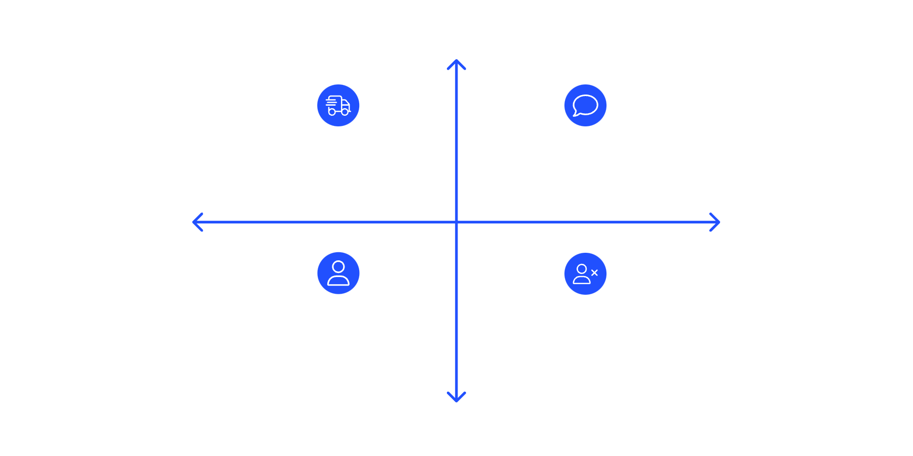

Deep-Dive: Delivery vs. Customer Satisfaction
Correlation Finding
High On-Time
A statistically meaningful negative correlation of ~-0.30 was identified between delivery time and customer review scores.
Fast Delivery — High Satisfaction & Reviews
Delayed Delivery — Low Satisfaction & Reviews
More Negative Reviews
More Positive Reviews
What This Means
As delivery time increases, customer satisfaction scores decline. Late deliveries lead to measurably lower ratings, confirming that delivery time is a critical experience driver.
Repeat Customers — Loyal Promoters
Customer Churn — Lost Accounts
Low On-Time
The analysis clearly demonstrates that logistics performance is not just an operational metric — it is a direct lever for customer experience and long-term retention.
Correlation coefficient: r ≈ -0.30 — a moderate negative relationship confirmed across the full dataset.

Slide 7

Statistical Validation
Two-Sample T-Test Results
The difference in customer satisfaction scores between on-time and late deliveries is statistically significant — this is not a random variation. It is a real, measurable business phenomenon.
To rigorously validate the observed difference in customer review scores between on-time and late deliveries, a two-sample t-test was performed on the full dataset.
Test Type
With a p-value well below 0.001 and a t-statistic of 92.22, the null hypothesis is decisively rejected. The data confirms that delivery timing has a genuine, significant impact on how customers rate their experience.
Two-Sample T-Test on review scores
T-Statistic
92.22 — extremely large, indicating a strong signal
P-Value
< 0.001 — far below the 0.05 significance threshold

Slide 8

Business Impact
Delivery Delays Reduce Satisfaction
Late deliveries directly suppress customer review scores, creating a measurable gap in perceived service quality between on-time and delayed orders.
Risk to Retention & Repeat Orders
Poor delivery experiences may discourage customers from returning, threatening repeat purchase rates and long-term customer lifetime value.
Logistics Optimization is Critical
Improving logistics performance is not just an operational goal — it is a strategic business priority with direct impact on revenue, retention, and brand reputation.

Slide 9
Strategic Recommendations
Target High-Delay Regions
Actively Reduce Late Delivery Rates
Identify geographic regions with the highest late delivery rates and prioritize logistics improvements, carrier partnerships, or fulfillment center expansion in those areas.
Set measurable KPI targets for late delivery reduction. Implement real-time tracking, proactive customer communication, and SLA enforcement with logistics partners.
Optimize Heavy Product Shipping
Invest in Customer Experience
Heavy and bulky products are disproportionately prone to delays. Develop specialized logistics workflows and carrier agreements for this product segment.
Focus investments on the key touchpoints that drive satisfaction — from post-purchase communication to delivery confirmation — to build loyalty and encourage repeat purchases.

Slide 10
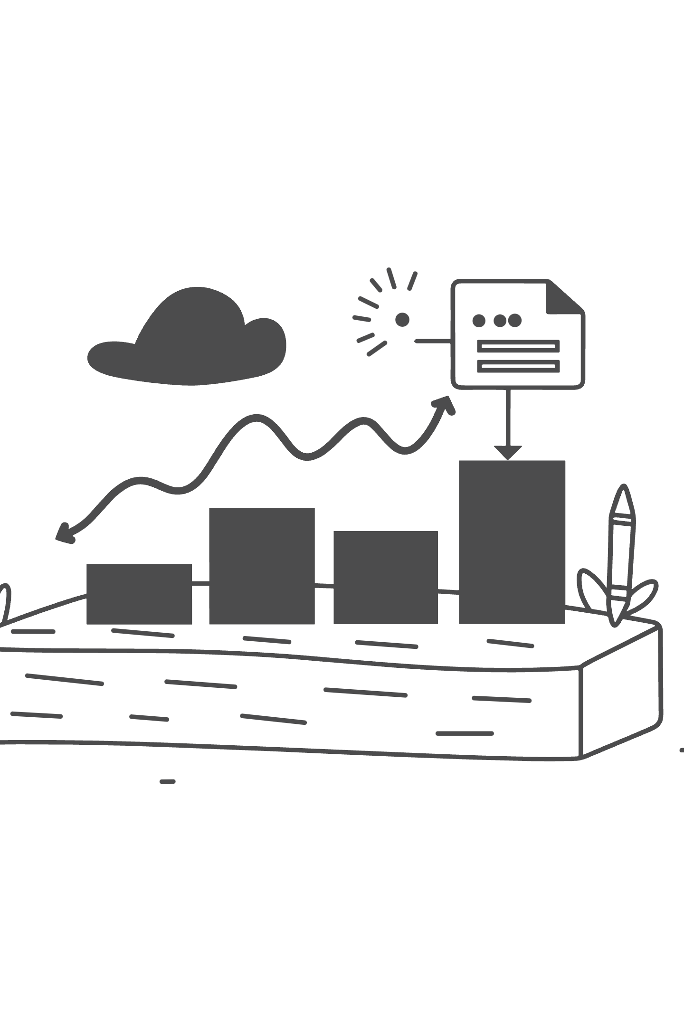
Conclusion
Strong Revenue Performance
Key Takeaway
The business demonstrates strong overall revenue performance with $16.64M in total revenue and nearly 100K orders, reflecting healthy demand and market presence.
Operational excellence in logistics is not just a cost center — it is a revenue and retention engine.
Delivery Drives Satisfaction
By acting on these data-driven insights, the business can unlock higher satisfaction scores, stronger customer loyalty, and sustained revenue growth.
Delivery efficiency is the single most impactful operational lever for customer satisfaction. The statistical evidence is clear and actionable.
Data-Driven Decision Making
ANALYTICS
INTERNSHIP 2024
The insights generated through this analysis empower the business to make smarter, faster, and more confident decisions — turning raw data into competitive advantage.

