Slide 1






SLK

Slide 2



The Ask where we started

Slide 3

Agenda
Objective of the Training
Framework for 8 Weeks
Overview
Our Journey
Tools Used
Objectives
Problem definition
Challenges
Scope and conclusion
Our Team
Demo

Slide 4

Objective of the Training
Become a Full Stack web developer by gaining all the skills required to work with front-end and back-end web technologies

Slide 5

Framework for 8 Weeks
1
Database Concepts and SQL
Introduction to Applications
2
Object Oriented Programming
Data Structures Core Java Programming
3
Project- Banking Application
JDBC and Web Design fundamentals
4
Html, CSS,
Bootstrap, AJAX
5
Java Script, ES5, ES6, Angular7
UML Daigrams
6
Architecture,framework of angular.
JEE Architecture
40 Days- 200 Hours of Training
7
JSP Servlet
Spring REST( Core & MVC)
myBatis
8
Project Presentation

Slide 6




Overview
Angular7
Java script
History, Introduction, Environmental setup, Architecture of Angular, Installation using Angular CLI, Components, Modules, Data Binding, Event Binding, Directives, Pipes, Routing, Services, Testing and building Angular Project.
History, Introduction, Types of Java Script,
Components of JS, Introduction of Typescript,
ES5 and ES6
Jsp and Servlet
Spring Rest
Introduction, Environmental Setup,
Architecture, Lifecycle,
Container(Apache TomCat),
Inbuilt services, API
Introduction, Spring framework, Environmental setup in eclipse Mars, Architecture, Containers, Configurations, Annotations, Components of Spring Application

Slide 7

Our Journey

Slide 8
Sapphire Bank
Project-Banking Application
Low Level Diagrams- Use Case , Class, Application Flow.
Data Base Schema Design
Architecture of Banking Application.
UI Structure using Angular7( HTML/CSS/JS).
Backend Structure using JAVA, Spring Rest, Database.

Slide 9
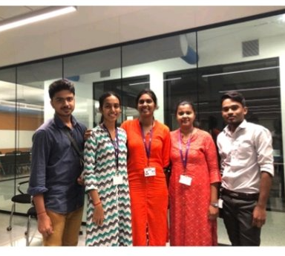
Our Team

Slide 10

Team Sapphire
Amit Balyan

Slide 11








BACKEND
DevOps
DATA
FRONTEND

Slide 12
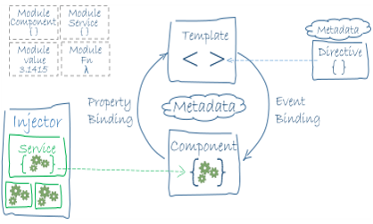

Slide 13
Sapphire Bank Management Application

Slide 14
Objective
The main objective of Online Banking Management Application is to View the transaction of the customer ,View customers of particular branch ,Approve the customers.

Slide 15
Problem Definition
Agent will handle the customer transaction ,view the transaction of the customer and Approve the customer

Slide 16
Overview of Bank Management Application
These are various job positions within Bank System. The positions are as follows
Superuser
Admin
Agent
Customer
Agent : Agent can Approve the customer , delete the customer
Can view customer
Can view transaction

Slide 17


Slide 18
Scope and Conclusion
Scope
This project can be implemented in any bank by fulfilling the basic need
Conclusion

Slide 19


