Slide 1

Project Name : Snake game using Python
By
Soumajit Chatterjee
(B.Tech 3rd Year, Roll No: 14200119002 )
Dept. of Computer Science & Engineering
Meghnad Saha Institute of Technology

Slide 2
Outlines
Introduction
Motivation
Objectives
Features
Outcomes
Literature Review
Proposed Model
Result Analysis
Conclusion & Future Scope
Reference
Acknowledgement

Slide 3
Introduction
The game called “Snake Game” typically involve the player controlling a snake, there is no official version of the game, so gameplay varies. The most common version of the game involves the snake eating apple which make it longer, with the objective being to avoid running into a border or the snake itself for as long as possible.
The player loses when the snake either runs into a border or its own body . Because of this, the game becomes more difficult as it goes on, due to the growth of the snake.
Nokia has installed the “Snake Game” on many of its phones. The game is also available on several websites, including YouTube, which allows viewers to play the game while a video loads.
Dept. of CSE, MSIT

Slide 4
Motivation
This game motivates user to learns something how the game is working.
Though this game is about fun. And it will inspire us to build and understand a Snake game.
This is an excellent opportunity to learn about spatial awareness and plan ahead to your next move.
Dept. of CSE, MSIT

Slide 5
Objectives
This project in python language of Snake game is a simple Graphical User Interface application with very simple graphics. In this project, you can play the popular “snake Game” just like you played it elsewhere. You have to use the up, down, right or left arrows to move the snake.
Apples are provided at the several co-ordinates of the screen for the snake to eat. Every time the snake eats the food, its length will by increased by one element along with the score.
It isn’t the world’s greatest game, but it does give you an idea of what you can achieve with a relatively simple python program and perhaps the basis by which to extend the principles and create more interesting games of your own.
Dept. of CSE, MSIT

Slide 6
Features
There is only one level in the game.
The snake has to eat the apple.
When The Snake eats the apple, it's length and score both increases.
When the snake hits either the boundary or it's own body, the game ends.
As it is a simple game, anyone can play it.
Dept. of CSE, MSIT

Slide 7
Outcomes
Outcomes(Expected):
Start the game
view score
Pause the game
Resume the game
Exit the game
View score and highest score
Dept. of CSE, MSIT

Slide 8
Literature Review
A literature review is described as a scholarly paper which often includes current knowledge concerning theoretical and methodological contributions regarding a particular thought, idea or topic. In a more simple term, literature reviews are surveys of literature books, articles and other sources that help give a detailed insight on the theories and concepts regarding a research topic.
Literature reviews are written occasionally in the humanities but mostly in the sciences and social sciences. They are sometimes part of experiments and lab reports or can be written as a paper itself.
Dept. of CSE, MSIT

Slide 9
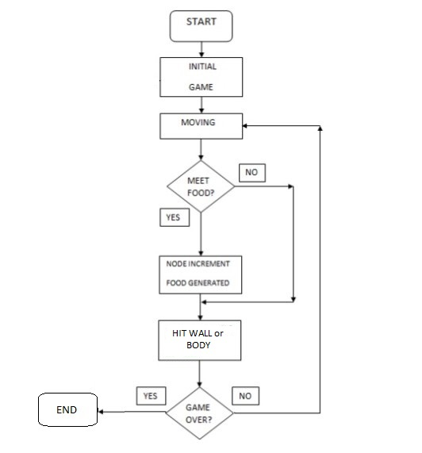
Proposed Model
Dept. of CSE, MSIT

Slide 10
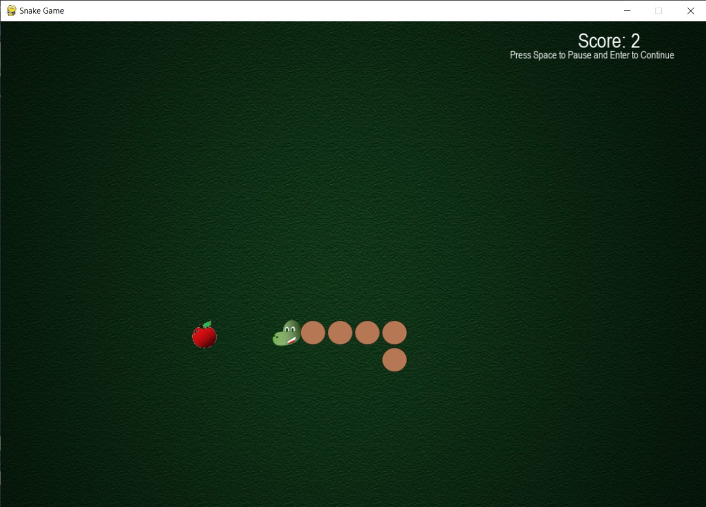
Result Analysis
Starting the game
Dept. of CSE, MSIT

Slide 11
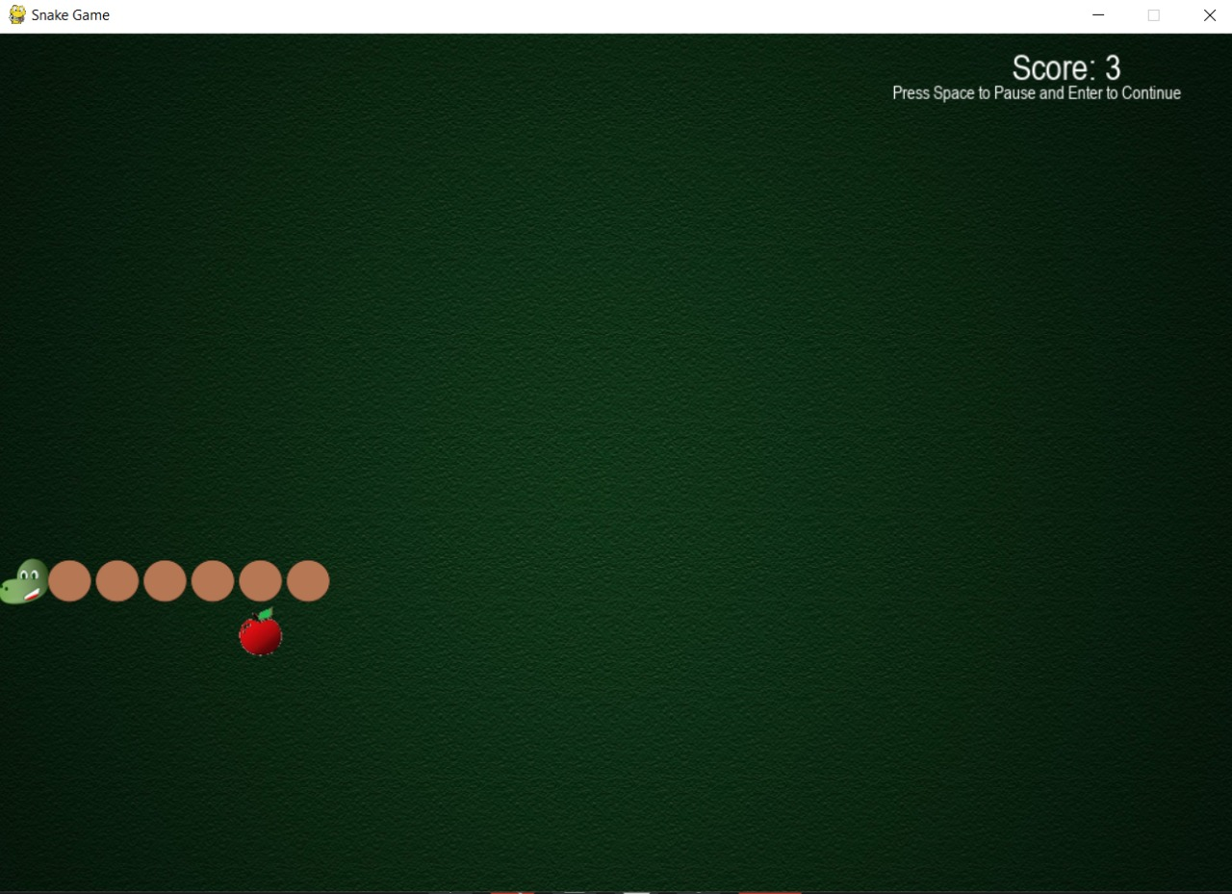
Snake is moving and hits the boundary
Dept. of CSE, MSIT

Slide 12
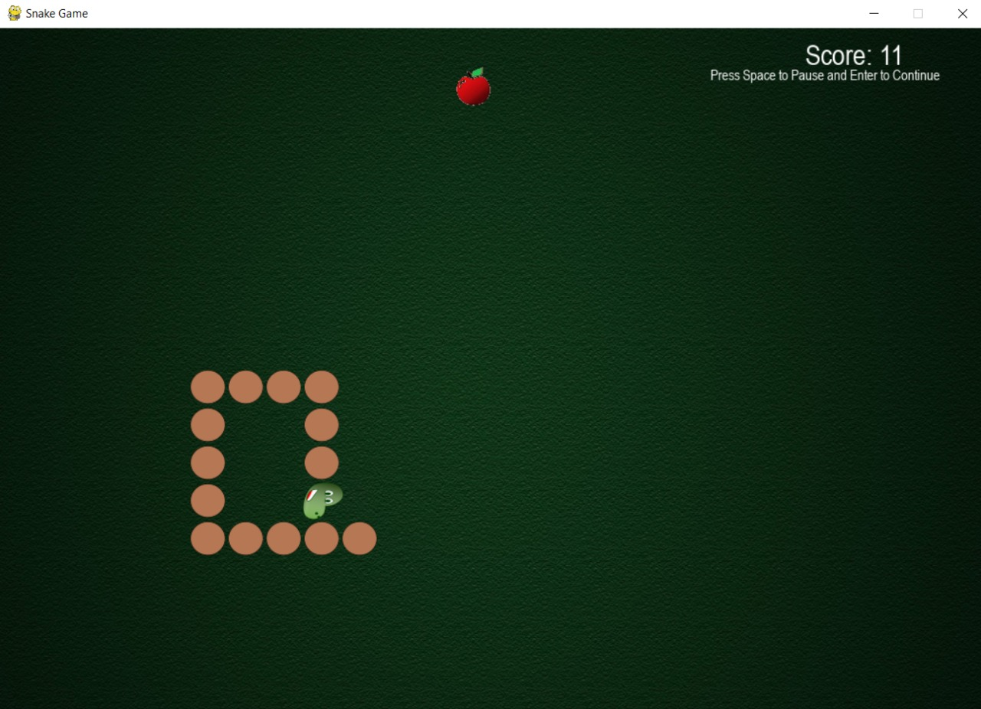
When the snake hits its own body
Dept. of CSE, MSIT

Slide 13
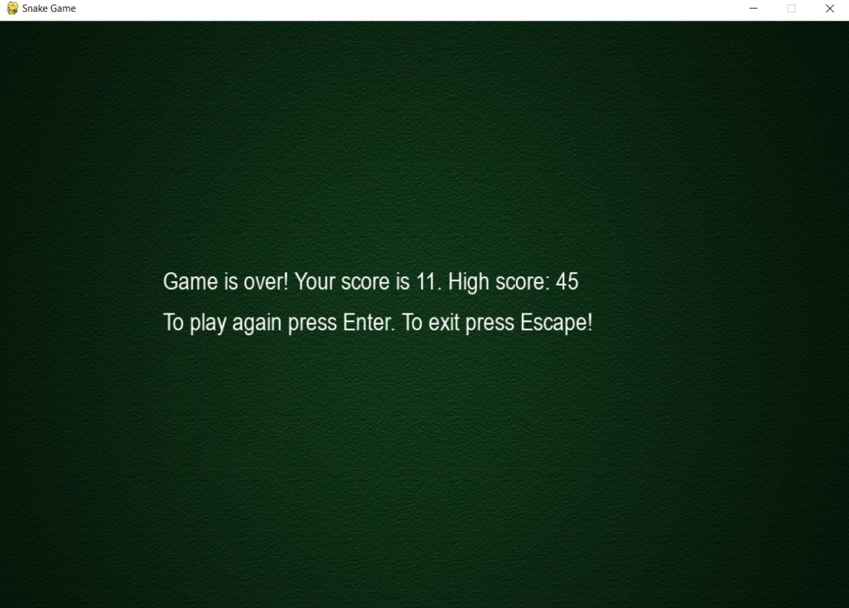
When game is over and you can view the high score
Dept. of CSE, MSIT

Slide 14
Conclusion & Future Scope
We were successful in creating a single player version of snake game.
Our project will be able to implement in future after making some changes and modifications as we make our project at a very low level. So the modifications that can be done in our project are:
It can be made with good graphics.
We can add more options like Player Profile
We can add multiplayer option.
Dept. of CSE, MSIT

Slide 15
References
https://www.python.org/
https://www.pygame.org/docs/
https://www.mathsisfun.com/games/snake.html
https://snake.googlemaps.com/
google.com
youtube.com
Dept. of CSE, MSIT

Slide 16
Acknowledgement
I have taken efforts in this project. However, it would not have been possible without the kind support and help of many individuals and organizations . I would like to extend my sincere thanks to all of them.
I am highly indebted to (Prof. Krishnendu kundu) for their guidance and constant supervision as well as for providing necessary information regarding the project & also for their support in completing the project.
I would like to express my gratitude towards my parents for their kind co-operation and encouragement which help me in completing of this project.
My thanks and appreciations also go to the people who have willingly helped me out with their abilities.
Dept. of CSE, MSIT

Slide 17

Dept. of CSE, MSIT

