Slide 1
DATA ANALYSIS water_potability.csv
Soumya Kataria Student ID: 100897536

Slide 2
RATIONAL STATEMENT
Marketing
2XXX
Learning curves were generated for both Logistic Regression and Naïve Bayes algorithms. The Logistic Regression algorithm was configured with specific parameters (solver, class_weight, max_iter, and random_state) to ensure balanced performance. Optimized models were developed for both Logistic Regression and Naïve Bayes algorithms. ROC/AUC curves were employed to assess the models' ability to discriminate between positive and negative classes. An Ensemble Voting Model was constructed to predict water potability. This model combined the strengths of one chosen algorithm (either Logistic Regression or Naïve Bayes) and a boosting technique (e.g., Adaboost or Gradient Boosting).
The primary objective of this assignment was to develop a robust classification model to predict the potability of water based on various water quality attributes. The dataset contained 2,007 observations with 10 independent variables and a binary dependent variable indicating whether the water was potable (1) or not potable (0). Exploratory Data Analysis was performed using the pandas-profiling library. This involved gaining insights into the dataset's structure, identifying missing values, distribution of variables, and correlations among attributes. To improve model performance, outliers were detected and removed using the Isolation Forest algorithm.

Slide 3
EXPLORATORY DATA ANALYSIS
01.
3 KEY INSIGHTS FROM PANDAS PROFILING REPORT

Slide 4
3 KEY INSIGHTS FROM PANDAS PROFILING REPORT
NORMAL DISTRIBUTION
The distribution of all the variables is nearly Gaussian in shape. When we say the variables "follow almost normal distribution," it suggests that the data points are not precisely normal but show a close resemblance to it.
2. CLASS IMBALANCE
The classes are labeled as 0 and 1, and you have provided the following counts for each class:
Class 0: 1196 instances
Class 1: 811 instances
From this information, we can see that there is a class imbalance between the two classes. Class 0 has a significantly higher number of instances compared to Class 1. he class imbalance indicates that Class 0 is overrepresented compared to Class 1, which may have implications for building and evaluating machine learning models.
3. MULTICOLLINEARITY
Logistic regression requires that the independent variables are not strongly correlated with each other to avoid multicollinearity issues. Multicollinearity can cause instability in the model's coefficient estimates, affecting the reliability and interpretability of the results. In the padas profile it can be observed that the variables are not strongly correlated with each other.

Slide 5
LEARNING CURVES AND ROC/AUC CURVES
02.
2 INSIGHTS FROM THE LEARNING CURVES OF BOTH THE MODELS.

Slide 6
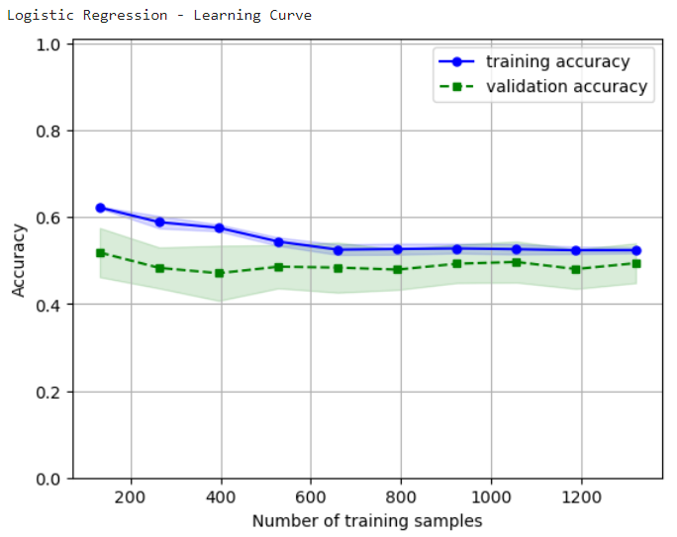
LEARNING CURVE Logistic Regression
Y axis represents model accuracy and x axis denotes the number of training samples.
Variance: As the number of training samples increases, the gap between the curves gradually diminishes, and at around 1280 (approximately), the curves nearly intersect. This behavior indicates a low variance.
Bias: The initial training accuracy is around 63%, while the starting validation accuracy is at 50%. Both accuracies are relatively modest, indicating that the model's performance is not significantly high at the beginning of the learning curve.
Initially, the gap between the curves is more significant, suggesting low bias and high variance. However, as the learning progresses, the gap gradually reduces, indicating decreasing variance and low bias. Eventually, the curves almost converge, implying a balanced model with both low variance and low bias. However higher accuracy implies better model and the optimum accuracy range is 80-90.

Slide 7
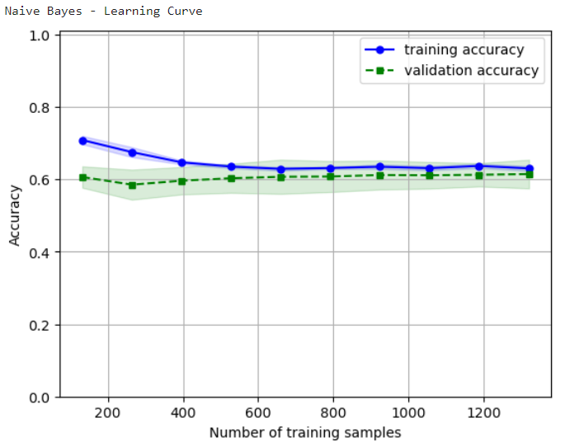
LEARNING CURVE Naïve Bayes
Y axis represents model accuracy and x axis denotes the number of training samples.
Variance: As the number of training samples increases, the gap between the curves gradually diminishes, and at around 1280 (approximately), the curves nearly intersect. This behavior indicates a low variance.
Bias: The initial training accuracy is around 72%, while the starting validation accuracy is at 60%. Both accuracies are relatively modest, indicating that the model's performance is not significantly high at the beginning of the learning curve.
Initially, the gap between the curves is more significant, suggesting low bias and high variance. However, as the learning progresses, the gap gradually reduces, indicating decreasing variance and low bias. Eventually, the curves converge, implying a balanced model with both low variance and low bias. However higher accuracy implies better model and the optimum accuracy range is 80-90.

Slide 8
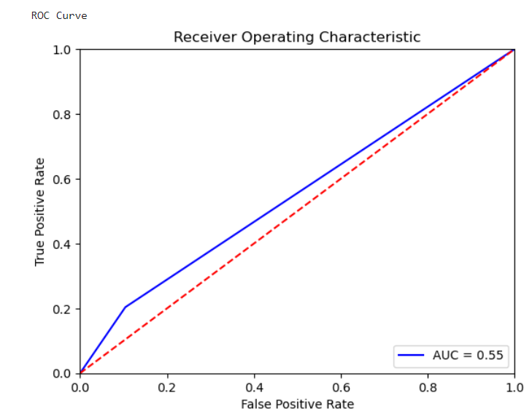
ROC/AUC CURVES
Naïve Bayes
An AUC of 0.55 is slightly better than random chance, but the discriminatory power of the model remains relatively low. While the model has some ability to differentiate between the classes, it's still not performing significantly better than random guessing. This suggests that the model's predictions might have limited practical value and could potentially benefit from further improvement.

Slide 9
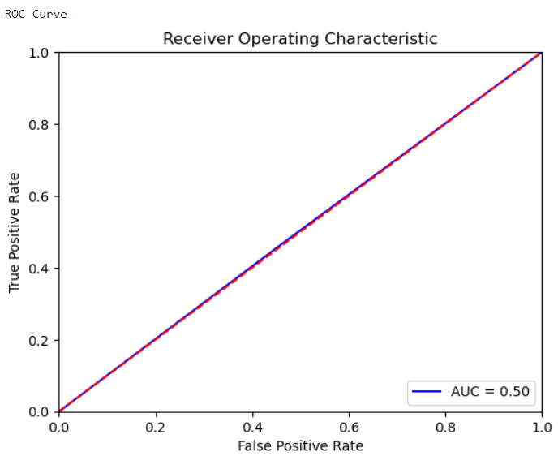
ROC/AUC CURVES
Logistic regression
An AUC of 0.5 indicates that the model's performance is no better than random chance. In other words, the model's ability to discriminate between positive and negative classes is no better than flipping a coin. This suggests that the model is not effective at distinguishing between the two classes and is essentially making random predictions.

Slide 10
CLASSIFICATION REPORT
03.
CLASSIFICATION REPORT FOR LOGISTIC REGRESSION AND NAÏVE BAYES

Slide 11
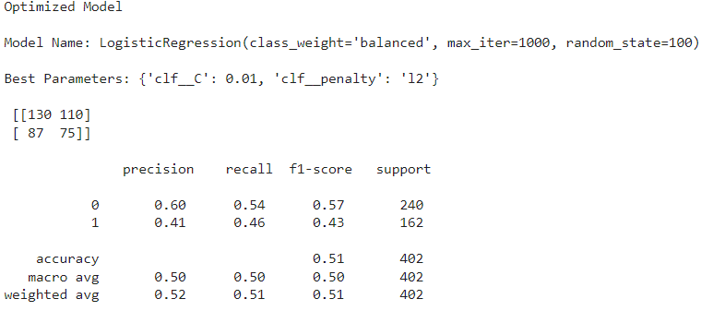
CLASSIFICATION REPORT
LOGISTIC REGRESSION
In the confusion matrix:
True Positives (TP): 75 (Predicted class 1 and actually belong to class 1).
False Positives (FP): 110 (Predicted class 1 but actually belong to class 0).
True Negatives (TN): 130 (Predicted class 0 and actually belong to class 0).
False Negatives (FN): 87 (Predicted class 0 but actually belong to class 1).

Slide 12
CLASSIFICATION REPORT
Precision for class 1 is 41%, and for class 0 is 60%. Precision represents the accuracy of positive predictions.
Recall for class 1 is 46%, and for class 0 is 54%. Recall (also known as sensitivity) represents the ability to correctly identify positive instances.
F1-Score is the harmonic mean of precision and recall. The weighted average F1-Score is 0.51, representing the overall performance of the model.
Accuracy: The overall model accuracy is 51%. It is the percentage of correct predictions out of the total predictions.
Macro Avg: It is the average of precision, recall, and F1-Score across both classes, giving equal weight to each class. In this case, the macro average F1-Score is 0.50.
Weighted Avg: It is the average of precision, recall, and F1-Score, weighted by the number of samples in each class. The weighted average F1-Score is 0.51.
Interpretation:
The model's performance is moderate, with an overall accuracy of 51%.
The precision, recall, and F1-Score for both classes are not very high, indicating that the model struggles to accurately predict both positive and negative instances.
The class imbalance is being handled effectively due to the class weighting, but the model could benefit from further improvements.
LOGISTIC REGRESSION

Slide 13
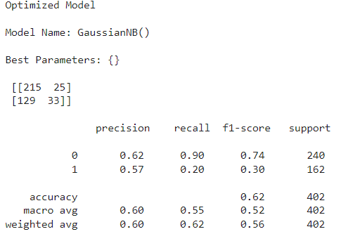
CLASSIFICATION REPORT
NAÏVE BAYES
In the confusion matrix:
True Positives (TP): 33 (Predicted class 1 and actually belong to class 1).
False Positives (FP): 25 (Predicted class 1 but actually belong to class 0).
True Negatives (TN): 215 (Predicted class 0 and actually belong to class 0).
False Negatives (FN): 129 (Predicted class 0 but actually belong to class 1).

Slide 14
CLASSIFICATION REPORT
Precision (also known as Positive Predictive Value): The percentage of true positive predictions (class 1) out of all positive predictions (both true and false positive). Precision for class 1 is 57%, and for class 0 is 62%.
Recall (also known as Sensitivity or True Positive Rate): The percentage of true positive predictions (class 1) out of all actual positive instances (true positive and false negative). Recall for class 1 is 20%, and for class 0 is 90%.
F1-Score: The harmonic mean of precision and recall, providing a balance between the two. It is a metric that considers both precision and recall. The weighted average F1-Score is 0.56.
Support: The number of occurrences of each class in the test dataset.
Accuracy: Overall model accuracy is 62%. It is the percentage of correct predictions out of the total predictions.
Macro Avg: It is the average of precision, recall, and F1-Score across both classes, giving equal weight to each class.
Weighted Avg: It is the average of precision, recall, and F1-Score, weighted by the number of samples in each class.
Interpretation:
The model performs better at predicting class 0 (precision 62% and recall 90%) compared to class 1 (precision 57% and recall 20%).
The F1-Score for class 1 is lower (0.30), indicating that the model has difficulty accurately predicting class 1 instances.
The overall model accuracy is 62%, which might be acceptable depending on the problem domain and the baseline accuracy. However, the class imbalance might influence the accuracy, especially if the majority class is predicted more frequently.
NAÏVE BAYES

Slide 15
ENSEMBLE VOTING MODEL
04.

Slide 16
ENSEMBLE VOTING MODEL
GaussianNB: The first base classifier is Gaussian Naive Bayes (GaussianNB). The mean of the weighted recall (test_rec_weighted) obtained from repeated cross-validation is approximately 0.61. Weighted recall takes into account class imbalances and provides an average recall score for all classes, considering their proportion in the dataset. This score suggests that the Naive Bayes classifier achieved an overall recall of around 61% on the test data.
GradientBoostingClassifier: The second base classifier is Gradient Boosting (GradientBoostingClassifier). The mean of the weighted recall obtained from repeated cross-validation is approximately 0.64. This indicates that the Gradient Boosting classifier achieved an overall recall of around 64% on the test data.
VotingClassifier: The voting ensemble model (VotingClassifier) combines the predictions from both the Gaussian Naive Bayes and Gradient Boosting classifiers. The mean of the weighted recall obtained from repeated cross-validation is also approximately 0.64. This suggests that the voting ensemble performed similarly to the individual Gradient Boosting classifier, achieving an overall recall of around 64% on the test data.
Interpretation:
The Gradient Boosting classifier achieved slightly better performance (higher recall) than the Naive Bayes classifier.
The voting ensemble, which combines the predictions from both classifiers, achieved a recall score comparable to that of the Gradient Boosting classifier.
The voting ensemble may have benefited from the diversity of the base classifiers, as it performed similarly to the stronger Gradient Boosting classifier.

Slide 17
WHICH MODEL TO IMPLEMENTED?
05.

Slide 18
Based on the results, the Gradient Boosting Classifier (GradientBoostingClassifier) would be a suitable model to implement. Here's why:
Performance: The Gradient Boosting Classifier achieved a higher weighted recall (approximately 0.64) compared to the other models (e.g., Gaussian Naive Bayes with weighted recall of approximately 0.61 and the Voting Ensemble with the same weighted recall as Gradient Boosting). This indicates that the Gradient Boosting model was able to better capture the true positive instances across all classes.
Ensemble Benefits: The Voting Ensemble achieved a performance similar to the Gradient Boosting classifier. However, ensemble models like Voting Classifier can be more complex to interpret and computationally expensive, especially when combining multiple base classifiers. If the performance is comparable to the individual Gradient Boosting classifier, it may be more straightforward to implement the single Gradient Boosting model.
WHICH MODEL TO IMPLEMENTED?

Slide 19
Robustness: Gradient Boosting is known for its ability to handle complex patterns and interactions in the data, making it robust for a wide range of tasks. It is less prone to overfitting compared to some other algorithms like Decision Trees.
Interpretability: While Gradient Boosting may not be as interpretable as Naive Bayes, it still provides feature importances, which can help in understanding the contribution of each feature to the model's predictions.
Flexibility: Gradient Boosting can handle a mix of continuous and categorical features and can be extended to handle multiclass classification tasks if needed.
Overall, the Gradient Boosting Classifier shows promising performance, versatility, and robustness, making it a good choice for implementation

Slide 20
TWO RECOMMENDATION
06.

Slide 21
TWO RECOMMENDATION
Hyperparameter Tuning:
Conducting thorough hyperparameter tuning can significantly improve the model's performance. Gradient Boosting has several hyperparameters that can be fine-tuned to achieve better results. For example:
n_estimators: The number of boosting stages (trees) in the ensemble. Increasing the number of estimators may improve model performance up to a point but may also lead to overfitting.
learning_rate: The step size at which the model's weights are updated during each boosting iteration. A smaller learning rate may result in more accurate predictions, but it requires more boosting stages to converge.
max_depth: The maximum depth of each decision tree. Setting an appropriate value for max_depth can prevent overfitting and improve generalization.
min_samples_split and min_samples_leaf: These parameters control the minimum number of samples required to split an internal node or be at a leaf node. Adjusting these values can impact the model's performance and prevent overfitting.

Slide 22
TWO RECOMMENDATION
Feature Engineering:
Feature engineering plays a crucial role in model performance. Improving the quality of input features can lead to better model generalization and interpretability. Some steps to enhance feature engineering include:
Feature Selection: Identify and select the most relevant features that contribute the most to the model's predictive power. Removing irrelevant or redundant features can simplify the model and improve training efficiency.

