Slide 1

“SMILE”- A FOOD, CLOTH AND STATIONERY DONATION WEBSITE
Presented By:
SOUMYA VERMA (18MCA010)
Under the Supervision of:
DR. MOUMITA MAJUMDAR
Professor, CSED,
NIT AGARTALA
20th December 2020

Slide 2
OUTLINE
INTRODUCTION
OBJECTIVE
HARDWARE AND SOFTWARE REQUIREMENTS
PROJECT DEMONSTRATION
SNAPSHOTS
CONCLUSION
REFERENCES

Slide 3
OBJECTIVE
The Objectives of this project are:
Provide an easy to use online platform for donation.
Providing basic necessities like food, cloth and stationery items to the people in need.
To provide an ease of access to the NGOs for receiving donations.

Slide 4
INTRODUCTION
“SMILE”- A FOOD, CLOTH AND STATIONERY DONATION WEBSITE, can be used mainly by donors for donating food, cloth and stationery products online and by receivers (NGOs) for collecting the donated items and further providing it to the people in need.
It is an online platform for donations.
It has a user-friendly interface.

Slide 5
SOFTWARE AND HARDWARE REQUIREMENTS
HARDWARE REQUIREMENT
Processor: Intel Pentium or higher version.
Hard disk: 1GB free space.
RAM minimum: 1GB or above.
SOFTWARE REQUIREMENT
SERVER: Xampp Server
OS: Windows / Linux /MacOS

Slide 6
PROJECT DEMONSTRATION SNAPSHOTS

Slide 7
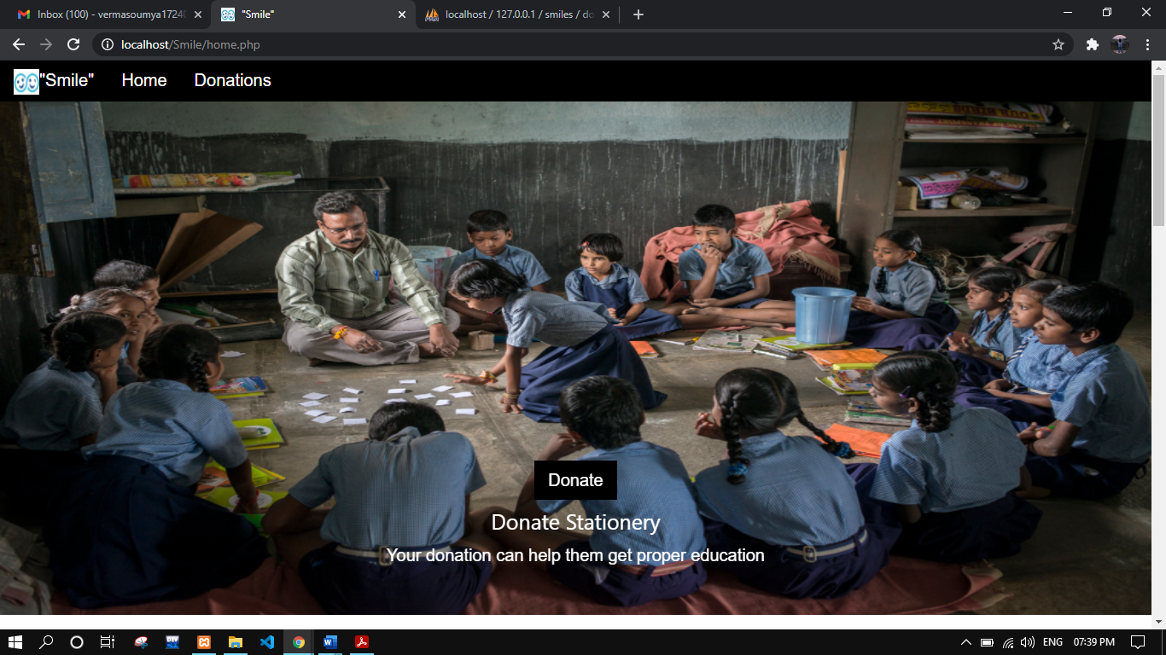
1.) HOME PAGE

Slide 8
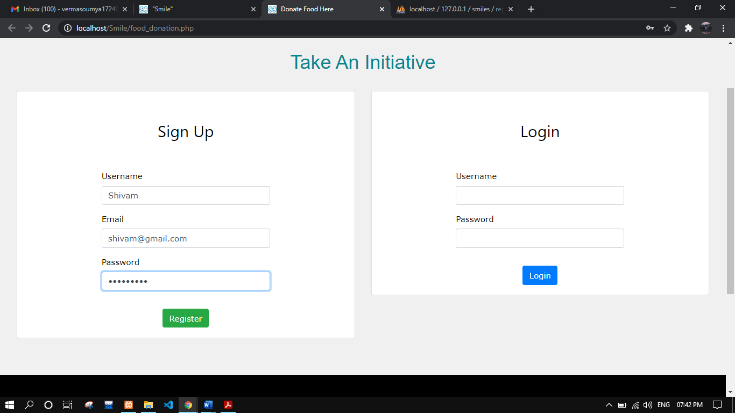
2.) REGISTRATION AND LOGIN PAGE

Slide 9
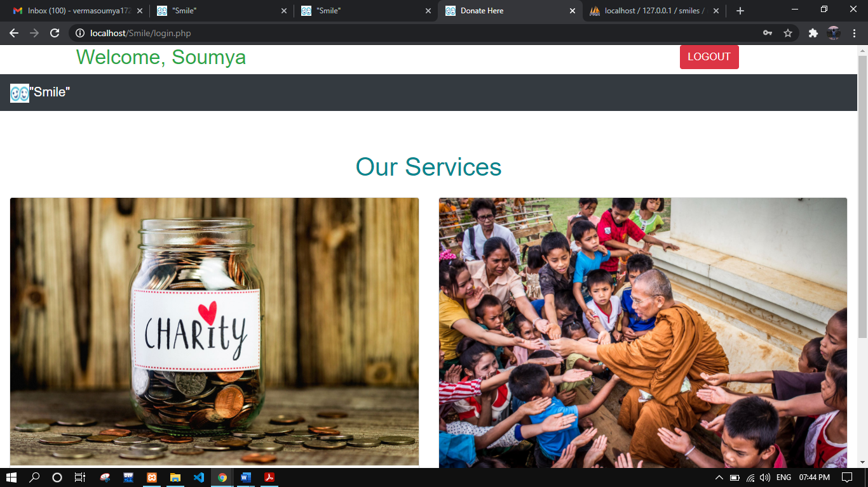
3.) WELCOME PAGE

Slide 10
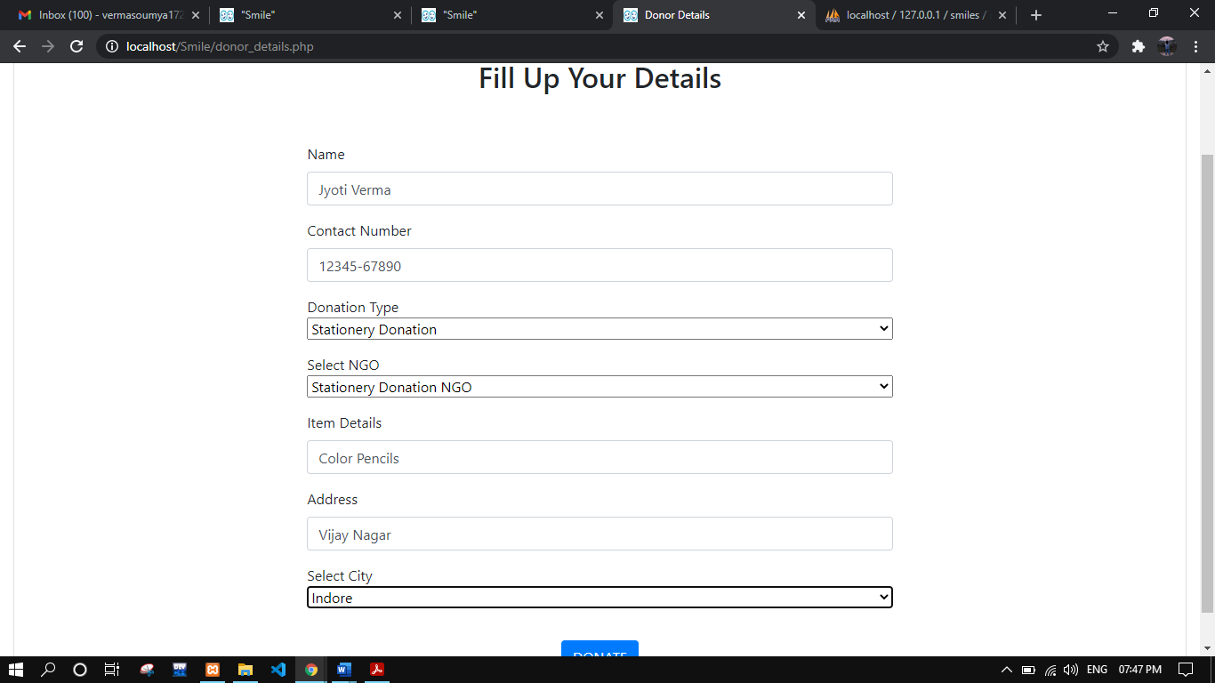
4.) DONOR DETAILS PAGE

Slide 11
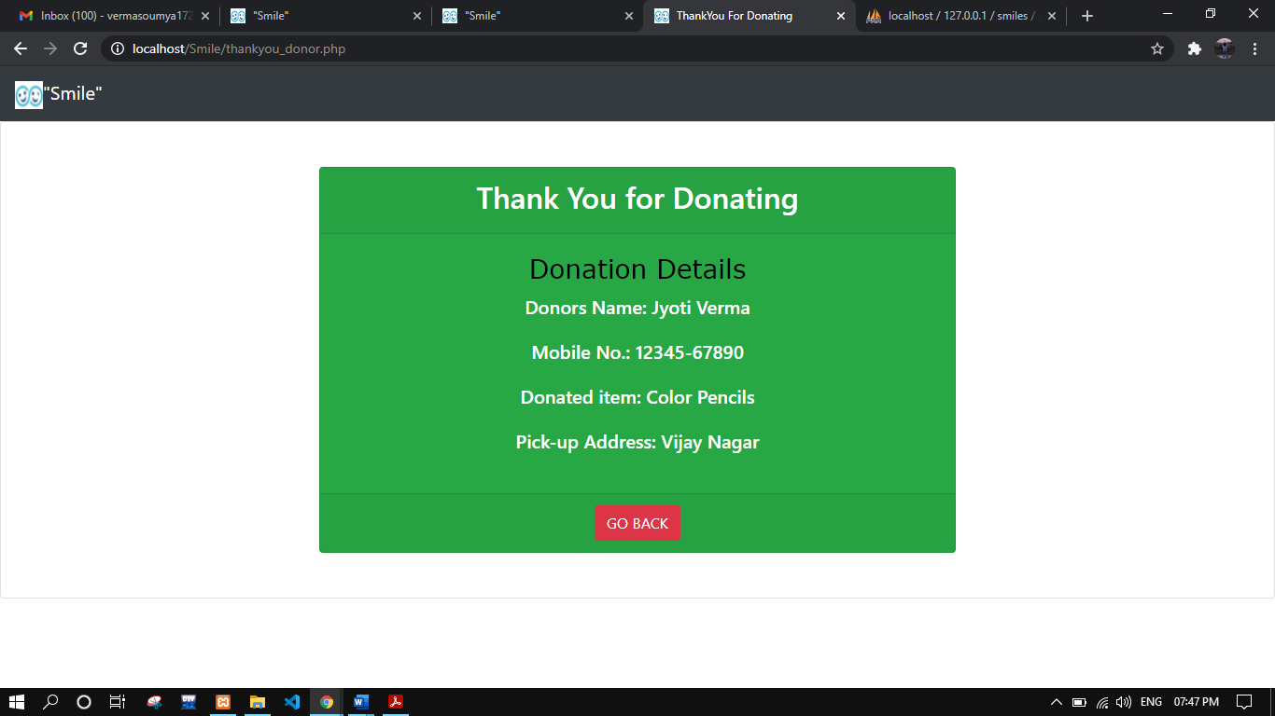
5.) THANK YOU DONOR PAGE

Slide 12
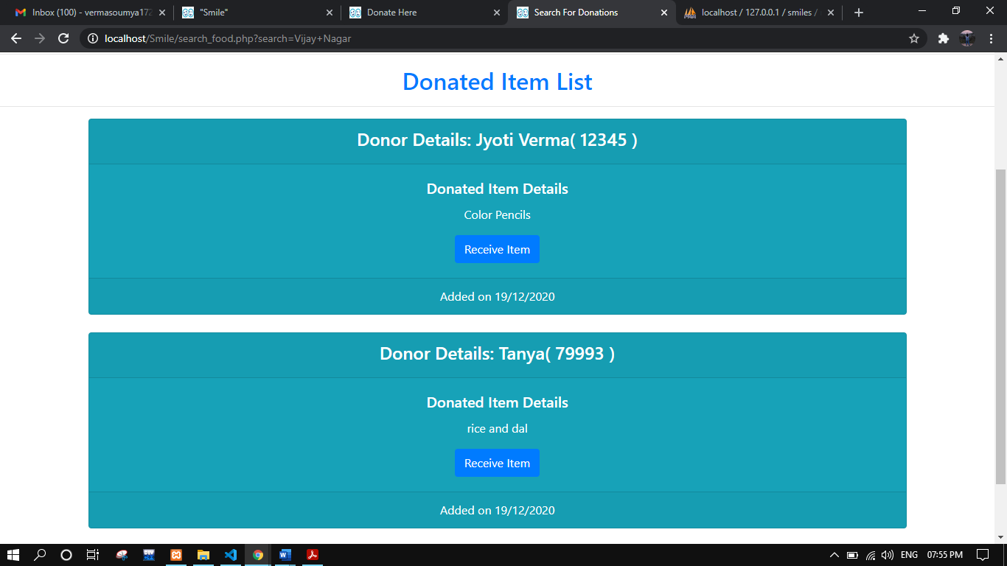
6.) DONATED ITEM PAGE

Slide 13
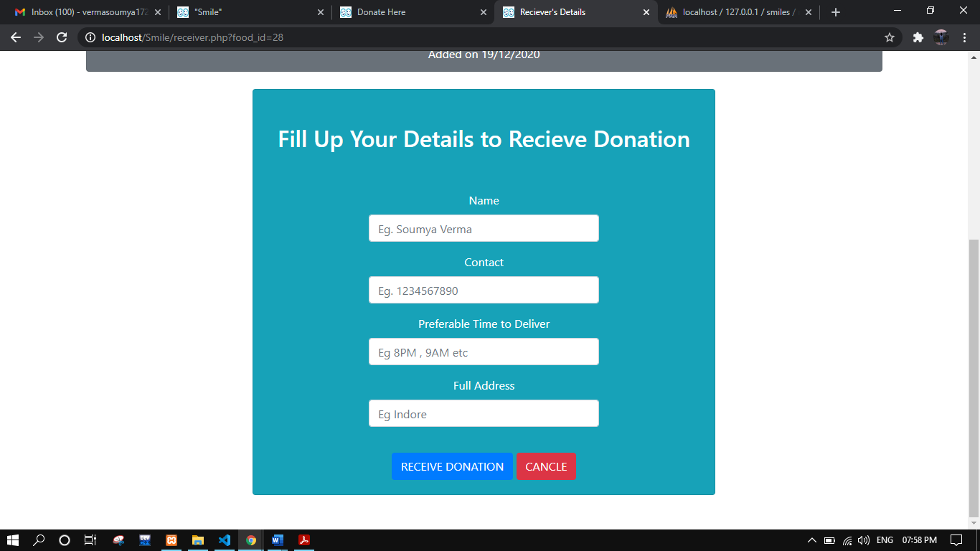
7.) RECEIVER DETAILS PAGE

Slide 14
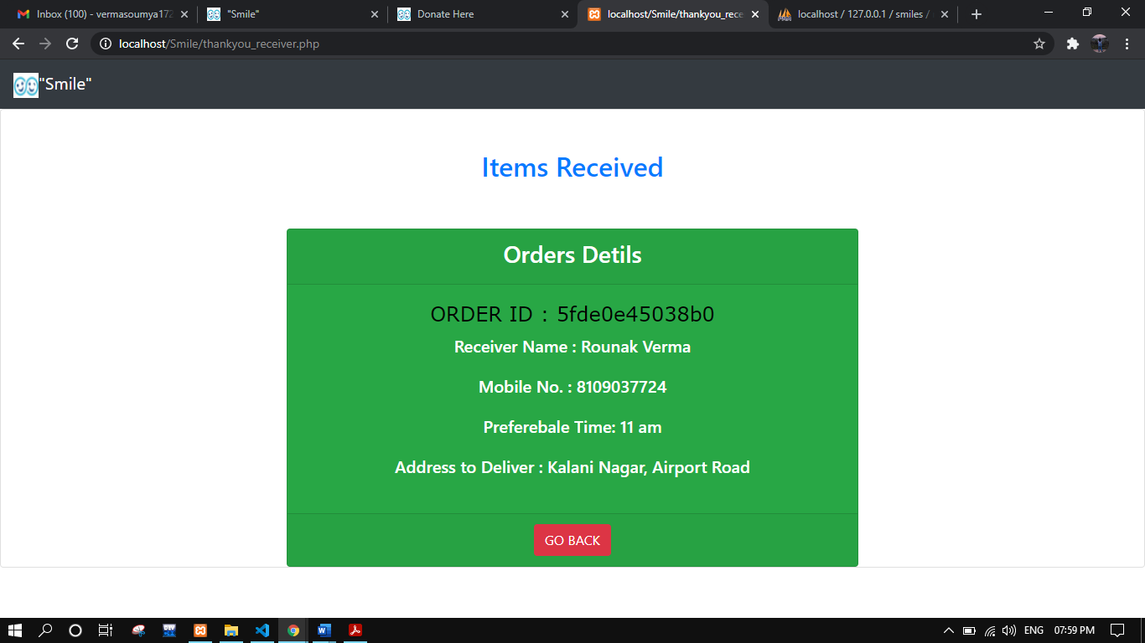
8.) THANK YOU RECEIVER PAGE

Slide 15
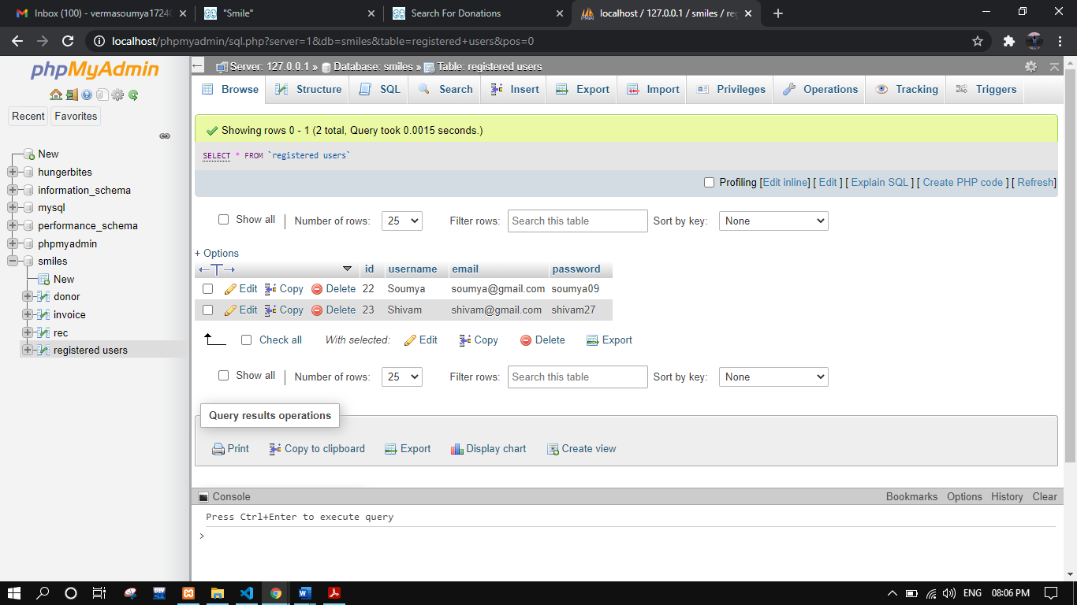
9.) DATABASE SNAPSHOTS I.) Registered Users Database

Slide 16
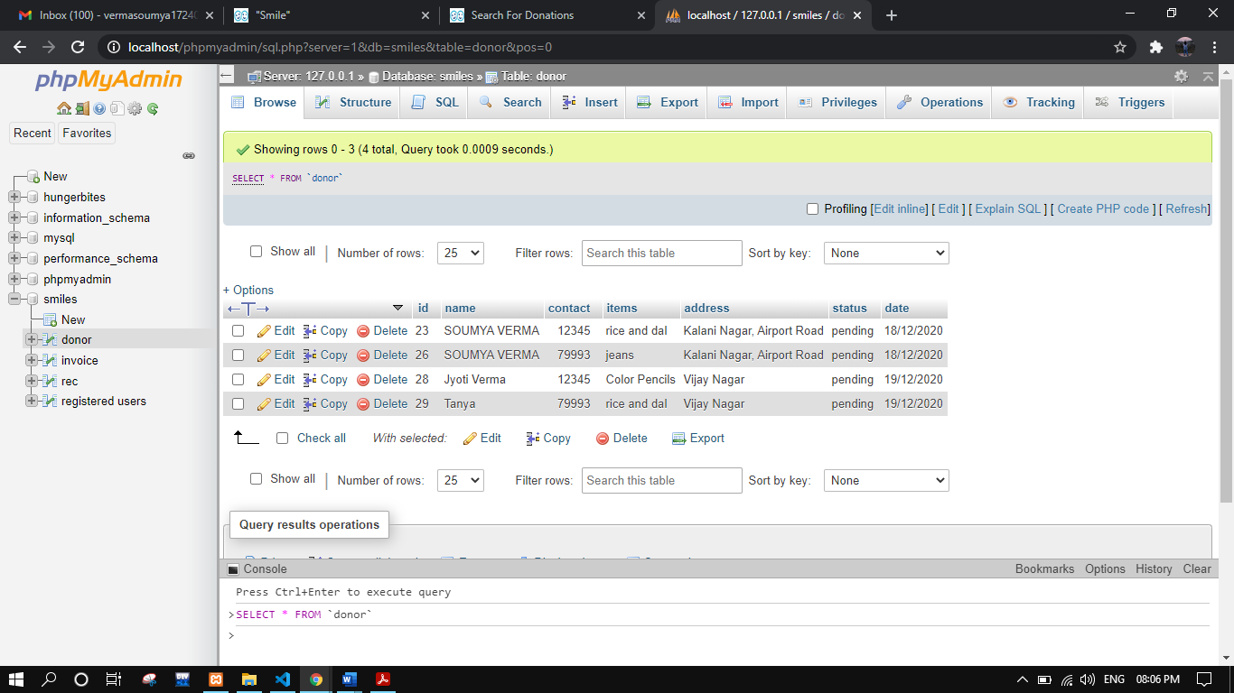
II.) Donor Database

Slide 17
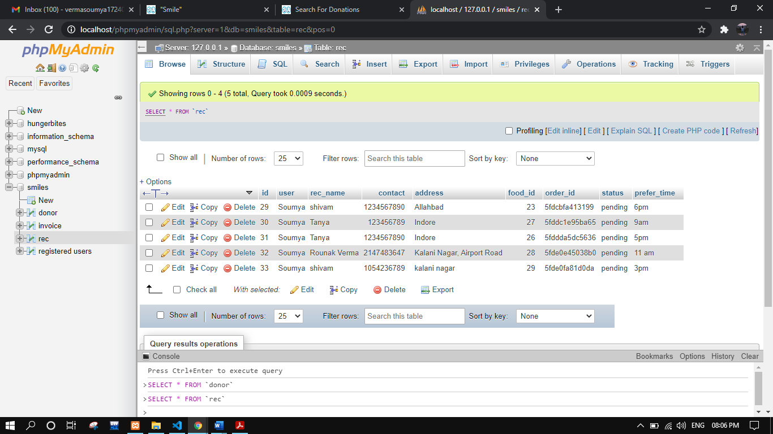
I.) Rec Database( i.e., receiver’s database)

Slide 18
CONCLUSION
In this era of technology many of the routine works have become a lot easier. And the technology advancements once again proved itself worthy during Covid-19 pandemic situation as all over the world more than 70% of the people are working from home and are taking advantages of the online services. This is much required for keeping ourself and others safe avoiding going out of our home unnecessarily. In this pandemic many of the people like: daily wage workers, homeless and rag pickers, etc. remains helpless and might need our help for fulfilling their basic necessity of daily life, such as Food, Cloths, or Stationery items for their children’s education. So, in order to provide them with all these necessary items we can help them sitting in home by using the online website for donations. Thus, keeping ourself and them safe.

Slide 19
REFERENCES
BOOKS:
PHP: The Complete Reference
HTML and CSS: The Complete Reference
Software-engineering: Rajib Mall
WEBSITES:
https://www.W3Schools.com
https://www.tutorialspoint.com
https://www.geeksforgeeks.org/

