Slide 1

SAMSUNG PRISM
Generative AI
Hackathon
3rd Edition 2026 – 27
Theme ID - Theme 01: Agentic Code Intelligence
Team Name - Shard
College Name - VIT Vellore
Member Name & Email 1 – Samyakk Jain<samyakkjain29@gmail.com>
Member Name & Email 2 – Soumya Sharma<soumya122006@gmail.com>
Member Name & Email 3 – Daksh Gupta<guptadaksh130@gmail.com>
Submission GitHub link - github.com/soumya12-droid/Agentic_Code_Intelligence

Slide 2
Theme
Theme 01 — Agentic Code Intelligence: retrieving the right code from a library too large for any LLM context window.
Our approach: a multi-stage hybrid retrieval pipeline — dense embeddings + BM25, combined by weighted Reciprocal Rank Fusion — with one core mechanism, content-addressed snippet identity, carried through the whole system:
  Accuracy: query routed to a structural (AST/call-graph) or semantic path; semantic queries get dense + BM25 combined by weighted RRF — a cross-encoder reranker was evaluated and dropped after it regressed NDCG@10
  Versioning: snippet_id = hash(normalized code) means unchanged functions never get touched on reindex — only real diffs are re-embedded, so rebuild time stays close to the size of the change, not the size of the repo
  Evolutionary retrieval: the same content-addressed IDs form lineage chains across versions, so near-duplicate edits of one function get grouped instead of crowding out genuinely distinct results
One design decision — content addressing — drives accuracy, fast reindexing, and cross-version ranking together, instead of three separate bolted-on features. That's the whole pitch of this deck.

Slide 3
Existing Solutions & Gaps
How code retrieval is commonly approached — and where it breaks down
Single dense embedding model + cosine similarity
  Fast to build, but misses exact identifier/keyword matches (vocabulary mismatch between natural language and code); no answer for structural questions like “which files call X before Y”
LLM-in-the-loop ranking
  Explicitly ruled out by the problem statement — thousands of snippets can't fit in any context window, and it's too slow for a retrieval-first step in a RAG pipeline
Full re-embedding on every commit
  Correct but doesn't scale — codebases change constantly, and the P1 goal explicitly requires indexes to rebuild in a “reasonable amount of time,” not from scratch every time
Treating every code version independently
  Near-identical snippets across versions crowd out genuinely distinct results — a hard ranking problem the Bonus goal calls out directly

Slide 4
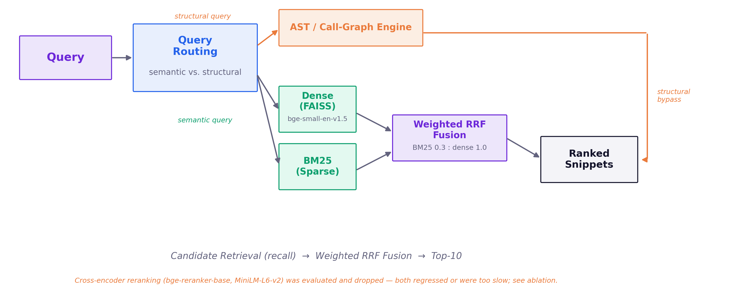
Our Solutions & Architecture Diagram
Multi-stage hybrid retrieval: recall-focused candidate generation, then weighted fusion.
Query is routed to a structural path (AST/call-graph) or a semantic path (dense + BM25, combined by weighted Reciprocal Rank Fusion) based on query type. A cross-encoder reranker was evaluated and dropped — see Results.

Slide 5
Demo & Product Walkthrough
Live demo covers:
  A natural-language query run end-to-end against the shipped pipeline — not just final numbers, the actual ranked snippet output
  Ablation, shown live: dense-only vs. +BM25 weighted RRF fusion (the shipped pipeline) vs. +cross-encoder reranking (evaluated, regressed, dropped) — same query, three configurations
  Structural queries: “who calls X” / “what does X call” / “X before Y” answered directly via the AST/call-graph engine (scripts/demo_structural.py)
  P1 in action: a single-file change triggers incremental reindexing — only the changed snippet is re-embedded, timed against a full rebuild (scripts/benchmark_reindex.py)
  Bonus in action: a cross-version query returns lineage-grouped results instead of near-duplicate clutter (scripts/demo_lineage.py)

Slide 6
Tools and tech stack used
▸ Embedding model
bge-small-en-v1.5 — switched from jina-embeddings-v2-base-code, which was too slow on CPU (2+ hr for a full eval pass)
▸ Sparse retrieval
Custom fast BM25, precomputed inverted index — full query set in ~5s vs. hours for naive rank_bm25 on long queries
▸ Fusion
Weighted Reciprocal Rank Fusion, hand-rolled (BM25 weight 0.3, dense 1.0) — this is the shipped pipeline, NDCG@10 0.0597
▸ Reranker
None in the shipped pipeline — bge-reranker-base (too slow, ~11.6h/full split) and MiniLM-L6-v2 (fast enough, but regressed NDCG@10 to 0.0528) were both evaluated and rejected
▸ Vector store
FAISS, IndexIDMap — local, no server dependency; supports incremental add/remove for P1 versioning
▸ Code parsing
tree-sitter, JS + Python grammars — function/block-level extraction, call-graph queries, and content-hash snippet identity for versioning
▸ Metadata store
SQLite — snippet/version bookkeeping, lineage chains (union-find over edit history), no server needed
▸ Evaluation
MTEB library, AppsRetrieval task — official submission format; cold-clone reproduced bit-identical scores across two dependency versions
▸ Orchestration
Plain Python, no heavy framework — kept debuggable and fast; no fallback-model indirection (removed as dead code)

Slide 7
Impact & Use case
Who this helps
  Any AI coding agent or developer tool that needs to find the right code in a codebase too large to fit in an LLM's context window — the exact scenario in the problem statement (voice-assistant codebases with dozens of agents spread across thousands of files)
Why it matters beyond the hackathon
  Retrieval is the bottleneck step in any RAG-for-code pipeline — faster, more accurate retrieval speeds up bug localization, code review, and onboarding to unfamiliar codebases
  Codebases change constantly; a system that can't keep pace with commits without full rebuilds doesn't survive production — why we treated P1 as a first-class requirement, not an afterthought
Concrete use case
  A developer asks “where is Bluetooth pairing handled?” or “which files call the auth token refresh before the API call?” and gets precise, ranked, file-and-line-level answers — instead of manually grepping thousands of files

Slide 8
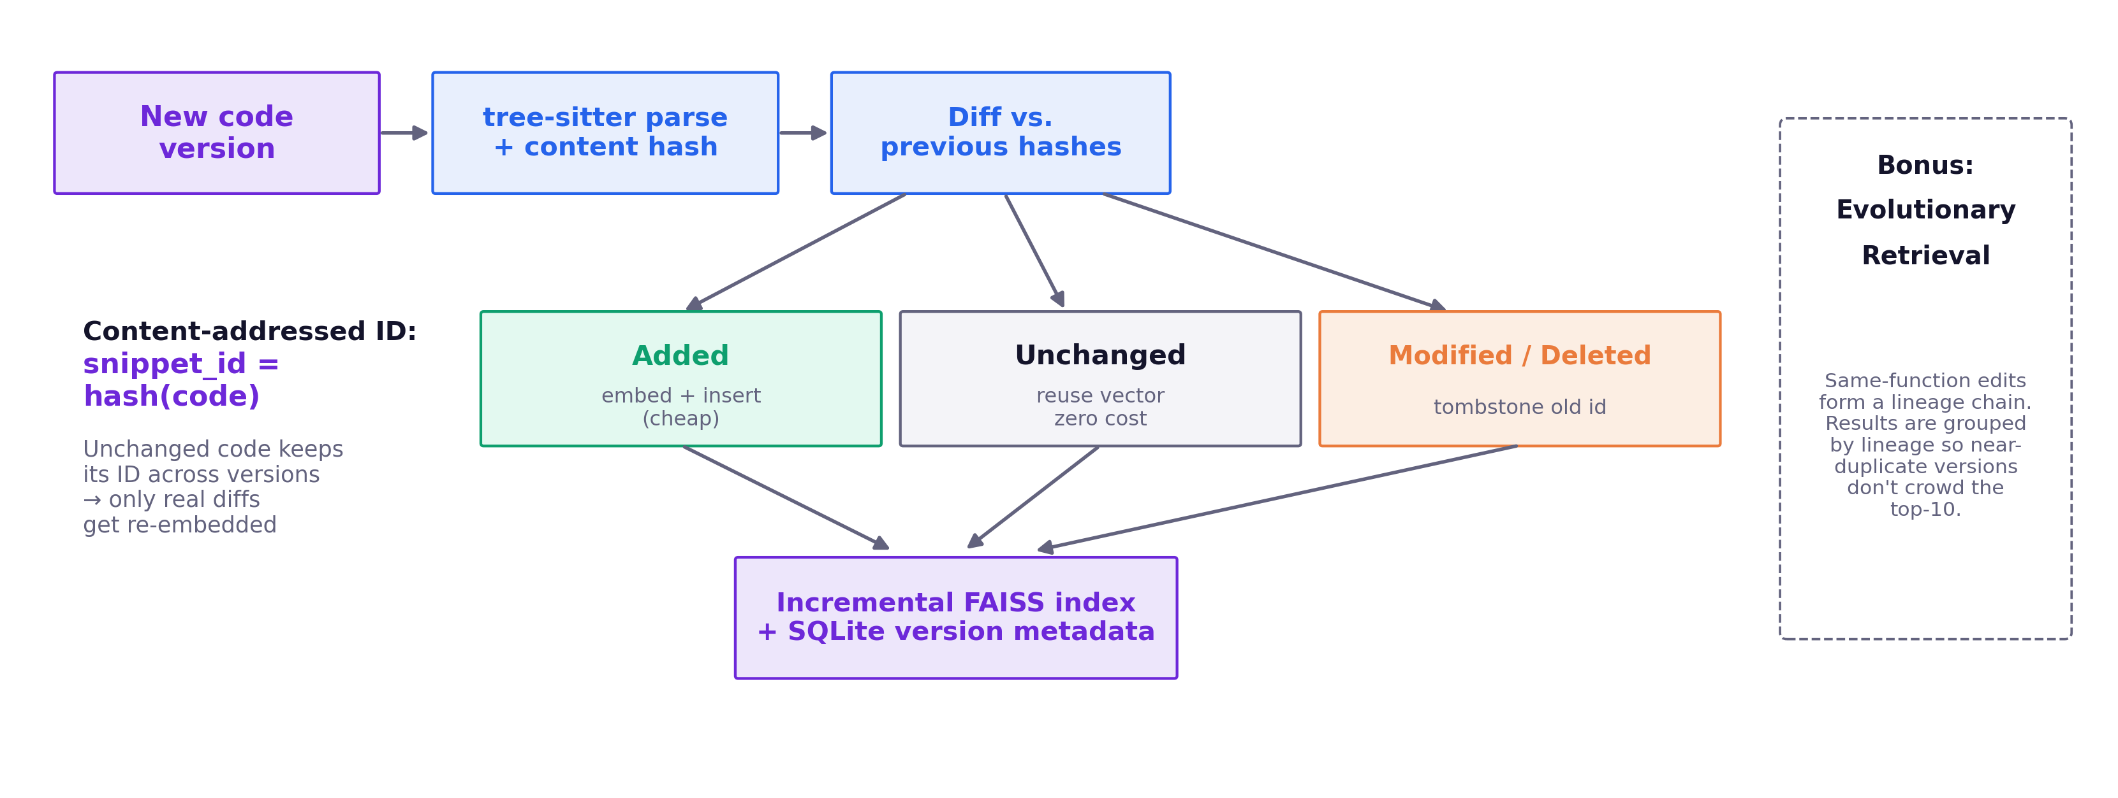
Innovation highlights, results and limitations
Innovation: content-addressed, diff-driven indexing
  snippet_id = hash(AST-structural code) — unchanged functions keep their ID across versions; only real diffs are re-embedded. One mechanism drives both P1 reindexing and Bonus lineage grouping.
Results: dense-only 0.0564 → +BM25 weighted RRF 0.0597 (shipped) → +MiniLM rerank 0.0528 (regressed, rejected). bge-reranker-base also rejected as too slow (~11.6h/full split).
P1: incremental reindex flat at 2–5s regardless of repo size (500–2,000 files, ≥18–67× faster than full rebuild); exactly 1 snippet re-embedded for a 1-file change.
Bonus: lineage grouping removed 100% of redundant near-duplicate slots in a scale test, 0 lineages ever dropped. Limitations and caveats are in the README/reproducibility audit.

Slide 9
What’s next
Extend structural query coverage
  Broader call-graph pattern support; rename+edit lineage linking (currently breaks the chain by design, documented as a known limit)
Move BM25 to an incrementally-updatable engine
  e.g. Tantivy/Whoosh, if rebuild time becomes measurable at larger corpus scale — not needed yet (rebuild is ~1s of a 2–5s incremental update)
Multi-language support beyond JS + Python
  tree-sitter grammar swap, not an architecture change — already proven across two languages sharing one extractor interface
Query expansion
  Not built this round (out of scope for the submitted pipeline); would need its own recall-impact evaluation before adding
Package the pipeline as a reusable retrieval service/API
  So it can sit behind any coding agent, not just this evaluation harness

Slide 10
Brownie Points — Differentiation
One idea, three goals solved
Content-addressed snippet identity — snippet_id = hash(normalized code) — is the single mechanism behind both P1 and Bonus, not two bolted-on features:
  Unchanged functions keep their ID across versions → P1's fast reindexing falls out for free (2–5s incremental vs. minutes for a full rebuild)
  Edits to the same function form a lineage chain → Bonus's cross-version ranking groups by lineage instead of post-hoc deduplication
Every architectural choice is a measured number, not intuition
  Dense-only → +BM25 weighted fusion → +reranking, each stage benchmarked on the same NDCG@10/MRR baseline on CoIR apps — including the honest result that reranking regressed quality and was dropped
Dual routing solves both query types in the problem statement
  Structural queries (“which files call X before Y”) go straight to an AST/call-graph engine; semantic queries go through hybrid retrieval — one pipeline isn't forced to do both jobs badly
Reproducibility, verified not claimed
  Cold-clone audit reproduced the submission bit-identically across two dependency versions (mteb 2.21.10/2.22.2, torch 2.14.0/2.14.1) — 0 of 149 scores differed

Slide 11
Checklist- Updated on Public GitHub
Working prototype code — public or shared GitHub repo (Y/N) Y
README with reproducible setup instructions (Y/N) Y
Demo video, max 5 minutes (YouTube or Drive link)
Presentation file (PPT or PDF) (Y/N) Y
Release tag PRISM_GENAI_HACKATHON_Y2026 on final commit (Y/N) Y
MTEB results JSON attached as GitHub release artifact (Y/N) Y

Slide 12
Thank you
Organised by the Language AI Team and the PRISM Team, Samsung R&D Institute India
Notes:
Closing slide. Add the Google Form URL and a contact email before sharing. Edition 2 organising team for reference: Language AI - Sourabh Tiwari, Gaurav, Sanjeeth Pothireddy, Gorang Maniar; PRISM - Binny Lakra, Prakhar Chandrakar, Vishu Kumar; Kick-off and mentors - Giridhar Jakki, Deepraj Prabhakar Patkar (Language AI), Srimanu Prasad Nagaraju, Ashish Kumar (Tech Strategy).

