Slide 1
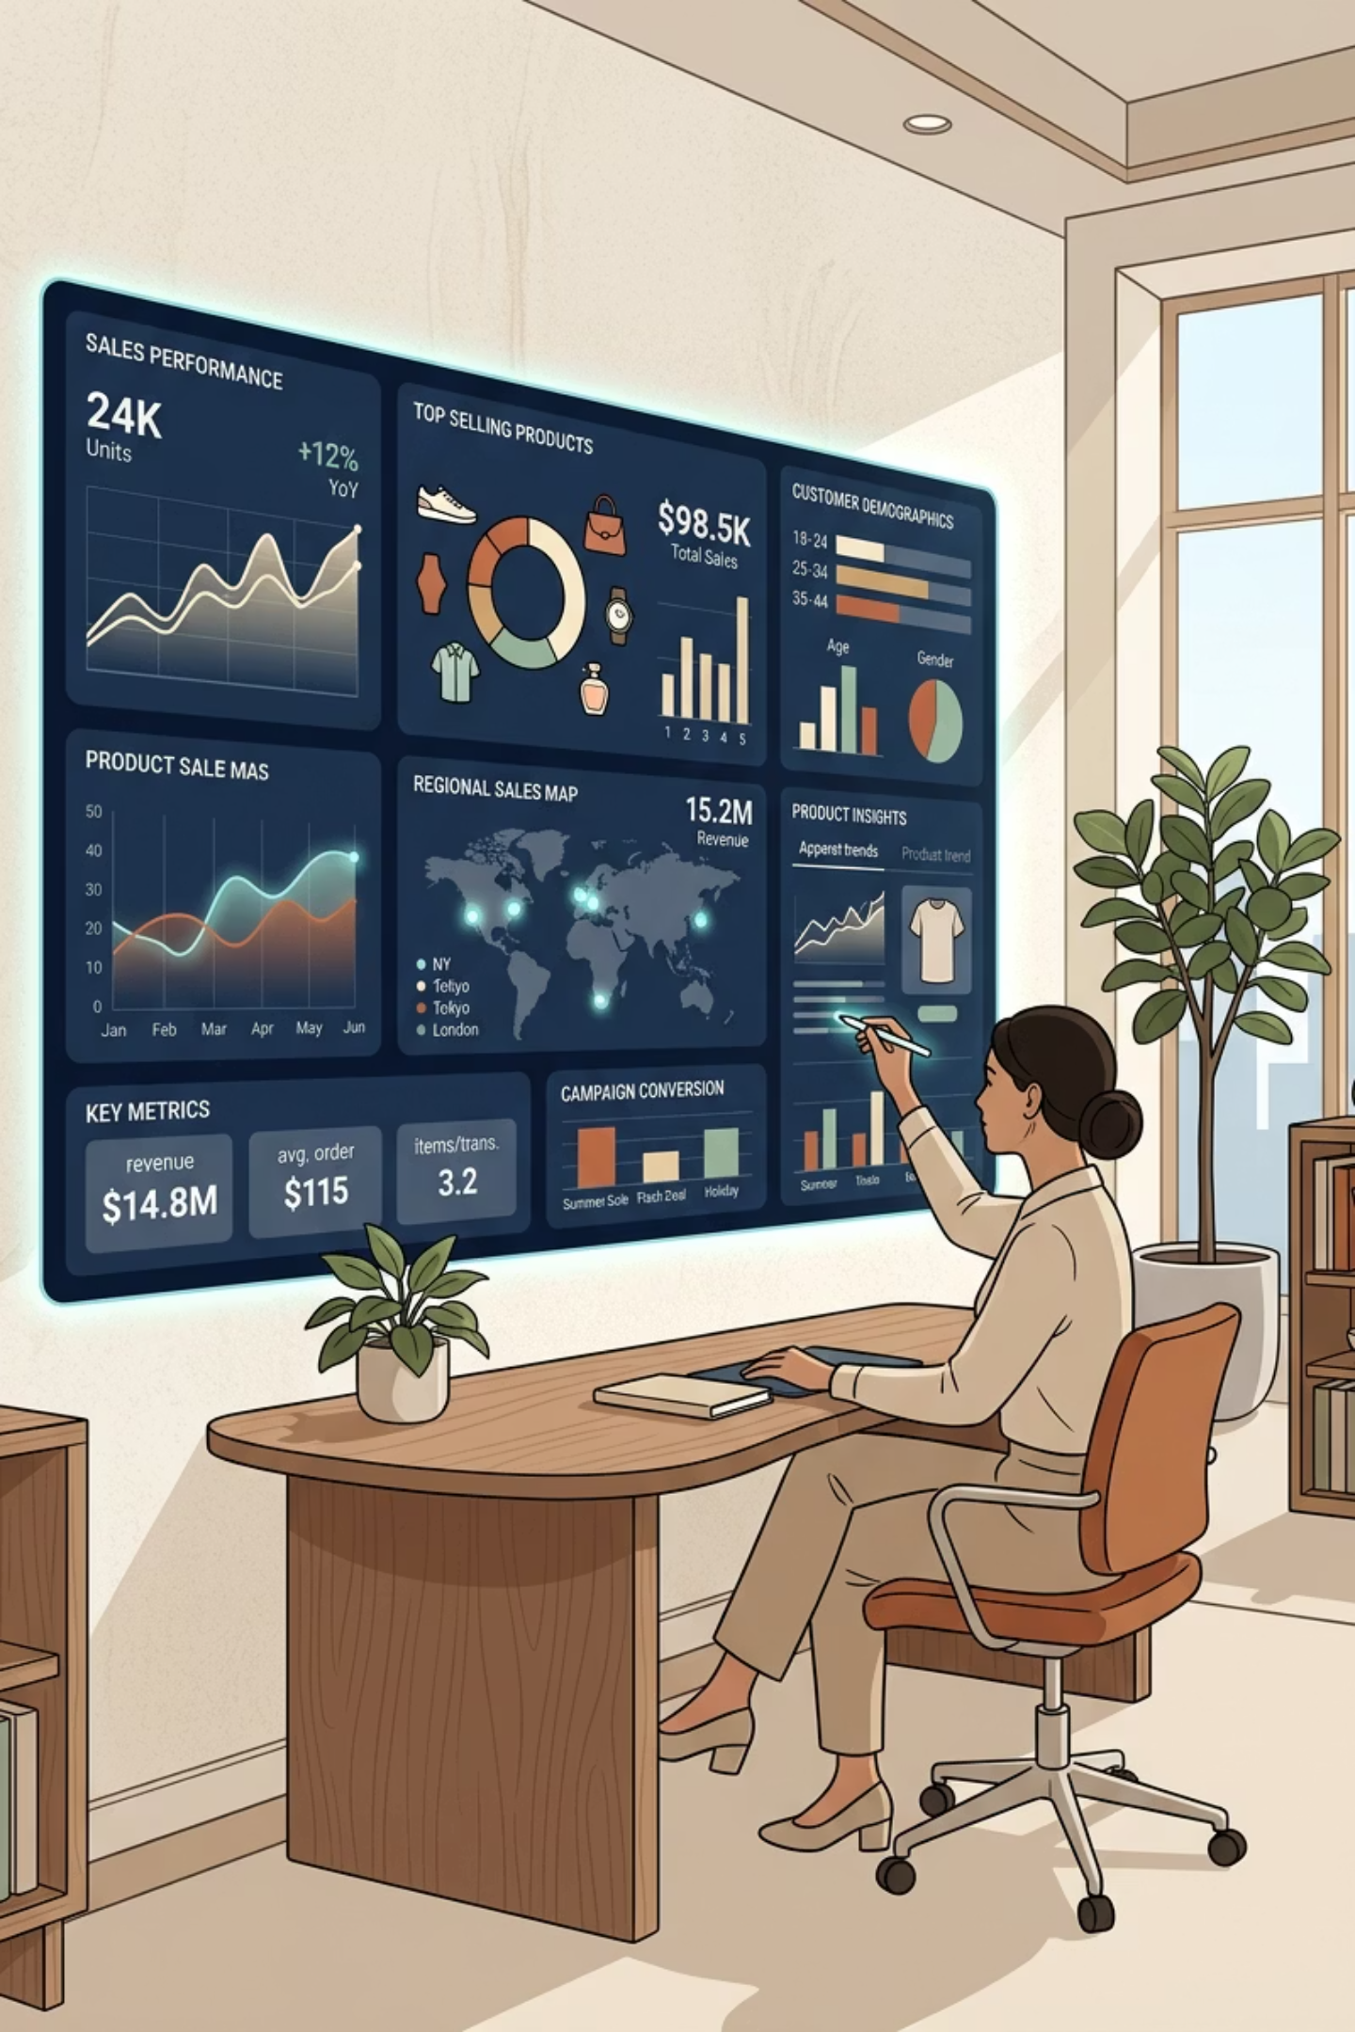
Customer Behaviour Analysis
A business-ready report covering Python data preparation, PostgreSQL SQL analysis, and Power BI dashboard delivery — translating 3,900 customer records into actionable retail insights.
PYTHON
POSTGRESQL
POWER BI

Slide 2
Project at a Glance
3,900
$233K
Customers
Total Revenue
Total records in source dataset
Represented by purchase amount
$59.76
3.75
Avg Purchase
Avg Rating
Mean purchase value per customer
After median imputation
Revenue is led by Clothing and Accessories due to order volume, while average purchase value remains tightly clustered around $60 across most customer segments.

Slide 3
Executive Summary
Headline Finding
Key Highlights
Broad, stable purchasing behavior across categories, seasons, and age groups. Subscribers average $59.49 vs. non-subscribers at $59.87 — subscription is not yet a spend differentiator.
Clothing revenue: $104,264; Accessories: $74,200
Fall is the strongest season: $60,018 revenue, $61.56 avg purchase
3,116 customers qualify as Loyal (10+ previous purchases)
Dashboard: 1 page, 18 visuals with category, gender, and subscription slicers
Discounted purchases average $59.28 vs. $60.13 non-discounted — discounting should be reviewed for margin impact.

Slide 4





Project Overview & Workflow
Ingest
Load CSV in pandas — 3,900 structured records
Prepare
Clean, impute ratings, engineer age & frequency features
Persist
Upload clean data to PostgreSQL customer table
Analyze
SQL queries on revenue, discounts, loyalty & segments
Visualize
Power BI dashboard with KPIs, slicers & charts

Slide 5
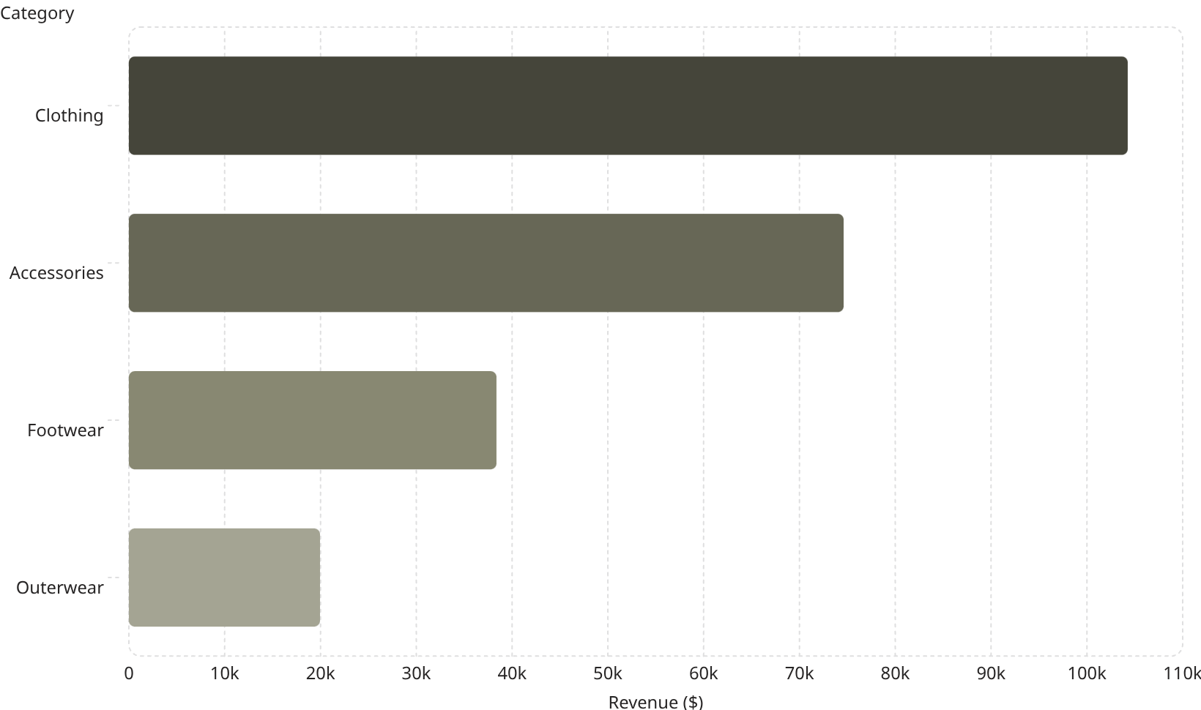

Dataset Overview
Source Dimensions
3,900 rows · 18 columns · 25 products · 4 categories · 50 locations · Ages 18–70
104k
74.2k
Only 37 missing values in Review Rating — resolved via category-median imputation.
36.1k
Category-median imputation preserves rating behavior without forcing a global average.
18.5k

Slide 6
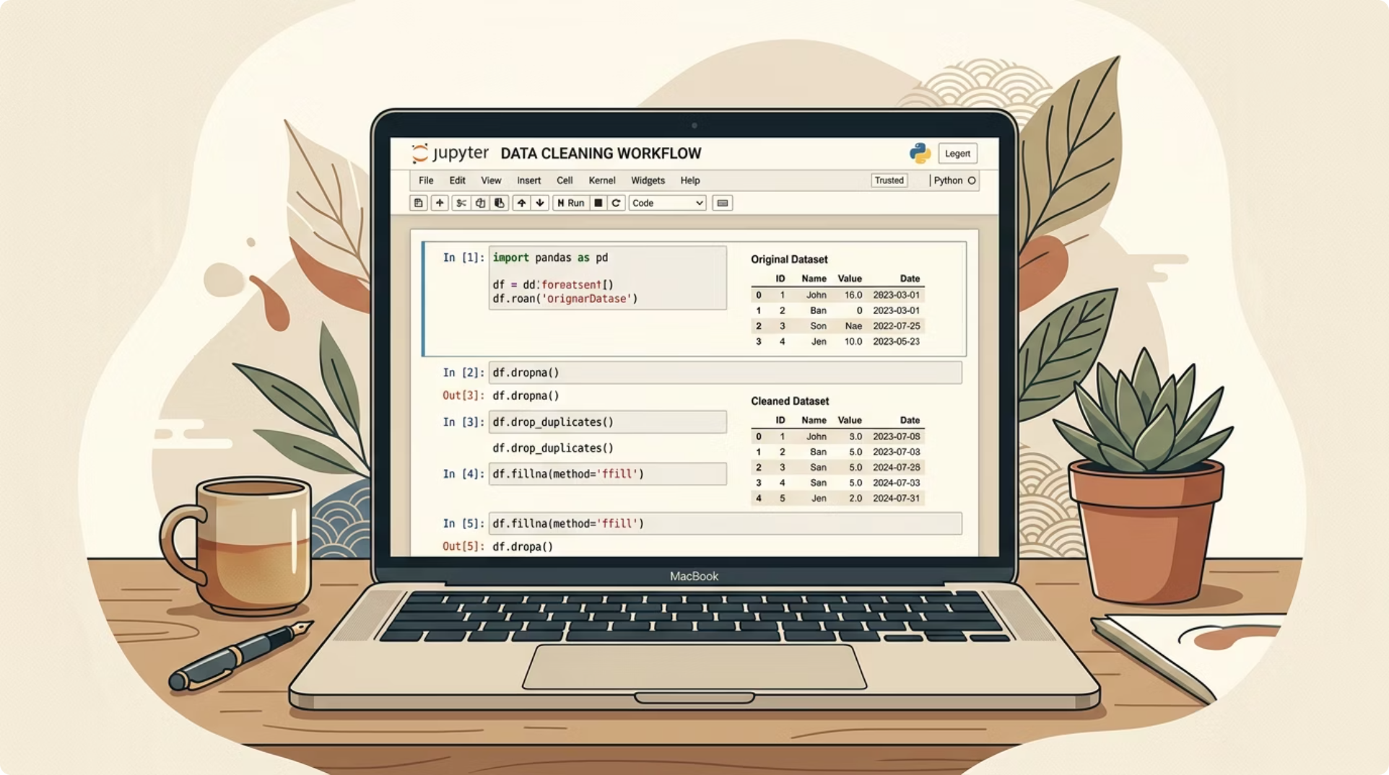
Python Data Preparation
Preparation Steps
01
Missing Rating Imputation
Fill 37 blanks using category medians — keeps rating analysis complete.
02
Column Normalization
Lowercase, underscore names; rename purchase amount field for SQL consistency.
03
Age & Frequency Features
Create Young Adult, Adult, Middle-aged, Senior segments; map frequency to day intervals.
04
Database Loading
SQLAlchemy + psycopg2 load clean customer table into PostgreSQL.

Slide 7
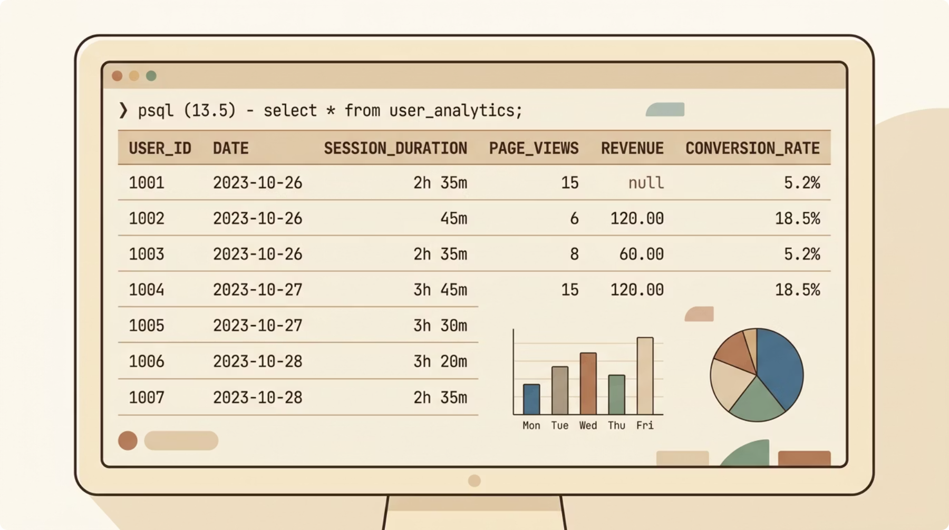

SQL Analysis
Business Questions Answered
Gender Revenue
Male customers drive higher total revenue; female avg spend is slightly higher.
Subscription
Subscribers do not yet spend more on average than non-subscribers.
Discount Analysis
Discounts are frequent but do not lift average spend in current data.
Segmentation
3,116 Loyal customers (10+ purchases); Young Adult leads age-group revenue at $62,143.
One extra closing parenthesis exists after the top-products-by-category query — remove it for clean execution.

Slide 8
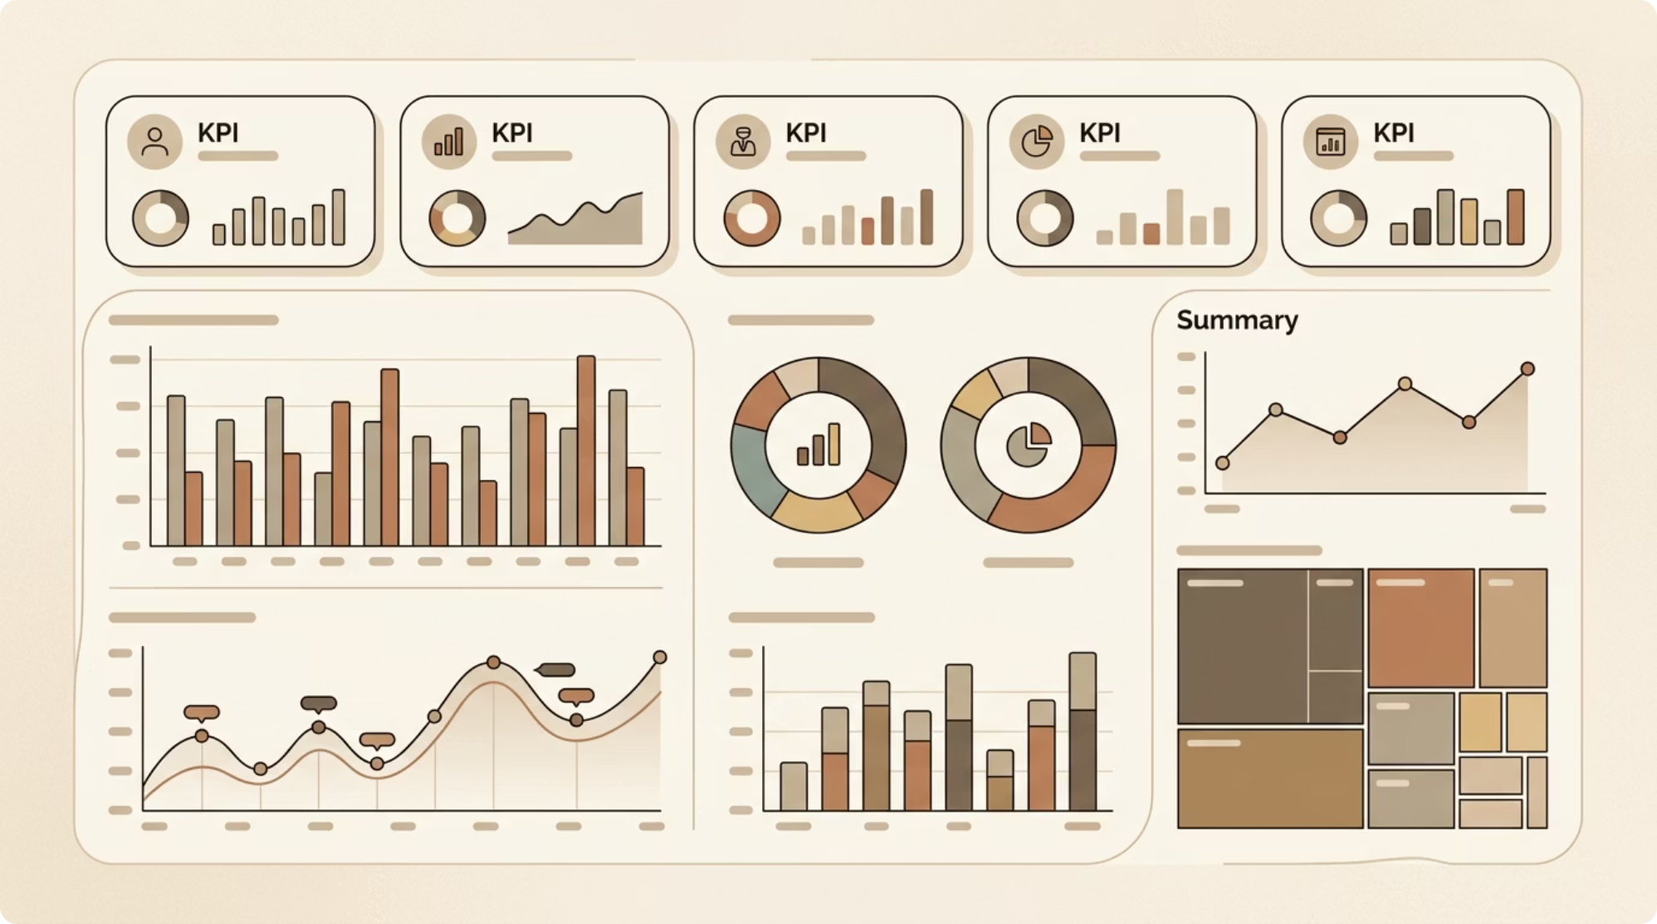
Power BI Dashboard
18 Visuals · 1 Page
Top KPI Strip
Customers, avg purchase, avg rating, revenue — quick performance baseline.
Slicer Panel
Filter by subscription, gender, category, and shipping type.
Category & Age Charts
Revenue and order count by category; revenue and customer count by age band.

Slide 9
Key Findings
Revenue Concentration
Gender Behavior
Clothing $104,264 and Accessories $74,200 dominate total revenue.
Female avg spend: $60.25. Male total revenue: $157,890.
Seasonality
Subscription Gap
Fall leads with $60,018 revenue and $61.56 avg purchase.
Subscribers avg $59.49 vs. non-subscribers $59.87 — underperforming.
Discount Effect
Top-Rated Products
Discounted avg: $59.28 vs. non-discounted $60.13 — no spend lift.
Gloves 3.86 · Sandals 3.84 · Boots 3.82. Hat has highest discount rate at 50%.

Slide 10


Recommendations & Conclusion
Strengthen Clothing & Accessories
Plan seasonal promotions, bundles, and stock depth around top-revenue categories.
Redesign Subscriber Benefits
Test subscriber-only bundles, early access, or loyalty credit tied to repeat purchases.
Audit Discount Strategy
Measure margin impact; reserve discounts for conversion or inventory-clearance goals.
Activate Loyal Non-Subscribers
Use 5+ previous purchases as a trigger for subscription campaigns.
Next upgrade: adding transaction dates would unlock retention trends, cohort analysis, and customer lifetime value modeling.

