Slide 1
Customer Behaviour
Analysis
A premium project walkthrough across Python, PostgreSQL, and Power BI
3,900
customer records
$233K revenue analyzed

Slide 2
PROJECT ARC
From raw shopping records to business decisions
The project turns a CSV into an analysis-ready database and an executive dashboard.
01
02
03
Python prepares
>
SQL interrogates
>
Power BI presents
Load, profile, clean missing ratings, standardize fields, create age and frequency features.
Answer revenue, discount, subscription, product, segmentation, and age-group questions.
KPI cards, slicers, category charts, subscription donut, and age-group views.
Customer Behaviour Analysis
02

Slide 3
DATA SNAPSHOT
The dataset is broad, balanced, and ready for business slicing
3,900 records across demographics, product choice, purchase value, rating, shipping, payment, and loyalty history.
3,900
Revenue by category
Customers
retail shopping records
$233,081
Revenue
total purchase amount
$59.76
Average purchase
stable across key segments
Customer Behaviour Analysis
03

Slide 4
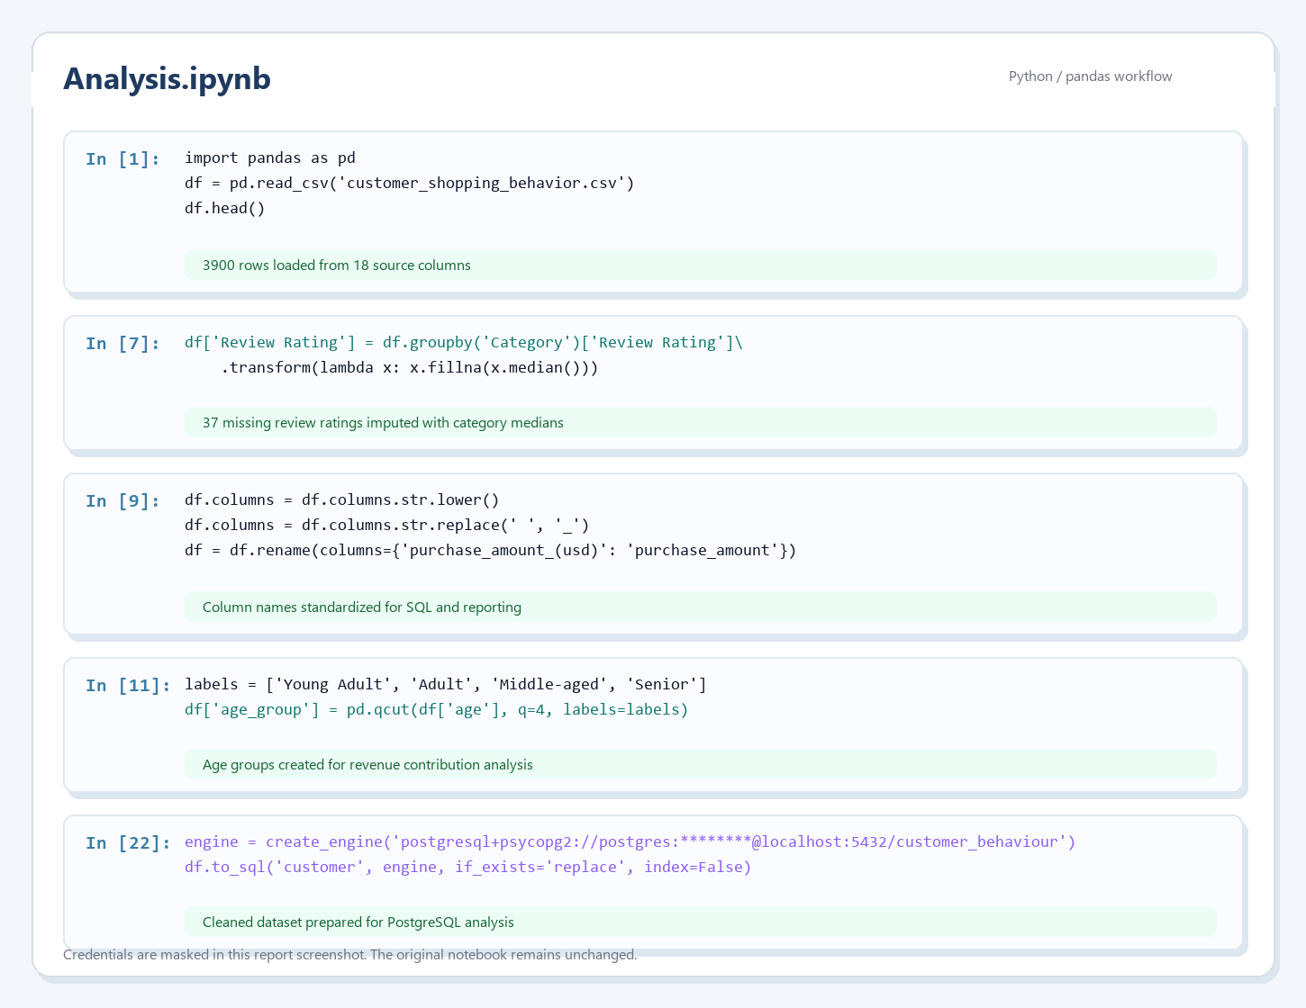
PYTHON WORKFLOW
Python turns messy source data into analysis infrastructure
The notebook handles quality, naming, derived fields, and database loading.
01
Missing ratings repaired
37 blank review ratings are filled using category medians.
02
Fields standardized
Column names become SQL-safe and easier to reuse.
03
Features engineered
Age groups and purchase-frequency intervals support segmentation.
04
PostgreSQL loaded
The cleaned table becomes the base for repeatable SQL analysis.
Customer Behaviour Analysis
04

Slide 5
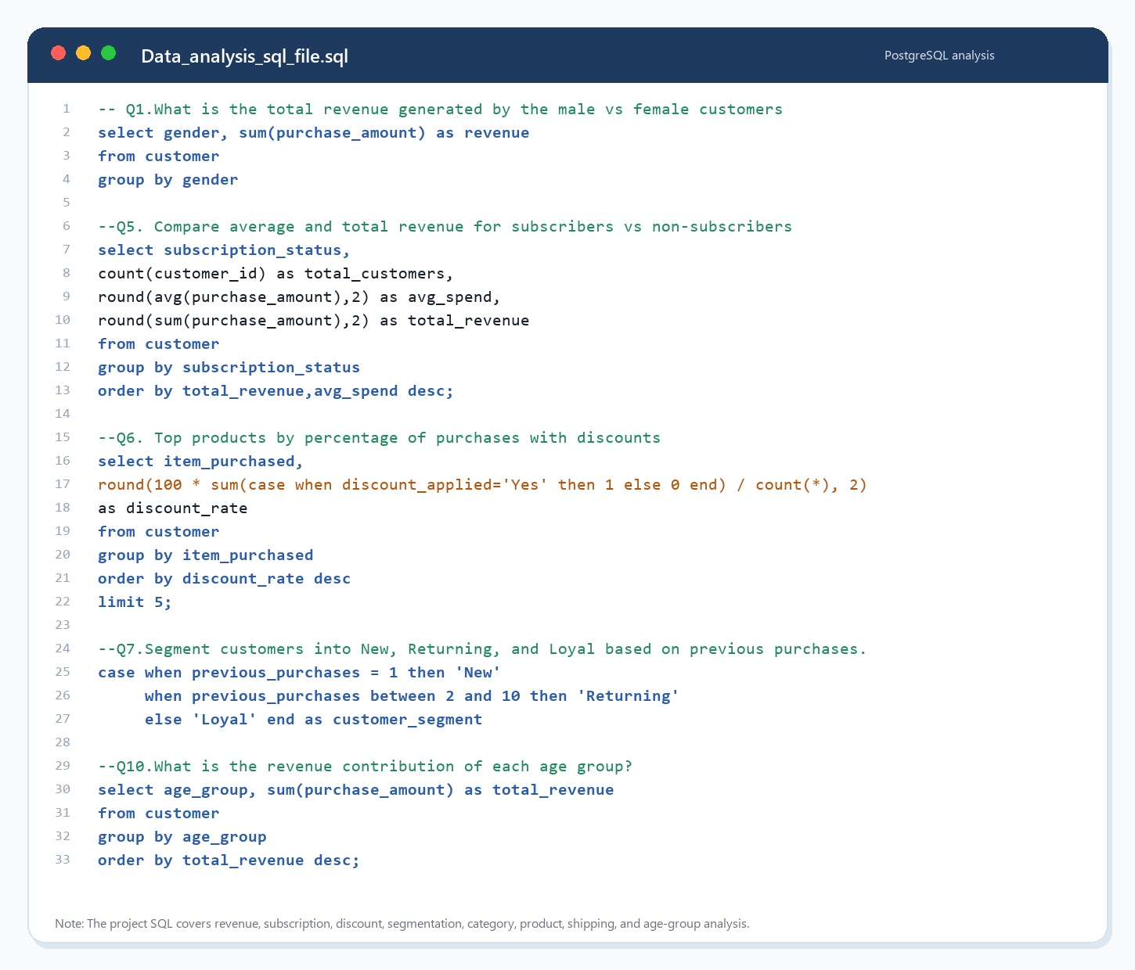
POSTGRESQL ANALYSIS
SQL turns data into business questions
Each query is framed around a decision area, not just a technical aggregation.
Q1
Revenue split
Gender and subscription comparisons reveal value distribution.
Q3
Product quality
Average rating highlights products with stronger customer feedback.
Q6
Discount pressure
Discount rates identify products that rely most on price incentives.
Q7
Customer loyalty
New, Returning, and Loyal segments expose retention depth.
Q10
Age contribution
Age groups show how revenue is distributed across the customer base.
Customer Behaviour Analysis
05

Slide 6
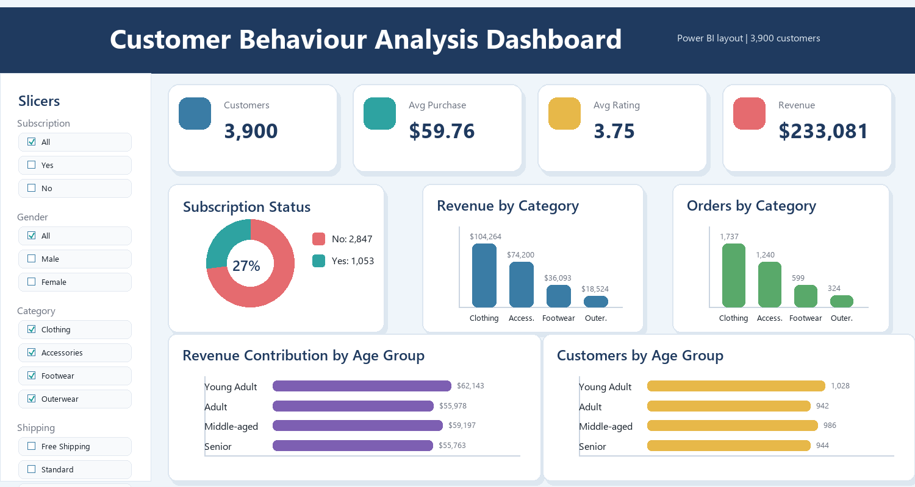
DASHBOARD LAYER
Power BI converts analysis into an operating view
One page, 18 visuals, four slicer families, and a clear KPI layer for fast exploration.
Customer Behaviour Analysis
06

Slide 7
KEY FINDINGS
The main story is stability with category-led revenue
Average spend is tightly clustered, so growth depends more on conversion, repeat activation, and merchandising than on one obvious high-spend segment.
01
Clothing leads revenue
3,116
Clothing contributes $104,264; Accessories follows with $74,200.
02
Fall is the strongest season
Loyal customers
based on more than 10 previous purchases
Fall revenue reaches $60,018 with the highest average purchase at $61.56.
Gloves 3.86
03
Subscription needs a sharper value promise
Subscribers average $59.49 vs $59.87 for non-subscribers.
Top rating
highest average review rating
04
Discounts are not lifting spend
Discounted purchases average $59.28 vs $60.13 without discounts.
Hat 50.0%
Highest discount rate
largest share of discounted purchases
Customer Behaviour Analysis
07

Slide 8
RECOMMENDATIONS
Recommended actions for a stronger customer strategy
Use the analysis to tune inventory, subscription value, discounting, and dashboard cadence.
Recommendation
Reason
Action
Strengthen Clothing and Accessories
These categories generate the largest revenue pools.
Plan seasonal campaigns and protect stock depth.
Redesign subscriber benefits
Subscribers do not spend more on average today.
Test bundles, early access, and loyalty credits.
Audit discount strategy
Discounted transactions average slightly lower spend.
Reserve discounts for conversion or inventory-clearance goals.
Target loyal non-subscribers
Most repeat buyers are not subscribed.
Trigger campaigns from previous purchases above five.
Use dashboard monthly
The PBIX already provides slicers and summary charts.
Extend with time trends if transaction dates become available.
Customer Behaviour Analysis
08

Slide 9
CLOSING MESSAGE
This project proves the full analytics loop.
Python prepares the data, SQL answers the business questions, and Power BI makes the findings usable for decisions.
3 tools
Project scale
Python, SQL, Power BI
5 actions
Business focus
inventory, subscription, discounting, loyalty, dashboard cadence
Next upgrade: add transaction dates for trend, cohort, retention, and customer lifetime value analysis.
Customer Behaviour Analysis
09

