Slide 1
Drone Fleet Management and Mission Simulation System
Object-Oriented Programming Project
Soumyakanta Sahu | ID: B125125 | Branch: CSEB-2 | 3rd Semester
Professor: Dr. Sobhanayak Srichandan

Slide 2
Problem Statement and Objectives
The problem
Managing several drones means tracking specifications, battery levels, availability, missions and maintenance. Done separately, it is easy to pick a drone that cannot do the job.
Our solution: one menu-driven C++ program that stores all data, selects suitable drones by clear rules, updates status automatically and saves records.
Objectives
Menu-driven C++ application for a simulated drone fleet
Register, view, search and manage different drone types
Create missions; assign drones using battery, range, payload and availability checks
Simulate completion, battery use, charging and maintenance
Demonstrate OOP, STL, exception and file handling

Slide 3
System Design: Class Structure
Drone (abstract base class)
pure virtual: performMission(), getEfficiencyFactor(), gettypename()
DeliveryDrone
battery factor 1.10
SurveillanceDrone
battery factor 0.85
MappingDrone
battery factor 0.95
RescueDrone
battery factor 1.25
FleetManager (coordinator)
Owns map of drones (unique_ptr), map of missions and the maintenance log. Assigns, completes, charges, services, reports statistics, saves and loads.
Mission
type, destination, distance, payload, priority, status
MaintenanceRecord
drone ID, date and time, description

Slide 4
How a Mission Is Assigned
1 Status
Drone must be AVAILABLE
2 Payload
Load must not exceed drone capacity
3 Range
Distance must not exceed max range
4 Battery
Enough for the trip plus a 10% reserve
Choosing the best drone
HIGH priority missions are served first (priority_queue)
Prefer a drone of the same type as the mission
Then the drone with more battery
No drone fits: mission stays PENDING and reasons are shown
Battery model (simulation)
used % = (distance / range) x 100 x type factor x (1 + 0.5 x payload / capacity)
Example: D1 (Delivery), 8 km, 2 kg
= 40 x 1.10 x 1.2 = 52.8% used
Battery 90% to 37.2% after the mission

Slide 5
OOP and C++ Concepts Used
Encapsulation
Private data; access through getters, charge(), assignTo()
Inheritance
Four drone types derive from Drone
Abstraction
Drone is abstract: it has pure virtual functions
Polymorphism
performMission() runs the version of each drone type
Exception handling
invalid_argument and runtime_error, caught in main()
STL containers
map, vector, priority_queue, string streams
Smart pointers
unique_ptr owns the drones; no manual delete
File handling
ifstream and ofstream save and reload all records

Slide 6
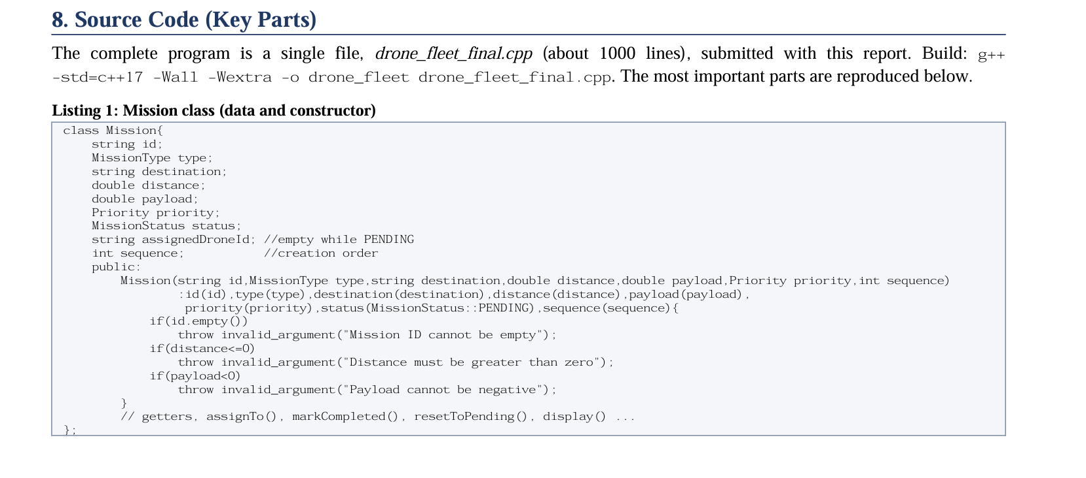
Implementations

Slide 7
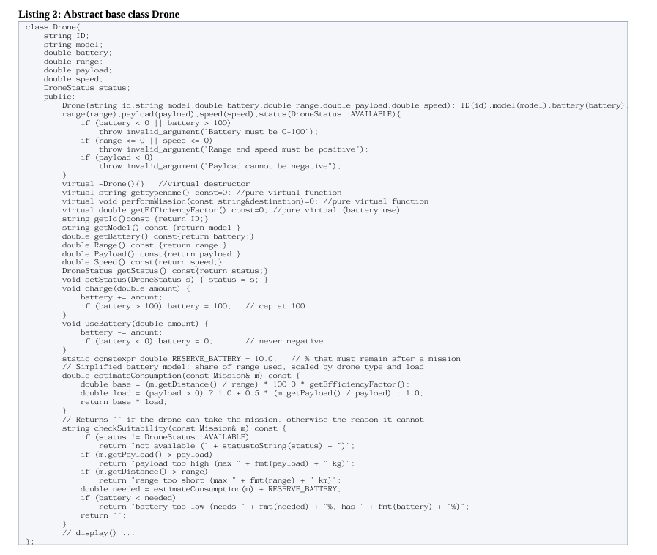
Implementation

Slide 8
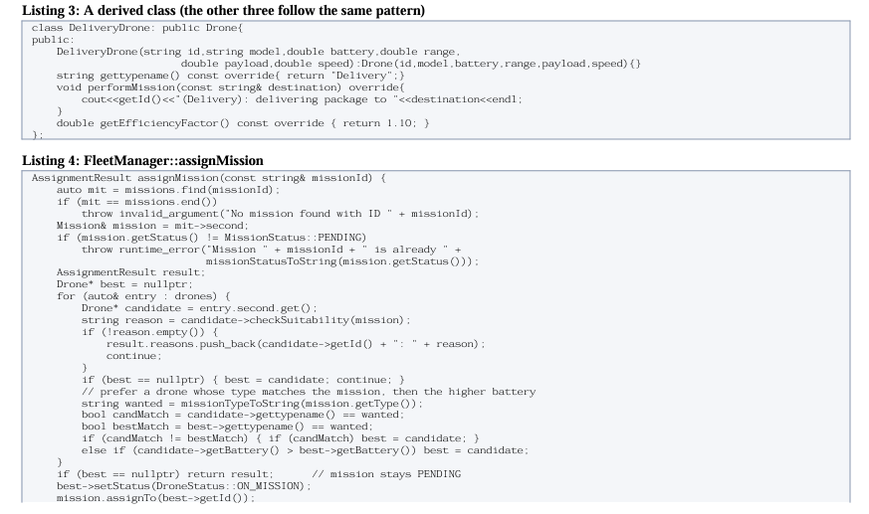
Implementation

Slide 9
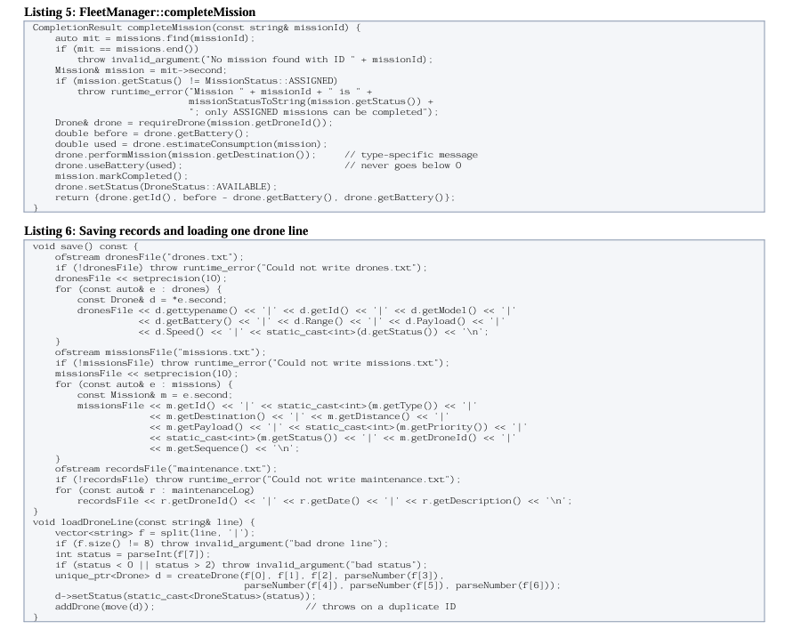
Implementation

Slide 10
Live Output
Selected highest-priority mission: M1
Mission M1 is now ASSIGNED to drone D1 (ON_MISSION).
Selected highest-priority mission: M2
Mission M2 is now ASSIGNED to drone R1 (ON_MISSION).
Selected highest-priority mission: M3
No suitable drone found. Mission M3 remains PENDING.
- D1: not available (ON_MISSION)
- R1: not available (ON_MISSION)
- S1: range too short (max 15.0 km)
Mission M1 marked COMPLETED.
Drone D1 used 52.8% battery; 37.2% remaining.
What the demo shows
HIGH priority is served first
Rescue mission goes to the Rescue drone
Clear reasons when no drone fits
Battery and status update automatically
Records are saved and reloaded on restart

Slide 11
Testing, Limitations and Conclusion
Testing
Invalid input, duplicate IDs, nan/inf rejected
Unsuitable drones: reasons displayed
Save, restart and reload verified
Corrupted data files skipped safely
Compiled without warnings; sanitizers clean
Limitations and future scope
Console only; simplified battery model
Simulated data: no real drones, no live GPS
Future: database for larger fleets
Future: graphical interface and real telemetry
A working, menu-driven C++ simulation that applies OOP to manage a drone fleet.
Thank you.

