Slide 1
Excalibur –Training v1.0

Slide 2
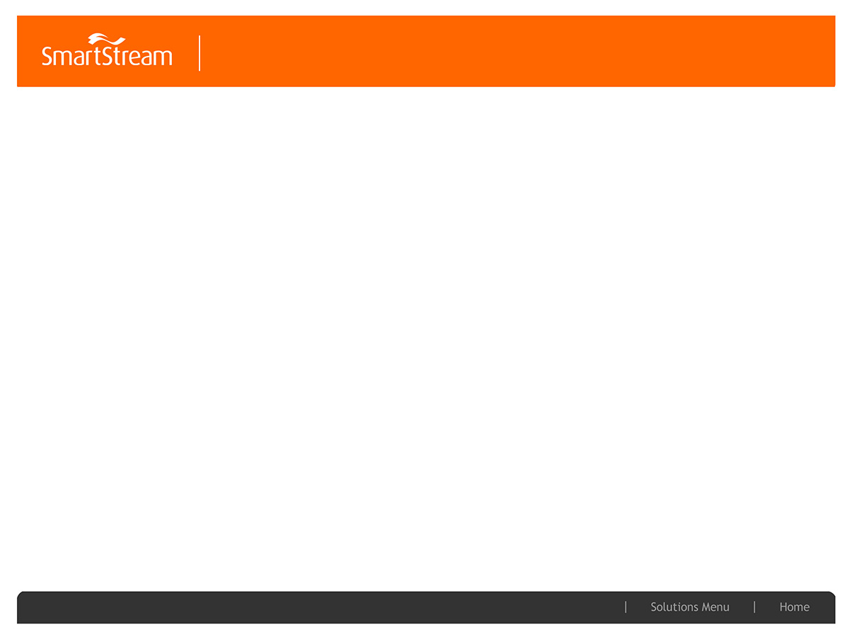
About Database
Tables
Partitions
Index
Sequence
Insert Query
Update Query
Delete Query
Select Query

Slide 3
Excalibur Table Categories
Configurations
EXAMIN_STATIC_REFERENCE
EXAMIN_BATCH
RULE_ATTRIBUTE
EXAMIN_SQL_REFERENCE
EXAMIN_BUSINESS_DATE
Audit table
Entity Audit
Invoice Audit

Slide 4
Excalibur Table Categories
Configurations
EXAMIN_STATIC_REFERENCE
EXAMIN_BATCH
RULE_ATTRIBUTE
EXAMIN_SQL_REFERENCE
EXAMIN_BUSINESS_DATE
Audit table
Entity Audit
Invoice Audit

Slide 5
Excalibur Calculation Rules
Rules tables
CALCULATION_RULE
CALCULATION_RULE_BASIS
RATE_SCHEDULE
EXAMIN_SQL_REFERENCE
RUNNING_TOTAL_TABLE
RULE_ATTRIBUTE_MAP
EXAMIN_SQL_REFERENCE

Slide 6
Excalibur Accrual Tables
ACCRUAL_LINK_REFERENCE
ACCRUAL_LINK_ATTRIBUTE
SUMMARY_KEY
SUMMARY_KEY_ATTRIBUTE
ACCRUAL_RULE
ACCRUAL_RULE_BASIS
ACCRUAL_ELIGIBILITY

Slide 7
EXCALIBUR ACCRUAL TRANSACTION TABLE
TRANSACTION_CHARGE_STAGING
TRADE_JOURNAL
TRANSACTION_JOURNAL
JOURNAL_SUMMARY
EXPENSE_LINE_SUMMARY
SUMMARY_ALLOCATION
GL_POSTING
TRADE_LINE_DETAIL
INVOICE_ACCRUAL_LINE_DETAIL

Slide 8
EXCALIBUR INVOICE TABLES
INVOICE_TRANSACTION_SOURCE
INVOICE_SUMMARY_SOURCE
INVOICE_HEADER_MAPPING
INVOICE_HEADER
INVOICE_DETAIL
INVOICE_TRANSACTIONS
INVOICE_ACCRUAL_RECONCILLIATION
INVOICE_AUDIT

Slide 9
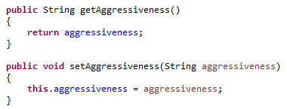
How to add new Attribute to Calc rules
To check in DecoratedExaminTransaction.java
To Insert values in RULE_ATTRIBUTE_MAP

Slide 10
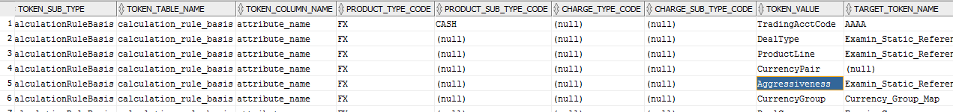
How to add new Attribute to Calc rules
select * from examin_static_reference where token_type='CalculationRule' and product_type_code='FX‘
SELECT * FROM EXAMIN_STATIC_REFERENCE WHERE TOKEN_TYPE='Aggressiveness

Slide 11
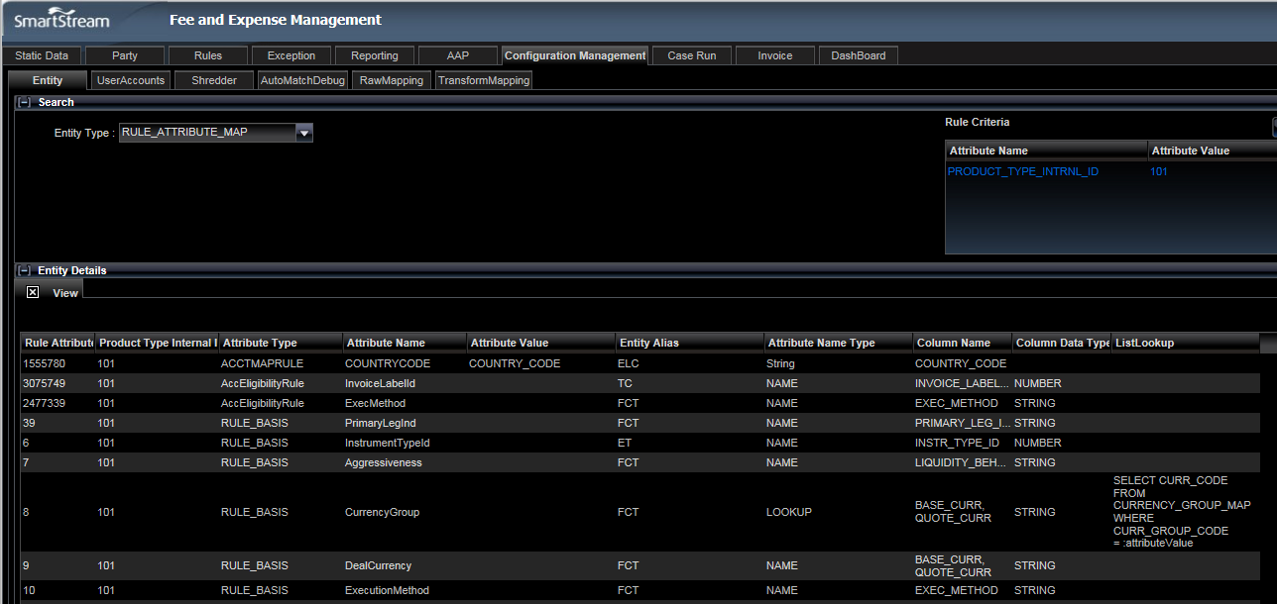
Configuration Management – RULE_ATTRIBUTE_MAP
Configuration Management Screen
New Attributes can be added
Existing rows can be edited

Slide 12
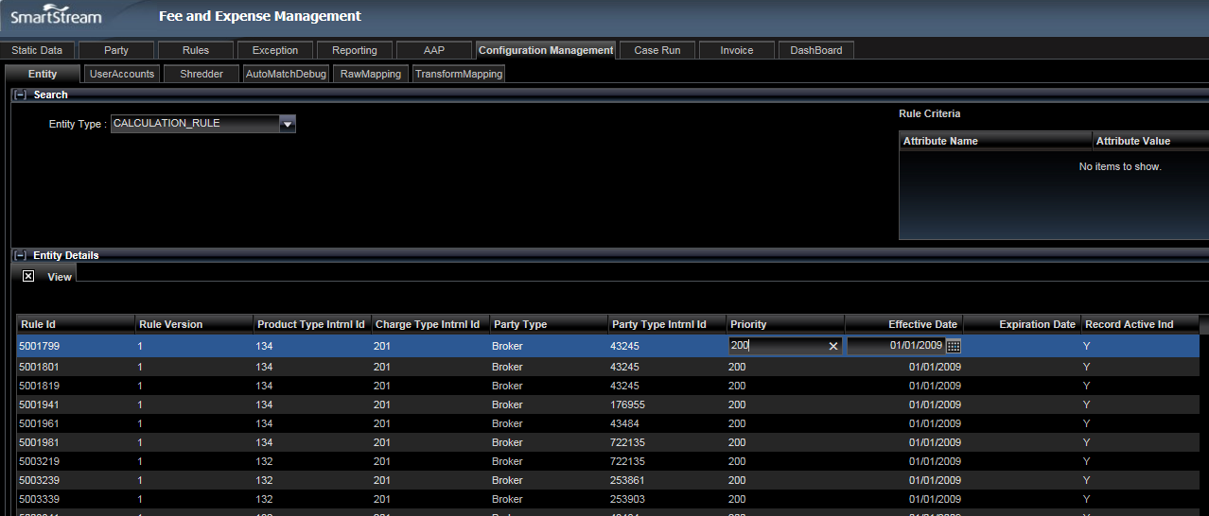
Configuration Management – CALCULATION_RULE
Existing rows can be edited like Prioritiy & Effective date as in given screen snap.

Slide 13
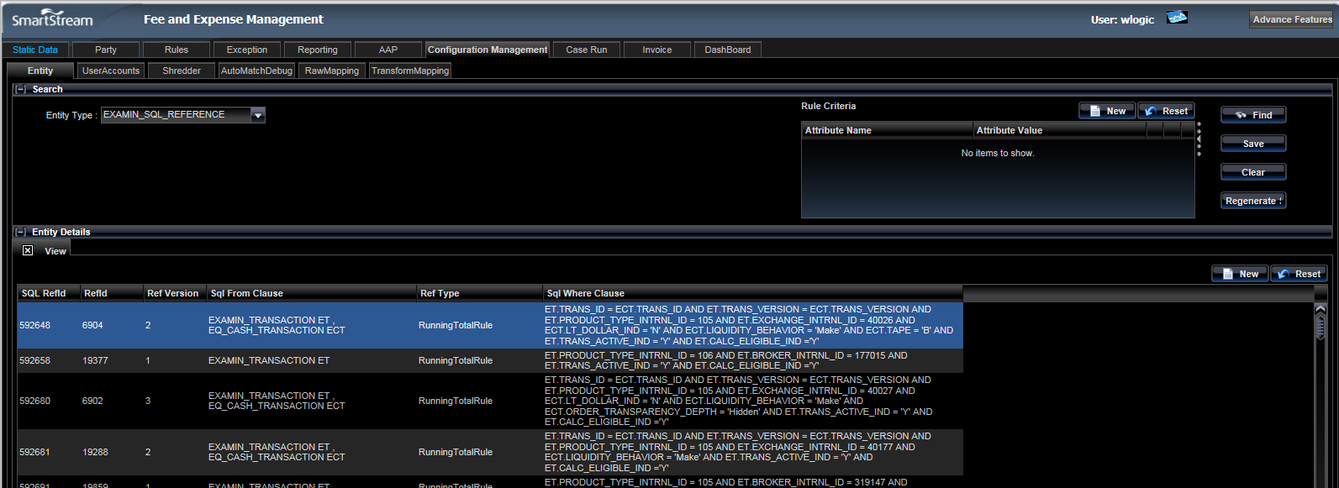
EXAMIN_SQL_REFERENCE
Examin_sql_reference holds the SQLs generated for each rules created.
In this screen the Query can be edited, but that will not have any reflection in the Rule.
Here mainly the Regenerate button is used to generate SQL again.

Slide 14
Calculation BATCH RUN
Batchs | EQ – Calculation | Non-EQ Calculation | Where clauses
CncDistributor | ✗ | ✓ | et.businessDate >= :startDate and et.businessDate <= :endDate and et.transActiveInd = 'Y' and et.processStateCd is null
EnrichmentEngine | ✗ | ✓ | et.businessDate>=:startDate and et.businessDate<=:endDate and et.processStateCd='CnCed' and et.calcEligibleInd='Y' and et.transActiveInd='Y'
RunningTotalInitilizer-Pre | ✓ | ✓ | com.cs.examin.batch.runningtotal.RunningTotalInitializer
CalcEngineDistributor | ✓ | ✓ | et.businessDate >=:startDate and et.businessDate <=:endDate and et.transActiveInd = 'Y' and et.calcEligibleInd='Y' and et.calcInd='N' and et.processStateCd in ('Enriched', 'Calced') and et.transactionReference.transExceptionInd ='N'
RunningTotalInitilizer-Post | ✓ | ✓ | com.cs.examin.batch.runningtotal.RunningTotalInitializer
UpdateTransactionStatusDistributor | ✓ | ✓ | et.businessDate>=:startDate AND et.businessDate <=:endDate AND et.calcEligibleInd='Y' AND et.calcInd='N' AND et.transActiveInd = 'Y' AND et.id.transId = tr.id.transId AND et.id.transVersion = tr.id.transVersion AND tr.transExceptionInd != 'Y'

Slide 15
Record Status
Status | PROCESS_STATE_CD | TRANS_ACTIVE_IND | CALC_ELIGIBLE_IND | CALC_IND | TRANS_EXCEPTION_IND | TRANS_CHARGE_STATUS
After Cancel N Correct & Ready for Enrichment | CnCed | Y | Y | N | N | NULL/BLANK
After Enrichment & Ready for Calculation | Enriched | Y | Y | N | N | NULL/BLANK
After Enrichment & Ready for Calculation | Enriched | Y | Y | N | N | NULL/BLANK
After Calculation | Calced | Y | Y | Y | N | Charges
Calculation-Exception | Calced | Y | Y | N | Y | NULL/BLANK

Slide 16
Execution of Batch
Description | Batch name | Command
Daily Job executed for Non-Eq products. It runs are Current Business date or business date passed as parameters | Cancel & Correct | ./startNewBatch.sh -DbatchName=CncDistributor -DbatchType=Daily -DproductTypes=FX -DstartDate=12/01/2015
Daily job executed for Non-Eq products. Current Business date or business date passed as parameter | Enrichment | ./startNewBatch.sh -DbatchName=EnrichEngineMain -DbatchType=Daily -DproductTypes=FX -DstartDate=12/01/2015
Daily job executed for both EQ and Non-EQ. Current business date is picked or business date can be passed as parameter | Calculation | ./calc.sh -s 07/29/2015 -e 08/05/2015 -d -0 FX

Slide 17
Recalc(Re-Calculation)
Calculating already calculated charges.
Calculation Rules changed
Any other auxiliary data changed like BrokerCode or res_code etc.
Tables
RATE_RECALC_REQUEST
RECALC_REQUEST
Re-calc Execution command
Description | Batch name | Command
It creates records in RECALC_REQUEST table | Recalc Setup | ./startNewBatch.sh -DbatchName=RateRecalcDistributor -DbatchType=Daily
Re-calc done for each product | Enrichment | ./startNewBatch.sh -DbatchName=ReCalcRequestEngine -DbatchType=Daily -DproductTypes=FX -DrunCleanup=yes
Update of transaction records and its status | Updatation of status. | ./startNewBatch.sh -DbatchName=RecalcUpdateTransactionStatus -DbatchType=Daily -DproductTypes=EQ,IRDRV,FX,CRDRV,EQDRV

Slide 18
System Accrual/Adjustment
System Accrual is a Monthly job which is driven by ACCRUAL_RULE and ACCRUAL_ELIGIBILITY
The records from TRANSACTION_CHARGE is read for the accrual rules and Accruals are created in TRADE_JOURNAL (For Transactions) and TRANSACTION_JOURNAL (For Summary)
Field Accrual_link_id is populated based on SUMMARY_KEY setup for product.
System Accrual | System Adjustment
Monthly | Daily
Previous month calculation data from TRANSACTION_CHARGE using TRADE_DATE is copied to TRADE_JOURNAL and TRANSACTION_JOURNAL | This picks previous and past 2 months based on ACCRUAL_RULE using CHARGE_CALC_DATE is copied to TRADE_JOURNAL and TRANSACTION_JOURNAL
For EQ –ETL based batch runs For Non-EQ – Java based batch runs | For both EQ and Non-EQ Java based batch runs
$EXAMIN_HOME/bin/RunAccrual.sh Monthly FX | $EXAMIN_HOME/bin/RunAccrual.sh Daily FX

Slide 19
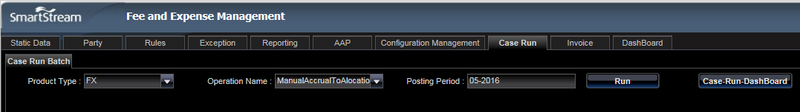
Case Run – Manual Accrual to Allocation
Manual Accrual to Allocation case run is run to process records which are sitting at JOURNAL_SUMMARY
Accruals grouped by and created in EXPENSE_LINE_SUMMARY
PAYABLE_ACCT_INTRNL_ID and EXPENSE_ACCT_INTRNL_ID will be populated in JOURNAL_SUMMARY
SUMMARY_ALLOCATION table will be populated

Slide 20
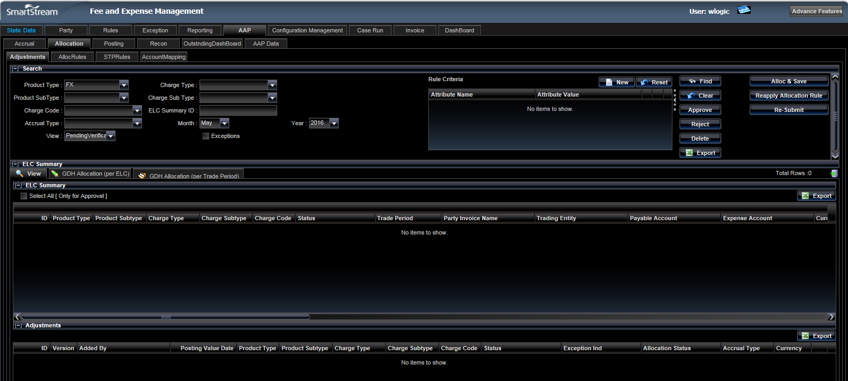
Allocation – Adjustment Screen
Screen is used for approving ELCs generated
Placing Adjustments
Rejecting the ELCs
Deleting the ELCs

Slide 21
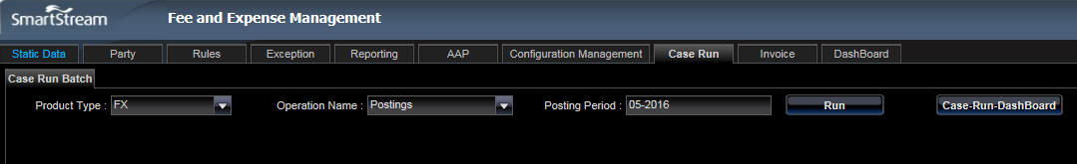
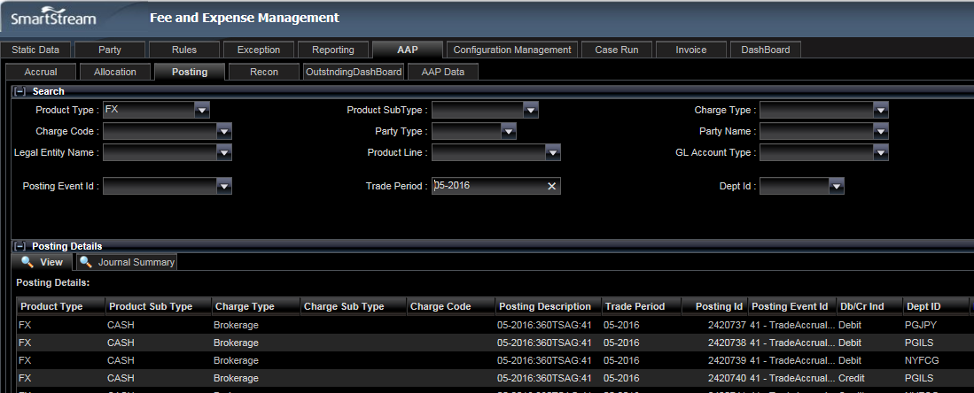
Case Run – Postings
To create Journal Posting in GL_POSTING table Case Run Postings need to be run.
Postings Screen can be used to search for Gernal Entries

Slide 22
Running IALD & TLD
There are 2 batch to Accruals to Invoice World. Prerequisite is the available of corresponding INVOICES captured and approved.
IALD Batch for Summary
From JOURNAL_SUMMARY to INVOICE_ACCRUAL_LINE_DETAIL
TLD Batch for Trades
From TRADE_JOURNAL to TRADE_LINE_DETAIL
Batch | Command
IALD (Invoice accrual line detail) | ./startNewBatch.sh -DbatchName=InvoiceAccrualDistributor -DproductTypes=BANKCHARGE -DpostingPeriod=03-2016 -DbatchType=Daily
TLD (Trade Line Detail) | ./startNewBatch.sh -DbatchName=TradeAccrualDistributor -DproductTypes=IRDRV -DpostingPeriod=03-2015 -DbatchType=Daily

Slide 23
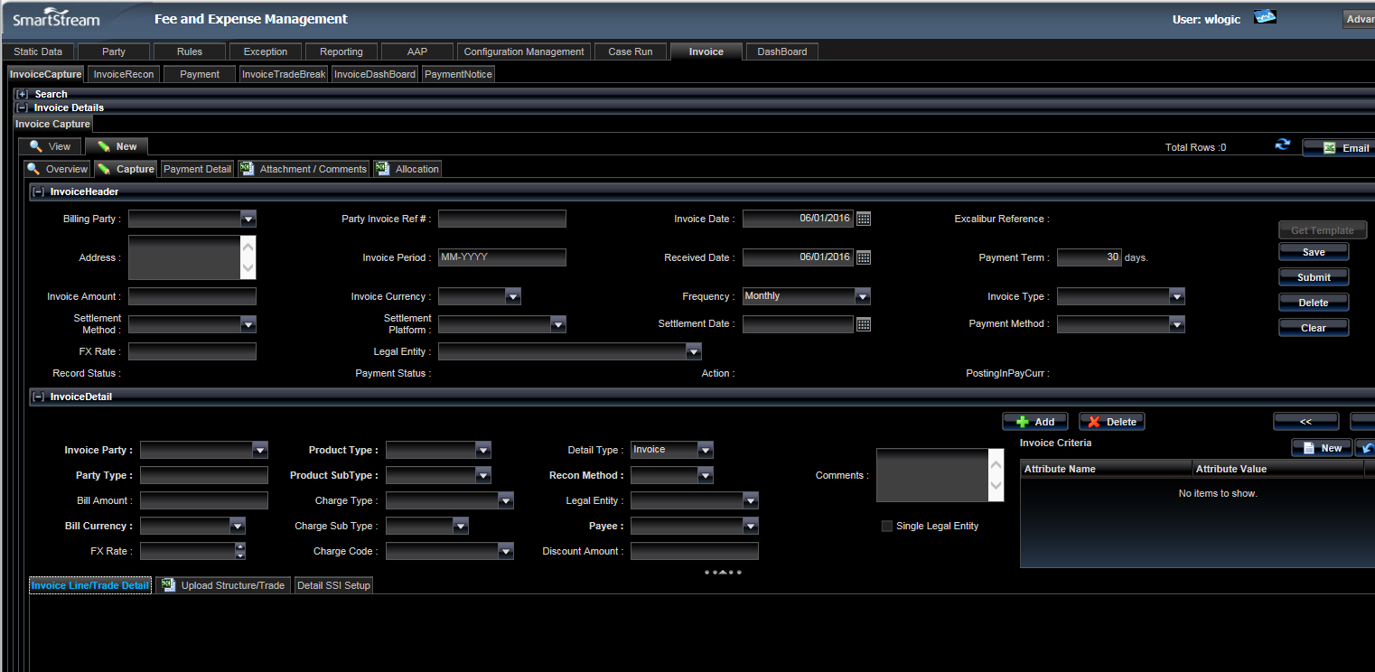
INVOICE – CAPTURE Manual
User can capture Invoice in the screen for both Trade or Summary.
All required fields to be selected and file needs to uploaded in the attachment tab.

Slide 24
INVOICE – CAPTURE Auto using Excalibur File format
Place the CSV file in a specific path (file must have execute permission)
/powercenter/Informatica/9.5.1/server/infa_shared/SrcFiles/SG/Invoices/FX
Update file name in a parameter file - SG_Load_Invoice.prm
Path - /powercenter/Informatica/9.5.1/server/infa_shared/Parameters
Run the below command to execute the workflow from a command line
pmcmd startworkflow -sv Fems_Integration_Dev -d Domain_femsserver.sst.stp -u jim -p jim -f EXCALIBUR_SG wf_m_SG_FX_Invoice
Multiple parameters should be provided in the command – like,
-sv Integration service name
-d Domain name
-u User name
-p Password
-f Folder name
-w Workflow name
Java batch needs to executed as below command and INVOICE tables will be populated.
./autoInvoiceCreation.sh

