Slide 1
MUTUAL FUND ANALYTICS DASHBOARD
Capstone Project Report
Prepared By: Soumya
B.Tech (Hons.) Electrical Engineering
NIT Jamshedpur
Bluestock Fintech Internship Program
May 2026 – July 2026

Slide 2
PROJECT OVERVIEW
Objective
Analyze mutual fund datasets and derive insights related to:
Investor Behavior
Investment trends
Fund Performance
Transaction Trends
State-wise Investment Patterns
Tools Used
Python
Pandas
SQLite
SQL
Power BI
Git & GitHub

Slide 3
DATASETS USED
The project utilizes the following datasets:
Fund Master
NAV History
AUM by Fund
Monthly SIP
Category Inflow
Industry Folio
Scheme Performance
Investor Transactions
Portfolio Holdings
Benchmark Returns

Slide 4
PROJECT WORKFLOW
Data Ingestion
↓
Data Cleaning
↓
SQLite Database Creation
↓
Exploratory Data Analysis
↓
Performance Analytics
↓
Advanced Analytics
↓
Power BI Dashboard Development

Slide 5
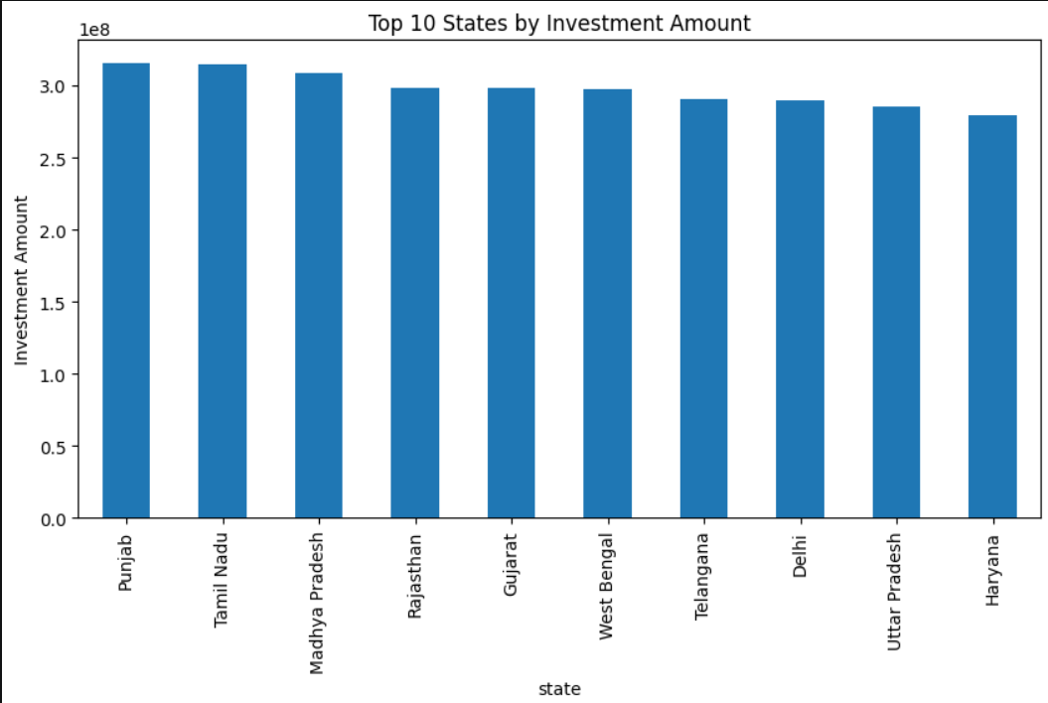
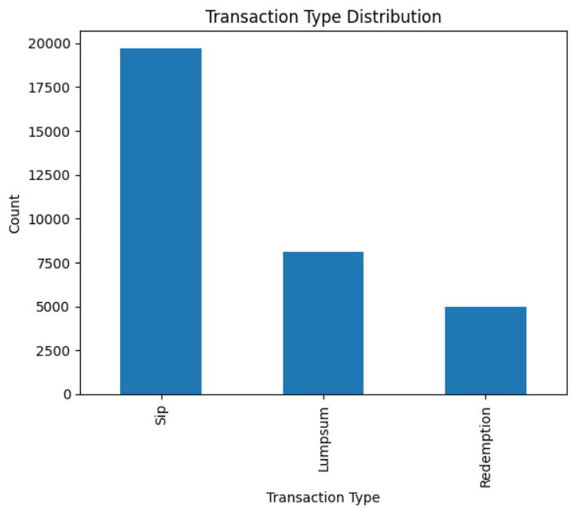
EXPLORATORY DATA ANALYSIS
Analysis Performed
State-wise investment
Gender-wise distribution
Transaction type analysis
Fund performance
Investor behaviour
.

Slide 6
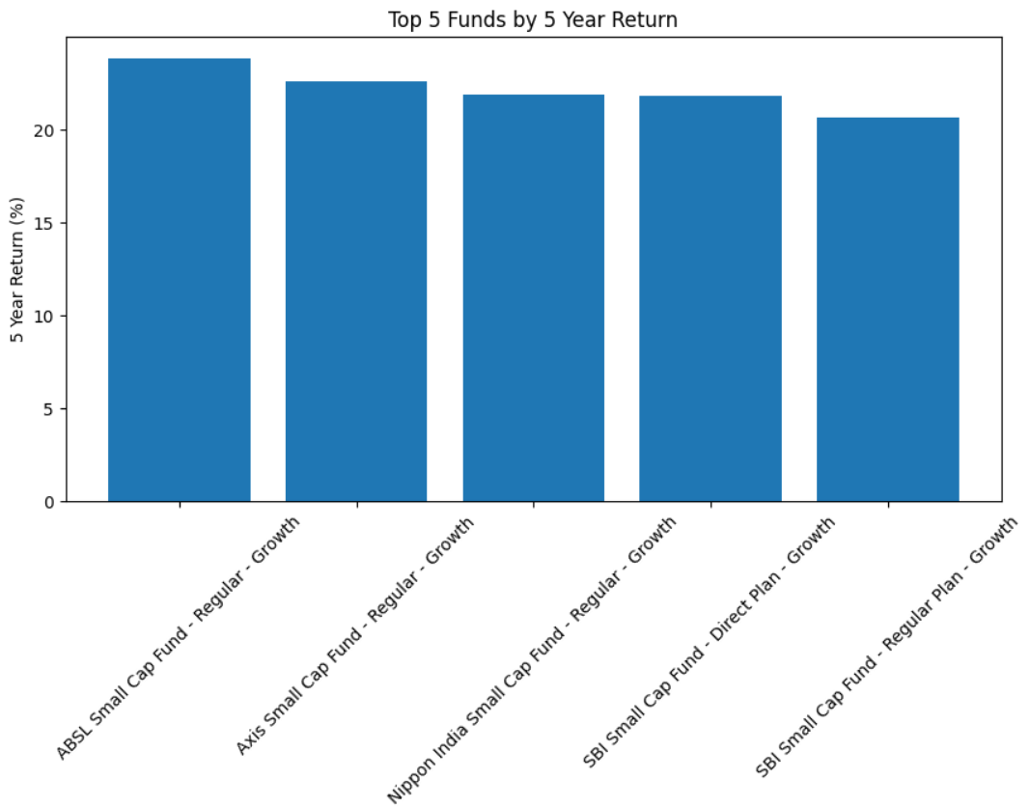
PERFORMANCE ANALYTICS
Metrics Evaluated
1-Year Return
3-Year Return
5-Year Return
Sharpe Ratio
Sortino Ratio
Alpha
Beta
Maximum Drawdown
Purpose
Evaluate risk-adjusted mutual fund performance and identify top-performing schemes.

Slide 7
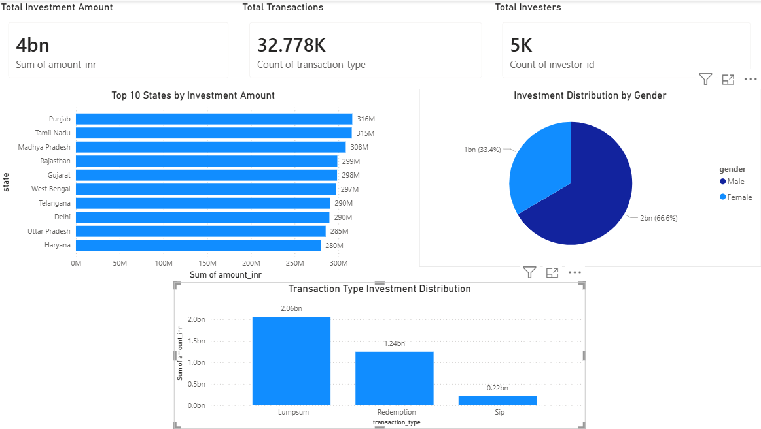
POWER BI DASHBOARD
Dashboard KPIs
Total Investment Amount
Total Transactions
Total Investors
Top 10 States by Investment
Transaction Type Distribution
Gender-wise Investment Distribution
Dashboard Benefits
Quick investment insights
Investor trend identification
Interactive visualization

Slide 8
KEY INSIGHTS & CONCLUSION
Key Insights
Punjab and Tamil Nadu recorded the highest investments.
Lump Sum transactions contributed the largest share of investment volume.
Male investors contributed a larger share of total investments.
Several schemes demonstrated strong long-term returns.
Conclusion
The project successfully implemented an end-to-end mutual fund analytics workflow using Python, SQL, SQLite, and Power BI. The dashboard provides meaningful insights into mutual fund investments and investor behavior.
Future Scope
Real-time NAV tracking
Fund recommendation system
Predictive analytics using Machine Learning

