Slide 1
CHEMICALS IN MAKEUP
A Project Report
Venisha Vora - 92300527042
Rabab Travadi - 92300527070
Soumya Bhatt - 92320527006
Internal Guide:
Prof. Vinod Kumar Pal
Bachelor of Computer Application (BCA)
Marwadi University (2025-26)

Slide 2
Synopsis
Cosmetic products like lipsticks, nail paints, foundations, and eyeshadows are widely used.
Some ingredients may pose health risks such as skin irritation, hormone disruption, or illness.
Data analysis helps in identifying harmful trends and better product development.

Slide 3
Project Description
Modules:
- Data Collection
- Data Preparation
- Data Analysis
- Visualization
- Interpretation

Slide 4
Data Collection
Source: Public Cosmetic Safety Repository
File: chemicals_in_makeup.csv
Contents: Product names, ingredients, categories, safety ID, counts

Slide 5
Data Preparation
- Cleaning and structuring data
- Used subset() and order() in R
Purpose: Ready dataset for analysis

Slide 6
Data Analysis
- Frequency distribution
- Identify missing values
- Filtered by categories
Purpose: Reveal data insights

Slide 7
Visualization
- Used R plotting tools
- Types: Pie, bar, histogram, line
Purpose: Easier understanding of data

Slide 8
Interpretation
- Most common products/chemicals
- Category-wise usage
- Correction: max() issue with alphabetical output

Slide 9
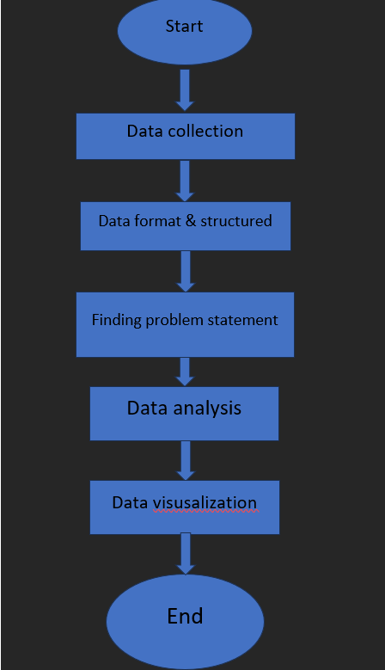
Flowchart

Slide 10
Case Diagram
- Upload Dataset
- Clean Data
- Analyze Patterns
- Visualize Data
- Identify Ingredients

Slide 11
Dataset Overview
- Product name
- Chemical name
- Category
- Initial Date Reported
- Chemical Count
Source: Public dataset

Slide 12
Data Collection Methodology
- From safety and cosmetic authorities
Format: CSV
Structure: Tabular (rows and columns)

Slide 13
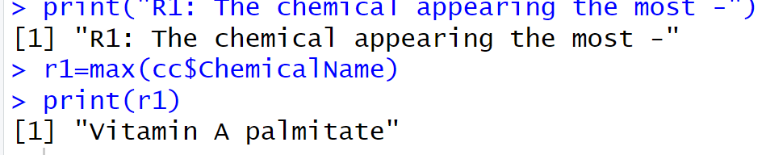
CODE OUTPUT PREVIEW
1. Most Common Chemical appearing in the makeup
Code:
print(&quot;R1: The chemical appearing the most -&quot;)
r1 = max(cc$ChemicalName)

Slide 14
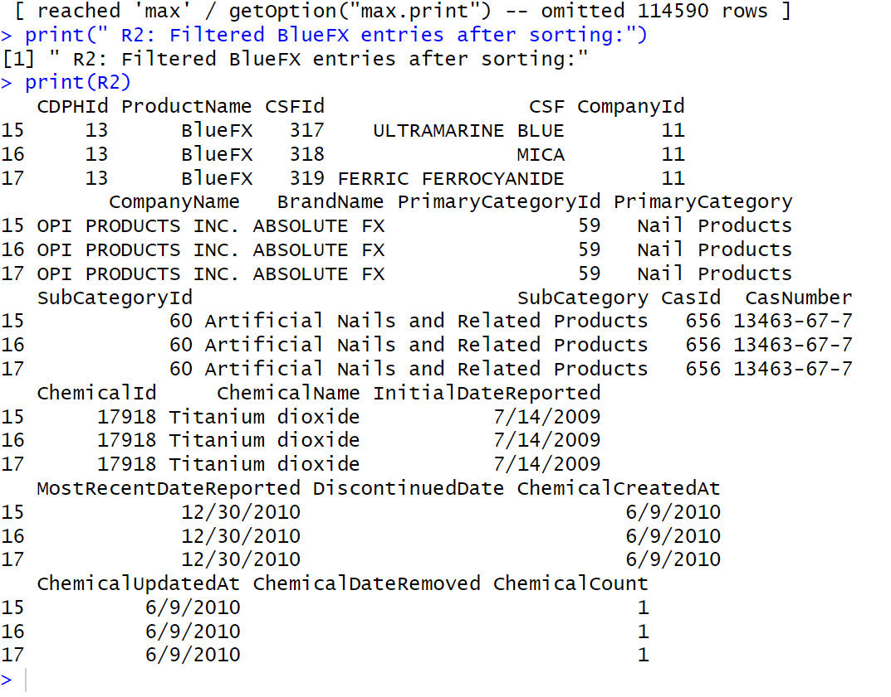

Slide 15
CODE OUTPUT PREVIEW
3. As the Nail art is currently in demand, we have analyzed rows where primary category is nail products.
CODE:
print("R3: Primary categories makeup (temporary)")
r3=subset(cc,PrimaryCategory == "Nail Products")
print(r3)
Output:

Slide 16
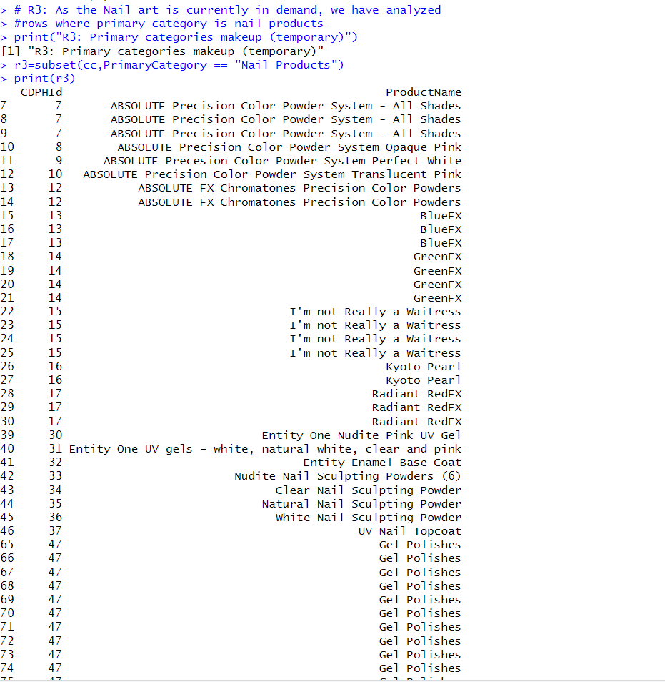

Slide 17
CODE OUTPUT PREVIEW
4. What are the top 5 frequently reported ?
Code:
print("R5: Top 5 Most Frequently Reported Products")
r5 <- sort(table(cc$ProductName), decreasing = TRUE)
print(head(r5, 5))

Slide 18
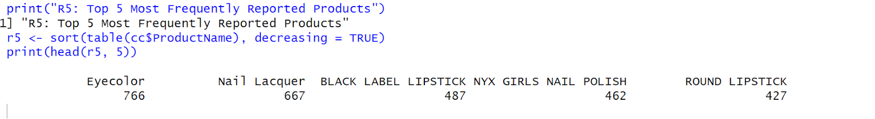

Slide 19
CODE OUTPUT PREVIEW
5. Finding products with missing values in CSFID
Code:
print("R5: Products with missing values-")
r5=subset(cc, is.na(CSFId))
print(r5)

Slide 20
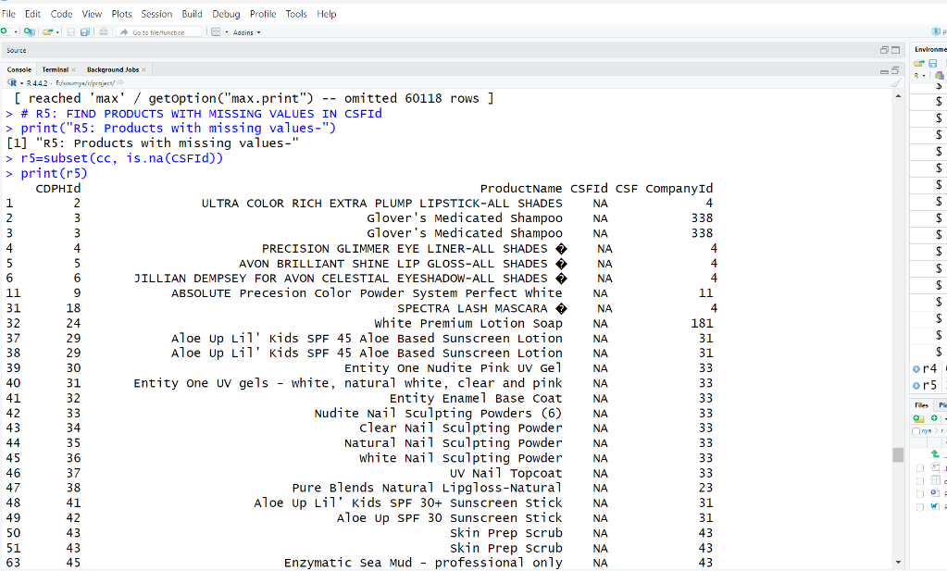

Slide 21
CODE OUTPUT PREVIEW
6. Which is the Minimum products in primary category used by customers?
Code:
print("R6: Least product in Primary category-")
r6 = min(cc$PrimaryCategory)
print(r6)

Slide 22
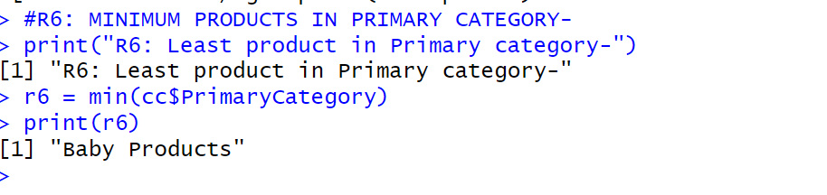

Slide 23
CODE OUTPUT PREVIEW
7. PIE CHART representing top 5 products in primary category
Code:
r7<- table(cc$PrimaryCategory)[1:5]
print(r7)
pie3D(r7,
labels = paste(round(100 * r7 / sum(r7),1),'%'),
col = rainbow(length(r7)),
main = "Pie chart representing top 5 products in primary category-")
legend("topright",fill = rainbow(length(r7)),
legend = names(r7),cex = 0.5,)

Slide 24
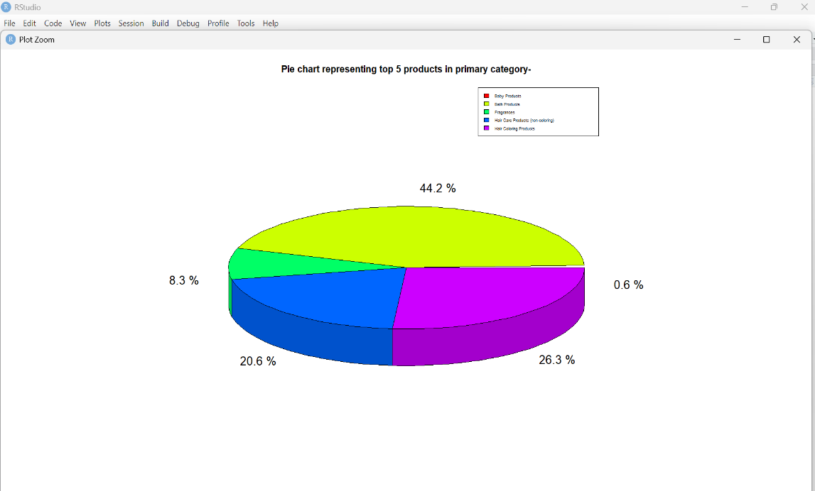

Slide 25
CODE OUTPUT PREVIEW
8. BAR GRAPH showing total count of top 7 chemicals.
Code:
cc <- read.csv("chemicals_in_makeup.csv")
r8 <- table(cc$ChemicalName)[1:7]
print(r8)
barplot(r8,col = rainbow(length(r8)),
las = 2,
main = "Bar graph showing total count of top 7 chemicals-")\

Slide 26
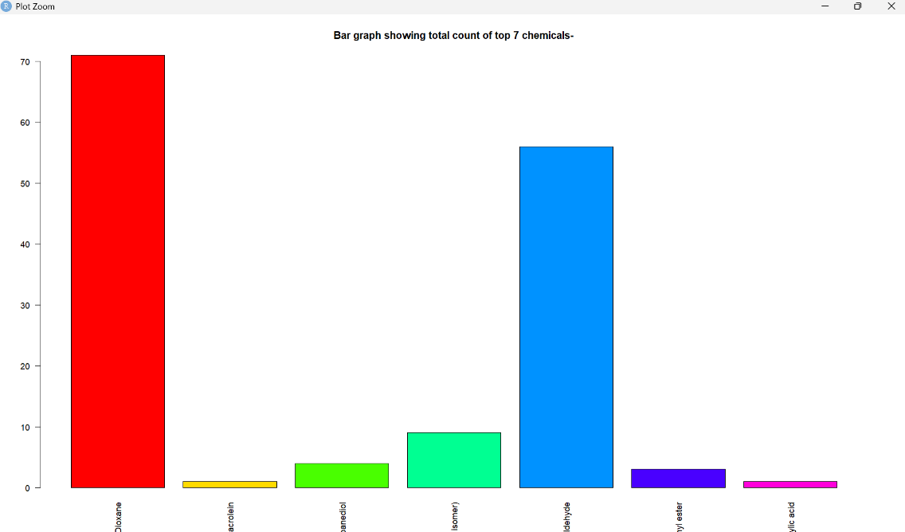

Slide 27
CODE OUTPUT PREVIEW
9. HISTOGRAM Chemical Count of Products in subcategory
(lip gloss and ) chemical MICA
Code:
cc <- read.csv("chemicals_in_makeup.csv")
r9 <- subset(cc, SubCategory == "Lip Gloss/Shine" & ChemicalName == "Mica")
print(r9)
r9$ChemicalCount <- as.numeric(r9$ChemicalCount)
hist(r9$ChemicalCount,
main = "Chemical Count of Products in subcategory (lip gloss) and chemical MICA",
xlab = "Chemical Count",
col = "lightblue",
breaks = 10)

Slide 28
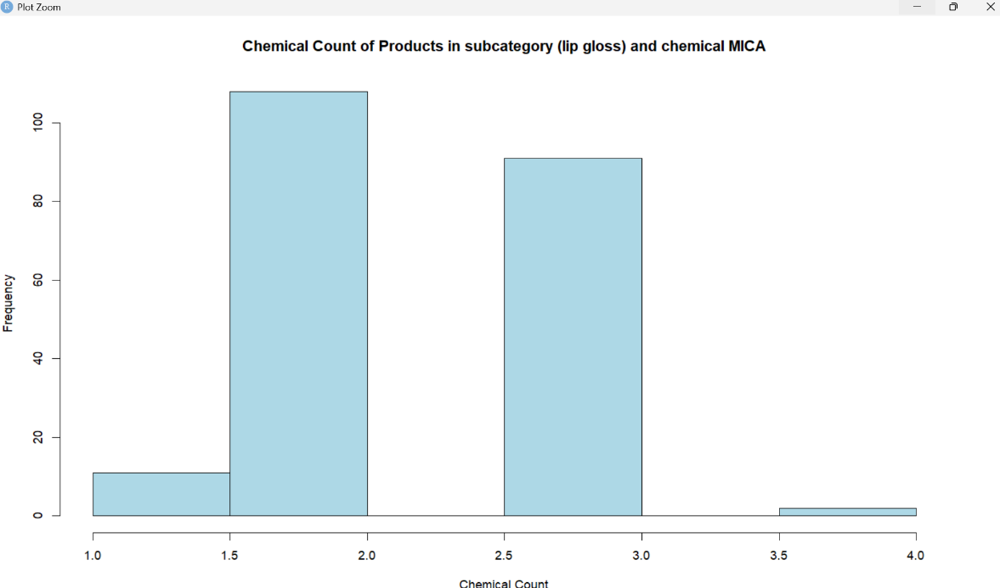

Slide 29
CODE OUTPUT PREVIEW
10. LINE GRAPH- Group the data by ProductType and count the products
Code:
x <- tapply(cc$CDPHId,cc$ChemicalCount, mean)
print(x)
plot(x,type = 'l',col = 'red',xlim = c(0,10),
xlab = "Chemical Count",ylab = "Chemical CDPHID",
main= "Chemical count by CDPHId")
grid()

Slide 30
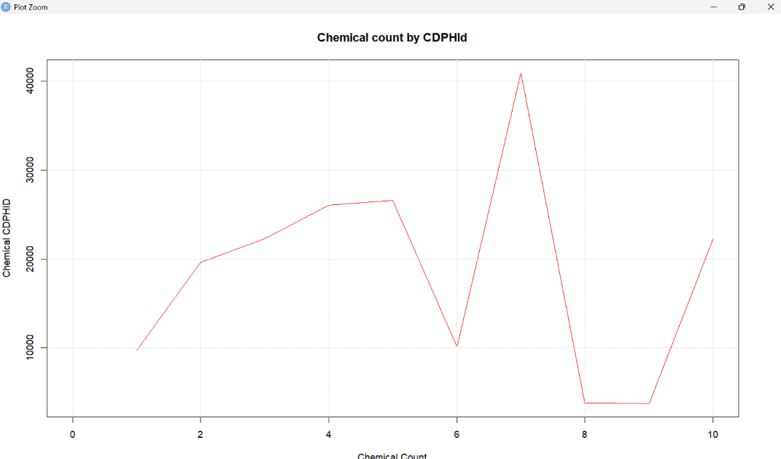

Slide 31
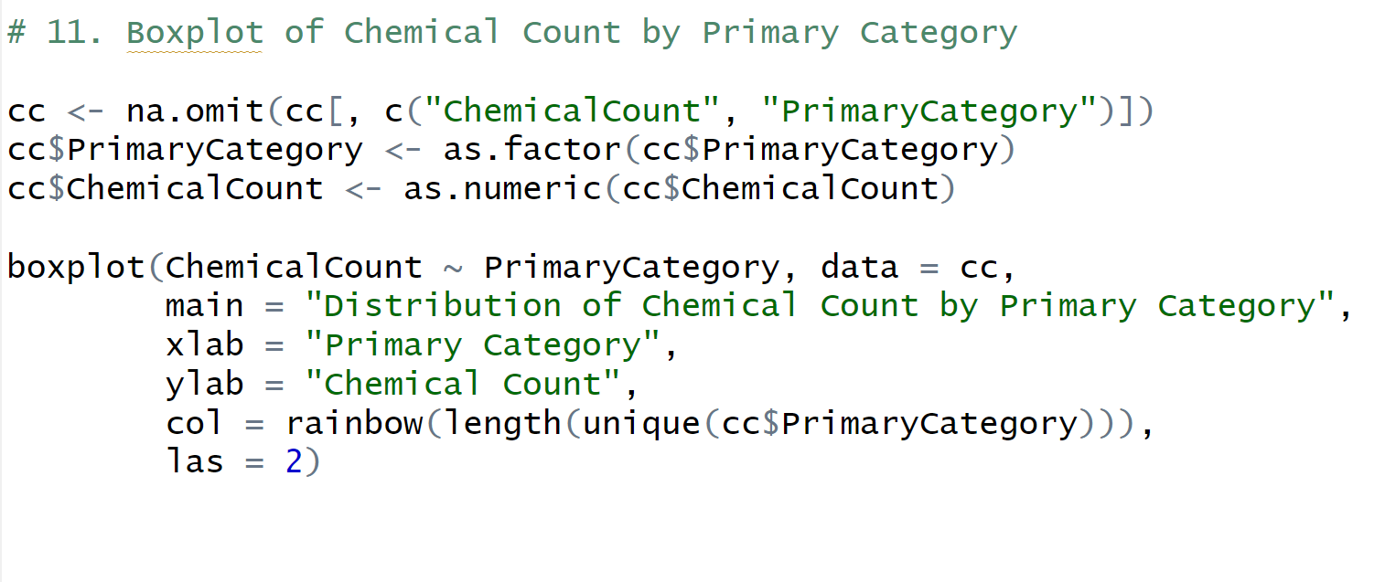
CODE OUTPUT PREVIEW

Slide 32
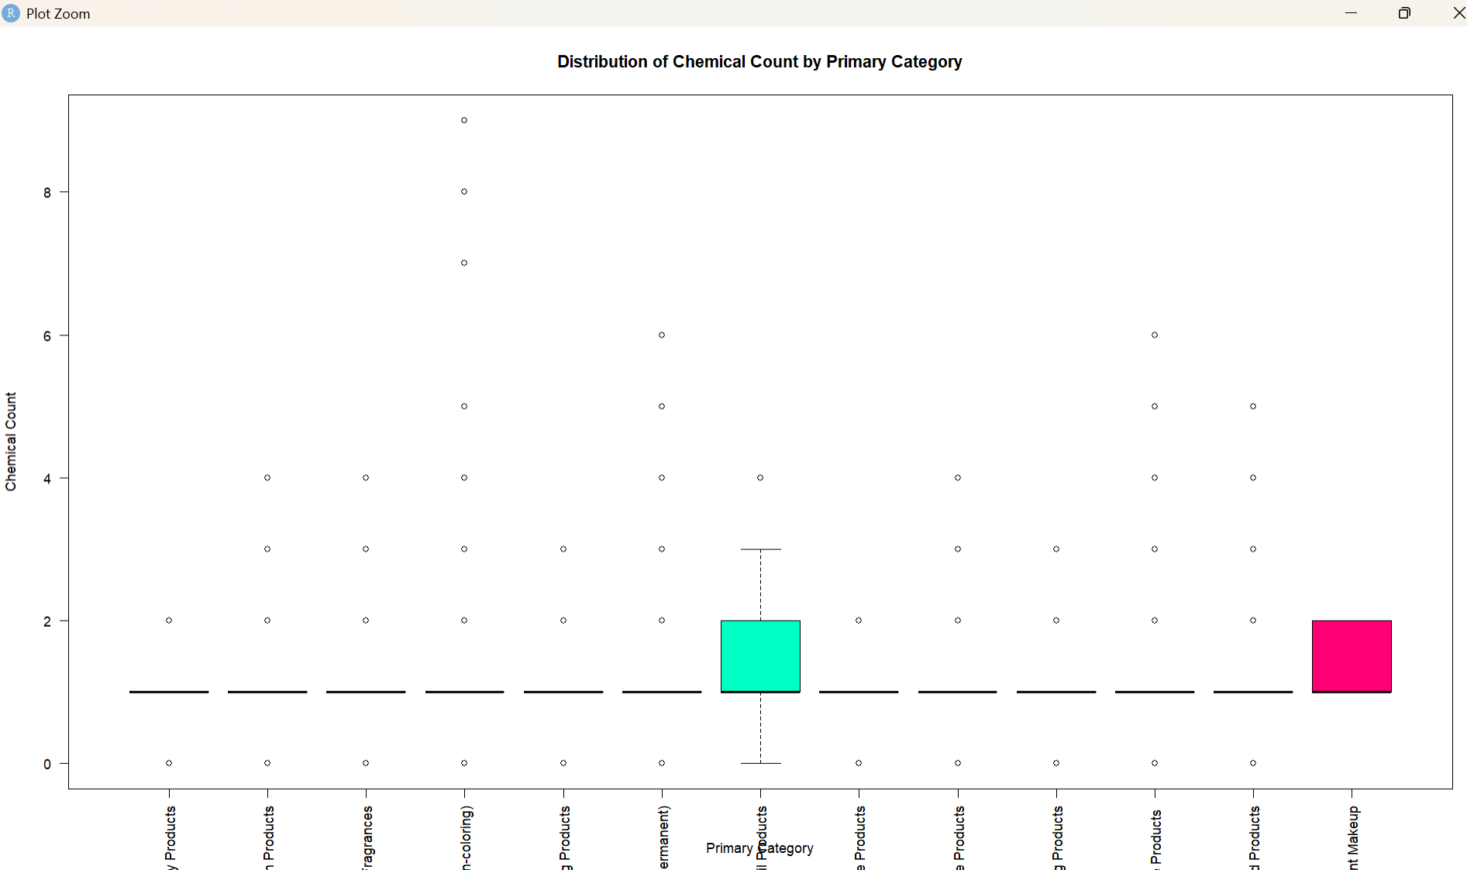

Slide 33
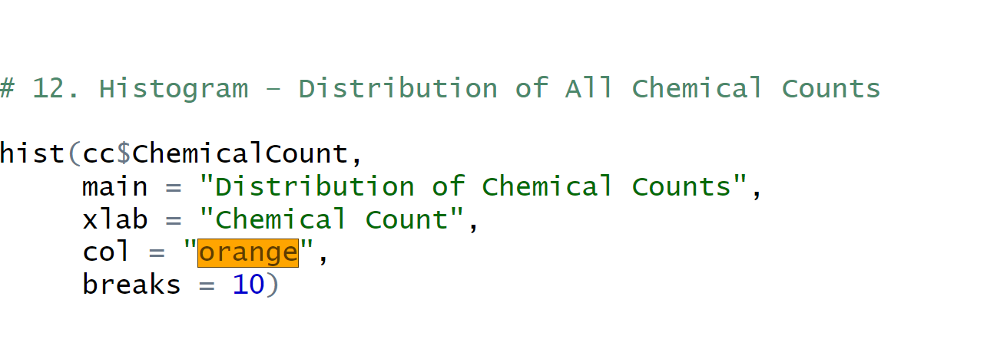
CODE OUTPUT PREVIEW

Slide 34
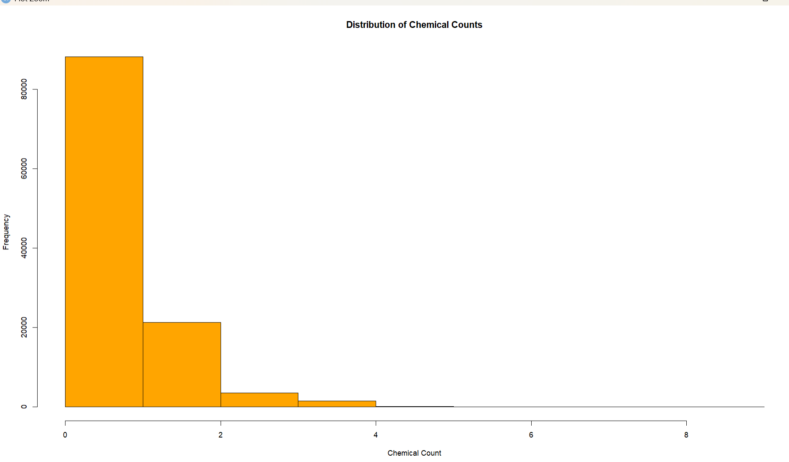
CODE OUTPUT PREVIEW

Slide 35
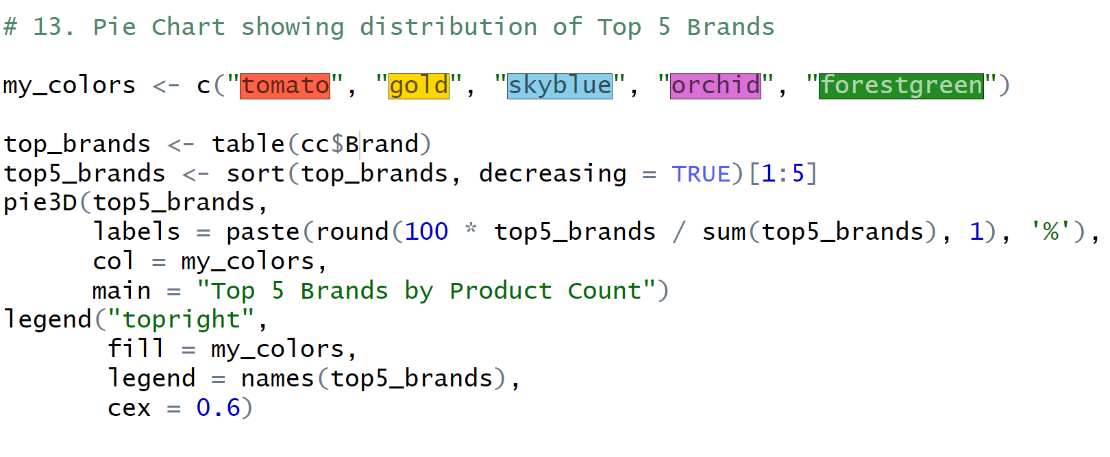
CODE OUTPUT PREVIEW

Slide 36
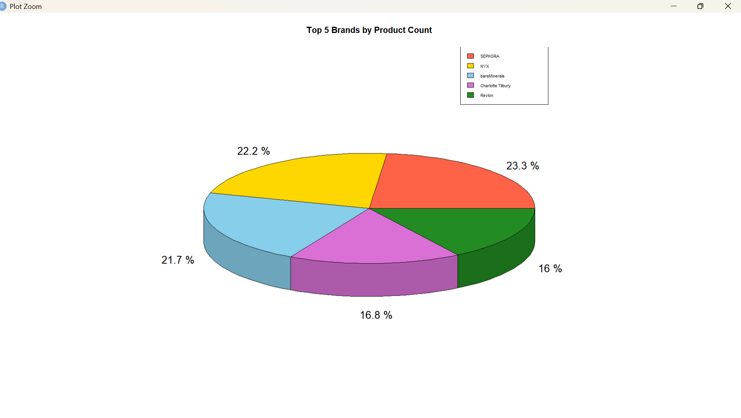
CODE OUTPUT PREVIEW

Slide 37
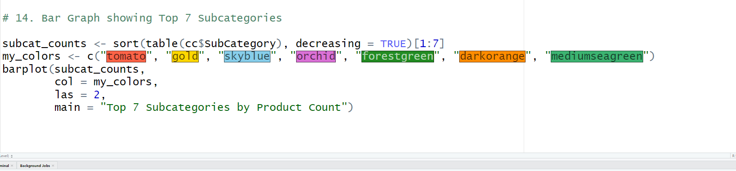
CODE OUTPUT PREVIEW

Slide 38
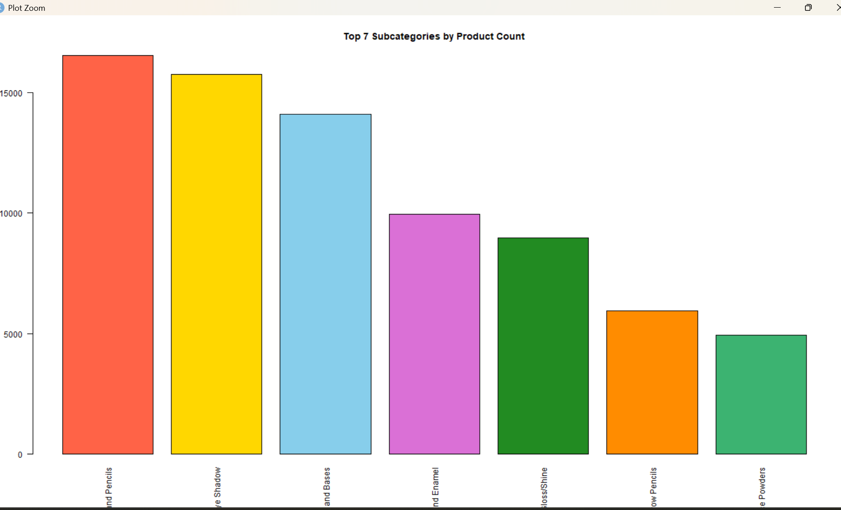
CODE OUTPUT PREVIEW

Slide 39
CONCLUSION
Through this project, we gained significant insights into the chemicals present in cosmetics. Our analysis helped identify common harmful ingredients and revealed trends across product categories. The project showcases how data science can enhance consumer awareness and safety in everyday products.

Slide 40
LEARNING DURING Sip
• Improved skills in R programming
• Learned data cleaning, filtering, and visualization techniques
• Understood public health implications of cosmetic ingredients
• Developed critical thinking while interpreting analytical results

Slide 41
Bibliography
- Online references for case diagram and project resources
-Online help for graphs

Slide 42
THANK YOU
Venisha Vora - 92300527042
Rabab Travadi - 92300527070
Soumya Bhatt – 92320527006
Internal Guide:
Prof. Vinod Kumar Pal
Bachelor of Computer Application (BCA)
Marwadi University (2025-26)

