Slide 1
Silicon (SI) Prediction & Optimization in Hot Metal

Slide 2
Dataset Analysis
Number of predictors – 25
Response variable – Silicon content(SI)
Initially dataset has null values in all variables except “Timestamp”.
Y variable(SI) has 4% null data and they were dropped for analysis. This was done to exclude any bias in the predictions.
Dropping null values in X variable leads to 50% reduction in data. Hence, imputation of null values of Predictors was chosen.
Linear interpolation was applied to all null values for X variables. Since the data is a multivariate timeseries data, so interpolation was chosen.
Since some columns like “ToGaPr”, “HoBlTe” etc have repetitive values, imputation by mode could also have been tried.
Distribution analysis for the X and Y variables is also done which indicate normal, skewed and bimodal distribution.
A correlation analysis between X and Y variables indicate mostly noisy relationship.
Collinearity among X variables was also checked, which indicates some variables have multicollinearity(“CoBF” vs “CoBlFl”).
Refer notebook – “Data_analysis.ipynb”

Slide 3
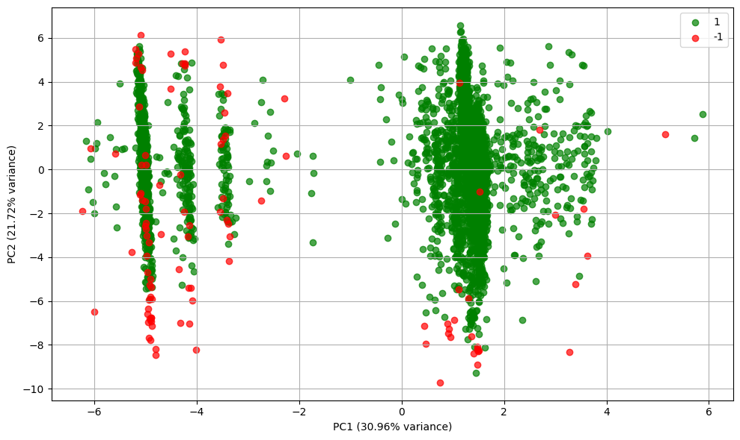
Anomaly Detection
Since there are no specific training data given with labels indicating anomaly, the same is treated as unsupervised anomaly detection.
Isolation Forest, with assumption of 2% anomalous data, was used for anomaly detection. The assumption is solely based on not excluding too much data as anomaly and maintain the original variance. The anomaly removed data was further used for model training and prediction.
Though autoencoder could also have been employed but the same is generally used for high dimensional data(like images) and also need computing power. DBSCAN could also be used, but it will need further assumptions on Core Distance and Minpts.
A PCA plot (using the first two principal components) for anomaly prediction is shown below:
This shows not all variations in data is excluded as anomaly.
Also indicating it will be very challenging for highly non-linear models to capture all the variations post training.
Refer notebook – “Anomaly_detection.ipynb”

Slide 4
Model Selection
XGBoost algo was used for modelling the data. “Timestamp” variable was not considered for training.
Random Forest was not used since the data is highly non-linear and a more complex model is needed. LightGBM was not used since the dataset is not that big and also lesser features are present. Neural networks was not used since it may need multiple iterations of choosing hidden layers, number of neurons etc.
Hyper-parameter selection of XGBoost Regressor model was done using KFold cross validation on the data using GridSearchCV.
Provided values for “sub-sample” and “gamma” were kept a bit higher to include regularization in the XGBoost model.
Selected hyper-parameters are mentioned below:
'gamma': 0.3
'learning_rate': 0.1
'max_depth’: 5
'n_estimators': 150
'subsample': 0.8}
Refer notebook – “Model_selection.ipynb”

Slide 5
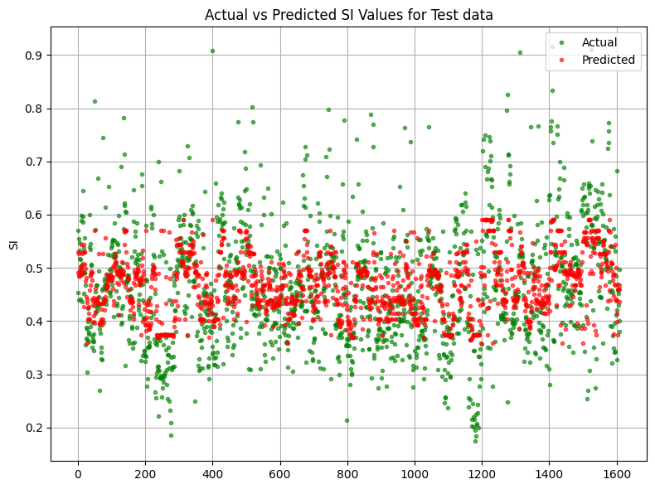
Model Training
Dataset was segregated in the below proportions:
Training – 56%
Calibration data – 14%
Test data – 30%
Calibration data was used since we will use Mapie Regressor for confidence interval calculation, since XGBoost doesn’t give confidence intervals.
Test statistics for the trained model are mentioned below:
R² Score: 0.3969
RMSE: 0.0862
RMSE(%)(based on mean of Y_pred) : 18.59%
MAPE: 14.84%
Though R2 Score is not that great, but given the highly non-linear and noisy nature of the data , it seems a single model mayn’t improve it further. An ensemble approach could have been tried considering stacked models like LSTM+XGBoost or Random Forest+XGBoost, but the same is not done in the current approach.
As indicated by the “Actual vs Predicted plot” above, not all variations have been captured by the model.
Refer notebook – “Model_fitting.ipynb”

Slide 6
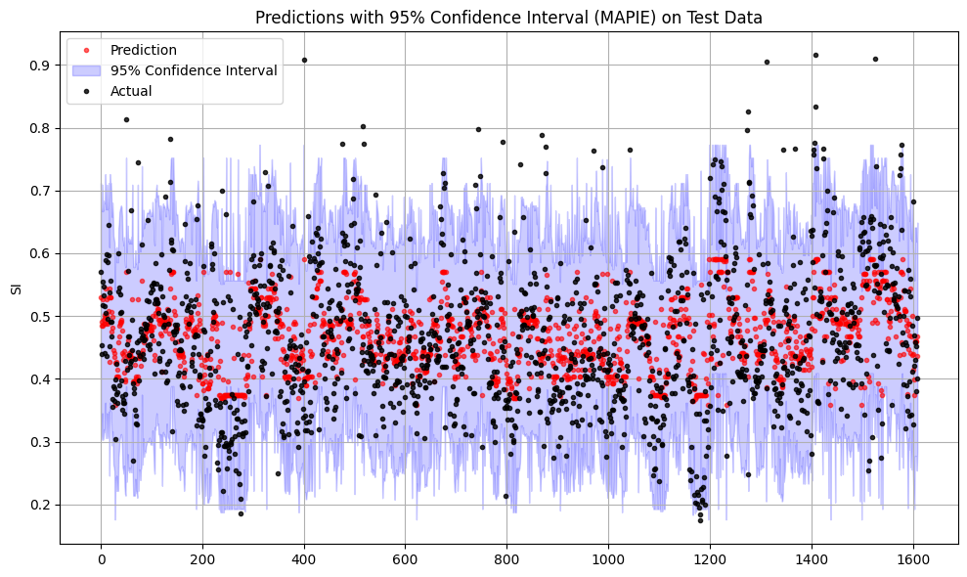
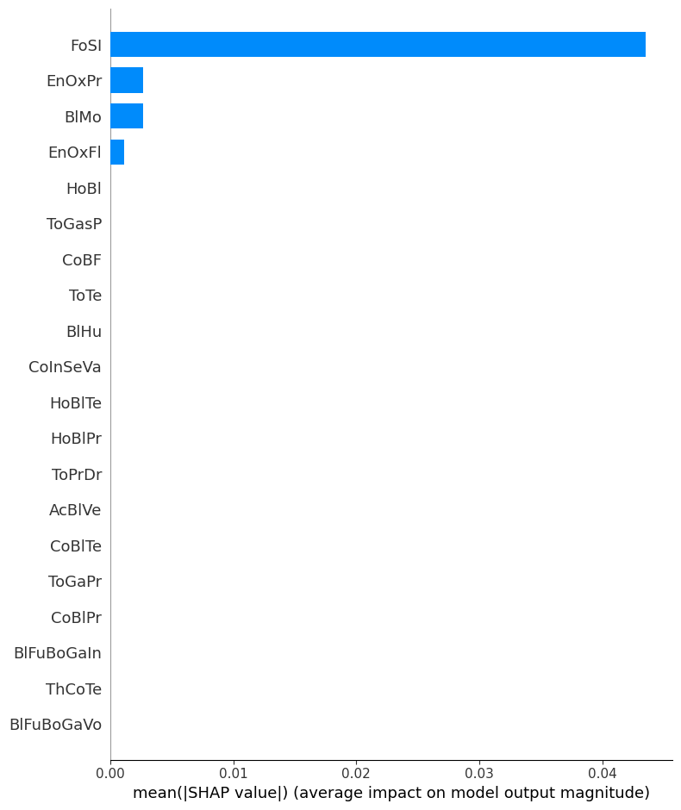
Confidence Interval & SHAP values
Mapie Regressor was used for confidence interval calculations based on 95% error quantile on calibration dataset using the trained XGBoost model.
The confidence interval plot shows it covers most of the actual test data within the confidence intervals.
SHAP analysis for feature importance was conducted on test data.
4 features were identified as having major influence in predicting SI values as shown in the SHAP plot.
A time-dependent variation of SHAP analysis could also have been done, but the same is not included in the current version.
Refer notebook – “Model_fitting.ipynb”

Slide 7
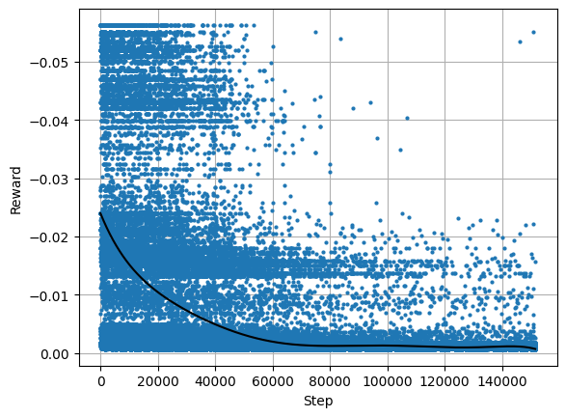
SI Optimization using Reinforcement Learning
PPO algo was used to optimize SI based on control variables. Genetic algo was not used since the idea is not to find a global solution but more of a stochastic approach which will predict change required to optimize SI based on the current state.
A custom environment was created for SI optimization based on the below considerations:
Upper and lower limits of the state variables(observation space) were chosen based on the provided data considering 95% and 5% quantile(to weed out some outliers).
Upper and lower limits of the actions(delta change required to optimize SI for each control variable) were chosen based on the delta as per data provided for each timestep considering 95% and 5% quantile(to weed out some outliers). All control variables were included in action space, though only SHAP variables could have been considered.
The rewards model was chosen based on negative square difference bw predicted SI from the train XGBoost model and an Optimal SI since the final task is to minimize SI. The Optimal SI was chosen based on 10% quantile of the observed SI as per data.
Two hidden layers with 128 neurons each were chosen for actor and critic.
As indicated by the rewards calculated during training step, the PPO model is learning to optimize the SI by dynamically changing the control variables.
Refer notebook – “Optimization_RL.ipynb”

Slide 8
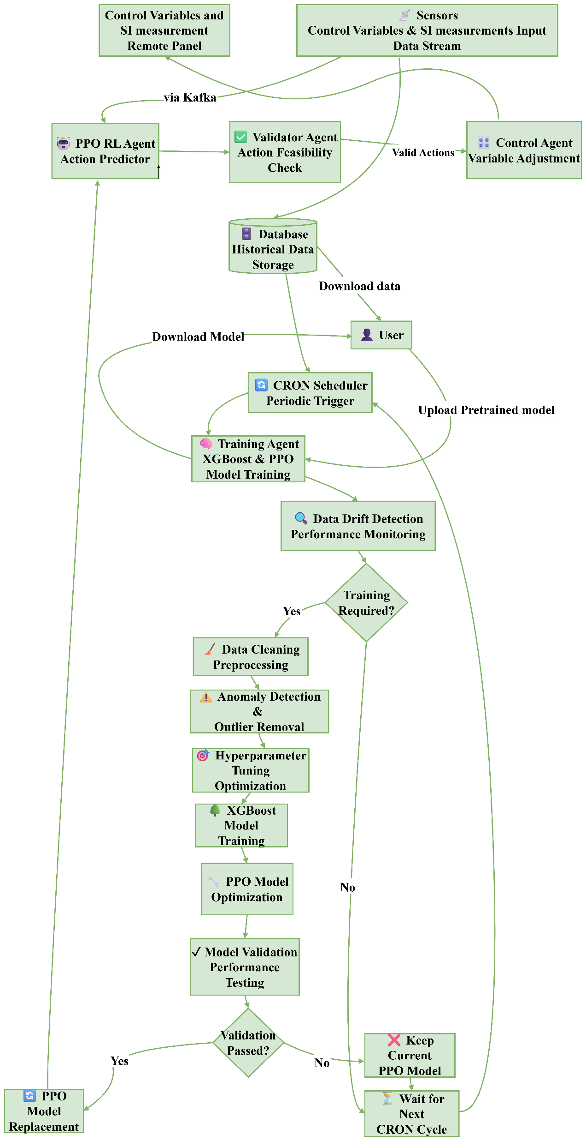
Deployment Workflow

