Slide 1


LOAN DATA ANALYSIS
DESTRO
Ayush Chandra
Prathmesh Kulkarni
Tanvi Singh
Aman Kumar
Soumyadeep Haldar

Slide 2
Problem Statement:
Understanding different loan components and its influence through data analysis.
We have to explore various factors that can influence loan disbursal and repayment using a comprehensive dataset.

Slide 3
Introduction:
This presentation covers the integration of data viewing and Loan ID search functionality in a web application.
We will explore the project's goals, technologies used, and the implementation process.
Key functionalities include accessing data from both a database and S3, and filtering data by Loan ID.

Slide 4
Steps Involved :
Data Cleaning and Analysis – This involves handling the inconsistent values , making the dataset reliable and performing analysis.
Database Management – In this we designed a schema so that we can answer business specific questions by generating reports based on queries.
Flask Application Development- Creating an interface where we can search for and display the required details.
Power BI Dashboard – Developing a Power BI dashboard for better visualization
AWS Migration – Moving the project to AWS, choosing appropriate services for hosting and managing the application.

Slide 5
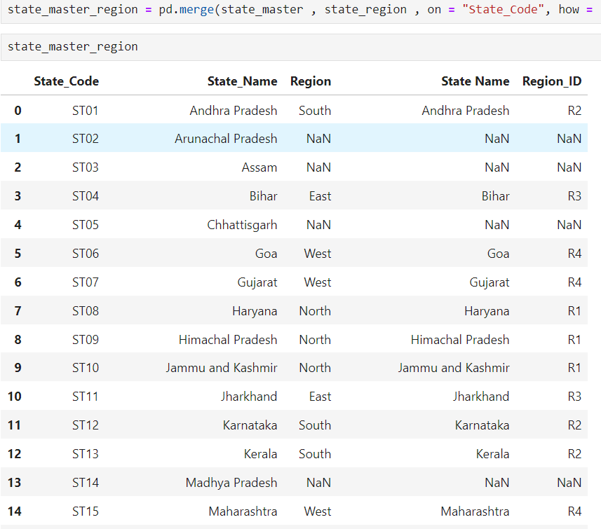
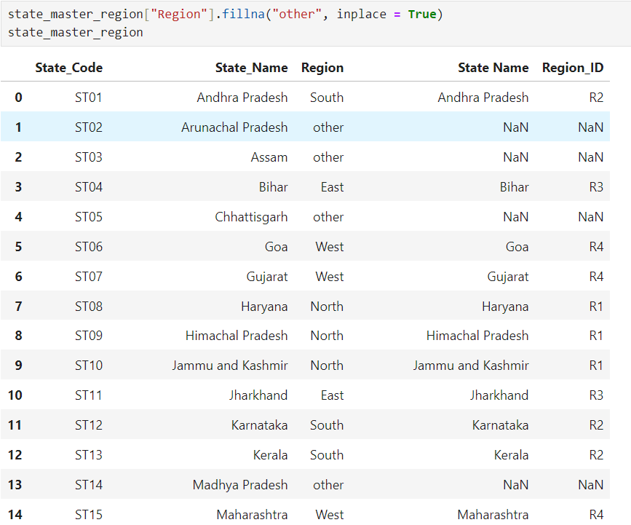
Merging Tables
Handling Null Values

Slide 6
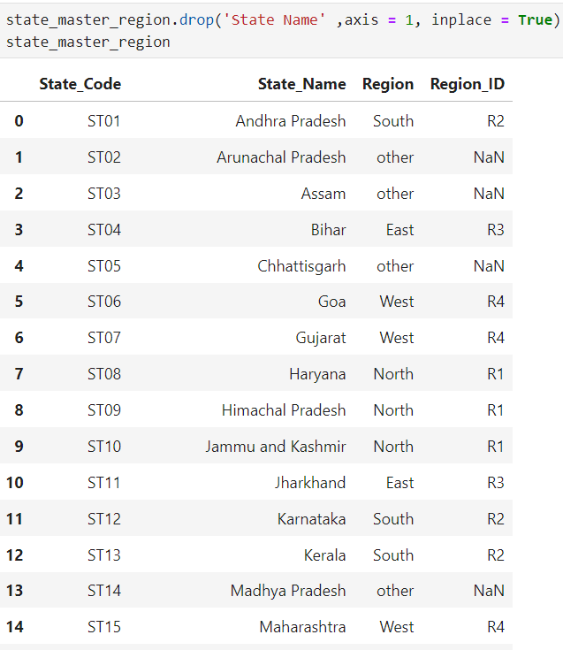
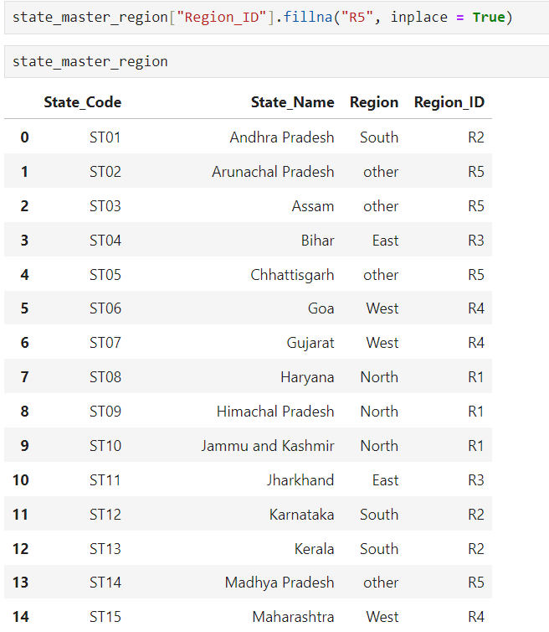
Data before cleaning
Data after cleaning

Slide 7
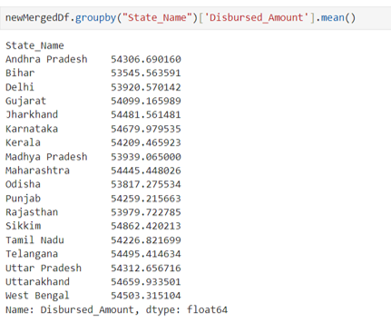
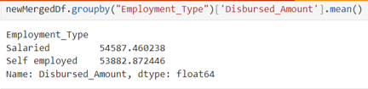
Grouping
This shows what is the average of disbursed amount per state.
This shows what is the average disbursed amount for employed and self-employed persons

Slide 8
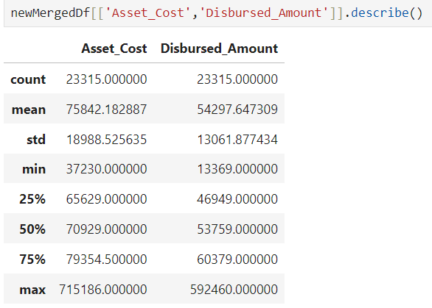
Analysis of Data

Slide 9
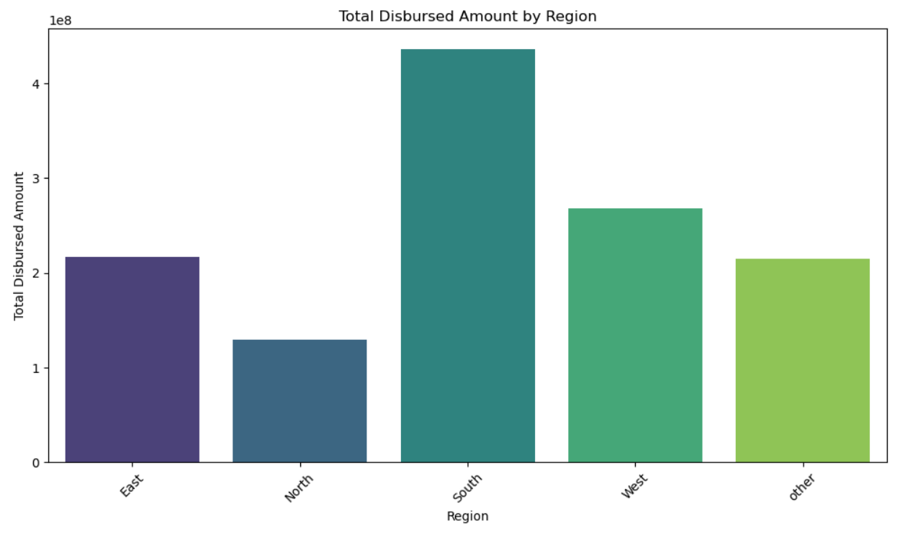
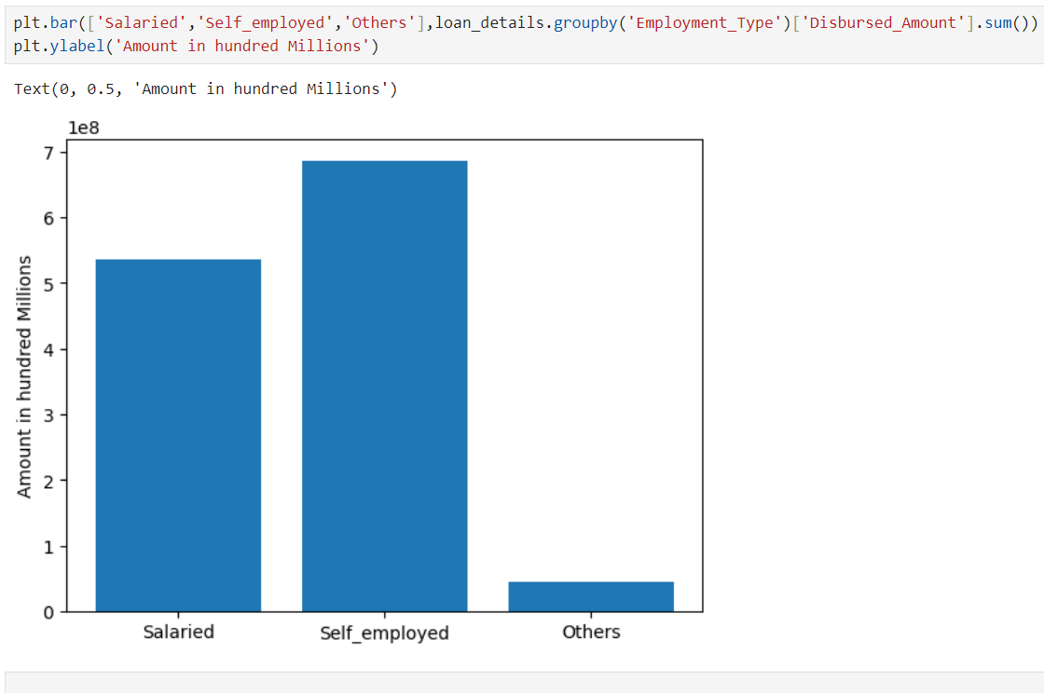
We can visualize what is the total amount disbursed region wise.
Count of loans by
employment type

Slide 10
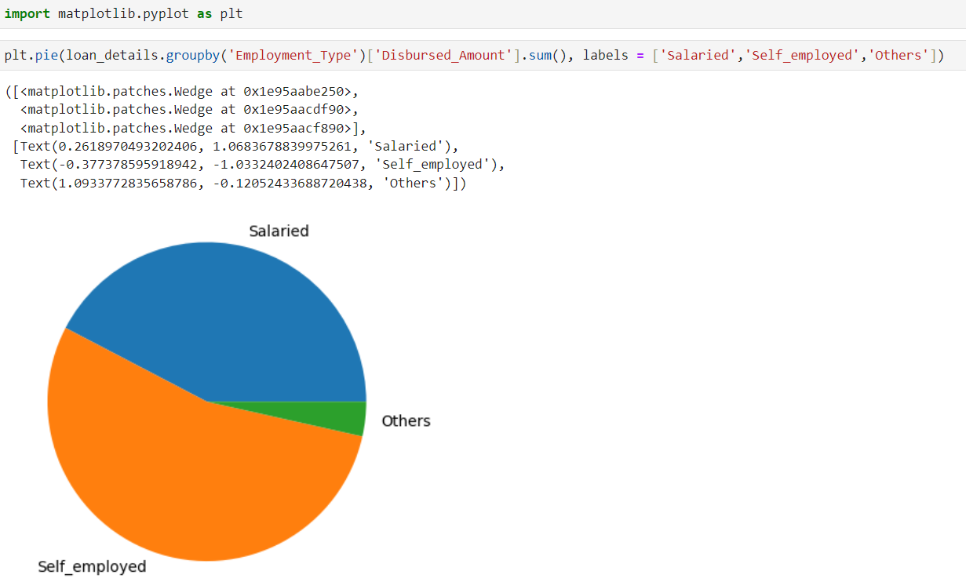
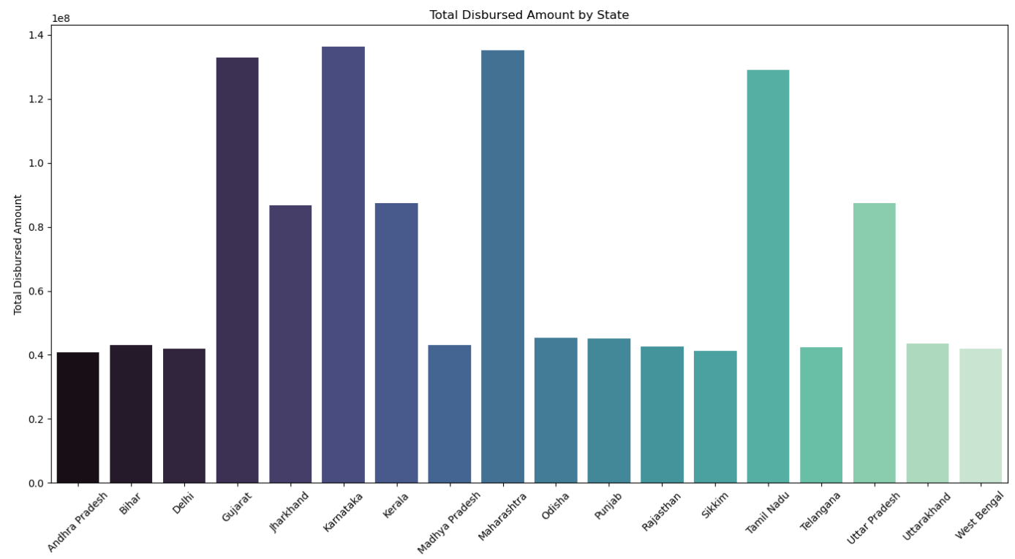
Disbursal amount by employment type
Amount by states

Slide 11
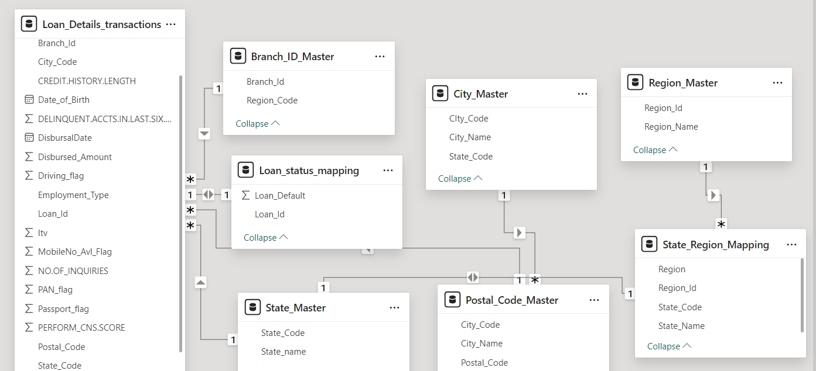
Relationships Between Tables

Slide 12
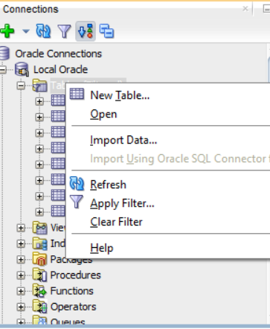
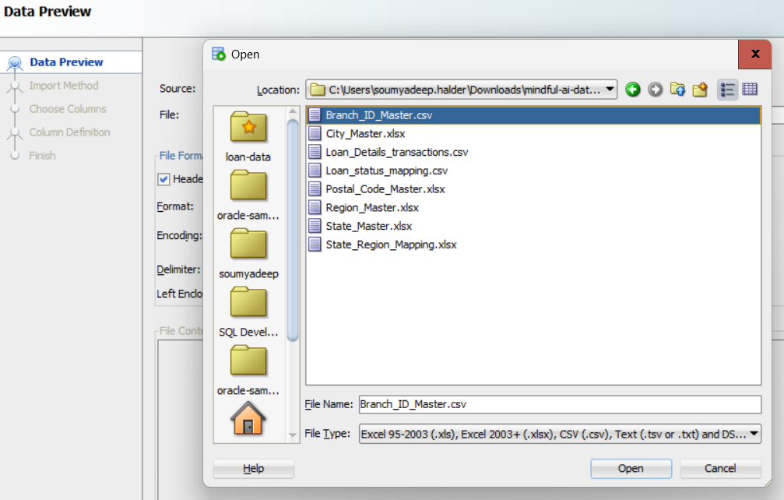
Loading Data
Query Result
Open your SQL Developer, set up a database connection, right-click on tables and click on import to load your csv and excel files into the database. Open the csv and excel files and give a name to the table of your choice and by default all columns will be selected. Click on finish and you will see that table showing under tables section.

Slide 13
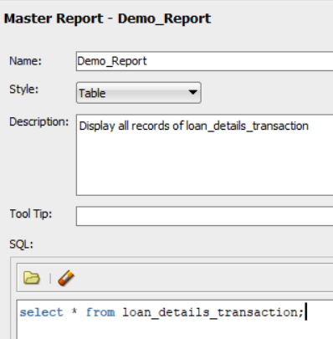
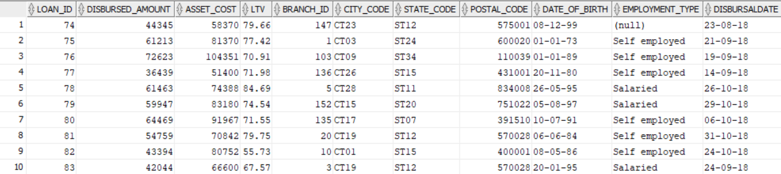
GENERATING REPORTS
In SQL Developer, go to view menu, find reports and and click on it, a report tab will be opened. Under reports, find user- defined reports and right-click on user-defined reports and click on new report to open a new report. Give any name to your report and add description about the report and in sql section you need to write queries. Click on apply to generate report.

Slide 14


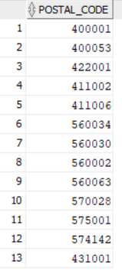

GENERATING REPORTS(CONTINUED)
DISPLAY ALL POSTAL CODES OF A STATE WHERE STATE_CODE= ST_12 and ST_15
Count of total loans sanctioned in Andhra Pradesh state

Slide 15
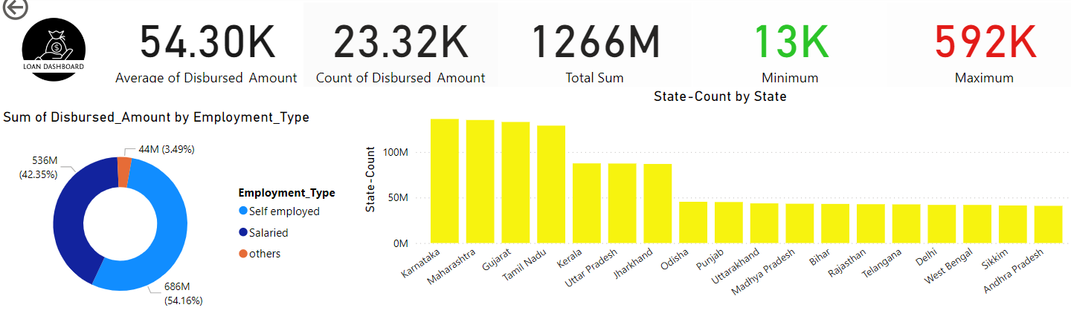
Loan Data Dash-Board

Slide 16
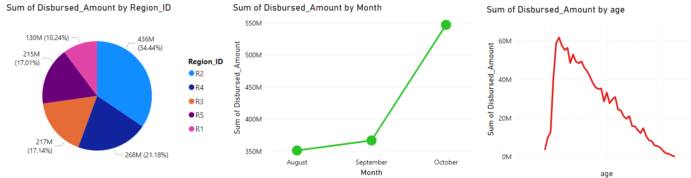
Loan Data
Some visualizations on Loan Data and its analysis

Slide 17
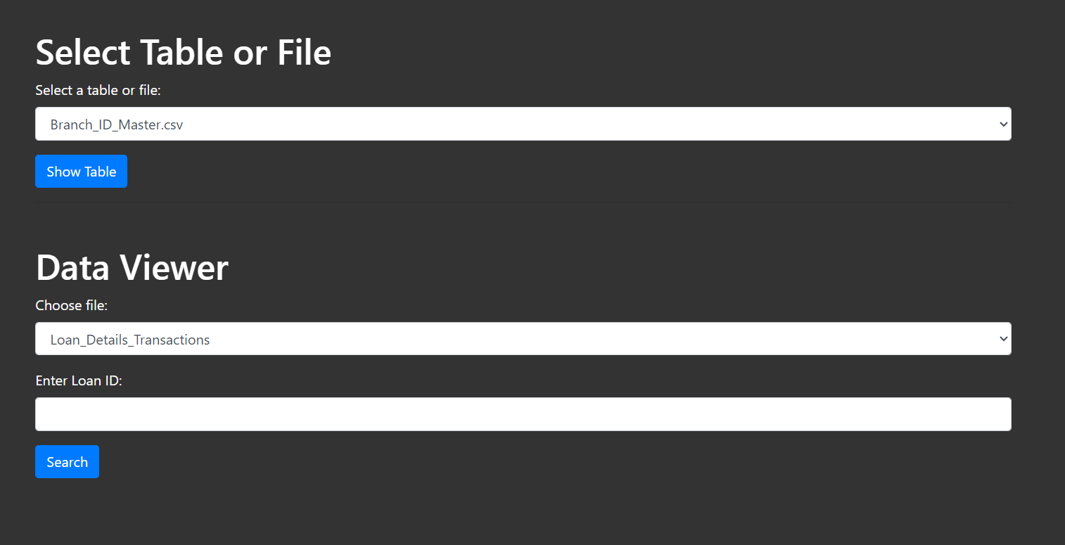
Flask Application

Slide 18
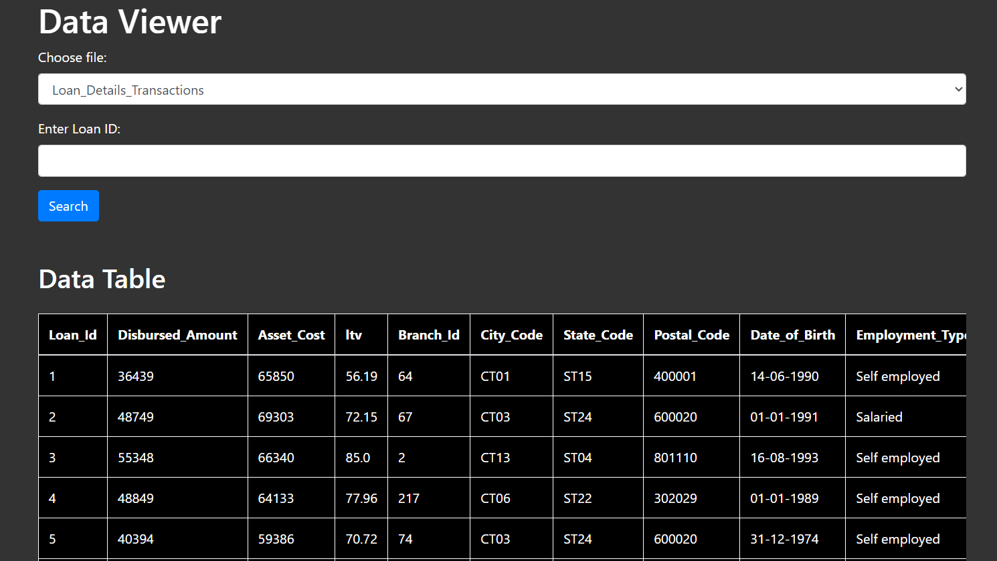
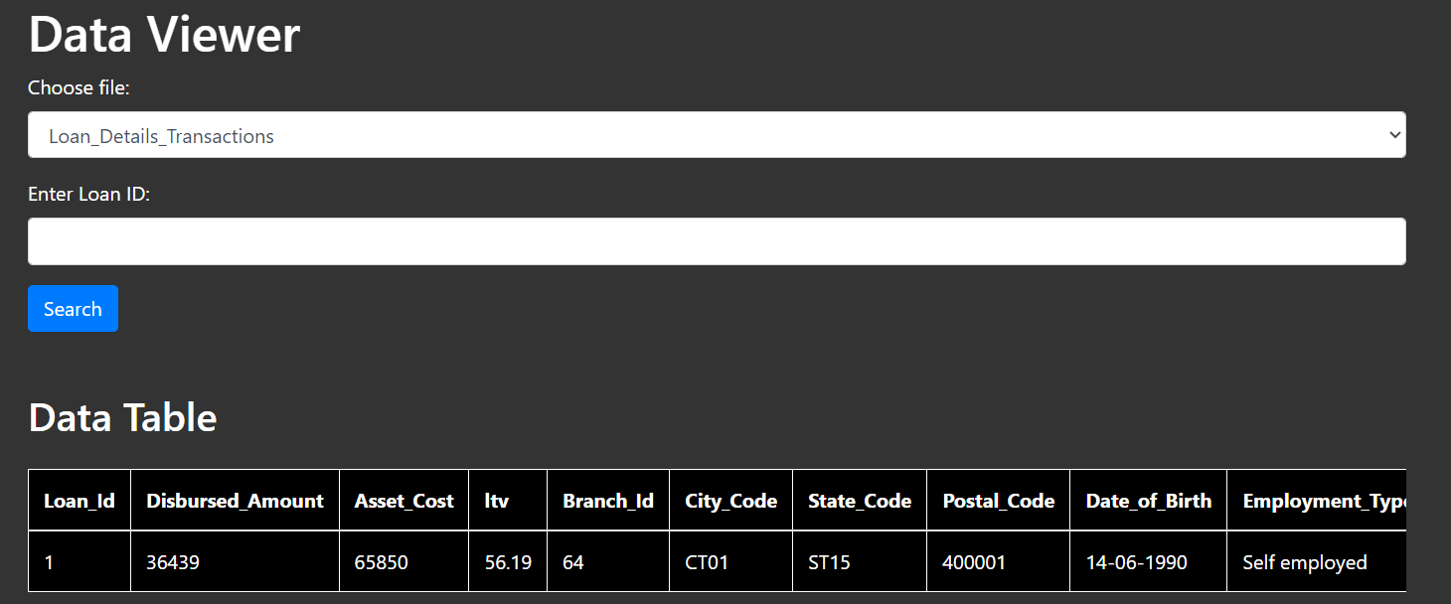
Fetching Tables :- we can see the whole table details with the help of only table name.
Fetching details using id: we can get particular details using the id.

Slide 19
Some Insights Based on Data Analysis
•Insight 1: People in MH, Karnataka are taking highest sum of loans, whereas AP comes last. Invest in promoting services in AP.
•Insight 2 : Self- employed people are taking more loans than salaried people. Slash interest rates for salaried people.
•Insight 3 : Need to expand services in northern region.
•Insight 4 : Disbursing amount in October has increased exponentially.

Slide 20
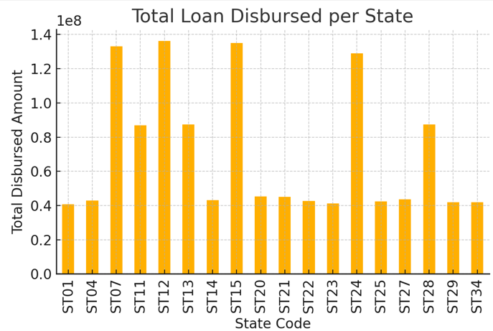
Insights and Applications
Geographic Performance:
Regional Analysis: Identifying regions or states with higher or lower average loan disbursal and LTV ratios can help in targeted policy making and regional performance improvement.
Branch Performance: Knowing which branches are most active can assist in resource allocation and operational planning.

Slide 21
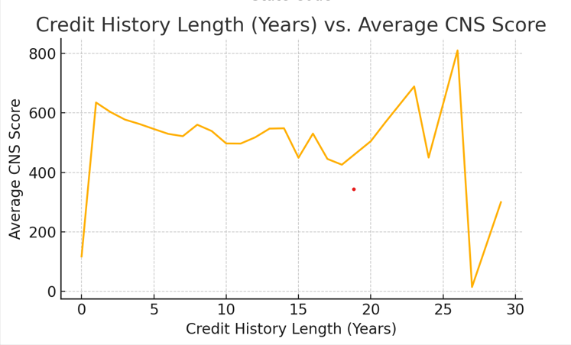
Insights and Applications
Customer Profiling:
Demographic Analysis: Analyzing the distribution of loans based on demographic factors such as employment type and age can help in tailoring financial products to customer segments.
Credit Score Analysis: Understanding the average loan amounts disbursed to different credit score groups can guide risk management and loan approval processes.

Slide 22
Conclusion :
Our project involved data cleansing, merging, and analysis to draw insights from loan data.
We have also used Power-BI for visualization and developed a Flask application for interactive data access.
Thank you for your attention.

