Slide 1
Safe Multi-Agent Teaching System using Agent-to-Agent Protocol and Model Context Protocol Tools
Application Name: EduSmartLearn
Name: Soumyadeep Saha
Email: m25ai1015@iitj.ac.in
Roll No: M25AI1015
Degree: MTech in Artificial Intelligence and Machine Learning
Supervisor: Dr. Binod Kumar (binod@iitj.ac.in)

Slide 2
Presentation Roadmap
01
Motivation & research gap
04
Architecture: agents, A2A and MCP
Why the problem matters
System design and protocols
02
Problem statement and objectives
05
Memory, safety and orchestration
Why the problem matters
Trustworthy deployment choices
03
Agentic AI foundations
06
Use cases, implementation and evaluation
Why the problem matters
Prototype realization and findings
Goal: move from an ad-hoc single-agent tutor to a safe, protocol-first, auditable multi-agent teaching system.

Slide 3
Problem Statement & Objectives
Problem statement
Design a safe, auditable multi-agent teaching assistant that supports concept learning and programming practice while using external tools only under explicit governance constraints.
Objectives
1. Decompose tutoring into specialist agents.
2. Define structured A2A messages with capabilities, consent and errors.
3. Expose tools through MCP with least-privilege scopes.
4. Manage session state and controlled long-term memory.
5. Log all A2A/tool actions and evaluate effectiveness, efficiency, robustness and safety.
Desired system properties
Safe
Reusable
Auditable

Slide 4
Research Gap, Contributions & Questions
Research Gap
• Few protocol-first educational tutors use explicit inter-agent messaging.
• A2A and MCP are rarely combined in teaching workflows.
• Safety mechanisms such as consent, least privilege and structured logging are often under-developed.
• Evaluation usually focuses on final answers rather than full agent trajectories.
Key Contributions
• A modular tutoring architecture with explicit agent roles.
• A2A message schema for routing, review and consent workflows.
• MCP-based tool layer with schema validation and least-privilege access.
• A defense-in-depth safety stack plus an evaluation methodology.
RQ1: Control & auditability
RQ2: Safety mechanisms
RQ3: Evaluation design
How does a protocol-first multi-agent design improve controllability? Which guardrails best prevent unsafe tool use? How should tutoring trajectories be evaluated?

Slide 5
Why Agentic AI Fits Teaching Workflows
Model
Tools
Orchestration
Memory
Evaluation
→
→
→
→
Reasoning and explanation
RAG, code run, quiz bank
Plan, delegate, revise
Session + learner profile
Critic, metrics, logs
Teaching requires a closed loop: explain → demonstrate → practice → evaluate → remediate.
A multi-agent design separates these steps into accountable specialists instead of one over-privileged component.
Agentic tutors can act, observe and refine.
Sessions keep immediate context; memory supports personalization.
Evaluation must inspect the full trajectory, not only the final answer.

Slide 6
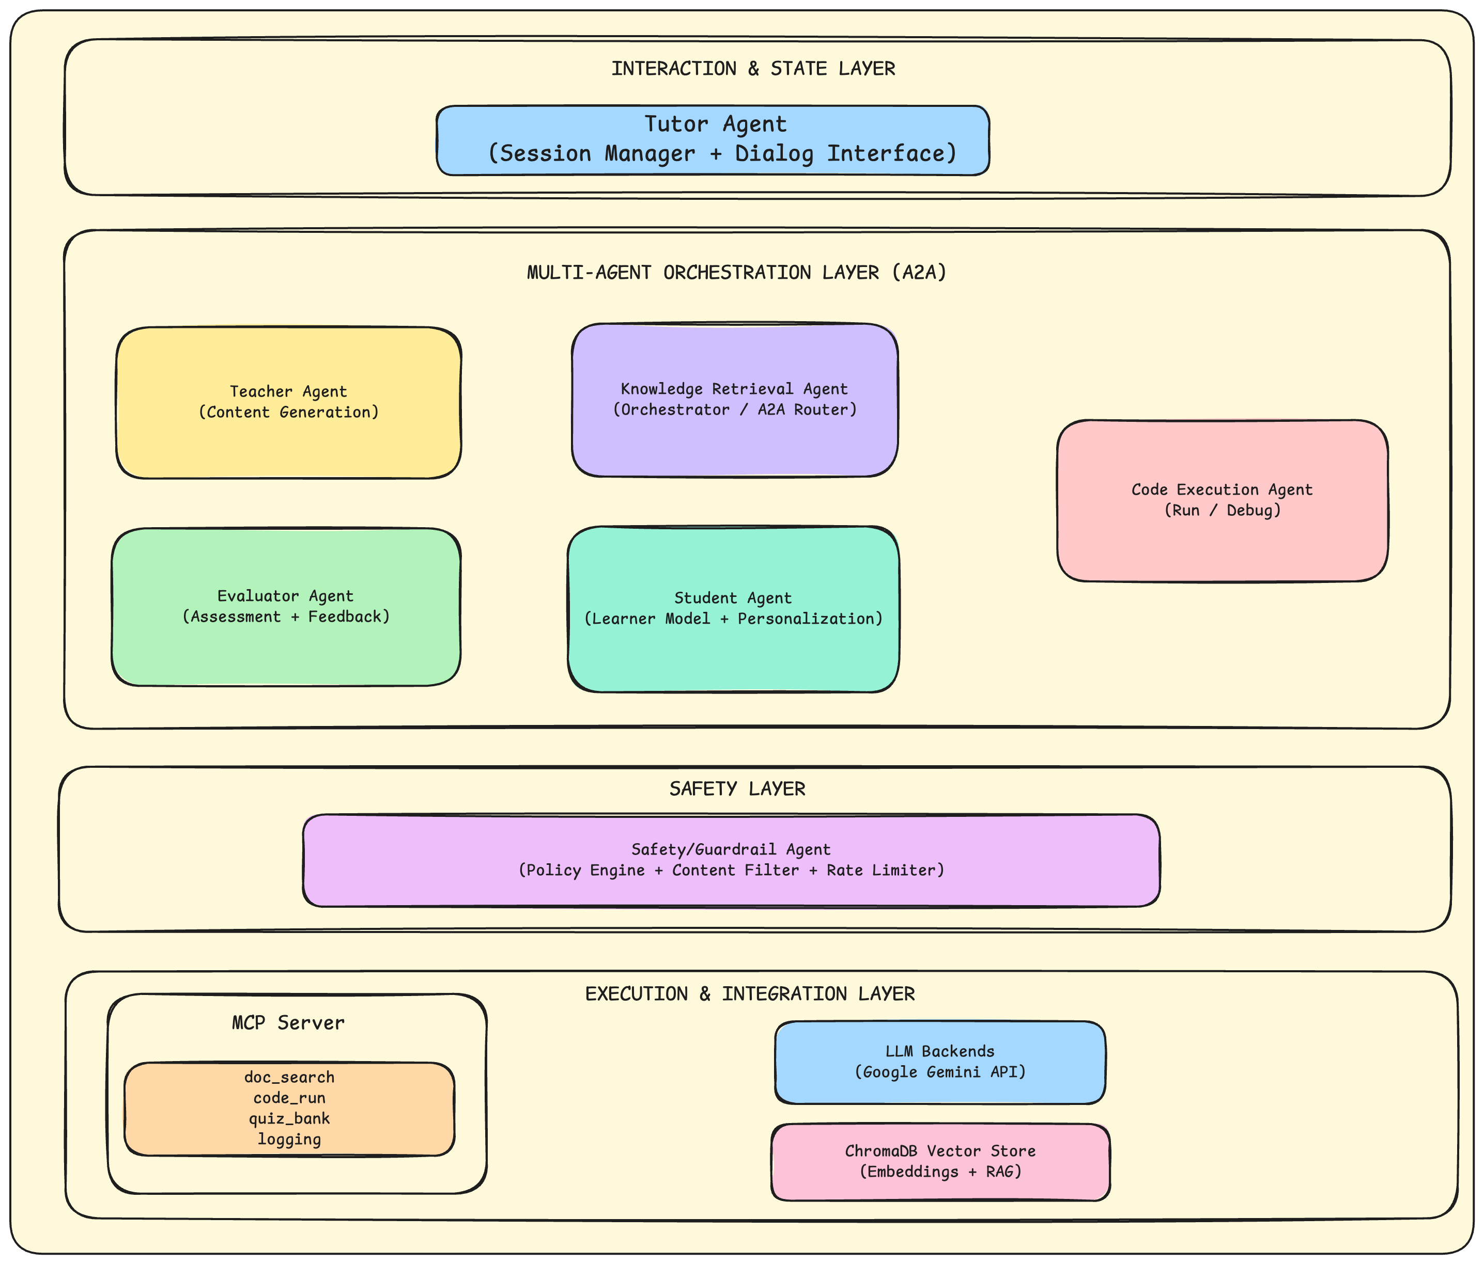
Initial Reference Architecture
Tutor agent manages user interaction and session state.
A2A orchestrator coordinates content generation, evaluation and code execution.
Execution layer connects MCP runtime, LLM backends and external resources.

Slide 7
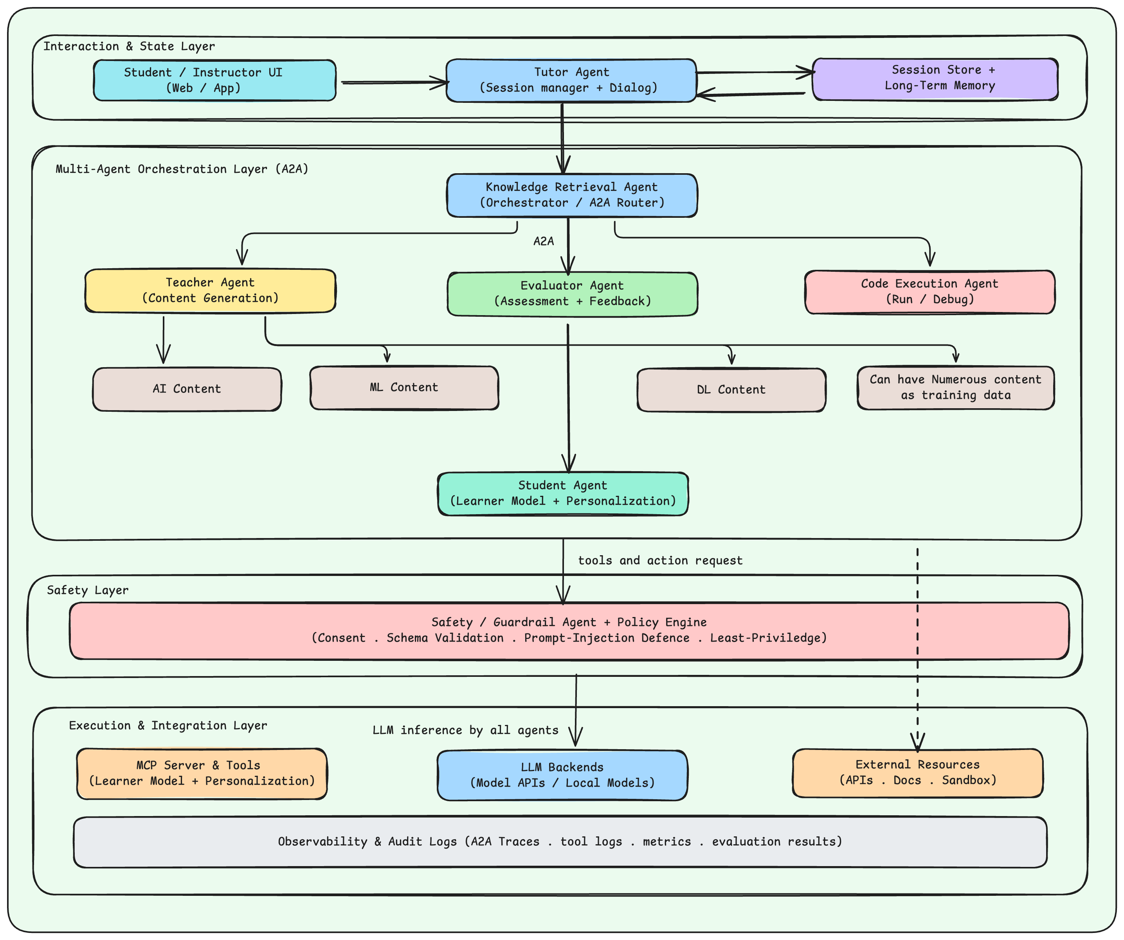
Final Academic Architecture for EduSmartLearn

Slide 8
Agent Roles & Responsibilities
Interaction & control
Tutor Agent manages conversation state; Orchestrator plans, routes A2A messages and merges results.
Teaching agents
Teacher explains concepts; Retrieval fetches trusted evidence; Quiz agent creates formative assessments.
Verification agents
Code Execution agent generates/tests code in a sandbox; Evaluator/Critic checks clarity, correctness and safety.
Personalization & safety
Safety/Guardrail agent enforces policies; Student Model agent updates learner profile under consent controls.
Typical tool scopes
Tutor: session, memory, logging
Teacher: doc_search
Quiz: quiz_bank + docs
Code: code_run + docs
Safety: policy + logs
Role separation improves modularity, makes failures easier to trace, and prevents any single agent from becoming over-privileged.

Slide 9
A2A Protocol Design
Core Message Types
TASK_REQUEST / TASK_RESPONSE
CAPABILITY_QUERY / RESPONSE
CONSENT_REQUEST / RESPONSE
REVIEW / REVISION
ERROR
Key Fields
message_id, sender, receiver, message_type, capability, consent, payload, trace, error
{
"message_type": "task_request",
"sender": "orchestrator",
"receiver": "code_execution_agent",
"capability": "execute_and_debug_code",
"consent": {"required": true, "status": "pending"},
"payload": {
"language": "python",
"timeout_s": 5
},
"trace": {"session_id": "sess_123"}
}
Structured delegation between specialist agents.
Capability negotiation and explicit consent for sensitive actions.
Full traceability for audits, replay and debugging.

Slide 10
MCP Tools & Interoperability
Teacher
Agent
doc_search
MCP Server / Tool Registry
Standard tool descriptions
JSON schemas
Structured errors
External resources
Course notes / RAG index
Sandbox runtime
Question bank
Metrics store
→
→
code_run
→
Quiz
Agent
quiz_bank
Code
Agent
logging
Why MCP matters
• A2A answers how agents talk to each other; MCP answers how agents use tools.
• Least-privilege scopes stop agents from seeing or calling unnecessary tools.
• Schema validation and descriptive errors reduce malformed requests and brittle prompts.

Slide 11
Sessions, Memory & Personalization
Session State
• Current conversation history
• Retrieved snippets and tool outputs
• Temporary plans and intermediate artifacts
• Used for immediate task completion
Long-term Memory
• Learner preferences and mastery
• Recurring misconceptions
• Past performance summaries
• Used selectively for personalization
→
Controlled memory write path
Session summary → policy check → user consent → minimal non-sensitive memory update → later selective retrieval
Context compaction keeps the prompt window efficient.
Retrieved text is compact and purpose-driven, not a raw transcript dump.
Privacy hygiene is essential before persisting learner data.

Slide 12
Safety, Permissions & Audit Logging
Risk coverage
Prompt injection → treat retrieved content as untrusted
Unsafe code execution → sandbox + approval
Privacy leakage → minimal storage + consent
Confused deputy → authority and intent checks
1 System prompts & response policies
2 A2A consent and capability checks
3 Policy engine / least-privilege scopes
4 Schema validation for tool I/O
5 Sandboxed execution: timeouts, limits, no network
6 Structured logs for every A2A and tool event
Defense-in-depth is critical because tutoring Agents reason, call tools, and retain user context across sessions.

Slide 13
End-to-End Orchestration Workflow
Student
Tutor
Safety
Orchestrator
Specialist
Agents
Evaluator
Response
→
→
→
→
→
→
1. Student asks a concept or coding question.
2. Tutor creates the session context and requests a safe plan.
3. Safety layer checks whether the intended actions are allowed.
4. Orchestrator decomposes the task and routes it via A2A.
5. Retrieval, teaching, code or quiz agents perform bounded subtasks.
6. Evaluator reviews correctness, clarity and safety.
7. Tutor returns the answer and optionally updates memory under consent.
Runtime controls: bounded loops, timeouts, retries with backoff, and safe fallbacks when tools fail or consent is denied.

Slide 14
Use Case 1: Concept Explanation with Retrieval
Example user query: “Explain backpropagation with a Python example.”
1
Retrieval Agent fetches trusted notes or documentation.
Why multi-agent?
Grounded explanation;
Quality review;
Cleaner audit trail;
Reusable across subjects
2
Teacher Agent builds a step-by-step explanation aligned to learner level.
3
Evaluator checks correctness, pedagogy and uncertainty.
4
Tutor presents the final answer and can trigger a follow-up quiz.
Output pattern: evidence-backed explanation + optional example + optional quiz for remediation.

Slide 15
Use Case 2: Programming Support & Debugging
Example query: “Debug this Python/Java code and verify the fix.”
• Safety agent checks whether code execution is allowed and requests user consent.
• Code Execution agent generates a patch or test case and invokes code_run in a sandbox.
• Sandbox enforces timeouts, resource limits and no-network execution by default.
• Evaluator verifies that the fix is correct, safe and clearly explained to the learner.
def add(a, b)
return a + b
print(add(2, 3))
If approval is denied or execution fails, the tutor falls back to a safe textual explanation and logs the event.

Slide 16
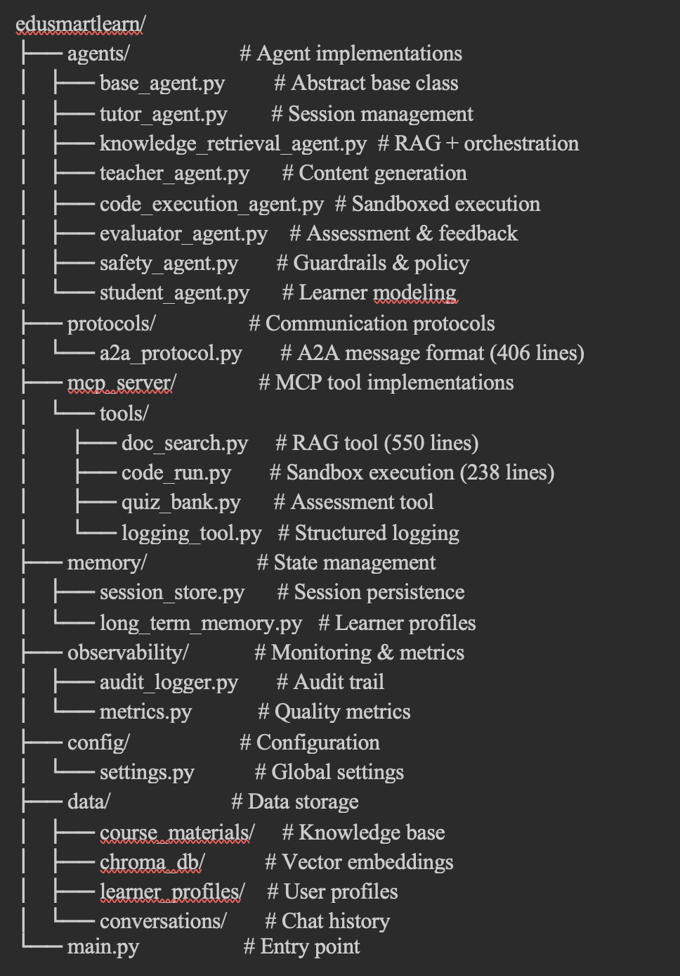
Prototype Implementation & Technology Stack
Language
Python 3.11/3.12
LLM Backend
Google Gemini
gemini-2.0-flash
Orchestration
Google ADK patterns
+ A2A routing
Retrieval
ChromaDB +
Sentence-Transformers
Tool APIs
FastAPI +
Pydantic schemas
Sandbox
RestrictedPython
resource limits

Slide 17
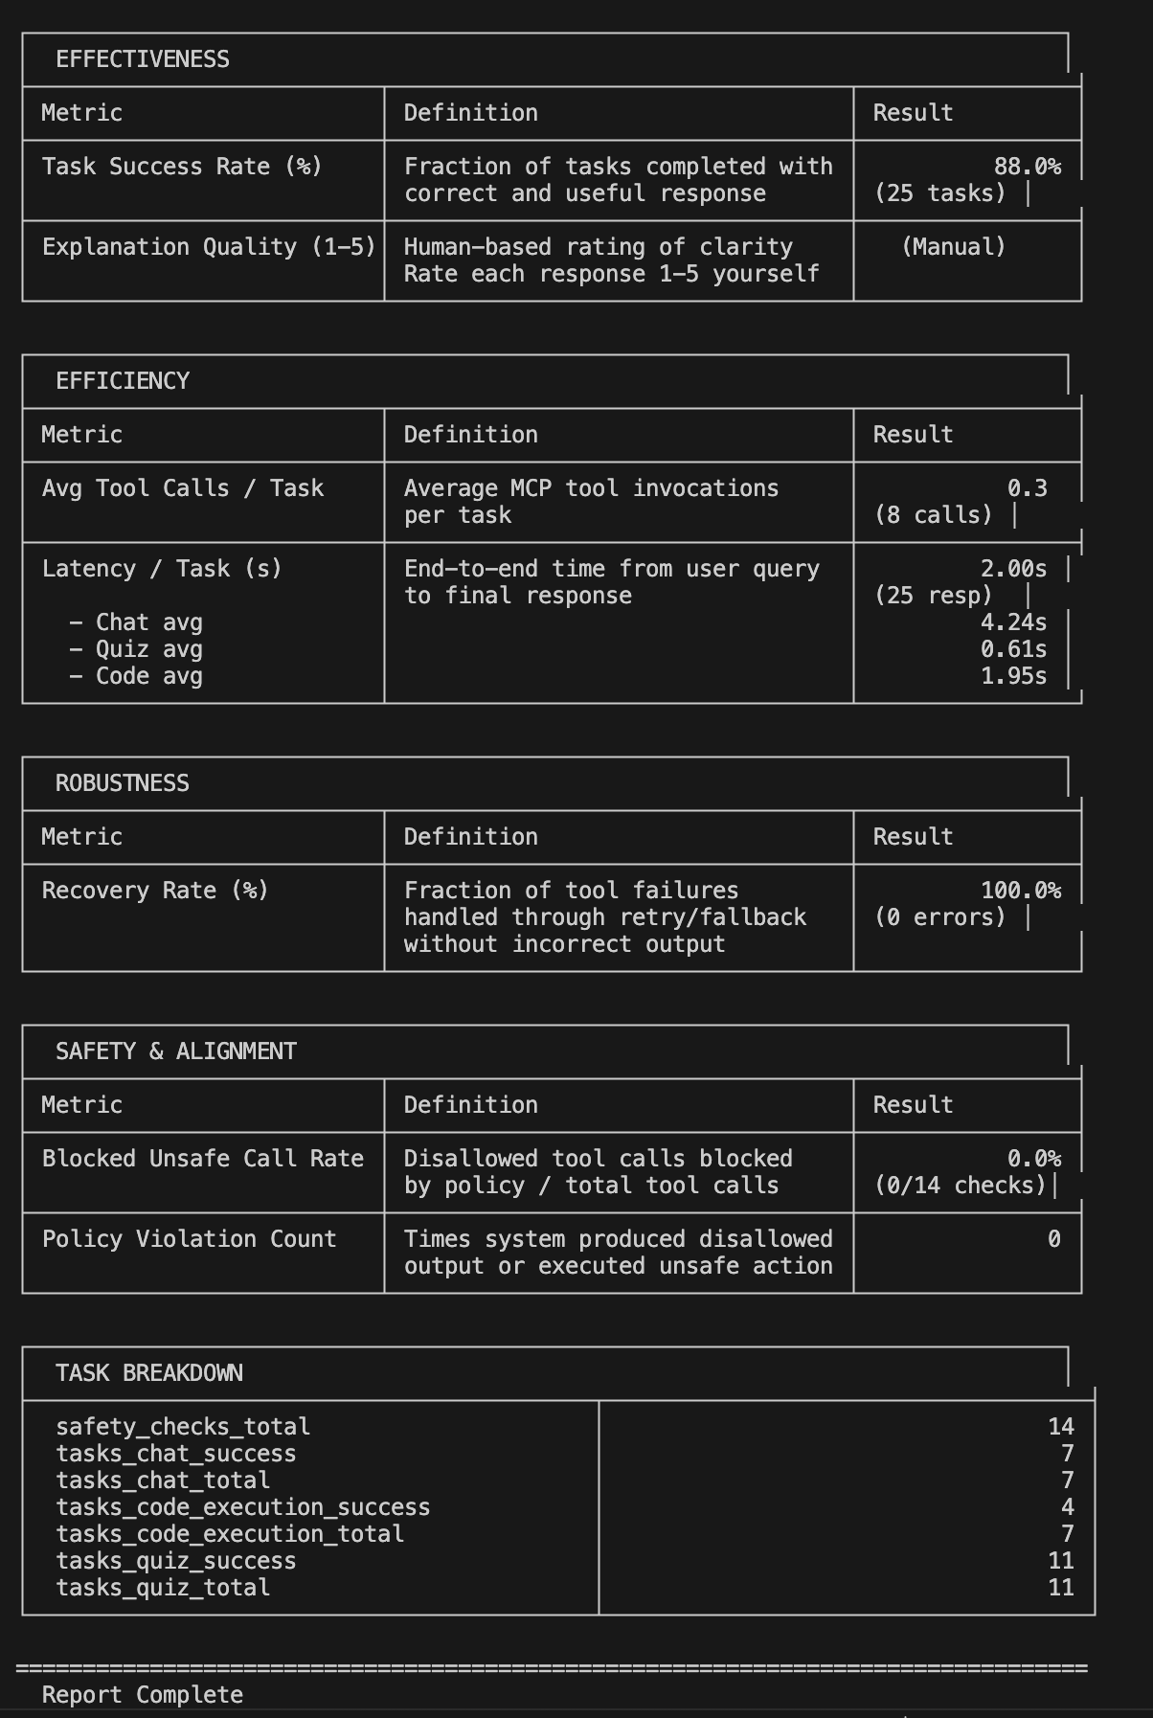
Evaluation Methodology & Illustrative Scorecard
Effectiveness:
Task success, correctness, explanation quality
Efficiency:
Tool calls, latency, compute cost
Robustness:
Recovery under failures and noise
Safety & alignment:
Blocked unsafe calls, refusals, policy compliance
Evaluation principle
Inspect the whole agent trajectory — plan, tool calls, reviews and policy decisions — not only the final answer.

Slide 18
Publications
Please find few of my publications
A2A vs MCP: Comparing Google’s Agent-to-Agent Protocol with Anthropic’s Model Context Protocol: https://medium.com/@saha.soumyadeep90/a2a-vs-mcp-comparing-googles-agent-to-agent-protocol-with-openai-s-model-context-protocol-6798491cc87e
Agent2Agent Protocol: Building the Language of AI Collaboration: https://medium.com/@saha.soumyadeep90/understanding-the-agent2agent-protocol-the-future-of-autonomous-system-communication-cbfa51bff502
Search, Retrieve, Respond: Model Context Protocol (MCP): https://medium.com/@saha.soumyadeep90/search-retrieve-respond-model-context-protocol-with-elasticsearch-010d60f08e26
You need to have a google Kaggle account to access this
My Kaggle competition documentations: https://www.kaggle.com/competitions/agents-intensive-capstone-project/writeups/a-multi-agent-teaching-system-for-ai-ml-dl-and-pro
My Kaggle competition working code: https://www.kaggle.com/code/soumyadeepsaha999/google-soumyadeep-capstone-project

Slide 19
References
Read the “Introduction to Agents” whitepaper: https://www.kaggle.com/whitepaper-introduction-to-agents
Agent Tools & Interoperability with Model Context Protocol (MCP)
Read the “Agent Tools & Interoperability with Model Context Protocol (MCP)” whitepaper: https://www.kaggle.com/whitepaper-agent-tools-and-interoperability-with-mcp
Context Engineering: Sessions & Memory
Read the Context Engineering: Sessions & Memory whitepaper: https://www.kaggle.com/whitepaper-context-engineering-sessions-and-memory
Agent Quality
Read the Agent Quality whitepaper: https://www.kaggle.com/whitepaper-agent-quality
Prototype to Production
Read the Prototype to Production whitepaper: https://www.kaggle.com/whitepaper-prototype-to-production
Adaptation of Agentic AI: https://arxiv.org/pdf/2512.16301
Recording Demo Link: https://www.loom.com/share/a0f621e993bd41b0bb020a0ced91228e
GitHub Code commit link: https://github.com/soumyadeep-saha/M25AI1015_MTP_EduSmartLearn/tree/main

Slide 20
Conclusion, Limitations & Future Work
Key Takeaways
Protocol-first multi-agent design improves control and observability.
A2A clarifies agent collaboration; MCP standardizes safe tool access.
Safety layers, consent and logging make the tutor more deployable in institutional settings.
Current Limitations
Results depend on prototype maturity and backend behavior.
Large-scale user studies are still pending.
Personalization through memory must be governed carefully to avoid privacy risk.
Future Work
User studies with students and LMS integration.
Stronger prompt-injection and policy defenses.
Continuous evaluation / CI-CD for production readiness.
Extension to more subjects, voice-based tutoring and classroom bots.
Thank You

