Slide 1

GOV TECHTHON 2020 Team: LEGIONX SecureShare
TEAM MEMBERS:
Soumyadeepta Das
Ananya Sajwan
ROOM: DOC-UPLOAD-3

Slide 2
FEATURES OF SecureShare APPLICATION
Supporting multiple formats (pdf, zip, txt, image etc.)
Size validation of the document with compression features.
Provides proper error message if document is not uploaded properly
Upload any file to the server and receive a certificate to securely offer the certificate to multiple users.
Analytics-based dashboard for user to understand how many files of a file type are there.
Verification at both ends if document is modified in any way or not.
Integration with other web applications easily.

Slide 3
TECHNOLOGIES APPLIED
UNIQUE FEATURES
Node JS
Express
json DB
Redis
NPM libraries like jszi, lowdb, morgan, md5, sh256-file.
A certificate (1KB in size) is generated when user uploads a document which is used to provide other applications access to the document.
Extra layer of security provided using password protection which is an optional feature for each document.

Slide 4
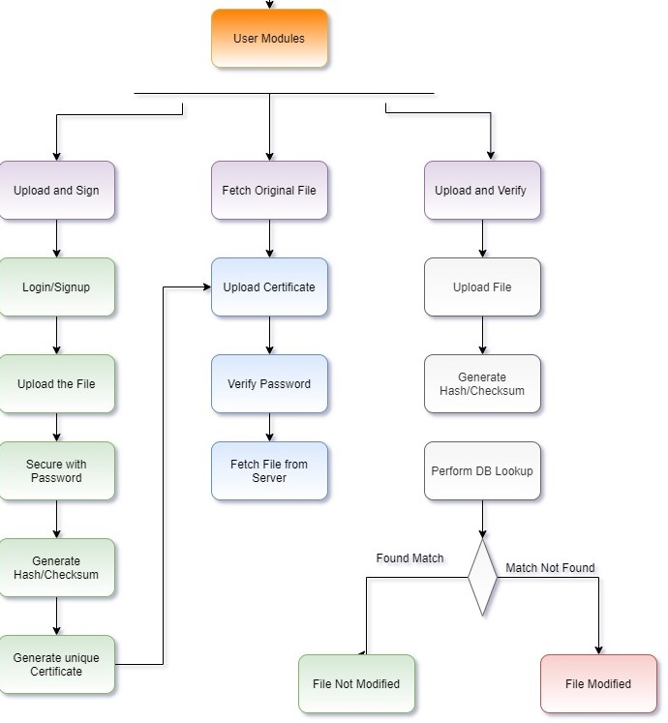
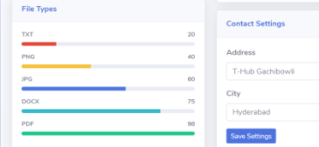
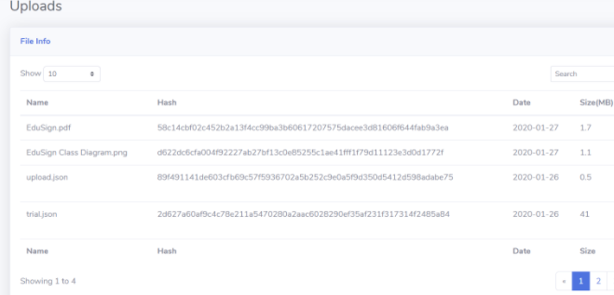
DESIGN/User interface
ARCHITECTURE and process flow

Slide 5
ADVANTAGES OF SECURESHARE
Users need not upload large documents again and again, a simple 1KB certificate generated from our application will allow them to give access to the document from anywhere.
No original document will be available anywhere else on the internet as users will use certificate to provide access, thus providing extra security.
Rules out any possibility of fraud documents as verification is done on both ends to check if document is modified.

Slide 6

Thank You!

