Slide 1

How Much Screen Time Is Too Much?
-Sourya saha

Slide 2


Average person spends 6–7 hours daily on screens. Is that helping or harming us?

Slide 3

How many hours do you spend on screens every day?

Slide 4
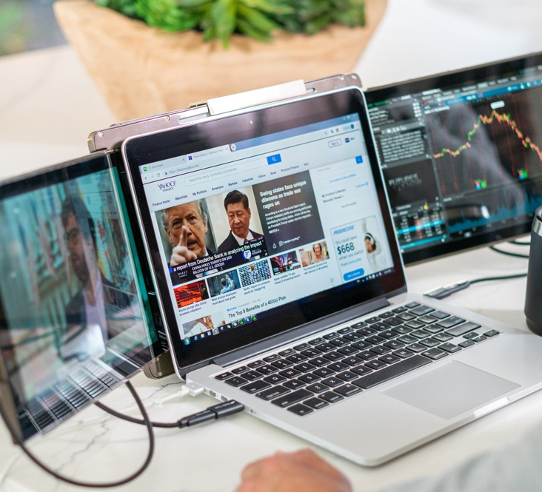
Why This Matters
Screens are Everywhere
Work, entertainment, social life—screens dominate our day.

Slide 5


Health Impact
Physical strain: Eye strain, headaches, poor posture, and disrupted sleep

Slide 6
Mental Impact
Stress, anxiety, and reduced attention span

Slide 7
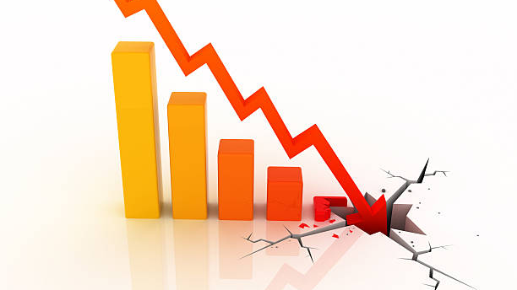
Efficiency Drops
Constant notifications reduce productivity by 40%.

Slide 8

The Solution
Healthy Habits
Limit leisure screen time, take breaks, and balance offline activities.

Slide 9

Easy Fixes
rack screen time, apply 20-20-20 rule, set no-screen zones.

Slide 10
If you had one extra hour offline daily, what would you do?

Slide 11
Thank You

