Slide 1
AirWatch Bengaluru
Statistical Modelling of PM2.5 Air Pollution
Statistical Modeling (24AM5PCSML), AAT project
Notes:
Introduce the project. We used daily air-quality data for Bengaluru to apply Units 1 to 4 of the course.

Slide 2
Why PM2.5, and what the data shows
Goal: explain what PM2.5 is linked to, and flag days above the 60 µg/m³ standard (SDG 11.6 and 3.9).
1,699
9.0%
cleaned days, 1,478 of them complete
of days are unhealthy (PM2.5 above 60)
1,181 / 297
71
train and test days, split in time order
sensor-error days removed
Notes:
PM2.5 is the pollutant most strongly linked to respiratory and cardiovascular disease, and Bengaluru regularly goes above the 60 microgram standard in winter. We set out to explain which pollutants and seasons are linked to it, and to flag unhealthy days, which supports SDG targets 11.6 and 3.9. The data comes from CPCB through Kaggle. We kept 1,699 days and split them in time order, with 1,181 for fitting and 297 for testing. Note the 71 sensor-error days we removed, which the diagnostics helped us find. Winter's average is about twice the monsoon's.

Slide 3
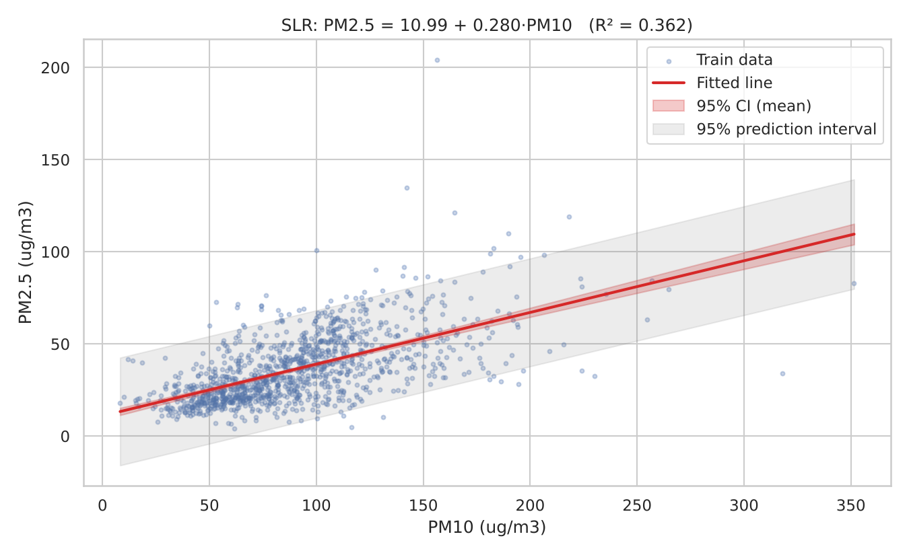
Unit 1: PM10 alone explains 36% of PM2.5
0.280
slope, 95% CI [0.259, 0.302]
t = 25.89
F = 670.36, and F = t²
R² = 0.3625
adjusted R² = 0.3619
39.0
predicted at PM10 = 100; one-day interval [9.9, 68.2]
Notes:
We computed the least-squares estimates by hand and confirmed them with statsmodels. Each 10 microgram rise in PM10 goes with a 2.8 microgram rise in PM2.5. The t-test and ANOVA both reject the null hypothesis, and F equals t squared, as theory predicts. The prediction interval is much wider than the confidence interval, and it falls below zero at low PM10, which is impossible. That motivates the log transform in Unit 2.

Slide 4
Unit 2: More predictors lift adjusted R² to 0.61
Model | Test RMSE | Test R²
Simple: PM10 | 8.08 | 0.630
Model 1 | 7.02 | 0.721
Model 2 | 8.57 | 0.584
Log model | 8.05 | 0.633
Overall F = 139.2 and partial F for season = 31.94, both p < 0.001
Best fit in training is not best on the test period, which is unusually clean
NO's negative sign reflects the overlap NOx ≈ NO + NO2
Notes:
Adding the other pollutants, season and then a log transform improves the fit on training data. But look at the test column: Model 1 predicts the test period best, at 7.02, because seasonal effects learned earlier carried over poorly to the unusually clean 2019-20 period. The partial F-test still shows season adds significantly in training, with F of 31.94. PM10 falls from 0.280 to 0.180 once other variables are included.

Slide 5
Unit 2: Remedies help; Ridge and LASSO add little
Assumption | Check | Model 2 | Log model | Remedy
Linearity | Rainbow p | 0.0003 | 0.105 | Log transform
Normality | Residual skew | 2.59 | −0.20 | Log transform
Constant variance | Breusch-Pagan p | < 0.001 | < 0.001 | HC3 robust standard errors
Independence | Durbin-Watson | 0.999 | 0.904 | Cochrane-Orcutt (d = 2.07), Newey-West
Multicollinearity | Largest VIF | 2.22 | 2.22 | None needed: below 5
Terms that survive every correction
PM10, NOx, NO, NH3, SO2, O3 and Monsoon stay significant under OLS, Newey-West and Cochrane-Orcutt. CO is not reliable.
Ridge and LASSO
Test RMSE: OLS 8.05, Ridge 7.94, LASSO 7.90. The gain is small because every VIF is below 2.5.
Notes:
The first model broke the linearity, normality, constant-variance and independence assumptions. The log transform fixes linearity and most of the skew. Formal normality tests still reject, but at this sample size they detect tiny departures. Robust standard errors handle unequal variance, and Cochrane-Orcutt moves Durbin-Watson from 0.90 to 2.07. Multicollinearity was not a problem, which is also why Ridge and LASSO, tuned by time-series cross-validation, improve test RMSE only slightly.

Slide 6
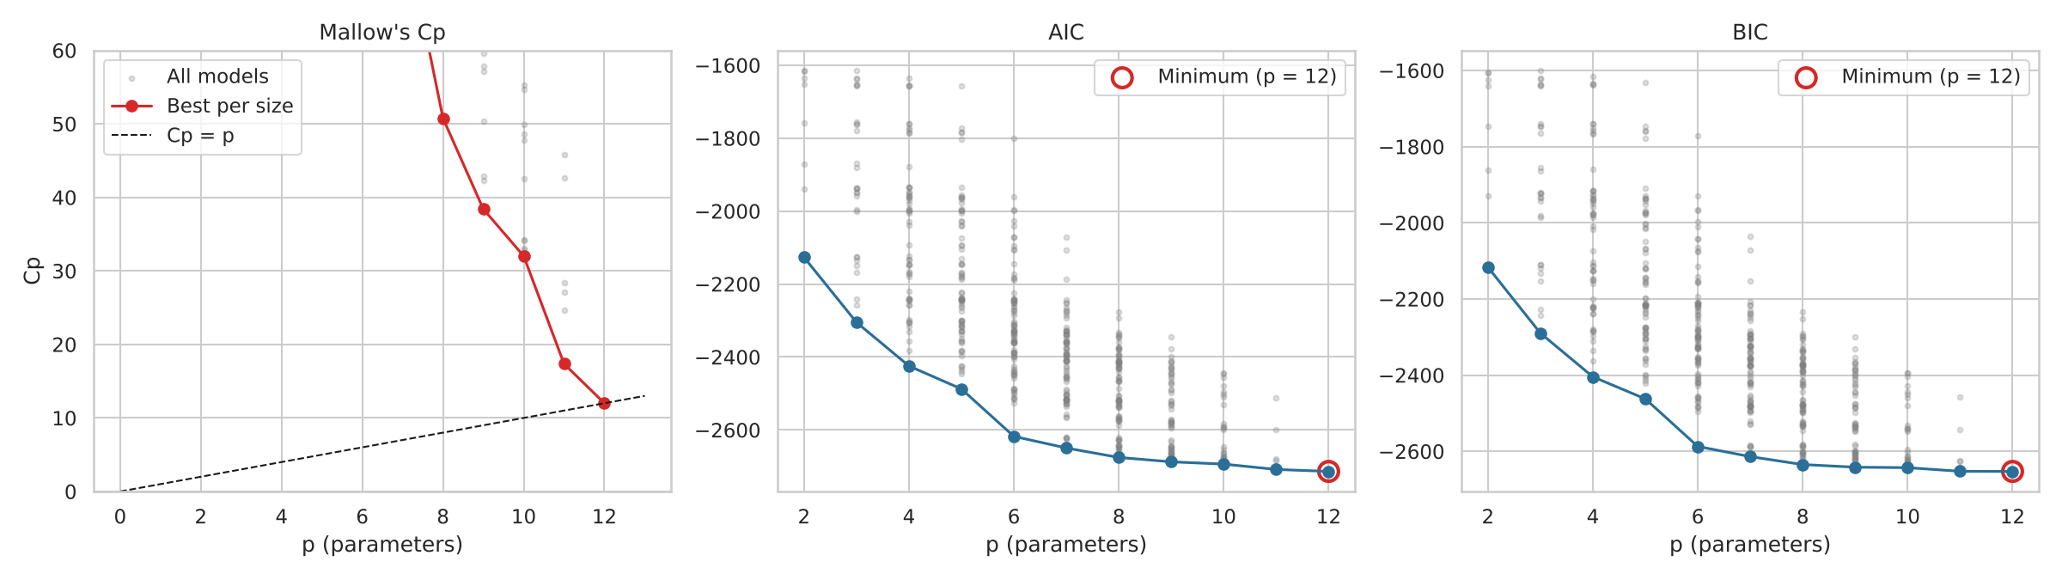
Unit 3: No dominant day, and the full model wins
Days flagged: studentized deleted residual 3, leverage 79, DFFITS 74, Cook's distance 72, DFBETAS 268
0.056
71
17.4 vs 11
largest Cook's distance, far below the strong cut-off of 0.95
sensor-error days removed after the diagnostics exposed a bad reading
Cp against p after dropping CO, so no smaller model reaches Cp = p
Notes:
First the diagnostics. Added-variable plots show clear relationships for PM10, NOx, NO2 and O3, and almost none for CO. The largest Cook's distance is 0.056, far below the strong cut-off of 0.95. Diagnostics also found a real problem: an early run flagged July 2017, which led us to one impossible reading that interpolation had spread over five days, and we then added quality checks. Removing the 72 Cook's-flagged days keeps every pollutant's sign and significance, so we kept them as real events. Then model selection. We compared all 511 possible models, and AIC, BIC and Cp all choose the full model with 12 parameters. For Cp, the full model equals p by definition, so the real test is whether a smaller model reaches the line. None does: dropping CO gives 17.4 against 11.

Slide 7
Unit 4: Winter, PM10 and NOx raise unhealthy odds
Odds of an unhealthy day | Odds ratio | 95% CI
Winter vs other seasons (raw) | 4.40 | [3.11, 6.22]
Winter, pollutants controlled | 2.30 | [1.35, 3.90]
PM10 (per 10 µg/m³) | 1.34 | [1.25, 1.43]
NOx (per 10) | 1.55 | [1.30, 1.84]
NO2 (per 10) | 1.30 | [1.02, 1.66]
SO2 (per 10) | 4.08 | [1.44, 11.56]
χ² = 111.42
p = 0.82
season vs air quality: df = 3, p = 5 × 10⁻²⁴
Hosmer-Lemeshow; McFadden pseudo-R² is 0.368
Notes:
Nearly one in five winter days is unhealthy, against 1 day out of 496 in the monsoon. The chi-squared test strongly rejects independence, and the smallest expected count is 24.2, so the test is valid. The odds of an unhealthy day are 4.4 times higher in winter, falling to 2.3 once pollutants are controlled for, because part of the winter effect works through higher pollutant levels. A 10 microgram rise in PM10 multiplies the odds by 1.34, and NOx by 1.55. SO2 looks largest, but it rarely varies by 10 micrograms and its interval is wide. O3, NH3, NO and CO are not significant at 5 percent. Weekdays are not significantly worse than weekends.

Slide 8
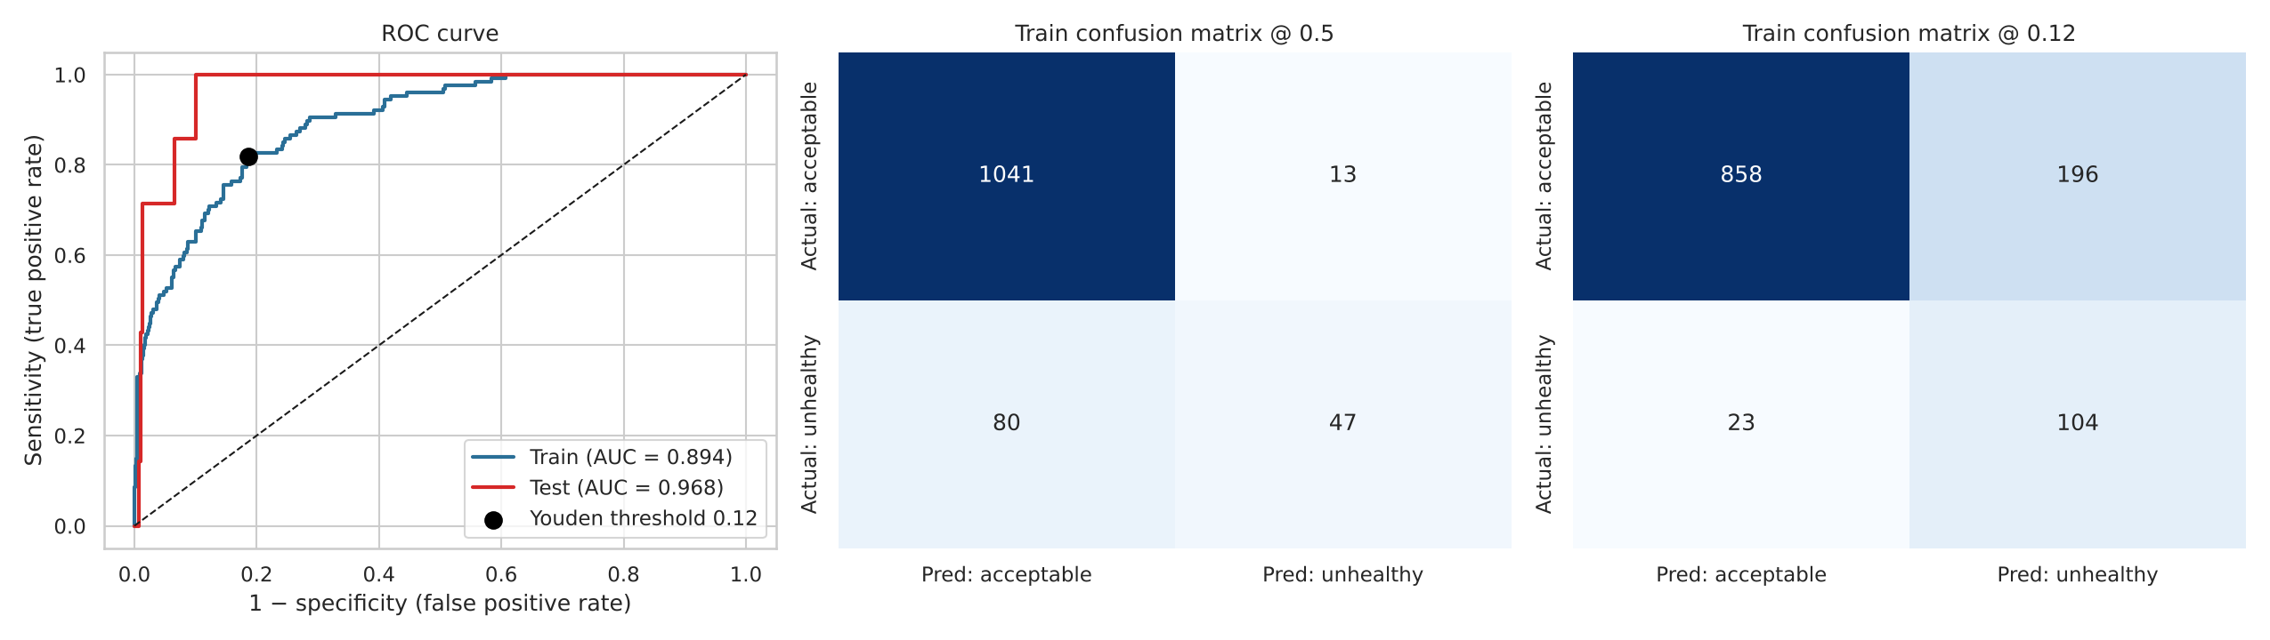
Unit 4: A lower threshold catches more bad days
Data and threshold | Sensitivity | Specificity | Precision | AUC
Train at 0.50 | 0.370 | 0.988 | 0.783 | 0.894
Train at 0.12 (Youden) | 0.819 | 0.814 | 0.347 | 0.894
Test at 0.12 (Youden) | 1.000 (7 of 7) | 0.848 | 0.137 | 0.968
Notes:
The ROC curves show the model ranks unhealthy days above acceptable days well. The default 0.5 threshold catches only 37 percent of unhealthy training days, and its 92 percent accuracy is misleading, since always saying acceptable would score 89 percent. Youden's J, chosen on training data, gives 0.12. That catches 82 percent. The cost is low precision, so most alerts are false alarms. All 7 test days were caught, but 7 is too few to be confident, so the training figures are the more reliable.

Slide 9
What the final model says about each factor
0.609
adjusted R² on 1,181 training days
8.05
test RMSE in µg/m³ (test R² 0.633)
CO, Summer and Post-monsoon are not shown: their intervals include 0 under robust methods.
Notes:
The final model explains 61 percent of training variation, with a test RMSE of 8.05 and test R-squared of 0.633. Each bar holds the other variables fixed. SO2 looks large per 10 micrograms, but it is low and varies little in Bengaluru. NO's negative sign reflects the overlap between NO, NO2 and NOx, not a cleaning effect. CO, Summer and Post-monsoon are left out here because their intervals include zero under the robust methods.

Slide 10
Conclusions and limits
1
Focus winter action on dust and traffic
PM10 and NOx show the strongest links (SDG 11.6)
What the results cannot tell us
Associations, not proof of cause
Same-day readings, not a forecast
Clean test period: RMSE 8.05, against about 12.8 in cross-validation
44 false alarms against 7 true alerts at the 0.12 threshold
The NO2 effect depends on the period
2
Use a sensitive threshold for health alerts
0.12 catches far more unhealthy days, with many false alarms (SDG 3.9)
3
Add automatic sensor checks
Rules such as PM2.5 never exceeding PM10 catch errors like these
Next: a next-day forecast using lagged values and weather.
Notes:
To conclude: PM10, NOx and season are the factors most consistently linked to PM2.5. The findings suggest three practical steps, though they would need more evidence on causes before becoming policy. It's also important to be clear about the limits. This is observational, city-level data, and both models use same-day readings, so they don't forecast. The test period is calm and includes the lockdown, so the test score is likely flattering, and our chosen model is not the most accurate on it. Most alerts are false alarms. The NO2 effect is 6.5 percent over the full period, but 0.6 percent and not significant from 2018 to 2020. The natural next step is a true next-day forecast using lagged values and weather data. Thank you, and we welcome questions.

