Slide 1
Amazon S3 Simple Storage Service

Slide 2
Contents
Introduction to S3
Features of Amazon S3
How it works
Amazon S3 data consistency model
Accessing Amazon S3
Paying for Amazon S3
Type of Question appear in exam

Slide 3
Introduction
Amazon Simple Storage Service (Amazon S3) is an object storage service that offers industry-leading scalability, data availability, security, and performance.
You can use Amazon S3 to store and retrieve any amount of data at any time, from anywhere.

Slide 4
Features of Amazon S3
Storage Classes
Storage Management
Access Management
Storage logging and monitoring
Strong consistency

Slide 5
How it works?
Buckets
Objects
Keys
S3 Versioning
Version ID
Bucket policy

Slide 6
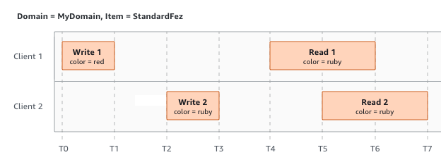
Amazon S3 Data Consistency Model

Slide 7
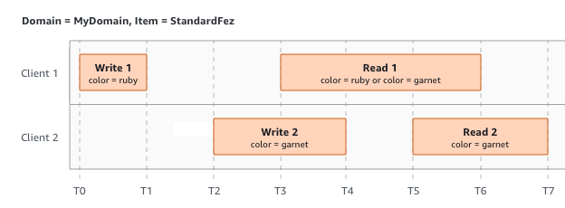

Slide 8
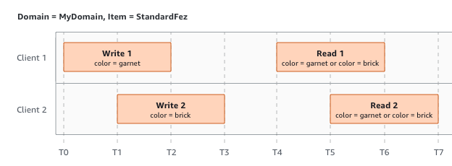

Slide 9
Accessing Amazon S3
AWS Management Console :
AWS Command Line Interface :
AWS SDKs :
Amazon S3 Rest API :

Slide 10
Benefits of Using S3
Durability
Low cost
Scalability
Availability
Security
Flexibility
Simple data transfer

Slide 11
Paying for Amazon S3
Amazon S3 charges you only for what you actually use, with no hidden fees and no overage charges.
This model gives you a variable-cost service that can grow with your business while giving you the cost advantages of the AWS infrastructure

Slide 12

Thank you

