Slide 1

Unit Testing-Junit
Introduction, Overview, Environment Setup, Test case run

Slide 2
Introduction of Unit testing
A unit is a single testable part of a software system and tested during the development phase of the application software
The purpose of unit testing is to test the correctness of isolated code. A unit component is an individual function or code of the application.
It is usually done by the developers.

Slide 3
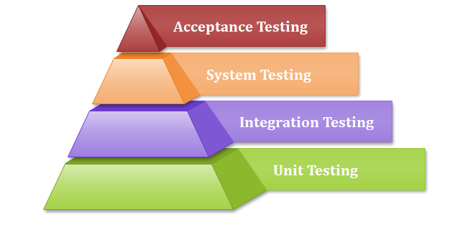
Why Unit Testing?

Slide 4
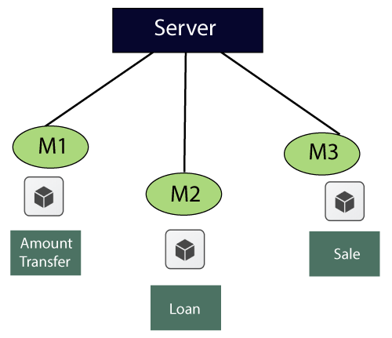
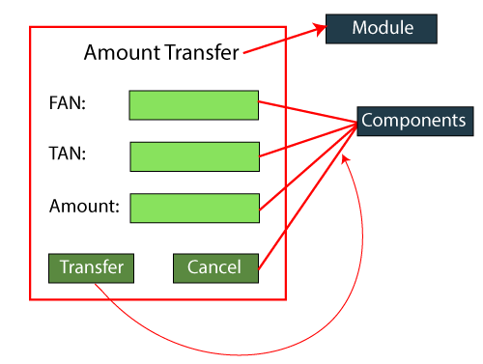
Example of Unit testing:

Slide 5
Values | Description
1234 | accept
4311 | Error message→ account valid or not
blank | Error message→ enter some values
5 digit/ 3 digit | Error message→ accept only 4 digit
Alphanumeric | Error message → accept only digit
Blocked account no | Error message
Copy and paste the value | Error message→ type the value
Same as FAN and TAN | Error message

Slide 6
Tools of Unit Testing
NUnit
JUnit
PHPunit
Parasoft Jtest
EMMA

Slide 7
Unit Testing Techniques:
Data flow Testing
Control Flow Testing
Branch Coverage Testing
Statement Coverage Testing
Decision Coverage Testing

Slide 8
Advantages of unit testing
Unit testing uses module approach due to that any part can be tested without waiting for completion of another parts testing.
The developing team focuses on the provided functionality of the unit and how functionality should look in unit test suits to understand the unit API.
Unit testing allows the developer to refactor code after a number of days and ensure the module still working without any defect.

Slide 9
Disadvantages
It cannot identify integration or broad level error as it works on units of the code.
In the unit testing, evaluation of all execution paths is not possible, so unit testing is not able to catch each and every error in a program.
It is best suitable for conjunction with other testing activities.

Slide 10
Junit- Introduction, Overview
It is an open-source testing framework for java programmers. The java programmer can create test cases and test his/her own code.
It is one of the unit testing framework. Current version is junit 4.
To perform unit testing, we need to create test cases. The unit test case is a code which ensures that the program logic works as expected.
The org.junit package contains many interfaces and classes for junit testing such as Assert, Test, Before, After etc.

Slide 11
Types of Unit Testing
Manual Testing
Automation Testing
Annotations of Junit Testing
@Test
@Test(timeout=1000)
@BeforeClass
@Before
@After
@AfterClass

Slide 12
Junit Environment Setup
JDK | 1.5 or above.
Memory | No minimum requirement.
Disk Space | No minimum requirement.
Operating System | No minimum requirement.

Slide 13
Steps
Verify Java Installation in Your Machine
Set JAVA Environment :
Set the environment variable JAVA_HOME to C:\Program Files\Java\jdk1.8.0_101
Download JUnit Archive : junit4.12.jar (http://www.junit.org )
Set JUnit Environment
Set the environment variable JUNIT_HOME to C:\JUNIT
Open Command Console | c:\> java -version

Slide 14
7. Set CLASSPATH Variable
Set the environment variable CLASSPATH to %CLASSPATH%;%JUNIT_HOME%\junit4.12.jar;.;
To set the classpath variable
Goto- Settings->Advance system setting->environmental variable->path->edit->new->add the path of junit->click on apply->ok
Test JUnit Setup
Create a java class file name TestJunit in C:\>JUNIT_WORKSPACE
Create a java class file name TestRunner in C:\>JUNIT_WORKSPACE to execute test case(s).
Verify the Result

