Slide 1
CAREERBRIDGE
Training & Placement
Management System
A full-stack operational workspace for student growth, institute performance, and placement outcomes.
Project presentation · 2026

Slide 2
WHY CAREERBRIDGE
CareerBridge
The problem and the product
The problem
The solution
The outcome
Student records, attendance, practice assessments, projects, and hiring outcomes are often spread across spreadsheets and disconnected tools.
One secure workspace where staff can see learner progress, create records, and move candidates through placement stages.
Clearer follow-up, faster operations, better visibility, and a complete Login → Placement workflow.
Core modules
Student and batch management
Attendance and low-attendance identification
Mock tests and mock interviews
Projects, teams, and trainer evaluation
Companies, applications, interviews, and offers
Dashboard metrics and operational reports
02

Slide 3
HOW IT IS BUILT
CareerBridge
Technology and architecture
Frontend
Backend
Database
React 19 + TypeScript + Vite
Responsive admin console
Lucide icon system
Node.js + Express + TypeScript
JWT authentication
Zod validation
SQLite for local development
Prisma ORM
Versioned migrations
Browser
HTTP / JSON / JWT
Prisma Client
Data is saved by the Express API immediately after a validated form submission. The UI reloads the latest records from the database.
03

Slide 4
PERSISTENCE AND RELATIONSHIPS
CareerBridge
Database design
Local database location
server/prisma/dev.db
Schema source: server/prisma/schema.prisma
People
Progress
Outcomes
User · Student · Batch
Roles: ADMIN, TRAINER, PLACEMENT, STUDENT
Attendance · MockTest · TestResult
Interview · Project · ProjectMember
Company · Application
Stages from APPLIED to SELECTED
Prisma migrations make schema changes repeatable. For production, SQLite can be replaced with PostgreSQL using the same ORM boundary.
04

Slide 5
SECURITY FLOW
CareerBridge
Authentication and roles
Login
bcrypt compare
JWT signed for 8 hours
Protected API
Bearer token
Database
Prisma query
POST /api/auth/login
Roles
ADMIN
TRAINER
PLACEMENT
STUDENT
Full operations access
Cohorts, attendance, projects
Companies and applications
Created through signup
05

Slide 6
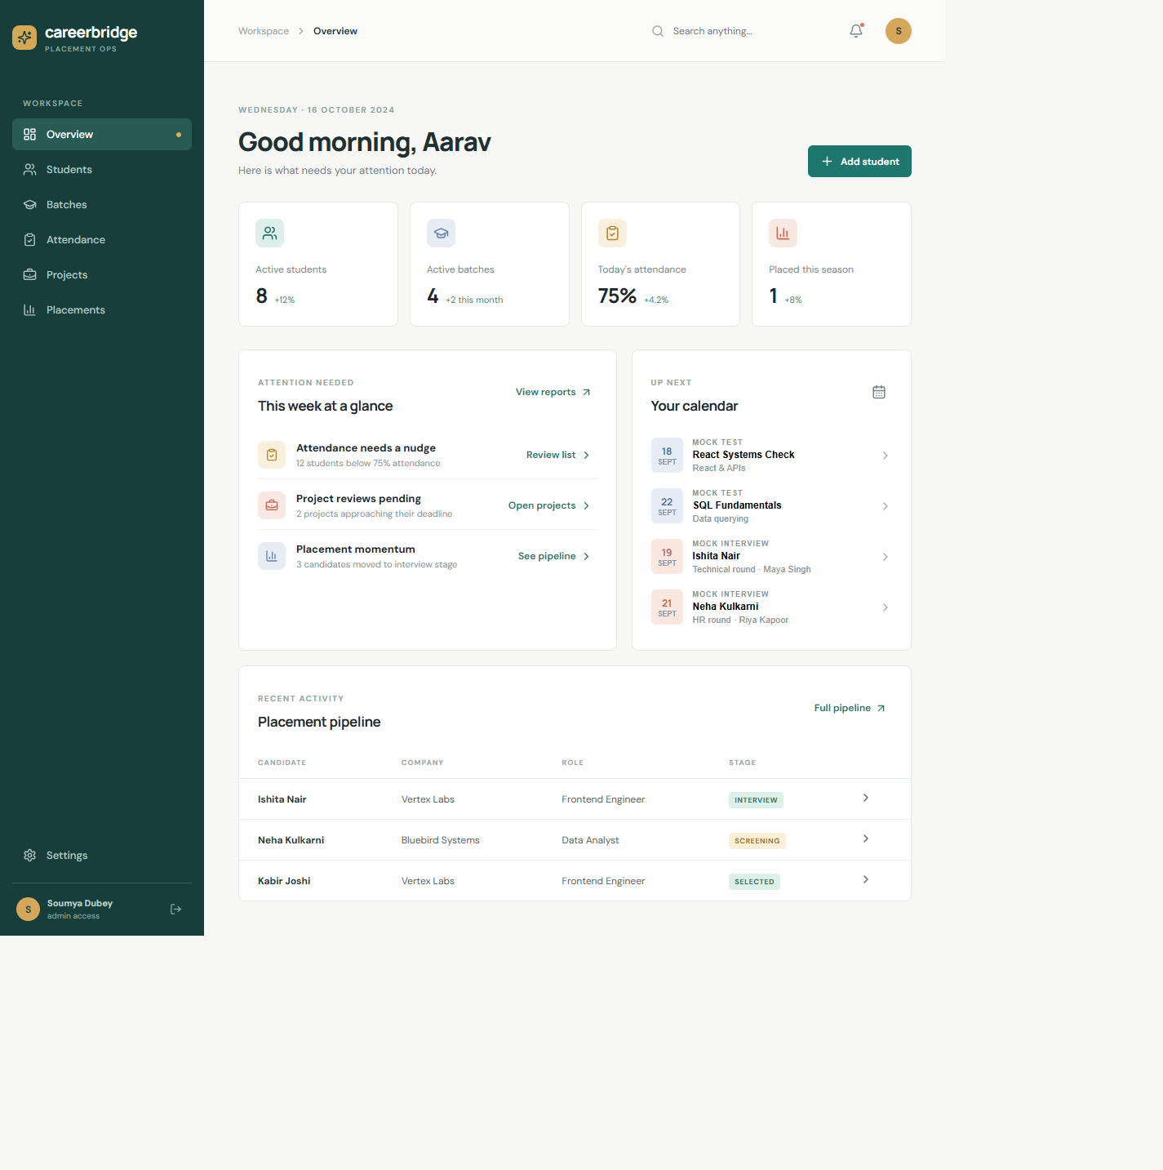
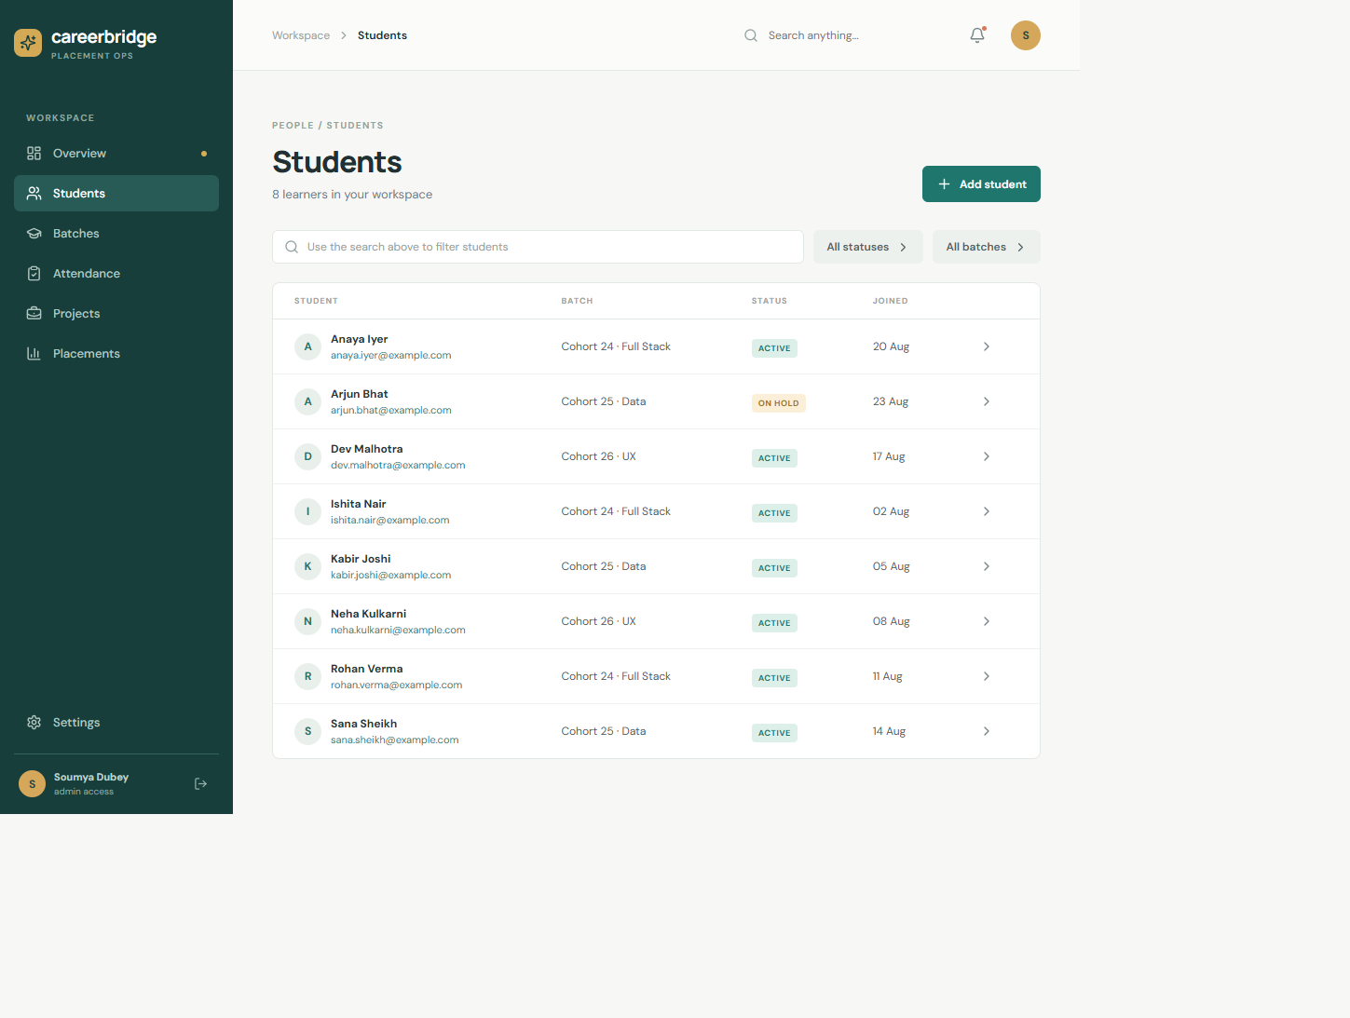
LIVE PRODUCT WALKTHROUGH
CareerBridge
Application screens
Dashboard overview
Students and direct email actions
06

Slide 7
HOW A STAFF MEMBER USES IT
CareerBridge
End-to-end operational workflow
1
Login
2
Add student
3
Create batch
4
Mark attendance
JWT session
Validated form
Course + trainer
Present / absent
5
Assess
6
Track project
7
Place
Tests + interviews
Team + deadline
Company + offer
Every create form now calls a protected API, persists through Prisma, and reloads the dashboard state after success.
07

Slide 8
IMPORTANT IMPLEMENTATION NOTE
CareerBridge
Why “Add” was not working
Before
Fix
After
Only Add student was connected to POST /api/students. Other buttons showed an informational toast and did not save a record.
Added validated endpoints and forms for batches, attendance, projects, and placement openings.
Submit → API validates → Prisma saves → UI reloads → success toast appears.
The system is now honest about its behavior: actions that create records have a form and a database route.
Current local admin account
dubeysoumya8@gmail.com · demo123
08

Slide 9
DELIVERY
CareerBridge
Run, demo, and next steps
Run locally
Open
npm install
npm install --prefix server
npm install --prefix client
npm run prisma:generate --prefix server
npm run prisma:migrate --prefix server
npm run seed
npm run dev
http://localhost:5173
Admin login
dubeysoumya8@gmail.com
demo123
Recommended next steps
Add complete edit/delete screens for every entity
Add real interview scheduling and project assignment APIs
Move production data to PostgreSQL
Add SMTP provider for automatic email notifications
Add automated tests, audit logs, and deployment secrets
09

