Slide 1
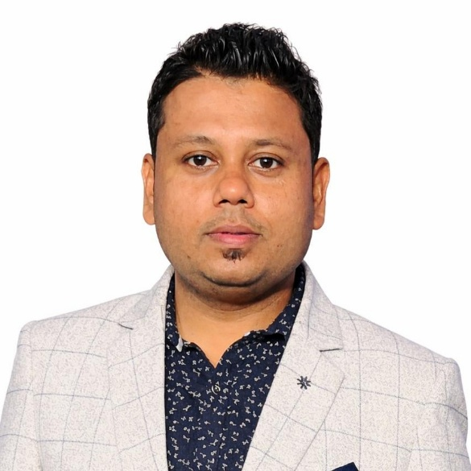
Soumya Dutta
Graphic Designer
CONTACT
ABOUT ME
Versatile graphic designer with over 12 years of experience creating premium digital layouts, corporate presentations, and print media. Focused on utilizing cutting-edge tools to deliver impactful visual designs.
+91 96745 34155
linkedin.com/in/soumya-dutta-72238b27/
soumyadutta100@gmail.com
1st-FR, FL 1B, 80 Lalgarh Colony, Kolkata 700 030
WORK EXPERIENCE
SKILLS
RS Software (India) Ltd.
Senior Executive
2020 – Present
Figma, Adobe Photoshop, Adobe Illustrator, Adobe InDesign
Infymax Solutions Pvt Ltd
Adobe Premiere Pro, Adobe After Effects, Adobe Animate CC
Graphic Designer
2014 – 2020
Basic HTML & CSS
Cognition Publication
Graphic Designer
LANGUAGES
2011 – 2014
EDUCATION
English
Graduation in Philosophy
2005 – 2008
Bengali
Calcutta University
Hindi
Multimedia Training
2008 – 2011
Arena Animation Academy Specialist Program (AAASP)
https://soumyadutta100.github.io/Portfolio2026/

