Slide 1
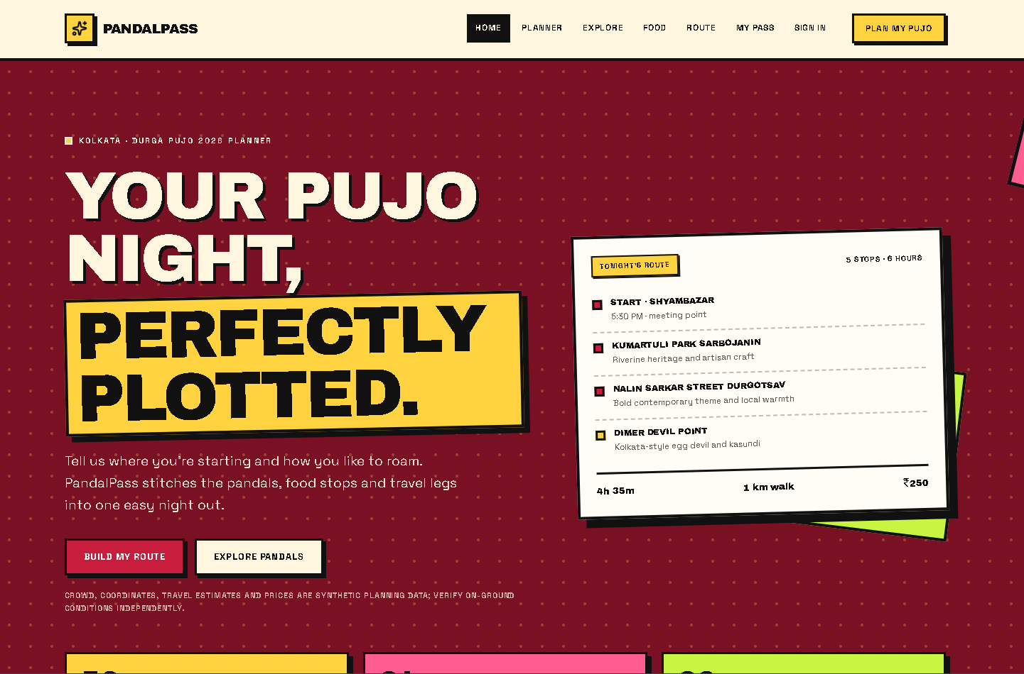
PANDAL
DURGA PUJO 2026 | KOLKATA
HOPPERS
A database-first route planner for pandal-hopping nights
Next.js
TypeScript
Aiven MySQL 8
pandal-hoppers.vercel.app
Notes:
Title slide. PandalHoppers (rebranded from PandalPass, Oct 2026).

Slide 2
ONE NIGHT, FIVE DECISIONS
THE PROBLEM
1
Which neighbourhood to start from
WHO IT IS FOR
College students and young professionals
Friend groups planning a Pujo night out
Anyone exploring pandals with a plan
2
How many pandals fit in my time window
3
Crowd level and vibe: iconic, photogenic, quiet
4
Where to slot a food stop between pandals
5
1
5
Total cost, travel time and walking distance
inputs
timed itinerary
Notes:
Planning a pandal night means juggling start point, time, vibe, travel mode and food.

Slide 3






SIX CORE CAPABILITIES
KEY FEATURES
Start points
Vibe filters
Time window
24 Kolkata origins, from Barasat to Joka
Iconic, photogenic, quiet, family, high-energy
2 to 12 hours maps to 2 to 8 pandals
Travel modes
Food stops
Cost and time
Metro, auto + metro, walk or cab
30 demo vendors slotted into the route
Per-person cost, minutes and km per leg
Notes:
Six core capabilities, all driven by database content.

Slide 4
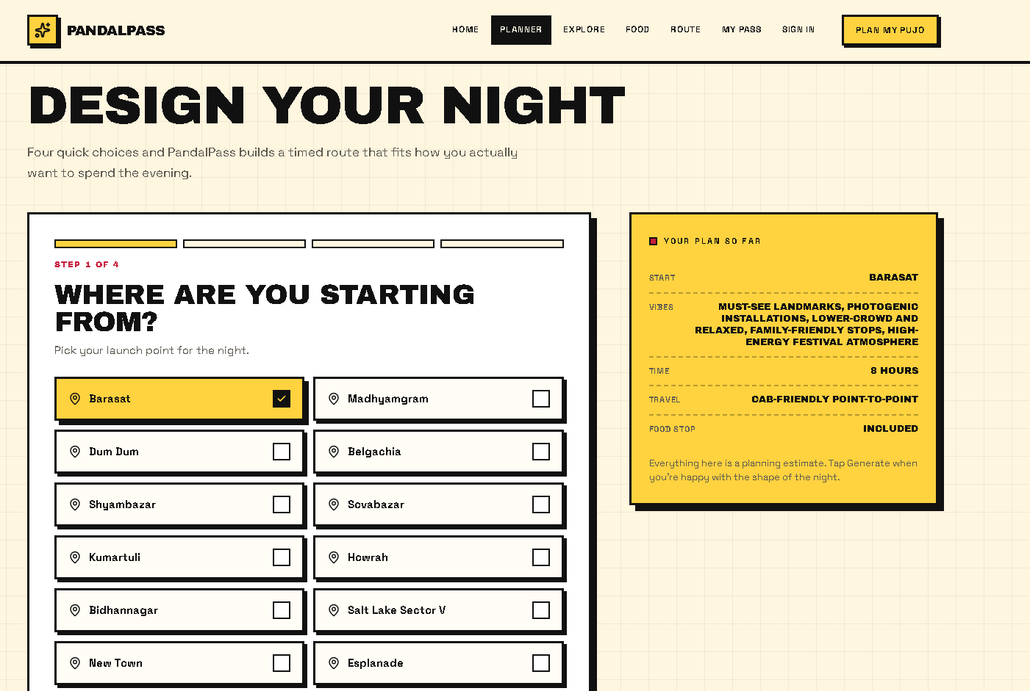
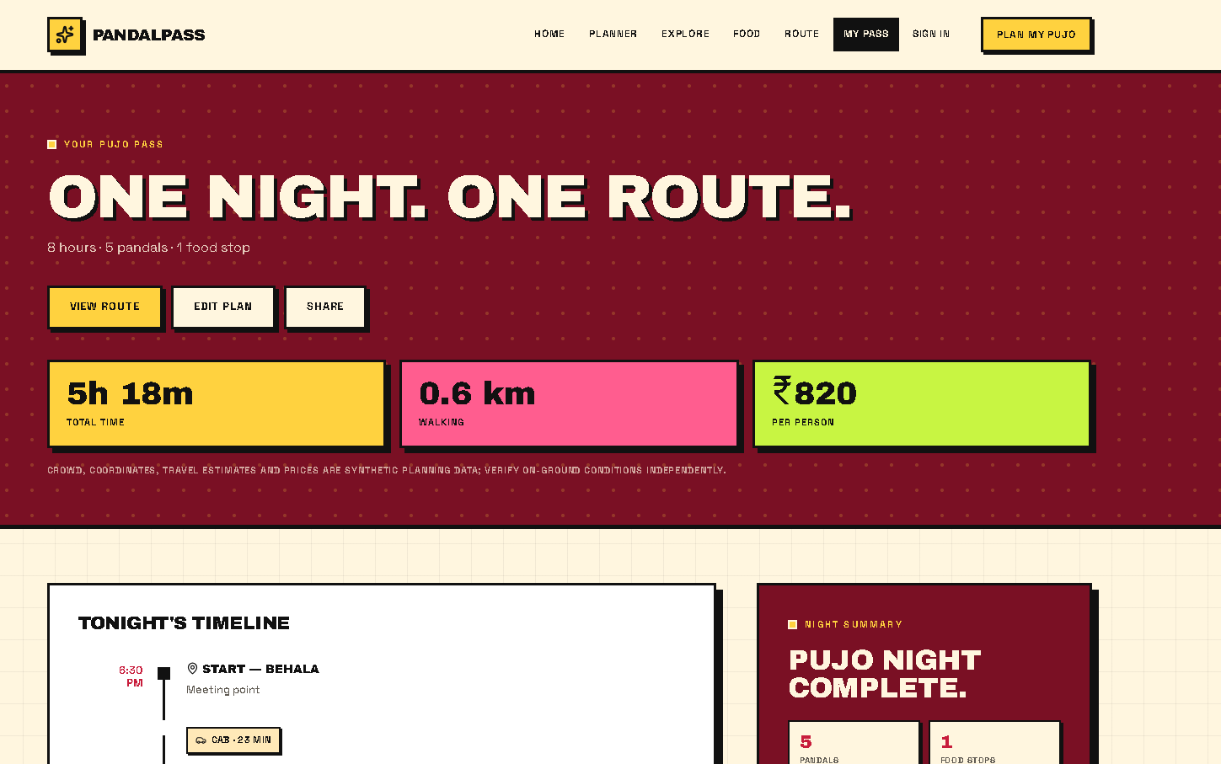
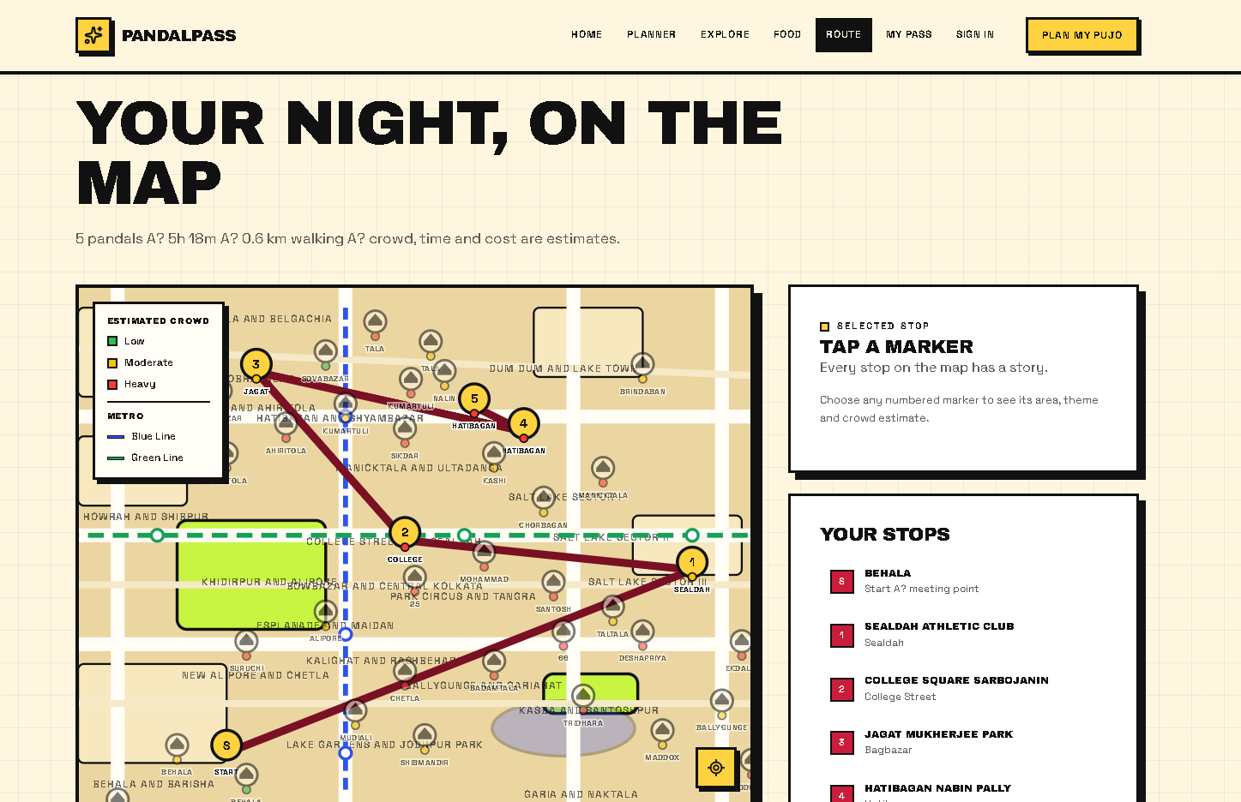
FOUR SCREENS, ONE ROUTE
THE PRODUCT, LIVE
1
2
1 HOME
Hero route card and stats
2 PLANNER
4-step wizard with live plan summary
3
4
3 PASS
Timeline, time, walking and cost
4 ROUTE
SVG map with crowd-coloured pins
Source: pandal-hoppers.vercel.app
Notes:
Screens captured from the live site pandal-hoppers.vercel.app (earlier PandalPass branding visible in the UI).

Slide 5
FOUR LAYERS, ONE SOURCE OF TRUTH
SYSTEM ARCHITECTURE
Browser
API routes
repository.ts
Aiven MySQL 8
JSON
read
SQL
Next.js 14 + React
Tailwind, TypeScript
app/api/*
Vercel functions
5-min in-memory cache + pooled reads
Catalog tables
Settings JSON, users
auth.ts
itinerary.ts
REQUEST FLOW
Planner wizard posts prefs to /api/planner
Validate, normalizePrefs, generatePass
Save pass + prefs, redirect to /pass
scrypt hash + http-only cookie (7d)
generatePass() route engine
Stateless by design: no server sessions, the catalog is read from MySQL and cached 5 minutes, so every page renders from one source of truth.
Notes:
Four layers: browser, API routes, repository cache, MySQL. Engine and auth are lib modules.

Slide 6
TEN TABLES, ALL CONTENT IN SQL
DATABASE SCHEMA
pandals
pandal_tags
starts
foods
vibes
56
2-3
24
30
5
rows
per pandal
rows
rows
rows
id, name, area, tagline, crowd ENUM, x, y
pandal_id FK, tag, position
name, x, y, position
id, icon, name, kind, area, price
id, icon, label, position
travel_modes
time_options
map_areas
settings
users
4
9
22
8
KEPT
rows
rows
rows
JSON keys
on reseed
id, icon, label, position
hours, count (pandals)
label, x, y, position
site, engine, defaultPrefs, home, tagLabels...
id, username, password_hash
pandals 1 ---< N pandal_tags (ON DELETE CASCADE) | all engine tuning lives in settings.engine JSON
Notes:
Ten tables. Content tables are rebuilt by the seed; users persist.

Slide 7
FIVE STEPS FROM PREFS TO PASS
ITINERARY ENGINE
getStart
pickPandals
legFor
Food stop
generatePass
Resolve start coordinates
Score by vibe + crowd, fit time
Mode, minutes, km, cost per leg
Insert after stop 2
Timeline + totals
Travel model (from settings.engine)
DEFAULTS
MODE | TIME | COST | LIMIT
Walk | 13 min per km | Free | Up to 1.8 km
Auto | 6 min + 3.4 per km | Rs 35 + 11 per km | Up to 4.5 km
Metro + walk | 11 min + 2.8 per km | Rs 25 flat | 0.35 km walk
Cab | 7 min + 3.2 per km | Rs 70 + 19 per km | Any distance
Start 17:30
Stay 22 min + 3 per step
Wait: 8 / 19 / 34 min
Food stay 38 min
Notes:
Wait base depends on crowd: low 8, moderate 19, heavy 34 minutes.

Slide 8
SEVEN ROUTES, ONE PATTERN
API REFERENCE
METHOD | ENDPOINT | PURPOSE
POST | /api/auth/login | Sign in, set cookie
POST | /api/auth/register | Create account
GET | /api/auth/me | Current session + data
POST | /api/auth/logout | End session
GET | /api/data | Full catalog
POST | /api/planner | Validate + generate pass
POST | /api/pass | Generate or fetch pass
POST /api/planner
{
"start": "Shyambazar",
"vibes": ["iconic","insta"],
"hours": 6,
"mode": "auto_metro",
"food": true
}
200 OK
{
"pass": {
"pandalIds": [...],
"totalMins": 330,
"cost": 420,
"items": [start, leg, pandal]
},
"redirect": "/pass"
}
Errors: 400 invalid input, 401 not signed in, 500/503 retry with backoff.
Notes:
All routes share one pattern: getProductData(), parse body, JSON response.

Slide 9
A SAMPLE NIGHT
EXAMPLE ROUTE
Illustrative output: Shyambazar, 6 hours, auto + metro, food on
Start: Shyambazar
Crowd mix across 56 pandals
17:30
Departure point
17:42
Hatibagan Sarbojanin
Heavy crowd, wait 34 min
18:50
Nalin Sarkar Street
Moderate, wait 19 min
19:50
Food: Luchi Alur Dom Stop
Rs 100, stay 38 min
~5h
4
Rs 420
20:40
Manicktala Chaltabagan
Heavy crowd, wait 34 min
route length
stops
est. cost / person
Notes:
Sample itinerary; crowd counts are from the 2026 seed (25 heavy, 26 moderate, 5 low).

Slide 10
STACK AND UI COMPONENTS
STACK AND UI COMPONENTS
TECH STACK
PAGES AND COMPONENTS
LAYER | TECHNOLOGY
Framework | Next.js 14, App Router
Language | TypeScript (strict)
Styling | Tailwind, Neo-Brutalist
Database | Aiven MySQL 8
Auth | scrypt + http-only cookie
Hosting | Vercel
ROUTE | COMPONENT | SHOWS
/ | Home + Marquee | Stats, picks
/planner | PlannerClient | 4-step wizard
/pass | PassClient | Timeline, metrics
/route | RouteMap | SVG map + route
/explore | ExploreClient | Vibe filters
/food | FoodCard | Food catalog
/login | LoginClient | Sign in / register
Rebranded PandalPass to PandalHoppers, Oct 2026
All components are functional, typed via PandalPassData props
Notes:
PandalPassData type name is intentionally preserved after the rebrand.

Slide 11
WHAT COMES NEXT
FUTURE SCOPE
HIGH
MEDIUM
LOW
User accounts + email
Multi-day planning
Multi-city support
3-4d
5-7d
Shareable route links
Metro / bus / ride modes
ML route scoring
2-3d
3-4d
Live crowd data
Favourite pandals
Social + group plans
4-5d
2-3d
PWA + offline
Weather-aware routes
3-5d
Also ongoing: type safety, test coverage, performance, accessibility (WCAG 2.1 AA)
Database-first, so every feature extends the schema, not the code.
Notes:
Roadmap priorities from Future-Scope.md.

Slide 12
ONE NIGHT.
SEE YOU AT THE PANDALS
ONE ROUTE.
pandal-hoppers.vercel.app
Notes:
Closing slide. Live demo at pandal-hoppers.vercel.app.

