Slide 1
Amazon_Sales_Data_Analysis_Wireframe
File created on: 30-09-2023 11:56:33

Slide 2
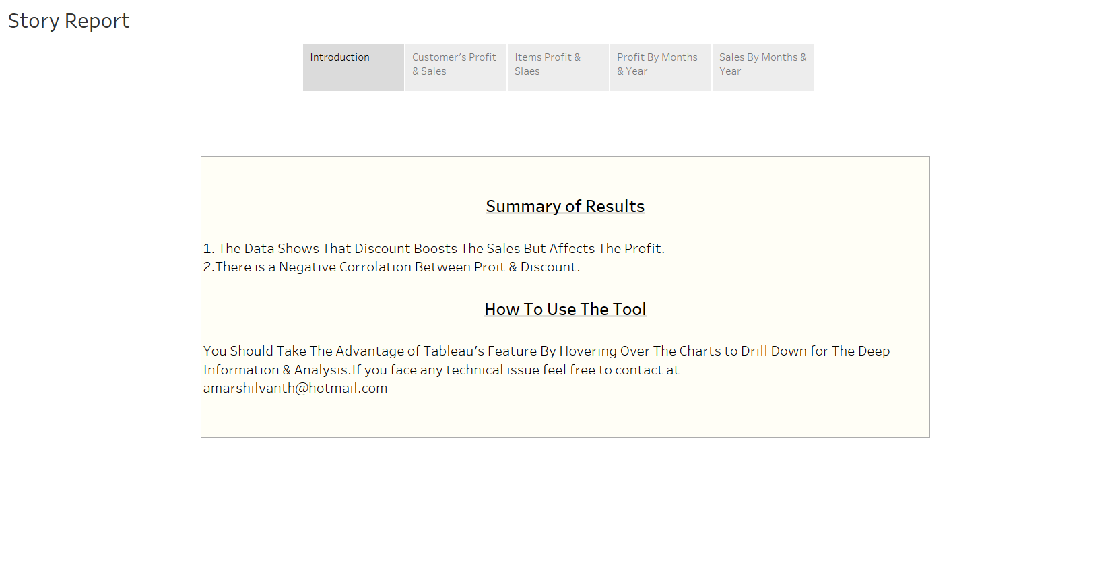

Slide 3
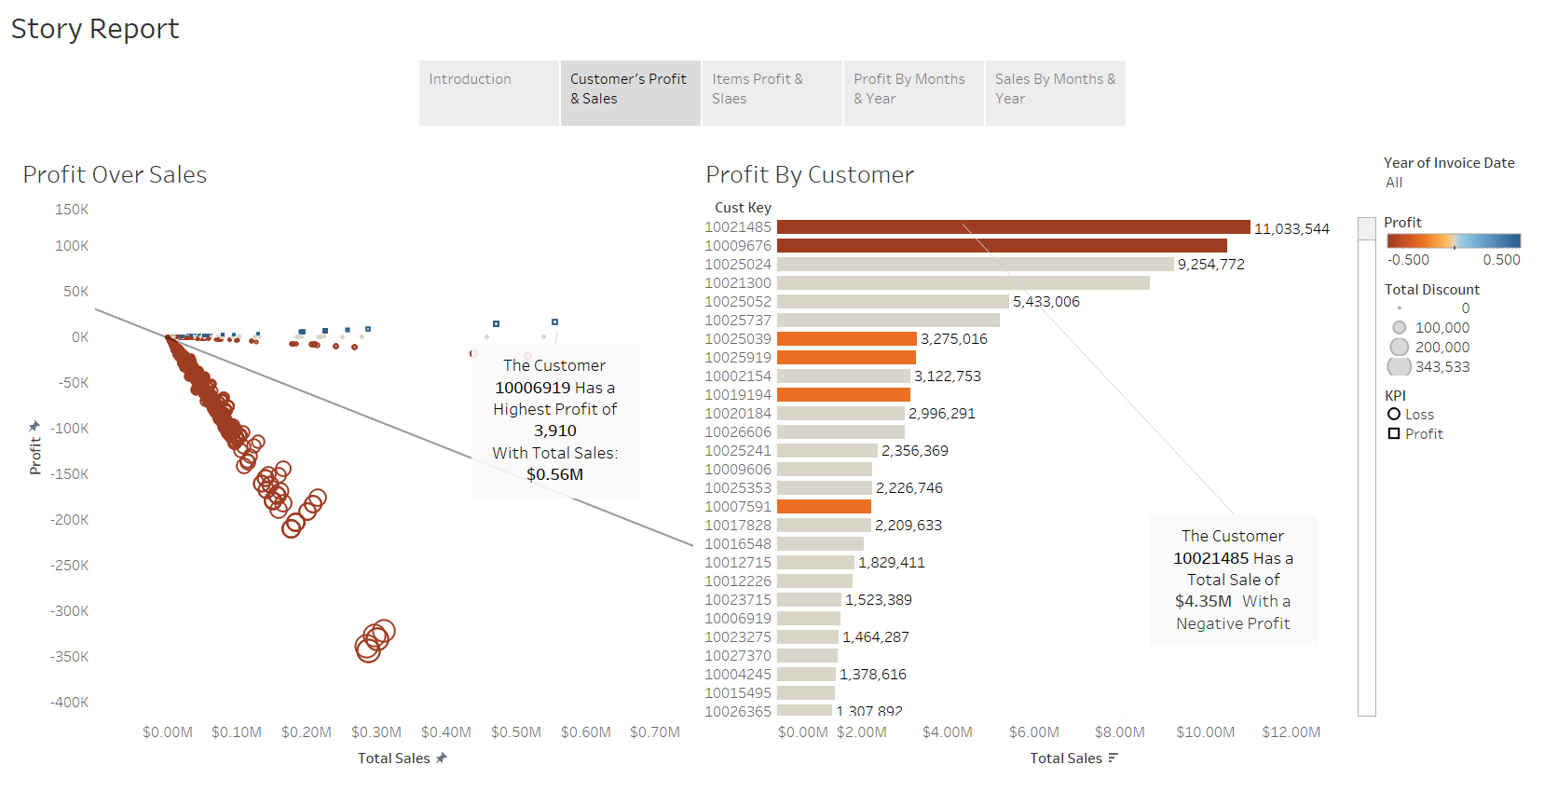

Slide 4
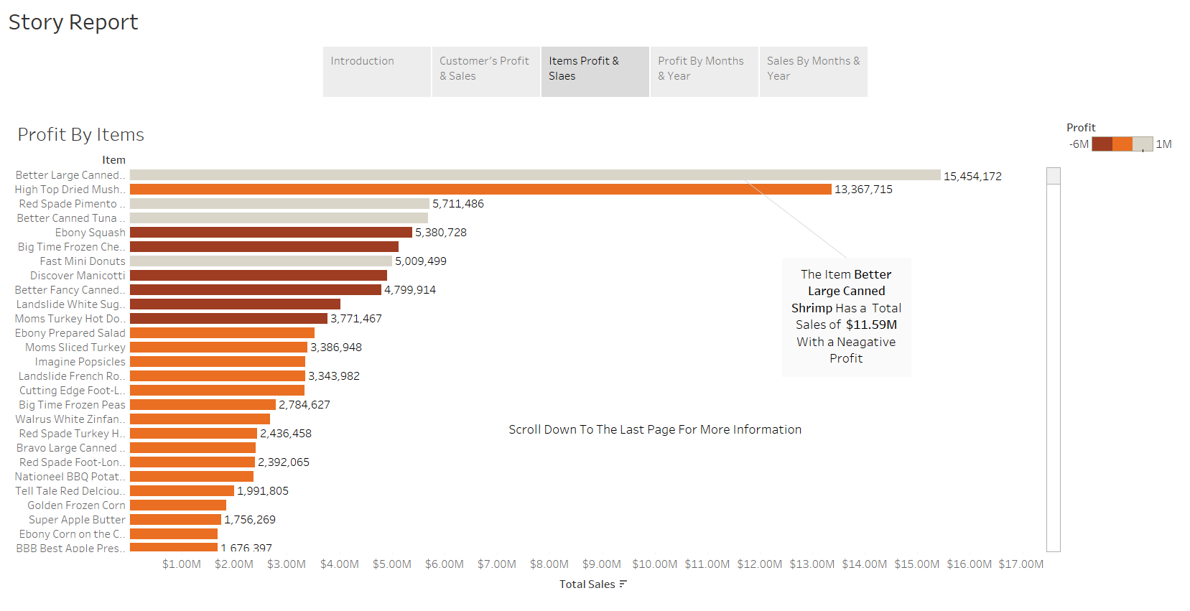

Slide 5
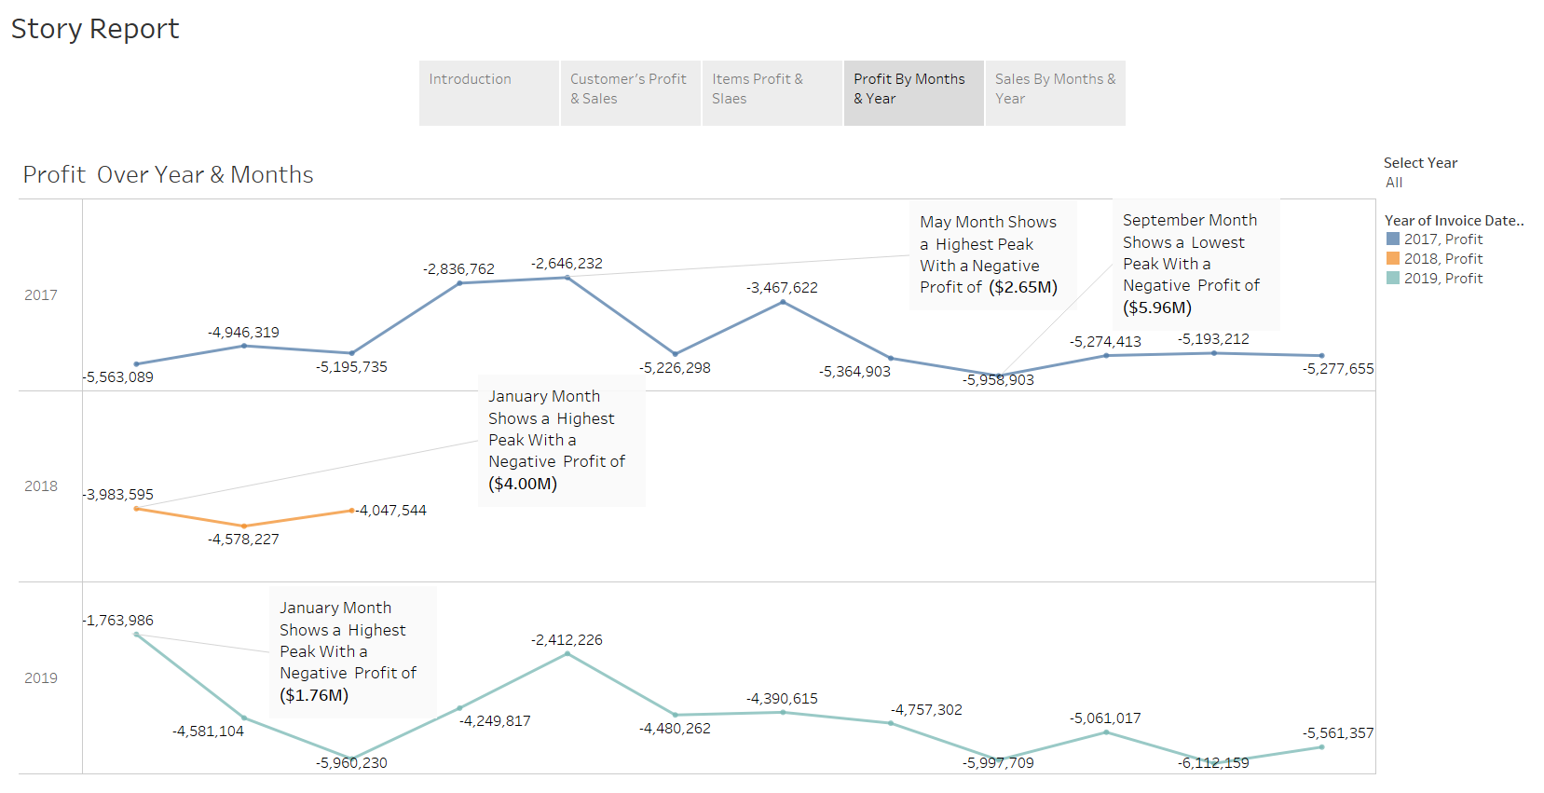

Slide 6
