Slide 1
A STUDY ON FAKE NEWS DETECTION USING MACHINE LEARNING AND DEEP LEARNING TECHNIQUES
SOUMYAJIT BHATTACHARYYA
ROLL NO.- 192CS025

Slide 2
OVERVIEW
Fake News :
Misguide readers intentionally.
Propaganda , Hoax.
Spread through traditional news and social media.
Impact on political scenario & financial market.
Currently emerging research area .

Slide 3
OVERVIEW
Problem Definition :
Manually fact checking not possible.
Quick and accurate classification of news .
Build models combining NLP and Machine Learning techniques.
Compare them in terms of accuracy,precision,recall & f1-score.

Slide 4
WORK DONE UPTO MID SEMESTER
Dataset Collection :
Dataset source - Kaggle
ID, Title, Author, Text, Label
Label 1 - Unreliable.
Label 0 - Reliable.
Approx. 20,500 records.
Nearly half are reliable and half are fake.

Slide 5
WORK DONE UPTO MID SEMESTER
Data Preprocessing :
Remove null, infinity values.
Remove all non-alphanumeric characters.
Remove stopwords.
After preprocessing nearly 16,600 records.
Apply Doc2Vec to convert to LabeledSentence & extract feature.

Slide 6
WORK DONE AFTER MID SEMESTER
Models used :
Naive Bayes
SVM
Random Forest
Deep Neural Network
Best performance given by Deep Neural Network

Slide 7
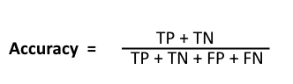



WORK DONE AFTER MID SEMESTER
Metrics used for comparison :

Slide 8


NAIVE BAYES
Based on Bayes’ theorem
Assumes independence among features .
Posterior probability for each class is calculated.
Class with max. probability is assigned to sample.

Slide 9
SUPPORT VECTOR MACHINE (SVM)
To find maximally separating hyperplane.
Y=W.X+b.
For an incoming sample -
If Y-WX-b >= 0 it will be on one class.
If Y-WX-b <=0 it will be on another class.

Slide 10
RANDOM FOREST
Ensemble Classifier
Grow multiple decision trees on different samples (Done with replacement).
Combine multiple random subset decision trees.
Produce a final class based on majority voting.

Slide 11
DEEP NEURAL NETWORK
3 Hidden layers of size 128, 64 & 32.
Size of input layer 300.
ReLU in input and hidden layers.
Sigmoid in output layer.
Batch size = 64 , optimizer is adam.
Loss function is binary cross entropy.

Slide 12
 | Accuracy | Precision | Recall | F1-score
Naive Bayes | 72.14% | 68.08% | 85.95% | 75.98%
SVM | 91.55% | 90.72% | 92.83% | 91.77%
Random Forest | 88.35% | 89.68% | 87.04% | 88.34%
Deep Neural Network | 92.29% | 91.97% | 92.93% | 92.45%
RESULTS

Slide 13
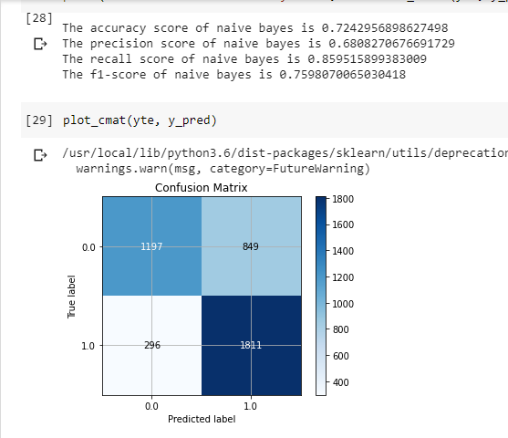
SNAPSHOT(NAIVE BAYES)

Slide 14
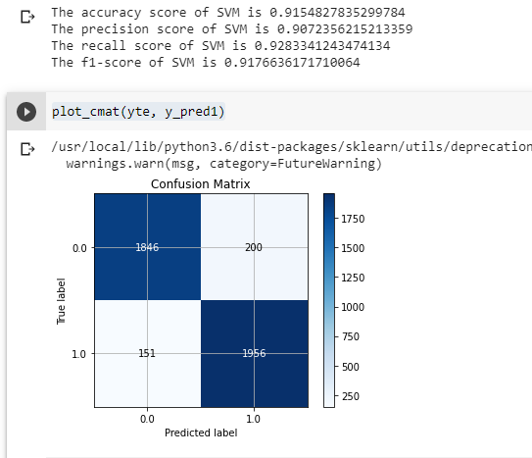
SNAPSHOT(SVM)

Slide 15
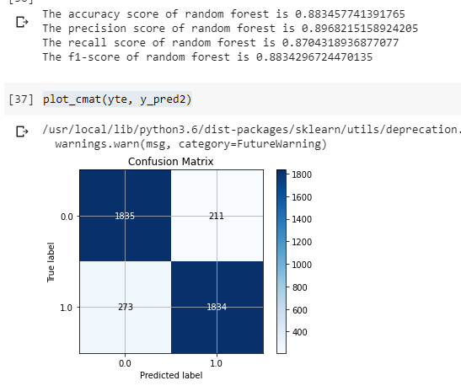
SNAPSHOT(RANDOM FOREST)

Slide 16
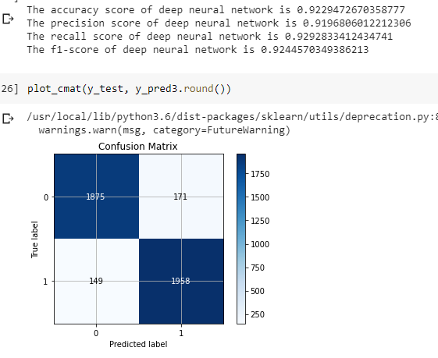
SNAPSHOT(DEEP NEURAL NETWORK)

Slide 17
FUTURE WORK
POS tags & EMPATH can be used for syntax & semantic analysis.
GloVe embedding can be used for preserving semantic similarity.
TFIDF can be used for better vector representation.
Metadata like author , title can be used.
CNN, LSTM can be used.

Slide 18
REFERENCES
“Liar, Liar Pants on Fire : A New Benchmark Dataset for Fake News Detection” - William Yang Wang ,2017.
“A Benchmark Study on Machine Learning Methods for Fake News Detection” - Junaed Younus Khan, Md. Tawkat Islam Khondaker, Anindya Iqbal, Sadia Afroz,2019.

Slide 19
THE END

