Slide 1

Implementation of Quantum Hash
NETAJI SUBHASH ENGINEERING COLLEGE
DEPARTMENT OF ELECTRONICS AND COMMUNICATION
SUBMITTED BY :
SOUMYAJYOTI SAHA-10900320058
SHOUVIK PAUL- 10900320067
SNEHA SAHA – 10900320090
DEBOSMITA MONDAL - 10900320094
UNDER THE GUIDANCE OF :
PROF. ANINDITA SARKAR

Slide 2
Implementation of Quantum Hash
Hash Function is a Popular cryptographic function known for its high collision resistance property. It is used for authentication purpose in many significant applications.
Emergence of quantum computing poses a threat to current cryptographic solutions. Most of these cryptographic algorithms cannot resist quantum attacks.
In this thesis, a 256-bit Quantum Hash has been proposed which is a modified version of SHA-256.
It is designed with reversible gates which are the key components in a quantum computer.
The quantum hash can be implemented on both classical and quantum computers.
It is Simulated using Python's Qiskit framework.
It is dynamic and lightweight as well as provides advantages in power reduction and speed maximization.
The circuit comprises of XOR and Feynman Gates.
Comparative performance analysis is done with standard SHA-256.
The comparison is done on the basis of gate count, garbage value, and time complexity.

Slide 3
Introduction of SHA-256
Part of the SHA-2 family, designed by the NSA.
Produces a 256-bit (32-byte) hash value.
Ensures data integrity and authentication.
Fixed Length Output: 256-bit hash.
Preimage Resistance: Hard to reverse the hash to original input.
Collision Resistance: Unlikely for two inputs to produce the same hash.
Avalanche Effect: Small input changes result in significantly different hashes.
Data Integrity: Verifies data has not been altered.
Application:
Digital Signatures: Authenticates sender and message.
Password Hashing: Secures stored passwords.
Blockchain: Secures transactions.
Certificates and SSL/TLS: Secures internet communications.

Slide 4
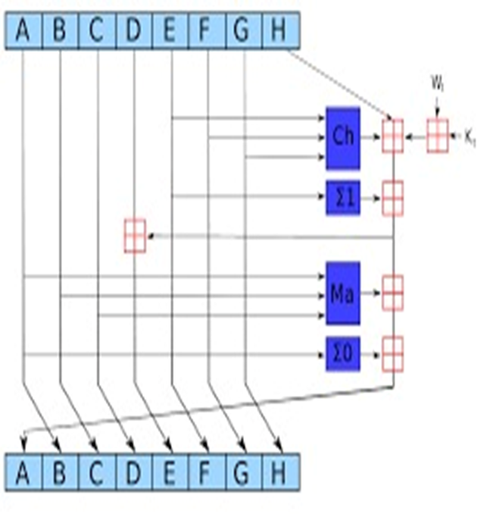
Pseudo Code for SHA-256
Step 1: Initialize Hash Values
The hash values (H0 to H7) are initialized to the first 32 bits of the fractional parts of the square roots of the first eight prime numbers. These values are constants specified in the SHA-256 standard.
Step 2: Initialize Round Constants
The array of round constants (K) consists of 64 values, each being the first 32 bits of the fractional parts of the cube roots of the first 64 prime numbers. These constants are also specified in the SHA-256 standard.
Step 3: Pre-processing (Padding)
Original Message Length: The length of the original message is calculated in bits.
Padding: A single '1' bit is appended to the message, followed by '0' bits until the length of the message (in bits) is congruent to 448 modulo 512. This ensures the final message length (including padding) is a multiple of 512 bits but leaves 64 bits free.
Append Length: The 64-bit big-endian representation of the original message length is appended to the message. This finalizes the padding process.
Step 4: Process the Message in 512-bit Chunks
The padded message is processed in 512-bit chunks.
Step 4.1: Break Chunk into 32-bit Words
Each 512-bit chunk is divided into sixteen 32-bit words (W[0] to W[15]).
Step 4.2: Extend Words
The first 16 words are extended into 64 words (W[0] to W[63]). Each word from W[16] to W[63] is computed based on a combination of previous words.

Slide 5
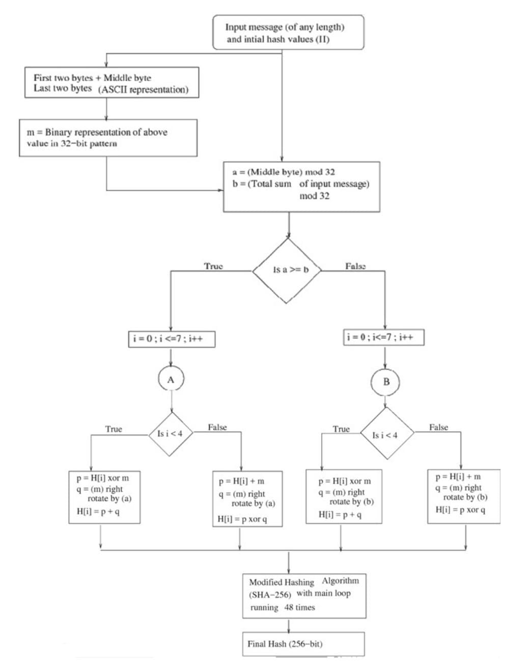
DYNAMIC SHA-256
The algorithm SHA-256 has initial hash values fixed (32 bits) which are derived from the square root of the first eight prime numbers and there are no specific reasons for the selection of such fixed values.
It is proposed to design the hash values as a function of input text message instead of those directly chosen fixed values.
The proposed algorithm can be added as module to the initial pre-processing stage of the current SHA-256 implementation leaving less changes in the rest of the rounds.
Keeping hardware, power requirements and cost of implementation in mind, we have modified initial hash values based on the incoming message and reduced further rounds (if standard implementation has r rounds) in main loop to (r-16) to maintain the complexity of the hashing and security level as that of SHA standard implementation.

Slide 6
Proposed Algorithm
1. Calculate two values:
A = (Middle byte of message) mod 32
B = (Total sum of the message) mod 32
2. Update the initial hash values (H(0)1-H(0)8) based on four conditions:
If (A ≥ B) and (i < 5), then H(0)i = ((H(0)i XOR m) + (m rotate right by A))
If (A ≥ B) and (i ≥ 5), then H(0)i = ((H(0)i + m) XOR (m rotate right by A))
If (A < B) and (i < 5), then H(0)i = ((H(0)i XOR m) + (m rotate right by B))
If (A < B) and (i ≥ 5), then H(0)i = ((H(0)i + m) XOR (m rotate right by B))
3. Reduce the number of rounds in the main loop of the SHA algorithm to (r-16), i.e., for SHA-256, reduce to 48 rounds.
4. Feed the updated hash values into the main loop of the SHA algorithm.

Slide 7
A Comparative Analysis of Original SHA-256 & Dynamic SHA-256
Parameter | Original SHA-256 | Dynamic SHA-256
Time Complexity | O(n) | O(n)
Garbage Values | 0 | 384 (Modifying initial hash- 256 + Word expansion- 128
Gate Count | 104 | 96
Space Complexity | O(1) | O(1)
Round | 64 | 48

Slide 8
CONCLUSION
As the concept of a mechanical quantum computer was proposed theoretically in the ’80s and the mid-’90s two algorithms were coined which showed devastating effects of its calculation capacity that cripple the cryptographic world with Shor’s and Grover’s algorithms. After such algorithms were introduced the researchers tried to make the existing cryptographic models quantum resistant. The classical RSA, DES, and AES failed to protect but the modification of AES 128 bit to AES 256 bit which becomes quantum resistant. After that, the researches moved along the asymmetric algorithm that leads to the development of Lattice-based systems. This thesis explains in detail the devastating impact of Shor’s and Grover and explains how it works. This paper also focuses on the quantum-safe symmetric algorithm such as 256 bit in details and it tries to differentiate quantum symmetric algorithms from asymmetric algorithms which have led to a detailed review of latticed based algorithms. This paper can help upcoming researchers to understand the differences and perform better in their respective research fields. Attack analysis of the proposed Hash Function is left for the future work.

Slide 9
REFERENCES
1. A. Barenco et al., “Elementary gates for quantum computation” Phys. Review, vol - A52, 3457. 1995.
2. A. G. Aruna et al, “A Study on Reversible Logic Gates of Quantum Computing”, (IJCSIT) International Journal of Computer Science and Information Technologies, Vol. 7 (1), pp 427-432, 2016.
3.Amandeep Singh, Praveen Agarwal, Mehar Chand, “Analysis of Development of Dynamic S-Box Generation”, International Conference on Computer Science and Information Technology 5(5), pp: 154-163, November, 2017. DOI: 10.13189/csit.2017.050502.
4. Hongbo Wang, Haoran Zheng, Bin Hui and Hongwu Tang, “Improved Lightweight Encryption Algorithm Based on Optimized S-Box”, 2013 International Conference on Computational and Information Sciences, pp 734-737, 2013.
5. M. Almazrooie, A. Samsudin, R. Abdullah et al. Quantum reversible circuit of AES-128. Quantum Inf Process 17, 112 (2018). https://doi.org/10.1007/s11128-018-1864-3

Slide 10


