Slide 1
2022 Key Performance Indicators Summary
Citi Finance
Senior Management Briefing | May 2026
Notes:
1

Slide 2
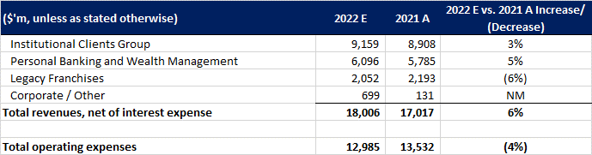
Consolidated KPI Movements (2022E vs 2021A)

Slide 3
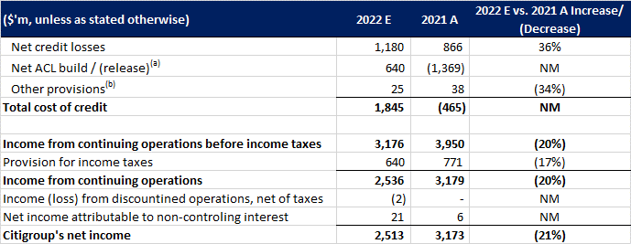
Key Drivers and Executive Summary
(a) Includes credit reserve build / (release) for loans and provision for credit losses on unfunded lending commitments. (b) Includes provisions for policyholder benefits and claims, HTM debt securities and other assets.

