Slide 1
Impact Study of Omicron on Credit Card Sales
Citi Finance
Notes:
1

Slide 2
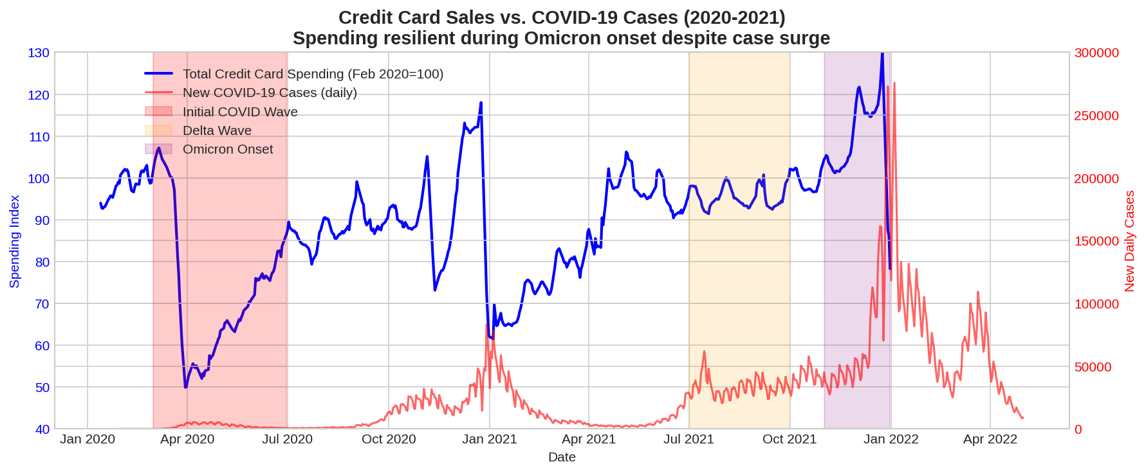
Credit Card Sales vs. COVID-19 Cases
GRAPH 1: Total Credit Card Spending vs. COVID-19 Cases (2020-2021)
Key Observation: Strong negative correlation in 2020 (spending fell ~25% during initial wave). By mid-2021, spending recovered to baseline (~100) despite Delta wave. Critically, during Omicron onset (Nov-Dec 2021), total spending rose ~10% above pre-Omicron levels, demonstrating consumer resilience and adaptation. No evidence of spending contraction entering the Omicron period.

Slide 3
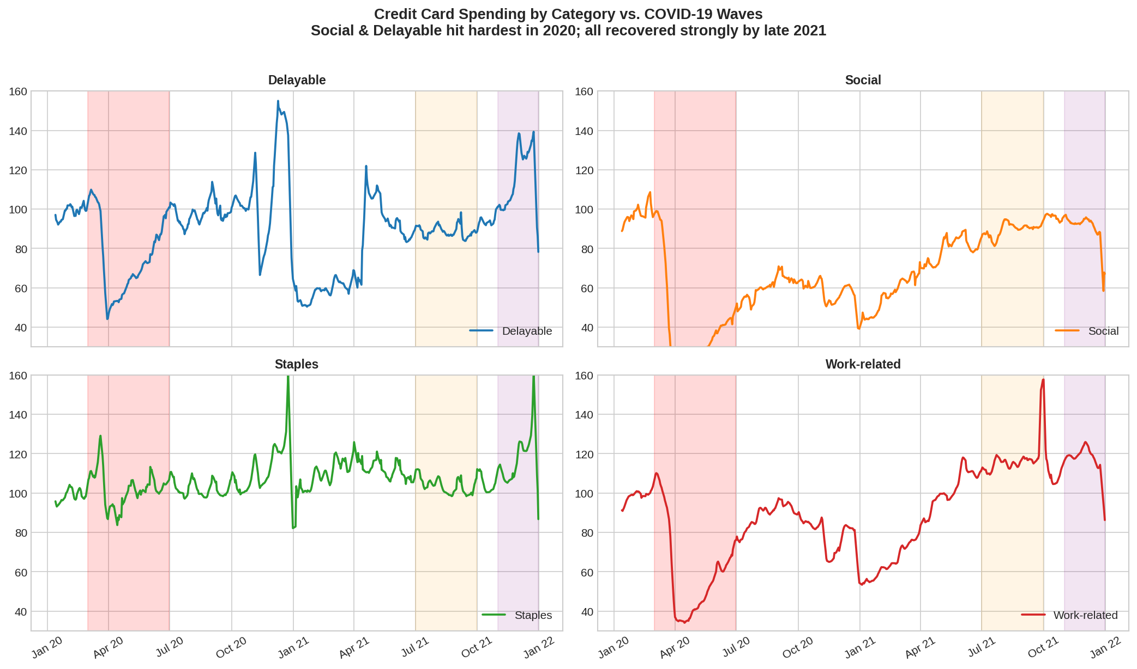
Detailed Credit Card Sales vs. COVID-19 Cases
GRAPH 2: Credit Card Spending by Category (Delayable, Social, Staples, Work-related) vs. COVID-19 Waves
Category Insights: Social spending (travel/eating out) was most impacted in 2020 (-60%+), but rebounded sharply by late 2021. Staples remained stable. Delayable and Work-related categories recovered to or above baseline by Q3 2021. All categories showed stability or growth during Omicron onset, indicating broad-based resilience rather than category-specific weakness.

Slide 4
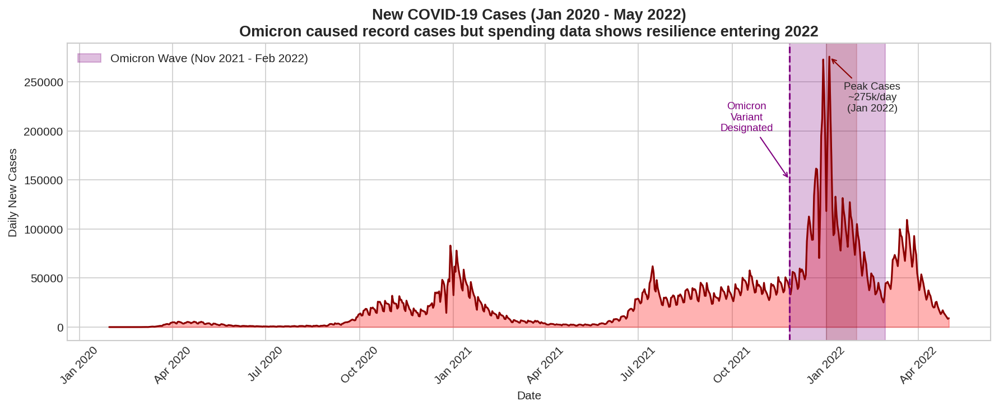
Expected Impact of Omicron on Credit Card Sales
GRAPH 3: New COVID-19 Cases (Jan 2020 - May 2022) with Omicron Wave Highlighted
Expected Impact: Omicron caused record daily cases (275k+ in Jan 2022) but occurred in a vastly different context than 2020: high vaccination rates, no widespread lockdowns, and learned consumer behavior. 2021 data shows spending resilience during rising cases (Delta/Omicron), with total spending +10% in Omicron onset vs. pre-wave. Social & Delayable categories—most vulnerable to restrictions—had recovered fully by late 2021. Conclusion: Minimal negative impact expected on 2022 credit card sales. Volumes likely to remain stable or grow modestly as economic normalization continues.

