Slide 1
Monthly Limits & Deposits Tracking Report | Citi Finance | March 2023
EWT & MAT Breach Report - Jan/Feb 2023 Positions (Entities 1-3)
This report analyzes daily deposit and loan data for Entities 1, 2, and 3 (Jan 1 - Feb 28, 2023) against Early Warning Triggers (EWT) and Management Action Triggers (MAT) per Treasurer policy. KEY FINDINGS: • Entity 2 is the primary concern with multiple EWT breaches and a confirmed MAT breach (surplus negative on 2 days, reaching -$13.2m). • Deposit attrition and rapid loan growth in Entity 2 have eroded the liquidity buffer below policy thresholds. • Stressed surplus (assuming 10% deposit outflow + 5% loan increase) shows heightened vulnerability in adverse conditions. • Entities 1 and 3 show minor EWT flags but remain compliant with MAT (surplus positive throughout). RECOMMENDATION: Immediate escalation of Entity 2 to CFO; implement deposit retention actions and loan growth pause. Full remediation plan due within 10 business days.
Citi Finance | Country Treasurer & CFO Report | March 2023 | Confidential

Slide 2
Risk Triggers Monitoring - Early Warning Triggers (EWT) Breaches
Entity | Trigger | Breach Count / Level | Magnitude | Status
Entity 2 | Deposit Drop >3% DoD | 8 days | Max -4.0% | EWT Breached
Entity 2 | Loan Increase >5% DoD | 5 days | Max +8.0% | EWT Breached
Entity 2 | Loan Growth >50% from Jan | Ongoing | +60.1% | EWT Breached
Entity 2 | MAT: Surplus < $0 | 2 days | Min -$13.2m | MAT BREACHED
Entity 2 | EWT: Surplus <50% Max | Ongoing | Min vs Max | EWT Breached
Entity 1/3 | Minor Deposit Drops | 4-5 days | <-4% | EWT (Low)
EWT Policy Context: These triggers are calibrated to provide early signals of balance sheet stress (e.g., client deposit flight or aggressive lending) allowing preemptive action before MAT levels are reached. Entity 2 exhibits the most severe concentration of breaches, driven by both deposit attrition and accelerated loan growth (60%+ from Jan baseline). No MAT breaches in Entities 1 or 3, though minor deposit volatility warrants monitoring. Data quality note: Entity 1 has several missing daily observations (filled with period mean for analysis).
Citi Finance | Country Treasurer & CFO Report | March 2023 | Confidential

Slide 3
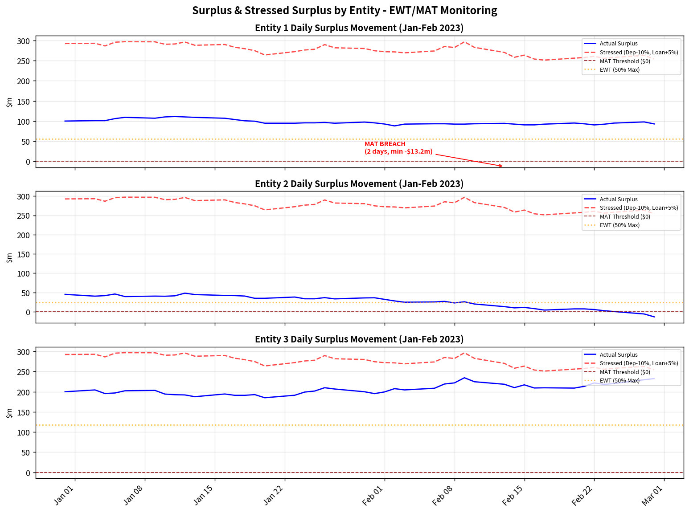
Management Action Triggers (MAT) & Surplus Movement Charts
⚠ MAT BREACH - ENTITY 2
Surplus fell below $0 on 2 days in Feb 2023 (min -$13.2m). This constitutes a formal Management Action Trigger breach requiring immediate escalation per policy. Actions: Notify CFO within 24h; prepare liquidity contingency plan; client outreach for deposit retention.
Chart Notes: Blue = actual surplus (Deposits - Loans). Red dashed = stressed scenario (Dep -10%, Loan +5%). Red line = MAT threshold ($0). Orange = EWT (50% of max surplus). Entity 2 clearly breaches both EWT and MAT; stressed view shows amplified risk. Entity 1 surplus remains positive but data gaps limit precision. Entity 3 is stable with comfortable buffer.
Citi Finance | Country Treasurer & CFO Report | March 2023 | Confidential

Slide 4
Recommendations & Next Steps for Country Treasurer & CFO
IMMEDIATE (within 48 hours): • Escalate Entity 2 MAT breach to CFO and Group Treasurer. • Issue formal notification to Entity 2 CEO/Finance Head; request root-cause analysis (client attrition? competitive pressure?). SHORT-TERM (within 10 business days): • Deploy targeted deposit retention campaigns (rate specials, relationship reviews) for Entity 2 top clients. • Pause new loan originations in Entity 2 pending surplus recovery above EWT threshold. • Enhance daily monitoring dashboard with automated EWT/MAT alerts for all entities. MEDIUM-TERM (Q2 2023): • Conduct full review of EWT/MAT threshold calibration in light of 2023 rate environment and post-pandemic deposit behavior. • Improve data quality controls with Deposits & Loans team (Entity 1 gaps). • Stress-test liquidity contingency plans incorporating combined deposit/loan shocks. The Entity 2 situation, while contained, underscores the importance of proactive monitoring. No systemic risk to the franchise, but timely action will prevent escalation and protect the 2023 P&L.
Citi Finance | Country Treasurer & CFO Report | March 2023 | Confidential

