Slide 1
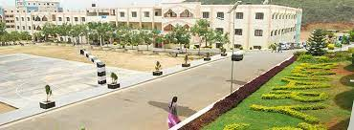
College Management System Presented By- Soumya Karra Enrollment Id:EBEON0922657363 Batch N0: 7942

Slide 2





Technologies Used.!
Frontend
Backend

Slide 3
AIM OF THE PROJECT
An Android and Web application for college is an application that can be accessed throughout the organization and especially by students well with proper login provided when needed.
Using college management application students will able to stay updated with their Mark results, sports, placement, college events, circular notice
An web and mobile based college campus to share the college campus activities application will provide updates to the students of their respective departments, notices regarding the recruiting company, campus interview date and other placement activities.
Using college management application system you can manage all information of all aspects of a college, its students, faculties, Departments, marks and other curricular activities.

Slide 4
SOFTWARE AND HARDWARE REQUIREMENTS HARDWARE REQUIREMENTS:
Processor : Intel(R) Core(TM) i5-6200U CPU @ 2.30GHz 2.40 GHz
Motherboard : intel 915gvsr chipset board
Ram :
Hard disk drive :
SOFTWARE REQUIREMENTS:
Front end : html5, css3, bootstrap
Back end : php, MySQL
Control end : angular java script

Slide 5
Screenshots

Slide 6
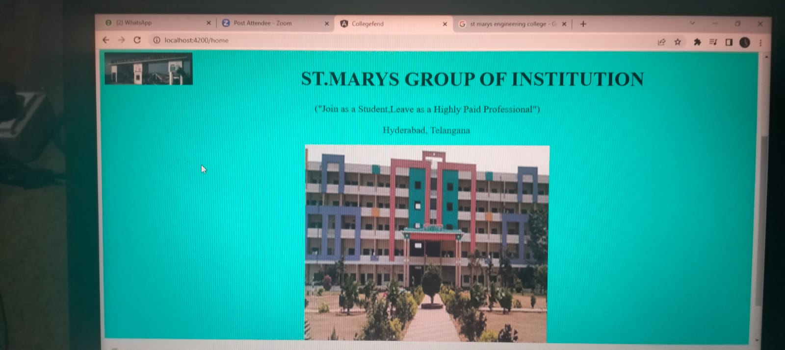

Slide 7
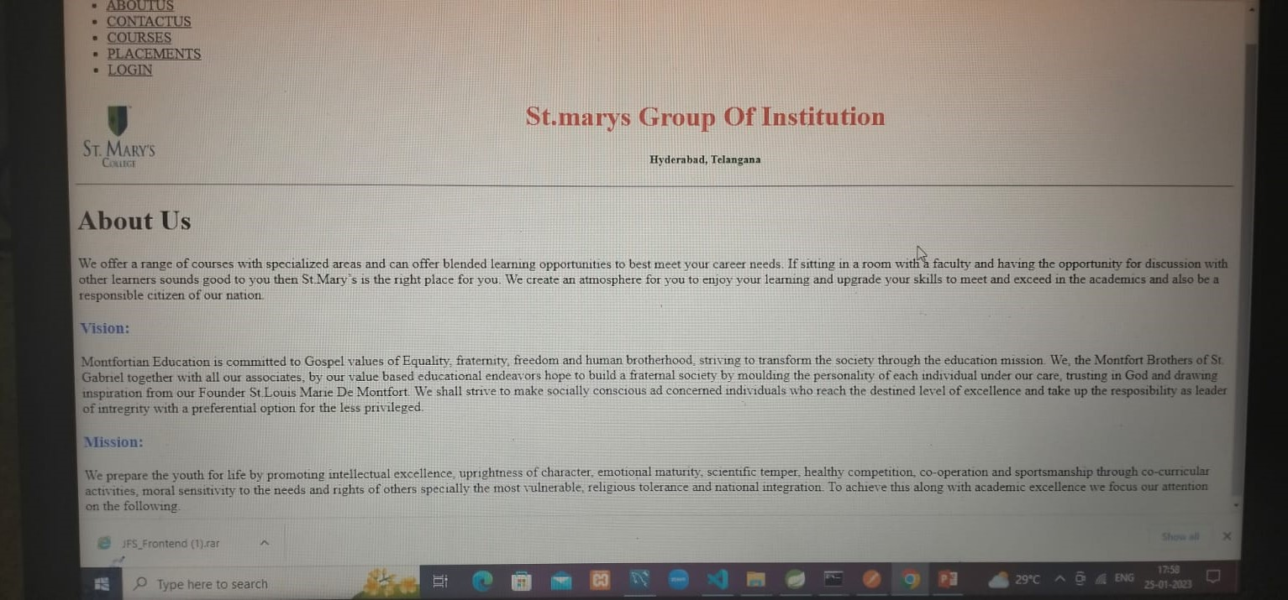

Slide 8
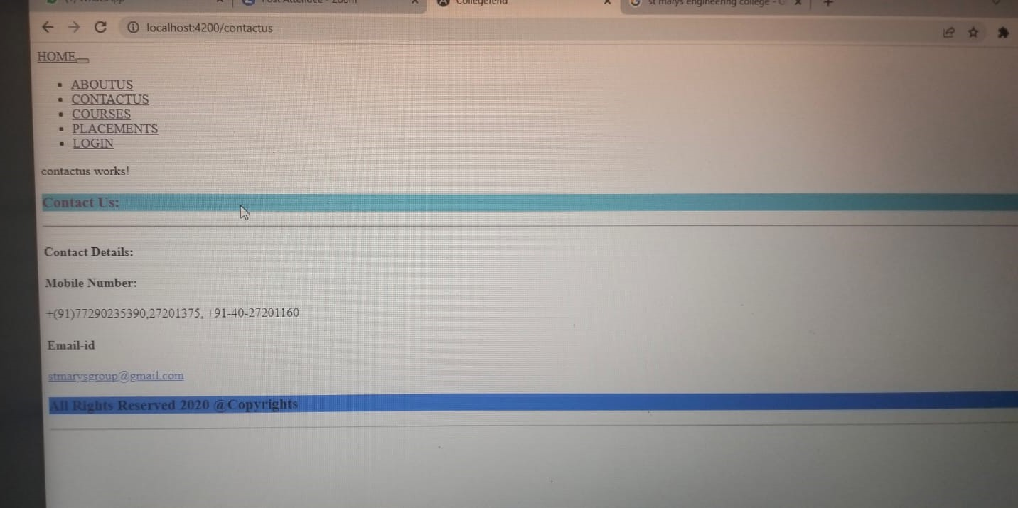

Slide 9
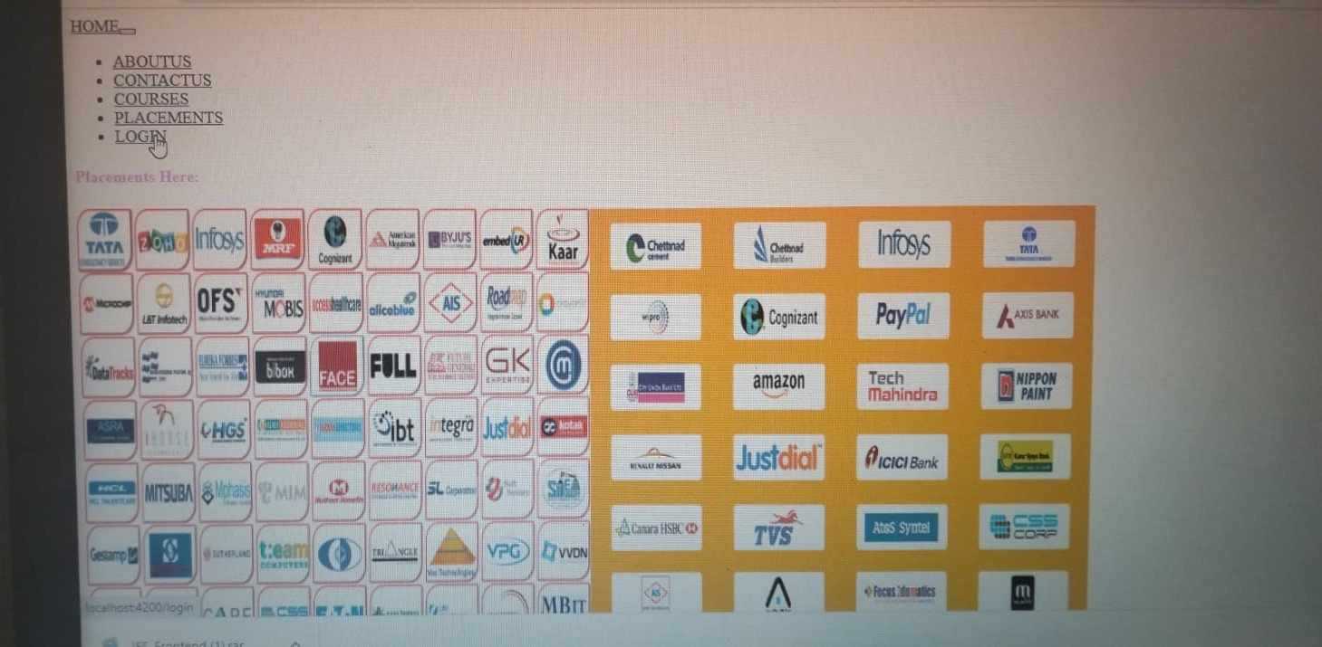

Slide 10
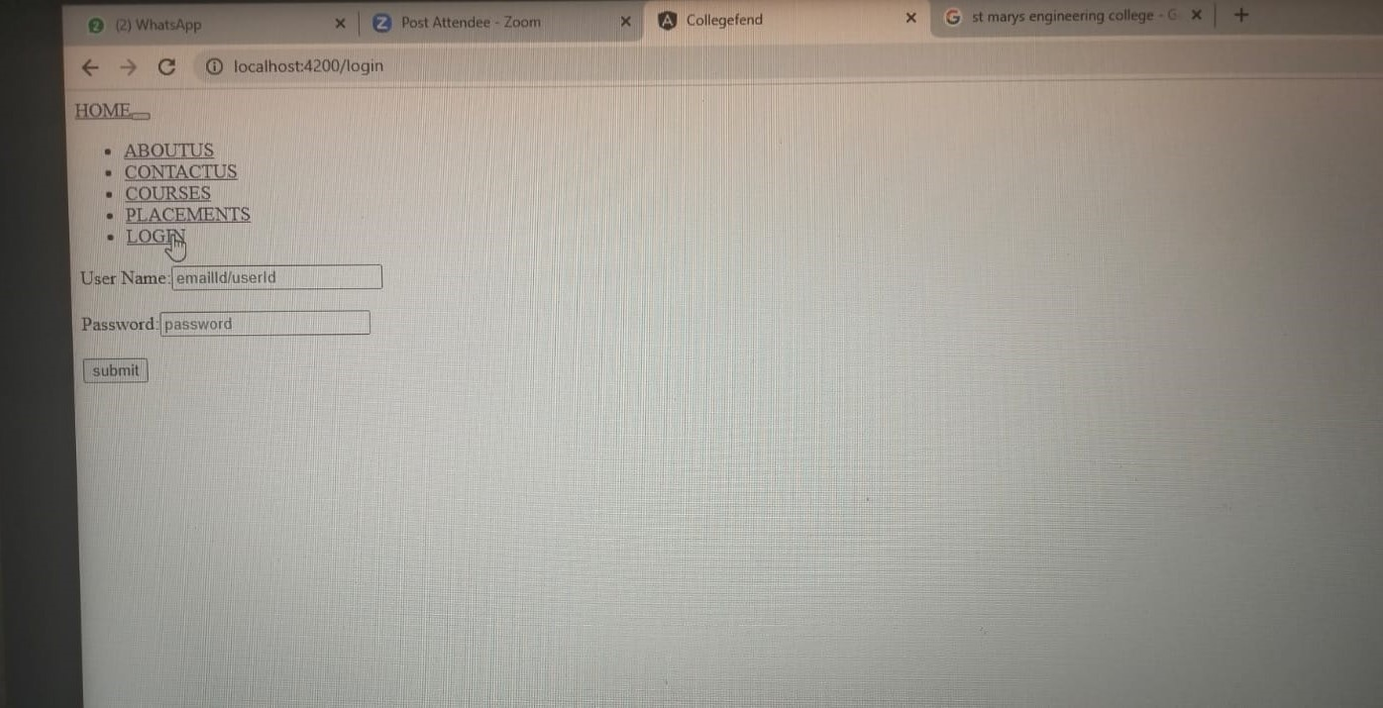

Slide 11
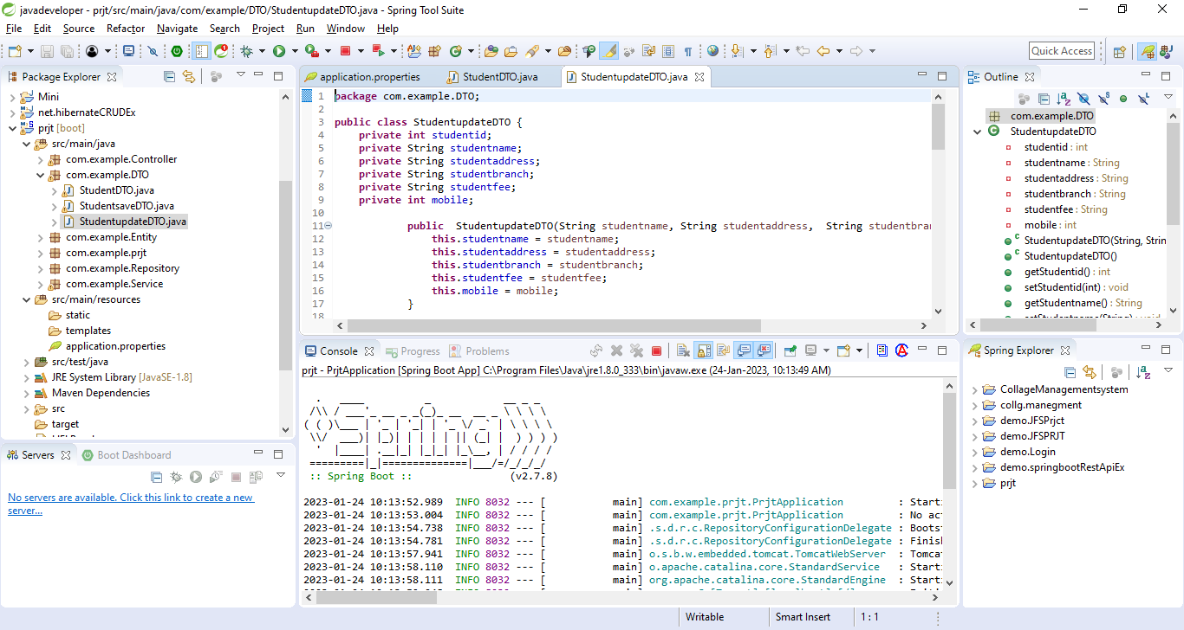

Slide 12
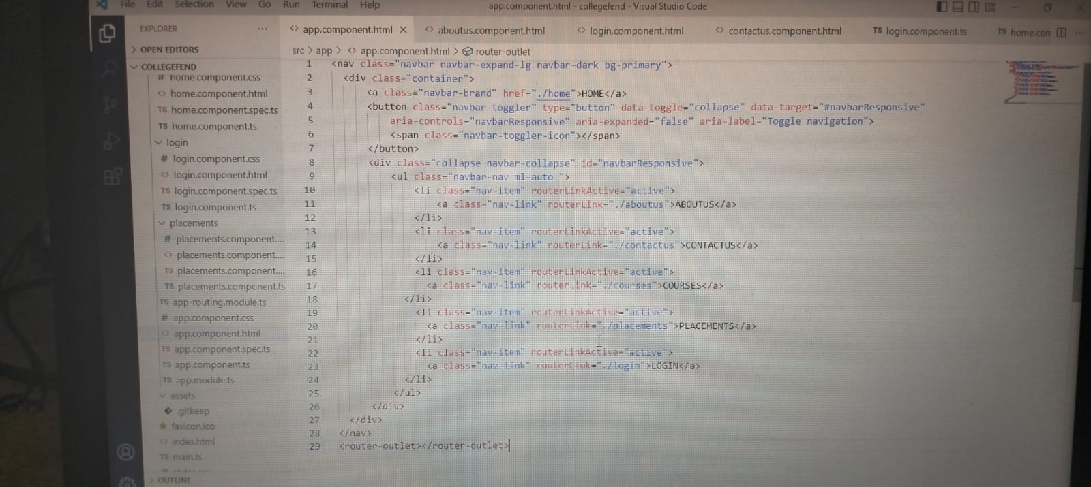

Slide 13
SCOPE OF IMPROVEMENT :
Creating user modules
Adding login, contacts us , about college, placements, home pages.
Information about college
Location of college

Slide 14


