Slide 1
Project Presentation of CO-OP Project at Industry (Module-2) (22CS421)
On
Towards Anatomy-Agnostic MRI Artifact Detection Using Unsupervised Learning
Soumya Makkar
2210992401
Supervised By
Dr. Gurpreet Singh
Department of Computer Science and Engineering,
Chitkara University, Punjab

Slide 2
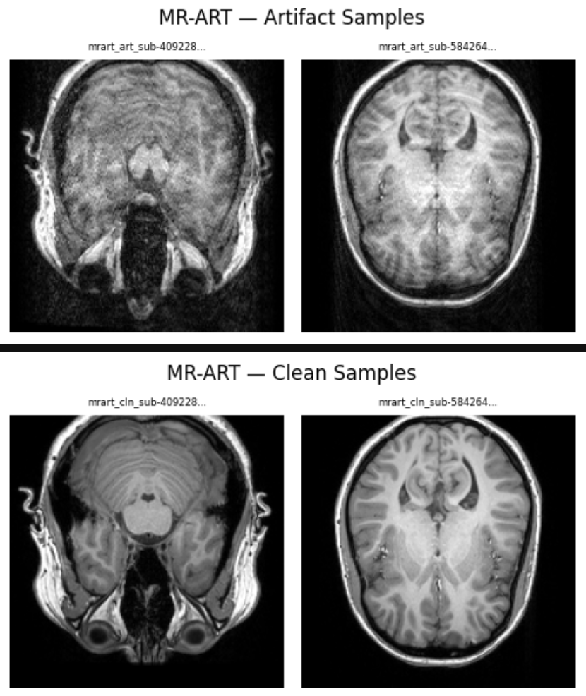
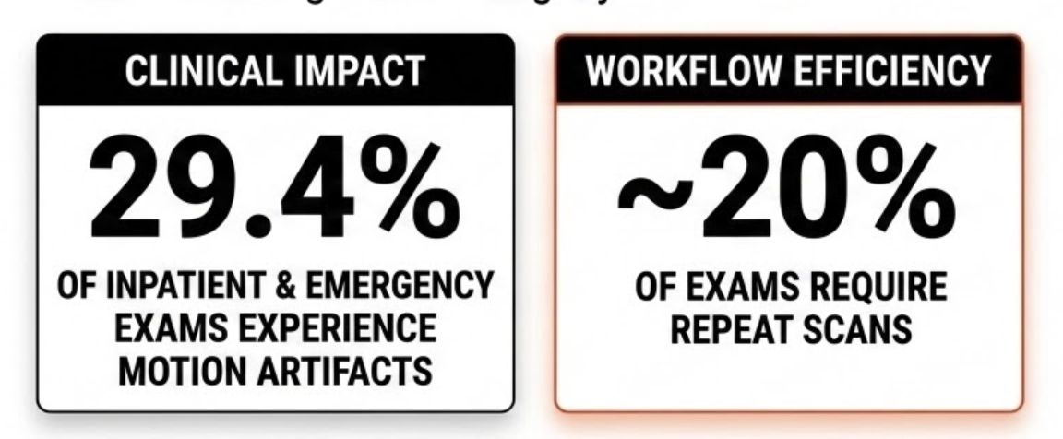
INTRODUCTION & MOTIVATION
WHY MRI ARTIFACT DETECTION MATTERS
MRI is a critical non-invasive imaging tool used for diagnosis and treatment planning. However, artifacts such as motion, ghosting, and blur frequently occur during acquisition. These artifacts can degrade image quality, mimic pathology, or even make scans unusable.
Therefore, automatic and scalable MRI artifact detection is essential for robust image quality control.
‹#›

Slide 3
RESEARCH GAP
CURRENT METHODS FAIL TO GENERALIZE ACROSS DIVERSE REAL-WORLD MRI SCENARIOS
psychology
Supervision & Labels: Mostly supervised methods; significant label scarcity & imbalanced datasets.
biotech
Anatomy Focus: Restricted to single anatomy (e.g. Brain); learns anatomy-specific features.
settings_input_component
Generalization: Limited performance across different scanners and diverse datasets.
warning
Real-world Validity: Synthetic artifact evaluation fails to reflect actual motion corruption.
"Most previous methods rely on supervised learning, but artifact annotations are hard to obtain and highly subjective. Existing methods often learn anatomy instead of artifacts, and synthetic tests don't match real clinical data."
‹#›

Slide 4






RESEARCH CONTRIBUTION
Objective: To systematically evaluate MRI artifact detection across brain and knee MRI using supervised, unsupervised, and self-supervised learning under one unified framework.
Anatomy-agnostic formulation
Benchmark Dataset
Comparative Analysis
Unified evaluation benchmark
Realistic cross-dataset/domain shift
Cross-anatomy setup: brain + knee
Supervised vs unsupervised vs self-supervised
Cross-anatomy generalization analysis
‹#›

Slide 5
DATASET OVERVIEW
Table 1: Summary of datasets used in this study, highlighting variations in anatomy, acquisition settings, and availability of artifact annotations.
Dataset | Anatomy | Scans | Clean/Artifact | Sequences | Field Strength | Manufacturers
IXI | Brain | ~600 | Clean | T1, T2 | 1.5T, 3T | Philips, GE
FastMRI | Knee | 200 | Clean | PD, PD-FS, T2-FS | 1.5T, 3T | Siemens
MR-ART | Brain | ~445 | Artifact | T1 | 3T | Siemens
KMAR-50K | Knee | 1,444 (paired) | Artifact | PD, T1, T2 (TSE/FSE) | 1.5T, 3T | Siemens, Alltech
Simulated | Brain | 3913 | Artifact | Unknown | Unknown | N/A
‹#›

Slide 6
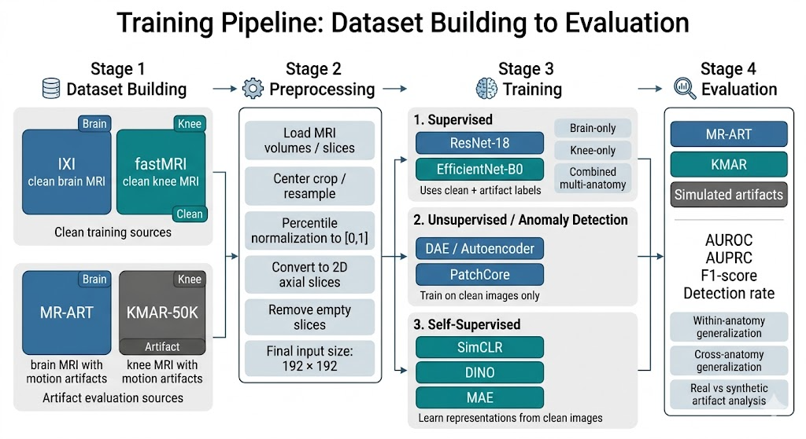
TRAINING PIPELINE
‹#›

Slide 7
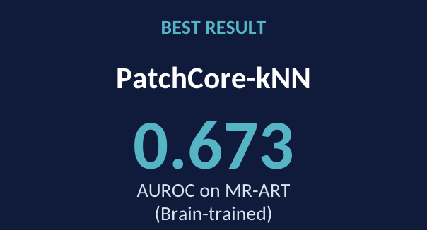
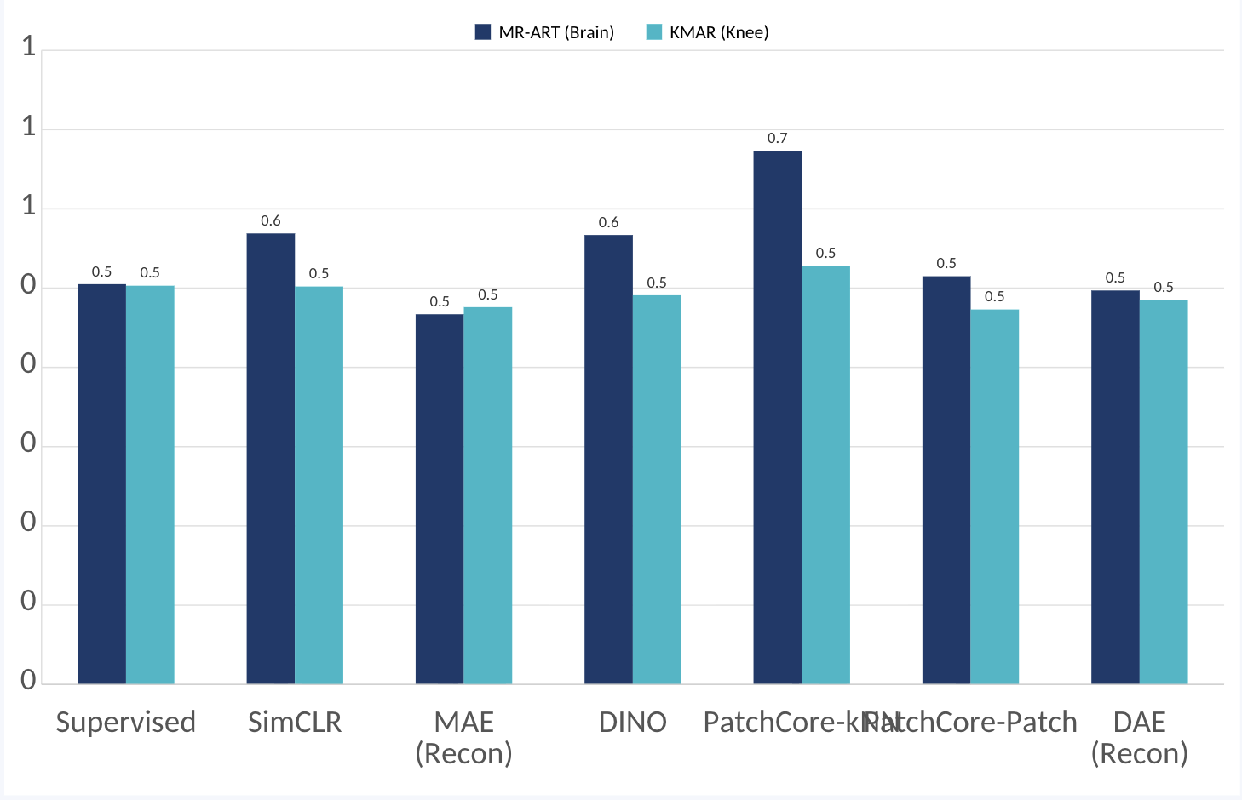
OVERALL QUANTITATIVE RESULTS
‹#›

Slide 8
OVERALL QUANTITATIVE RESULTS
Table 1: Summary of datasets used in this study, highlighting variations in anatomy, acquisition settings, and availability of artifact annotations.
Method | Best MR-ART AUROC | Best KMAR AUROC | Best Training Variant | Takeaway
Supervised | 0.505 | 0.503 | Brain / Combined | Near chance
SimCLR (kNN) | 0.569 | 0.502 | Brain | Slight gain on MR-ART only
MAE (kNN) | 0.454 | 0.512 | Combined | Weak overall
MAE (Recon) | 0.467 | 0.485 | Brain / Knee | Good on synthetic, weak on real
DINO (kNN) | 0.568 | 0.499 | Combined / Combined | Good on MR-ART, unstable on KMAR
DAE (kNN) | 0.444 | 0.500 | Brain / Combined | Near chance
DAE (Recon) | 0.517 | 0.494 | Combined | Slightly above chance only
PatchCore (Patch) | 0.515 | 0.473 | Brain | Weak overall
PatchCore (kNN) | 0.673 | 0.528 | Brain / Combined | Best real-artifact method
‹#›

Slide 9
KEY FINDINGS/DISCUSSION
F1
F2
F3
Source-Domain Confound
ResNet-18 classifies dataset source instead of artifact presence due to acquisition differences between IXI/FastMRI and MR-ART/KMAR.
PatchCore-kNN Superiority
Most competitive with 0.673 AUROC on brain MR-ART. Avoids domain contamination by using frozen ImageNet backbone.
Self-Distillation Collapse
DINO collapses on narrow, brain-only corpora. Requires multi-anatomy training or stronger augmentation to maintain feature rank.
F4
F5
F6
Synthetic Proxy Failure
MAE-Recon hits 98.9% on simulation but fails (0.459 AUROC) on real MR-ART. Synthetic benchmarks are unreliable clinical proxies.
Mild Artifacts Unsolved
The most clinically relevant regime remains an open problem. PatchCore-kNN only reaches 0.623 AUROC on mild cases.
Training Budget Constraints
20 epochs is insufficient for ViT-based MAE/DINO. Fast CNN convergence may artificially disadvantage Transformer methods.
Critical Discussion & Recommendations
Acquisition-Matched Pairs: Future supervised baselines must use clean/artifact pairs from the same scanner to avoid source-domain bias.
Collapse Diagnostics: Groups using self-distillation (DINO) should routinely report rank and cosine similarity metrics.
Clinical Regimes: Shift focus toward "Mild Artifact" detection which remains the key unsolved challenge.
‹#›

Slide 10
CONCLUSION
CORE CONTRIBUTIONS: REDEFINING ARTIFACT DETECTION
01
science
MOST THOROUGH MULTI-PARADIGM COMPARISON
Rigorously controlled experimental protocol across supervised, self-supervised, and unsupervised approaches for MRI artifact detection.
02
report_problem
EXPOSED TWO CRITICAL FAILURE MODES
Supervised shortcut learning from domain mismatch and the synthetic-real artifact gap—likely unreported in prior work.
03
layers_clear
DEMONSTRATED REPRESENTATIONAL COLLAPSE RISK
Self-distillation on narrow medical imaging corpora collapses; multi-anatomy training is a simple and effective mitigation.
‹#›

Slide 11
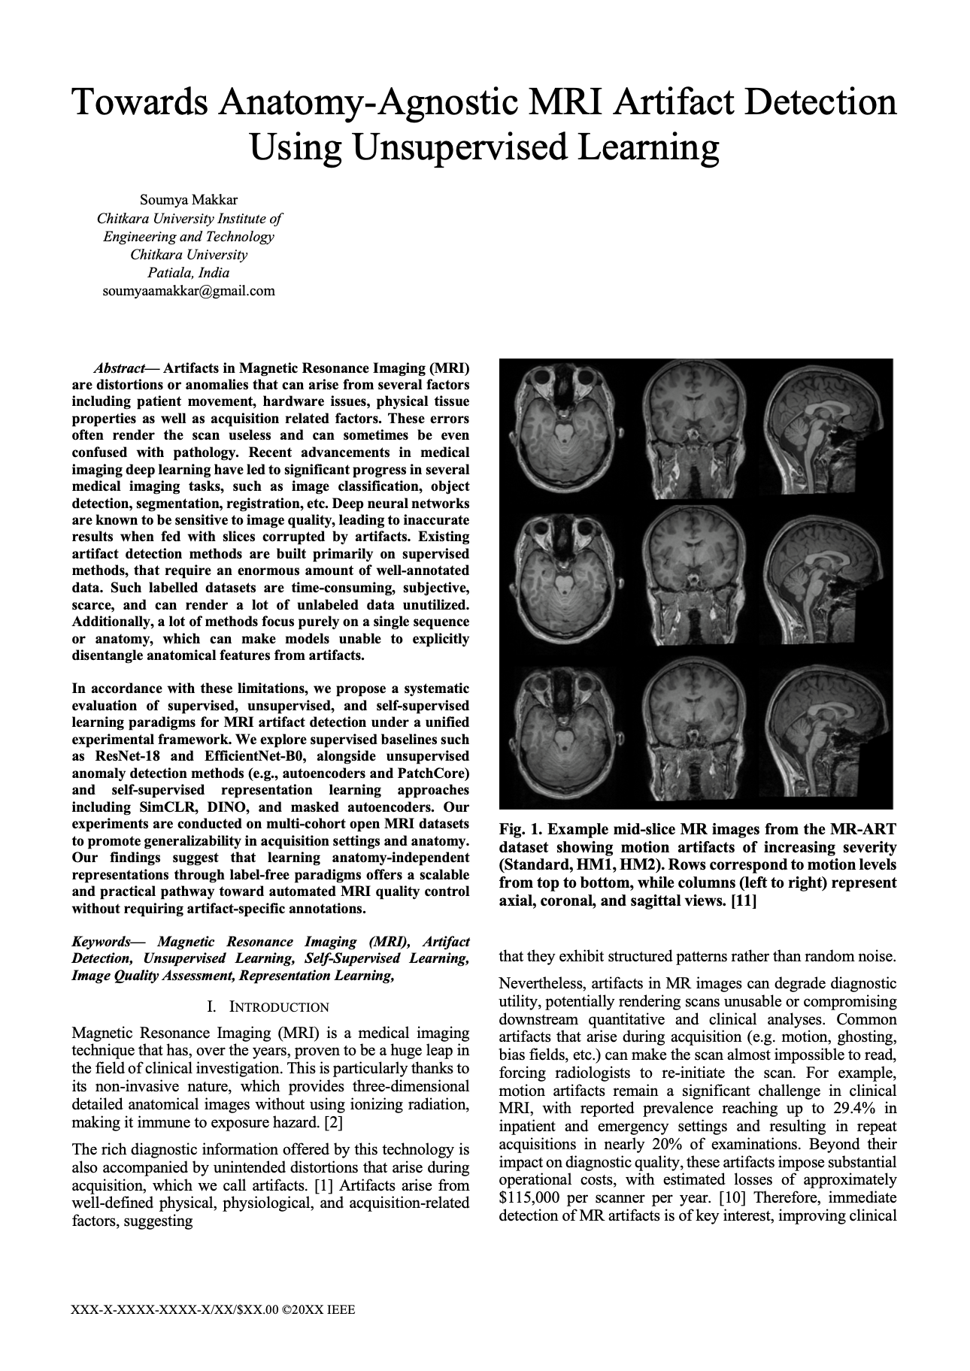
Thank You
Questions & Discussion Welcome
Soumya Makkar
Chitkara University Institute of Engineering and Technology
soumyaamakkar@gmail.com
Datasets
IXI, FastMRI (NYU Langone), MR-ART (OpenNeuro ds004173), KMAR-50K (Mendeley)
Models
ResNet-18 (He et al. 2016), EfficientNet-B0 (Tan & Le 2019), SimCLR (Chen et al. 2020), DINO (Caron et al. 2021), ViT-MAE (He et al. 2022), PatchCore (Roth et al. 2022)
‹#›

