Slide 1

MACHINE LEARNING PROJECT
Fake & Real News Detector
An AI-powered web application that classifies news as fake or real using natural language processing and machine learning
DEVELOPED BY
GUIDED BY
Soumya Ranjan Mishra
Registration Number-250522610022
Bibhudendu Panda — Assistant Professor
INSTITUTION
COURSE
Rourkela Institute of Mgmt. Studies
MCA
Notes:
Good morning/afternoon. My project is a Fake and Real News Detector — a machine learning web application that takes any news headline and tells you whether it's likely fake or real, with a confidence score. I'm Soumya Ranjan Mishra, MCA student at Rourkela Institute of Management Studies, guided by Bibhudendu Panda, Assistant Professor. Over the next few minutes I'll walk through the full pipeline — from raw data to a live deployed website.

Slide 2
INTRODUCTION
Problem statement & objective
THE PROBLEM
THE OBJECTIVE
Misinformation spreads faster than fact-checkers can respond
Readers cannot easily tell fabricated headlines from genuine reporting
Manual fact-checking does not scale to the volume of online news
Build a machine learning model that classifies news as fake or real
Deploy it as a live web application anyone can use instantly
Compare multiple algorithms to find the most accurate one
Fake & Real News Detector
2
Notes:
Before the pipeline, here's the problem and the objective. Misinformation spreads faster than fact-checkers can respond, and readers often can't easily tell a fabricated headline from genuine reporting — manual fact-checking simply doesn't scale to the volume of news published every day. So my objective was threefold: build a machine learning model that classifies news as fake or real, deploy it as a live web application anyone can use instantly, and compare multiple algorithms to find the most accurate one rather than assuming.

Slide 3
OVERVIEW
System architecture
Two layers, trained offline and served online, connected by a pair of saved model files.
OFFLINE — TRAINING (NOTEBOOK)
Fake.csv + True.csv
44,898 labelled articles
Clean & merge
title + text, label, shuffle
TF-IDF vectorizer
5,000 features fit
LR vs NB vs SVM
best model selected
joblib.dump
save to disk
model.pkl · vectorizer.pkl · word_scores.pkl
ONLINE — INFERENCE (FLASK APP ON RENDER)
User pastes headline
HTML form, POST request
Flask vectorizes input
app.py — model loaded once at startup
Model predicts label
FAKE / REAL + confidence
Result shown to user
+ top influencing keywords
Fake & Real News Detector
3

Slide 4
OVERVIEW
End-to-end ML pipeline
Raw news articles flow through eight stages to become a live prediction — each stage covered in detail on the slides that follow.
1
2
3
4
Data collection
Preprocessing
Feature engineering
Train / test split
Kaggle CSV files
Clean, merge, label
TF-IDF vectors
80% / 20%
5
6
7
8
Model training
Evaluation
Serialization
Deployment
LR, NB, SVM
Confusion matrix
joblib .pkl files
Flask + Render
Fake & Real News Detector
4
Notes:
Before diving into details, here's the full pipeline at a glance — eight stages from raw data to a deployed app. I'll go through each of these one by one. The first six stages, in navy, are the core machine learning workflow. The last two, in coral, are what turns the trained model into something people can actually use — saving it to disk and putting it on a live server.

Slide 5
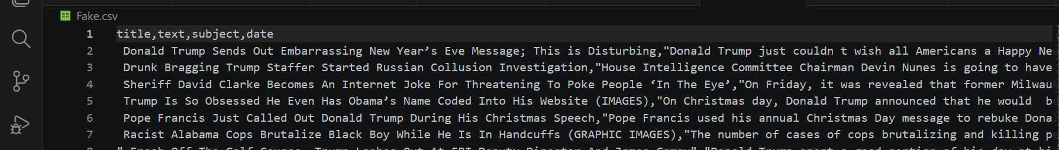
ML PIPELINE · STEP 1
Data collection scheme
Source
Kaggle — Fake and Real News Dataset (public, pre-labelled)
Method
Direct CSV download — no live web scraping involved
Files used
Fake.csv and True.csv, each with title, text, subject, date
44,898
23,481
21,417
Raw CSV — title, text, subject, date columns
Total articles
Fake news
Real news
Fake & Real News Detector
5
Notes:
Step one is data collection. I used the Kaggle Fake and Real News Dataset — a publicly available, pre-labelled dataset, so there's no live web scraping involved, which keeps things reproducible. It's split into two files, Fake.csv and True.csv, each with title, text, subject, and date columns. Combined, that's almost forty-five thousand articles — twenty-three thousand fake, twenty-one thousand real — so it's a reasonably balanced dataset, which matters a lot for training a fair classifier.

Slide 6
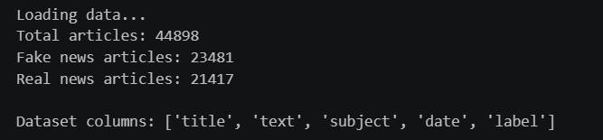
ML PIPELINE · STEP 2
Data preprocessing
1
2
3
4
Remove nulls
Merge fields
Label encode
Shuffle
Dropped incomplete rows
Combined title + text
Fake = 0, Real = 1
Randomised row order
WHY THIS MATTERS
Combining the headline and article body gives the model more context per sample. Encoding labels as 0/1 lets scikit-learn treat this as a binary classification problem, and shuffling prevents the model from learning order-based patterns instead of content patterns.
Notebook output — dataset summary after cleaning
Fake & Real News Detector
6
Notes:
Next is preprocessing — cleaning the raw data before it can be used for training. Four steps: I removed incomplete rows, merged the title and article text into a single field for more context per sample, encoded the labels numerically with fake as zero and real as one, and shuffled the dataset so the model doesn't learn anything from row order. You can see the output here — forty-four thousand eight hundred ninety-eight clean articles ready for the next stage.

Slide 7
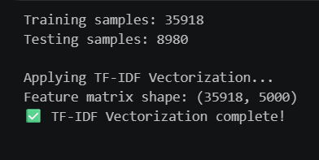
ML PIPELINE · STEP 3
Feature engineering — TF-IDF
THE CONCEPT
TF-IDF (Term Frequency – Inverse Document Frequency) converts raw text into numeric vectors that a model can learn from.
Term Frequency — how often a word appears in one article
Inverse Document Frequency — how rare that word is across all articles
Common words like “the” score low; distinctive words score high
Applied to the top 5,000 most informative words, English stop-words removed
5,000
80 / 20
TF-IDF features
Train / test split
Fake & Real News Detector
7
Notes:
Machine learning models need numbers, not raw text, so this step converts words into numeric features using a technique called TF-IDF — term frequency, inverse document frequency. In short, it scores each word by how often it appears in one article versus how rare it is across the whole dataset, so common words like 'the' score low and distinctive words score high. I used the top five thousand most informative words, with English stop-words removed, and split the data eighty-twenty into training and testing sets.

Slide 8
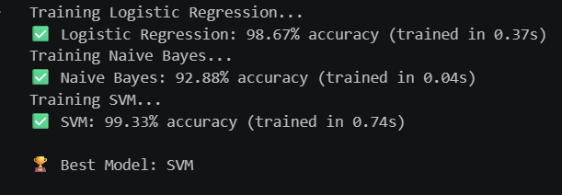
ML PIPELINE · STEPS 4-5
Train-test split & model training
Three algorithms were trained on the same TF-IDF features and compared head-to-head, so the final model choice is evidence-based rather than assumed.
Logistic Regression
Naive Bayes
SVM
BEST
98.67%
92.88%
99.33%
trained in 0.37s
trained in 0.04s
trained in 0.74s
Why these three: chosen as standard text-classification baselines spanning simple to complex — Naive Bayes (probabilistic), Logistic Regression (linear), SVM (margin-based) — rather than jumping straight to deep learning.
Fake & Real News Detector
8
Notes:
Rather than picking one algorithm blindly, I trained and compared three — Naive Bayes, Logistic Regression, and SVM. These represent a spread from simple probabilistic to linear to margin-based, which is a standard set of baselines for text classification before reaching for something heavier like deep learning. Naive Bayes trained almost instantly but scored lowest at ninety-two point eight eight percent. Logistic Regression hit ninety-eight point six seven percent. SVM won outright at ninety-nine point three three percent, though it took the longest to train.

Slide 9
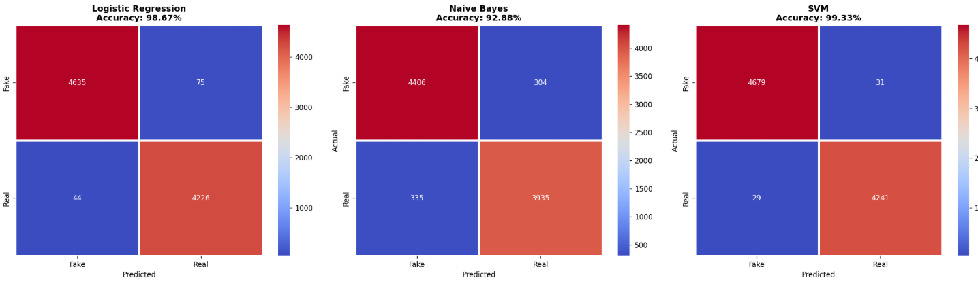
ML PIPELINE · STEP 6
Model evaluation
Four metrics across all three models — accuracy alone can hide weaknesses that precision, recall, and F1 reveal.
Model | Accuracy | Precision | Recall | F1-Score
Logistic Regression | 98.67% | 98.26% | 98.97% | 98.61%
Naive Bayes | 92.88% | 92.83% | 92.15% | 92.49%
SVM ★ Best | 99.33% | 99.27% | 99.32% | 99.30%
Why SVM wins: it finds the optimal separating boundary in high-dimensional TF-IDF space, which suits sparse text features better than Naive Bayes' word-independence assumption.
Fake & Real News Detector
9
Notes:
Accuracy alone can hide problems, so I evaluated all three models on four metrics — accuracy, precision, recall, and F1-score — shown in this table, alongside the confusion matrices above. SVM leads on every single metric: 99.33% accuracy, 99.27% precision, 99.32% recall, and 99.30% F1-score. SVM wins because it finds the optimal separating boundary in high-dimensional TF-IDF space, which suits sparse text features better than Naive Bayes' assumption that all words are independent of each other.

Slide 10

ML PIPELINE · STEPS 7-8
Model serialization & deployment
SERIALIZATION
The trained model and TF-IDF vectorizer are saved to disk using joblib as model.pkl and vectorizer.pkl.
This means the web app loads an already-trained model in under a second, instead of retraining on every request — critical for a low-memory cloud server.
Live on Render — status: deployed
DEPLOYMENT STACK
LIVE LINK
GitHub — version control & source hosting
Render — free cloud hosting with auto-deploy on push
Flask — serves the model behind a web interface
news-detector-mykz.onrender.com
GITHUB REPOSITORY
github.com/soumyamishra7/news-detector
Fake & Real News Detector
10
Notes:
Once trained, the model and vectorizer are saved to disk using joblib, as model.pkl and vectorizer.pkl. That means the live web app loads an already-trained model in under a second instead of retraining on every request — which matters a lot on a low-memory free cloud server. The app itself is built with Flask, version-controlled on GitHub, and deployed on Render with auto-deploy enabled, so every push to GitHub automatically updates the live site.

Slide 11
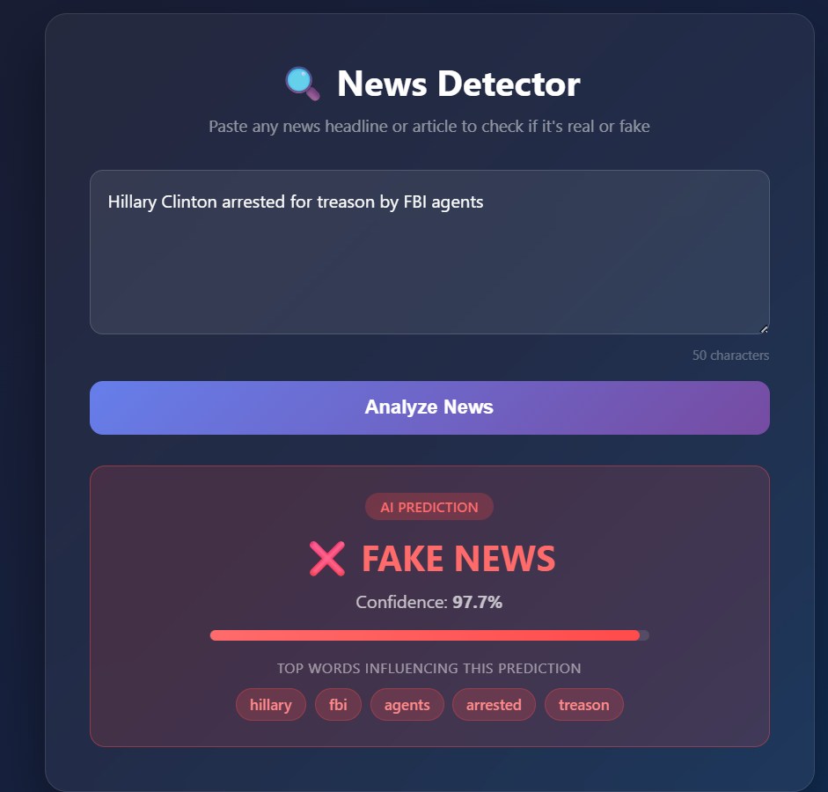
LIVE DEMO
See it in action
INPUT HEADLINE
“Hillary Clinton arrested for treason by FBI agents”
MODEL OUTPUT
✗ FAKE NEWS
Confidence: 97.7%
Top keywords: hillary, fbi, agents, arrested, treason
The Flask app loads the saved model instantly, vectorizes the input with the same TF-IDF transformer, and shows a confidence meter plus the exact keywords that drove the prediction — so the result is explainable, not a black box.
Fake & Real News Detector
11
Notes:
Now let's see it actually working. [If live: switch to the browser tab and demo it live with a fresh headline]. Here I pasted a deliberately sensational headline — about Hillary Clinton being arrested for treason — and the model flags it as fake news with 97.7% confidence. Notice it also shows the top keywords that drove that decision — hillary, fbi, agents, arrested, treason — so the prediction isn't a black box, you can see exactly what triggered it. If confidence had been below 60%, the app would show 'Uncertain' instead of forcing a label, which keeps the tool honest about its limits.

Slide 12
CLOSING
Limitations & future scope
CURRENT LIMITATIONS
FUTURE IMPROVEMENTS
Dataset is mostly US political news from 2016–17 — a known dataset bias
Accuracy drops on general topics like sports, health or entertainment
English-only; no multi-language support
TF-IDF ignores word order and deeper context
Expand dataset to cover diverse, recent, multi-topic news
Use transformer models (BERT) for deeper context understanding
Add explainability — show top keywords behind each prediction
Add multi-language support and a prediction history log
Fake & Real News Detector
12
Notes:
To close, I want to be upfront about the limitations rather than oversell this. The dataset is mostly US political news from twenty sixteen to twenty seventeen, so accuracy is highest on that kind of headline and drops on general topics like sports or health — that's a known dataset bias. It's English-only, and TF-IDF doesn't capture word order or deeper context. Going forward, I'd want to expand the dataset, try transformer models like BERT for deeper understanding, and add explainability so users can see which keywords drove each prediction.

Slide 13



Thank You
Questions are welcome
Fake & Real News Detector
13
Notes:
That's the project — thank you for your time and attention. I'm happy to take any questions.

