Slide 1
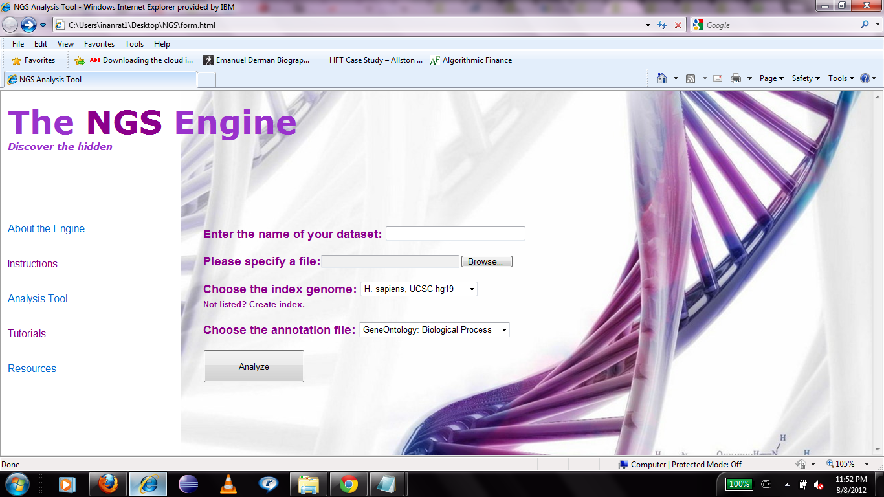
Screenshot of the NGS tool

