Slide 1

Finding biomarkers for lung cancer using NGS analysis of RNA sequences
Soumya Nayak
Mentor: Dr S. Srinivasan

Slide 2
Contents
The Problem
Our Approach to the solution
Nature of the Dataset
Computing Read per Gene
Computing RPKM
Results
Microarray Analysis
The NGS Engine: A tool

Slide 3
The Problem
Find Biomarkers for lung cancer
Why is it interesting?
Prediction of cancer
Understand gene expression in cancer
Explain the effect of smoking
Data, data and more data!

Slide 4
Our Approach to Solution
Download Datasets
Stat-analysis and results
Aligning it to an index genome
Compute
Reads per gene per each sample using an annotation file
Compute
(RPKM Value)
Storing the aligned data to MySQL server

Slide 5
Nature of the dataset
Downloaded from SRA (SRP006676).
Data is taken from 4 different types of people
Healthy non smokers
Current Smokers
Smokers with cancer
Smokers without cancer
Two different approaches were used on same sample to collect the dataset
NuGen
Illumina

Slide 6
Aligning each sample to reference genome
Reference genome used -Hg19
Tool used-Bowtie
Parameters used for bowtie
best,-v,-m
An example of map file:
SRR192335.7 HWUSI-EAS1671_0001:7:1:1030:18590 length=75 - chr11 76262558
CTATAGTTAATANNTTCCCACTAGAGTGACACTGAAGATTTAAACACAAGCATTCATAAGATGCGCTGATCTCT
G###############@B;BABBBBBA>C@BBBBC>BAB@CACCBCBCCACCCB<CCBCCCCCBCBCCC@CCC
C=C 0 61:A>C,62:A>G

Slide 7
Data entry to MySQL
23 tables corresponding to each chromosome is created in MySQL database.
An Example in table chr1:
sample | read_id | strand | start | end | seq
HNS1 | SRR192333.47 | + | 207103170 | 207103244 | NTACCTGTCACAGCATCTAGCAAAGCAC

Slide 8
Calculating Reads per Gene
What is it?
How to calculate?
Bowtie output data is compared with an annotation file
The final output is as follows:
Acc_id | chr | HNS1 | HS1 | SWOC1 | SWC1 | HNS2 | HS2 | SWOC2 | SWC2 | GENE_NAME
NR_015368 | CHR1 | 0 | 0 | 0 | 0 | 0 | 0 | 0 | 0 | NULL
uc001aar.1 | CHR1 | 123 | 256 | 98 | 16 | 23 | 12 | 34 | 6 | LOC6438

Slide 9
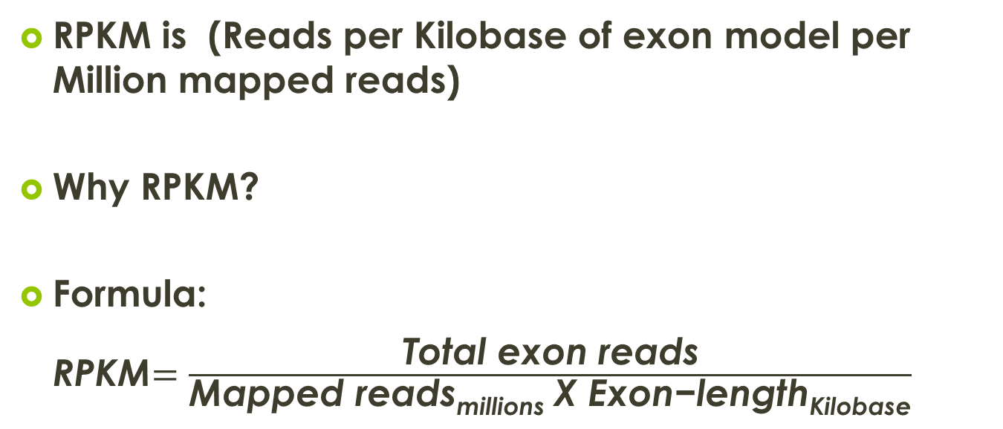
Calculating RPKM
RPKM is (Reads per Kilobase of exon model per Million mapped reads)
Why RPKM?
Formula:
RPKM$=\frac{\text{Total} \text{exon} \text{reads}}{\text{Mapped} \text{readsmillions} \text{X} \text{Exon}\text{−}\text{lengthKilobas}\text{e}}$

Slide 10
Results
Comparison between two methods
Many non-coding RNAs were captured in Nugen Protocol, i.e fold change was negative
Comparison between different samples
GENE_NAME | HNS1-HS1 | HNS1-SWC1 | median | "HS1-SWC1
ZFY | -8.47 | -8.54 | -8.5 | -0.07
CYorf15B | -8.22 | -9.07 | -8.64 | -0.85
BCAN | 6.17 | 6.8 | 6.48 | 0.71

Slide 11
Pathway Analysis
NEUROACTIVE LIGAND RECEPTOR INTERACTION
ANACHIDONIC ACID METABOLISM
SYSTEMATIC LUPUS ERYTHEMATOS
MELANOGENESIS
CALCIUM SIGNALLING PATHWAY

Slide 12
Microarray Analysis of Prostate Cancer
Pipeline used
Dataset taken : GSE6919
The experiment is about: Expression Data from Normal and Metastatic Prostate Tumor Tissues
For metastatic tumor is categorized into different types:
prostate tumor metastases in liver
prostate tumor metastases in para tracheal lymph node
prostate tumor metastases in para aortic lymph node
prostate tumor metastases in retro peritoneal lymph node
The output of the analysis

Slide 13
The NGS Engine: A tool
A Web-based tool for NGS
Automates the analysis of NGS gene expression process
Client-Server Architecture
Server
CGI-Perl
MySQL
Bowtie
Apache
Data
http response
Client
Browser
User
Data
http request
Welcome to The NGS Engine

Slide 14
References
NGS
http://bowtie-bio.sourceforge.net/index.shtml
http://www.ncbi.nlm.nih.gov/pubmed?LinkName=sra_pubmed&from_uid=69947
Beane J, et all,-2011 Characterizing the impact of smoking and lung cancer on the airway transcriptome using RNA-Se Cancer Prev Res (Phila). http://dev.mysql.com/doc/refman/5.0/en/tutorial.html
http://perl-tutorial.org/
http://www.clcbio.com/manual/genomics/Definition_RPKM.html
DATA
http://www.ncbi.nlm.nih.gov/sra/
TOOL
http://perl-tutorial.org/
http://www.w3schools.com/html/default.asp
http://www.w3schools.com/css/
http://www.milonic.com/apachesetup.php
http://tldp.org/LDP/LG/issue12/server.html
http://stackoverflow.com/questions/6852376/architecture-for-a-local-html-gui-with-a-perl-back-end

