Slide 1



INNOVATEX 5.0
THEME: AI/ML
Team Name : TECHZERO
Problem Statement Title : AI Based Early Warning System for Shipment Delays.
Team Leader Name : Soumya Saswat Sahoo
Institute Name : GITA Autonomous College
Team Lead Contact Number: 7847834847
Notes:
1

Slide 2
Problem Statement & Objectives
The modern logistics industry faces significant challenges such as unexpected shipment delays, traffic congestion, adverse weather conditions, and inefficient route planning. Traditional logistics systems rely heavily on static planning and manual monitoring, which makes them unable to react quickly to disruptions.
There is a need for an intelligent logistics system that can predict shipment delays, detect anomalies in routes, simulate possible disruptions, and automatically adapt routes to ensure timely delivery and operational efficiency.
The main objectives of this project are:
To develop an AI-based logistics delay prediction system using machine learning.
To analyze traffic and weather data to estimate shipment delay risk.
To implement AI Anomaly Detection to identify abnormal shipments or routes.
To simulate AI Disruption Scenarios such as heavy traffic or weather changes.
Notes:
5

Slide 3
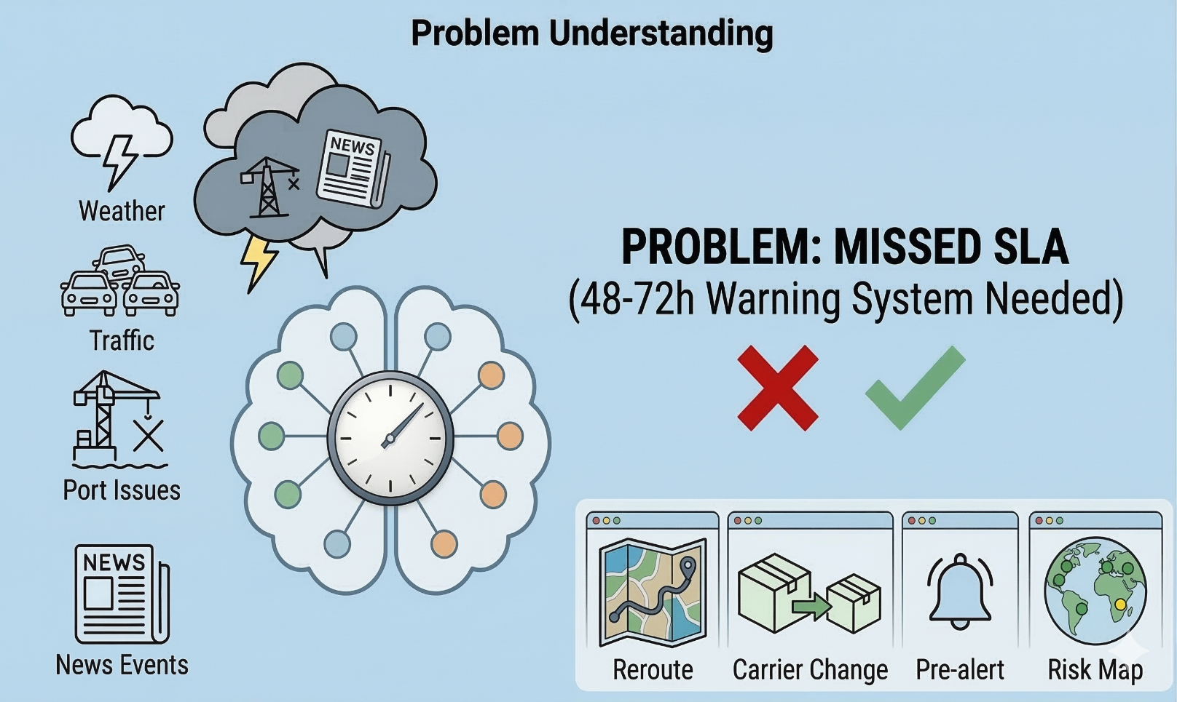
Problem Understanding
Key Factors Causing Delays
Weather disruptions
Port strikes or operational issues
Traffic incidents
External disruptions (news alerts, accidents)
Challenge
Companies cannot predict delays early.
Shipments may miss SLA (Service Level Agreement) commitments.
Goal of the System
Build an AI-based early warning system to predict shipment delays 48–72 hours in advance.
Expected Outcome
Identify shipments at risk of delay.
Provide recommendations such as:
Rerouting shipments
Assigning alternative carriers
Sending pre-alert notifications.
Notes:
2

Slide 4
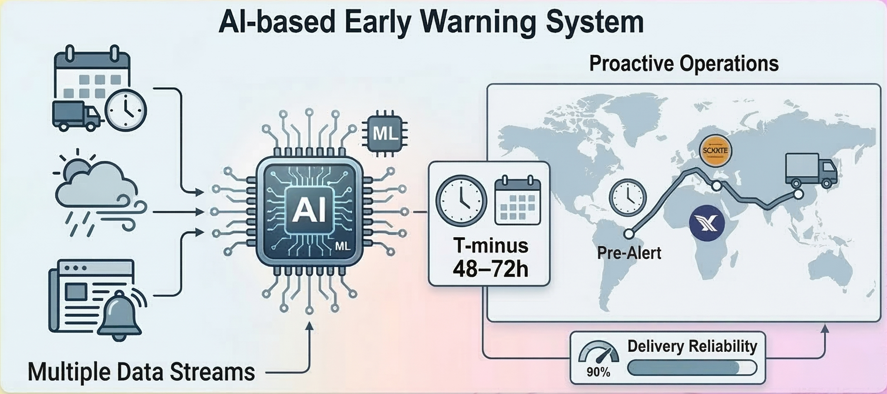
The Solution
Our team proposes an AI-based Early Warning System that monitors shipment data and external factors in real time.
The system analyzes inputs such as shipment ETA, delay flags, weather conditions, traffic updates, and news alerts.
Using machine learning models, it predicts which shipments are likely to miss their SLA 48–72 hours in advance.
When a potential delay is detected, the system provides recommended actions like rerouting shipments, assigning alternative carriers, or sending pre-alerts.
This helps logistics teams take proactive decisions, reduce delays, and improve delivery reliability.
Notes:
4

Slide 5
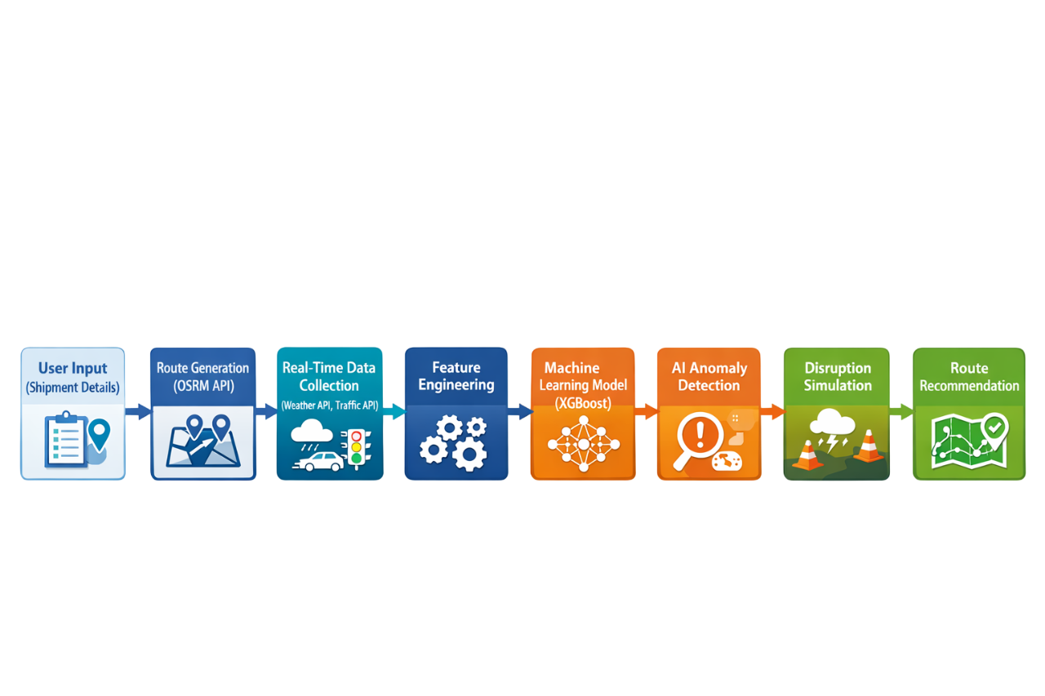
WorkFlow
The user enters shipment details such as origin and destination.
Possible delivery routes are generated using the routing API.
Live weather and traffic data are fetched from external APIs.
Important features like distance, ETA, weather, and traffic are prepared for the model.
The XGBoost model analyzes shipment data to learn delay patterns.
The model predicts the probability of shipment delay for each route.
The system detects unusual patterns or unexpected disruptions in logistics data.
Possible disruptions such as traffic jams or bad weather are simulated to test route reliability.
The system recommends the safest and most efficient route based on risk scores.
Notes:
5

Slide 6
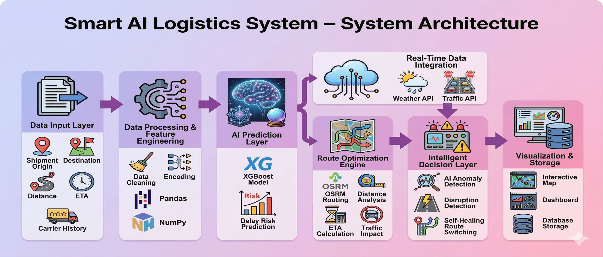
System Architecture
2. Data Processing
Data cleaning and preprocessing
Feature engineering using Pandas & NumPy
3. AI Prediction Layer
XGBoost model analyzes processed data
Predicts shipment delay risk
1. Data Input Layer
Shipment origin & destination
Distance and ETA
Carrier history
4. Real-Time Data Integration
Weather API
Traffic API
5. Route Optimization
Route planning using OSRM
Distance and ETA calculation
Traffic impact analysis
6. Intelligent Decision Layer
AI anomaly detection
Disruption detection
Automatic route switching
7. Visualization & Storage
Interactive logistics dashboard
Map-based monitoring
Database storage for analysis

Slide 7


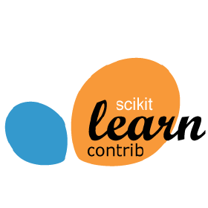


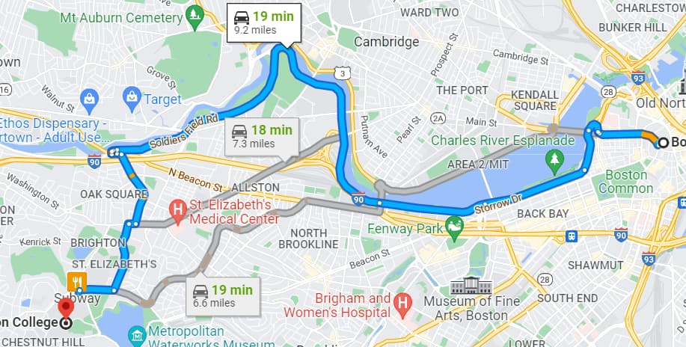


Tech stack
The system is built using a combination of machine learning, backend development, and real-time data integration technologies to enable intelligent logistics prediction, route optimization, and interactive visualization.
Then list the points:
Python – core development
Flask – integration of back-end and front-end
Scikit-learn – powerful machine learning library
Pandas, NumPy – for numeric calculation
Folium – For real time interactive map visualization
Matplotlib – Plotting the datas
MongoDB – non-relational database
Notes:
5

Slide 8
Impact & Benefits
IMPACT
1. Faster and More Reliable Deliveries
2. Real-Time Logistics Intelligence
3. Reduced Operational Risks
AI-powered prediction using XGBoost helps identify shipments that may face delays before they happen
Integration with OpenWeather API and TomTom Traffic API enables real-time monitoring of weather and traffic conditions
AI anomaly detection identifies unusual shipment patterns and potential disruptions in the logistics network.
BENEFITS
1. Optimized Route Selection
2. Reduced Transportation Costs
3. Self-Healing Logistics System
Multiple routes generated using Open Source Routing Machine (OSRM) allow the system to choose the most efficient path.
Efficient routing lowers fuel consumption and minimizes unnecessary travel time.
When disruptions occur, the system automatically recommends alternative routes to maintain delivery efficiency.

Slide 9
Challenges Faced & Solutions
Challenges | Solutions
Real-time logistics data is uncertain (traffic, weather). | Integrated live APIs for traffic and weather to improve prediction accuracy.
Detecting unexpected shipment delays. | Implemented AI Anomaly Detection to identify abnormal routes and high-risk shipments.
Sudden disruptions during transportation. | Built an AI Disruption Simulator to predict future delay scenarios.
Route failure due to high delay risk. | Developed a Self-Healing Route System that automatically switches to a safer alternative route.

Slide 10
Future Scope
Real-Time IoT Integration: In the future, the system can integrate with IoT devices like GPS trackers and vehicle sensors to collect real-time shipment location, temperature, and road conditions for more accurate predictions.
Advanced AI Models: More advanced machine learning and deep learning models can be used to improve delay prediction accuracy and optimize routes dynamically.
Live Traffic & Incident Data Integration: The system can integrate with real-time accident alerts, road closures, and construction updates to automatically reroute shipments.
Autonomous Logistics Decision System: The platform can evolve into a fully autonomous logistics management system capable of making real-time decisions without human intervention.
Scalable Cloud Deployment: Deploying the system on cloud platforms can allow logistics companies to manage thousands of shipments simultaneously with high scalability.

Slide 11
Conclusion
While large logistics companies in India use Al for route optimization and delivery prediction, our system combines early delay warning, disruption simulation, anomaly detection, and Al-assisted rerouting in a single decision-support platform.
The system integrates traffic data, weather conditions, and machine learning models to provide intelligent route recommendations.
Advanced features such as AI Anomaly Detection, Disruption Simulation, and Self-Healing Routing make the system more adaptive to real-world logistics challenges.
The solution provides data-driven decision support, helping logistics managers reduce delays, operational costs, and delivery risks.
Overall, the proposed system highlights the potential of AI-powered smart logistics for building more efficient, reliable, and intelligent supply chain networks.

Slide 12


