Slide 1

Docker Deployment on AWS EC2
MINOR PROJECT II (CUTM1577)
Name:- Soumya Ranjan Nayak
Reg.no:- 200301120175
Branch:- CSE
Sem:- 8th
Guided by:- Prof. Rajkumar Mohanta

Slide 2
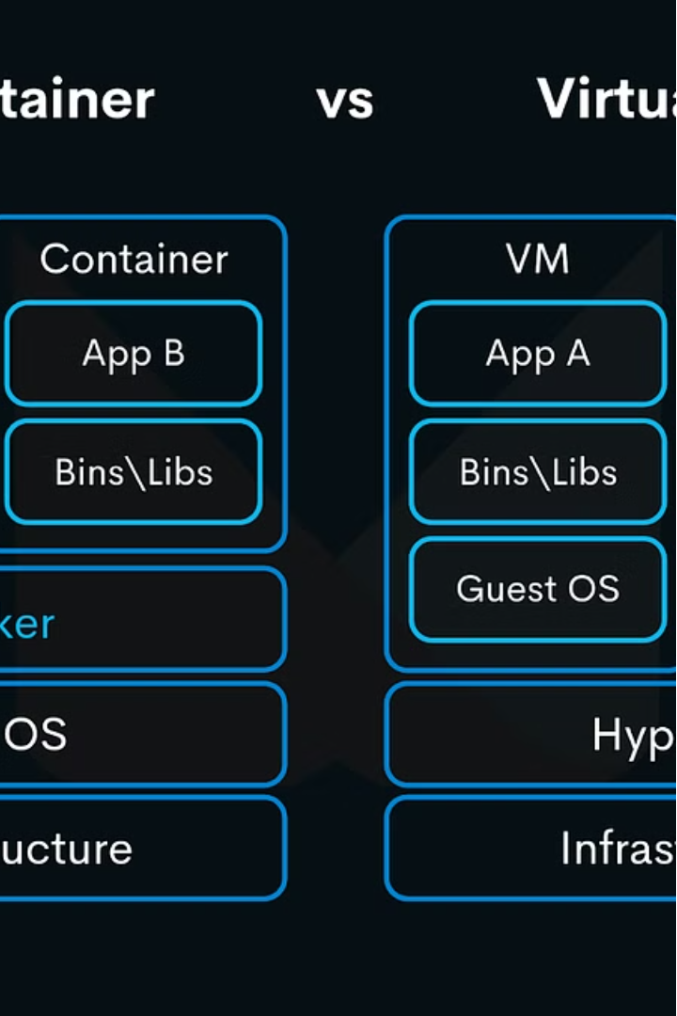
Docker Deployment on AWS EC2
Docker is a powerful platform that enables developers to build, deploy, and run applications in a consistent, reproducible environment. This presentation will explore the process of deploying Docker containers on Amazon EC2, a popular cloud computing service, to harness the benefits of containerization in the cloud.
By Soumya Ranjan Nayak

Slide 3
Docker Fundamentals
Containers
Images
Registry
Docker containers package an application and its dependencies into a standardized unit for software development.
Docker images are read-only templates used to create containers, containing all the necessary components to run the application.
The Docker registry is a service for storing and distributing Docker images, providing a centralized location for developers to access and share images.

Slide 4
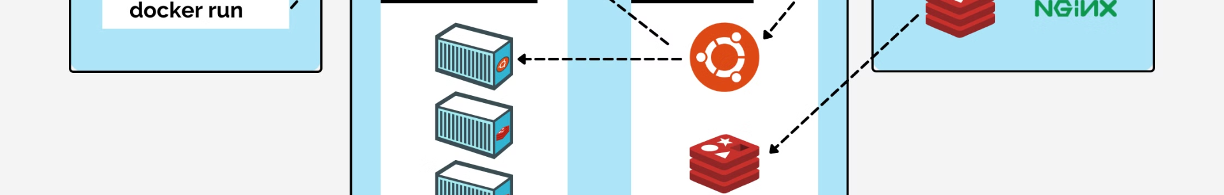
Docker Architecture
Docker Daemon
1
The Docker daemon is a background process that manages the lifecycle of Docker containers and images.
2
Docker Client
The Docker client is the primary interface for users to interact with the Docker daemon and execute Docker commands.
Docker Registry
3
The Docker registry is a centralized repository for storing and distributing Docker images, allowing for easy sharing and deployment of applications.

Slide 5
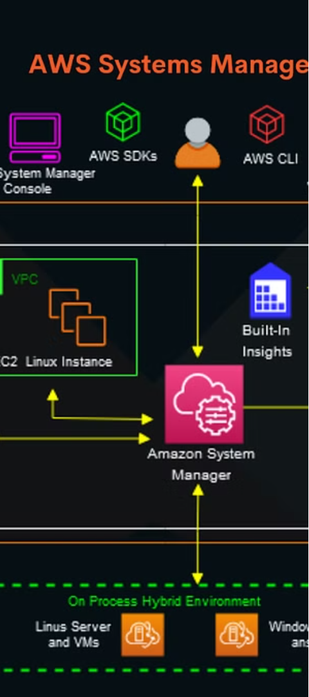
Docker Containers on AWS EC2
EC2 Instances
Docker Engine
Amazon Elastic Compute Cloud (EC2) provides the infrastructure to host Docker containers, offering scalable and reliable compute resources.
The Docker engine is installed on EC2 instances, enabling the deployment and management of Docker containers in the AWS cloud.
Container Orchestration
Services like Amazon ECS and Amazon EKS provide container orchestration capabilities to manage the lifecycle and scaling of Docker containers on AWS.

Slide 6




Deploying Docker Containers on AWS EC2
Build Docker Image
Push to Registry
Launch EC2 Instance
Deploy Container
Upload the Docker image to a registry, such as Amazon Elastic Container Registry (ECR), for easy deployment.
Create a Docker image that encapsulates your application and its dependencies.
Provision an EC2 instance and install the Docker engine to host your containerized application.
Pull the Docker image from the registry and run the container on the EC2 instance, making your application available.

Slide 7



Configuring Docker Networking on AWS EC2
Virtual Private Cloud
Subnets
Security Groups
Leverage AWS VPC to create a secure, isolated network environment for your Docker containers.
Organize your Docker containers into subnets to control network traffic and enhance security.
Use security groups to define firewall rules and control inbound and outbound traffic to your Docker containers.

Slide 8
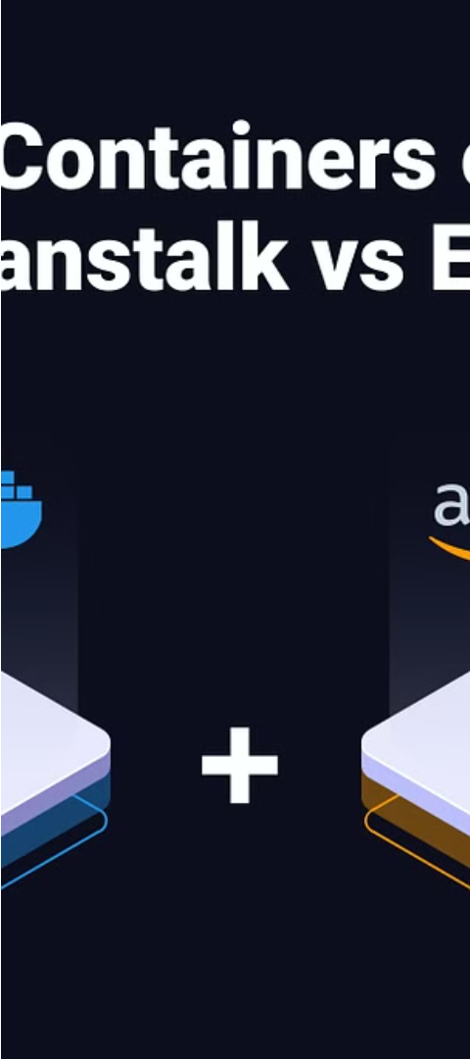
Scaling Docker Containers on AWS EC2
1
Auto Scaling
2
Load Balancing
Automatically scale the number of Docker containers based on demand and resource utilization.
Distribute incoming traffic across multiple Docker containers using AWS Load Balancing services.
3
Container Orchestration
Leverage container orchestration platforms like Amazon ECS or Amazon EKS to manage the scaling and deployment of Docker containers.

Slide 9
Monitoring and Troubleshooting Docker on AWS EC2
AWS CloudWatch
Collect and analyze metrics for Docker containers, including CPU, memory, and network usage.
Amazon ECS/EKS
Utilize the container orchestration services to monitor the health and performance of Docker containers.
AWS X-Ray
Analyze and debug distributed applications running in Docker containers on AWS EC2.

