Slide 1
Task-2
Finding vulnerability of a given website

Slide 2

Steps….
Open virtual box and login Linux
Open a virtual bank website, zero.webappsecurity.com
open Net speaker, if it is not available use the OWSAP zap app for vulnerability finding
Open OWSAP Zap then give details of website either URL or IP address
Start attacking
After completing click on the report and save it as a .html file
In the report all required will be obtained like vulnerability, URLs and the solution

Slide 3
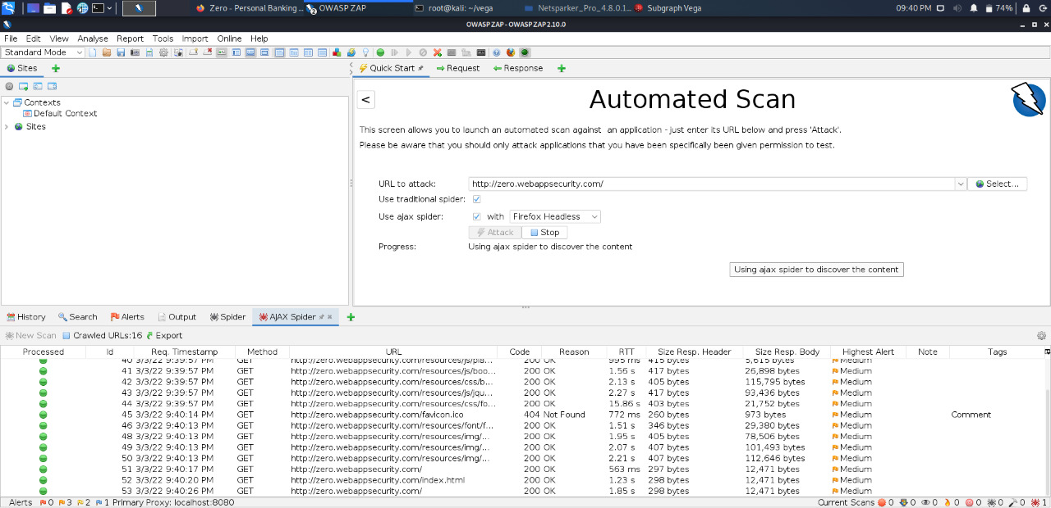

Slide 4
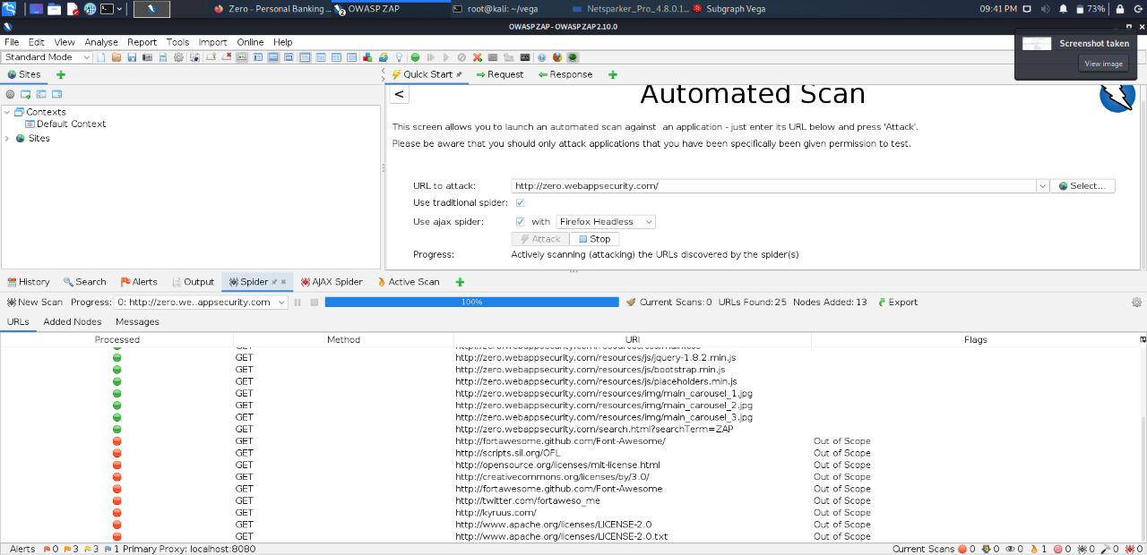

Slide 6
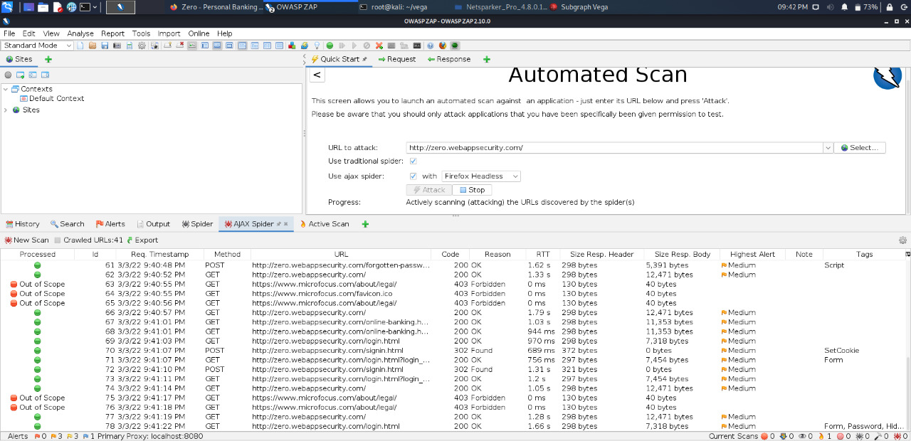

Slide 7
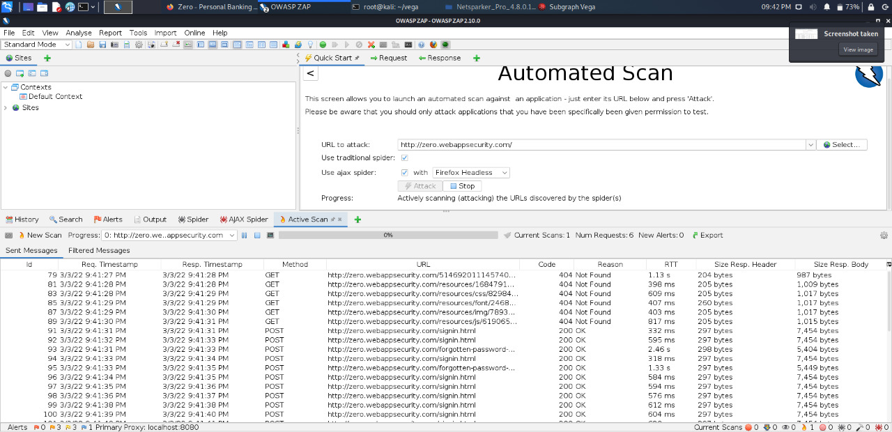

Slide 8
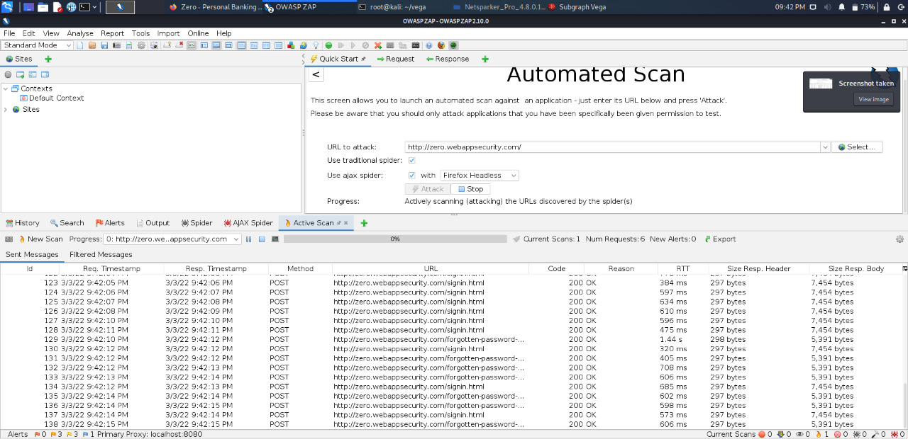

Slide 9
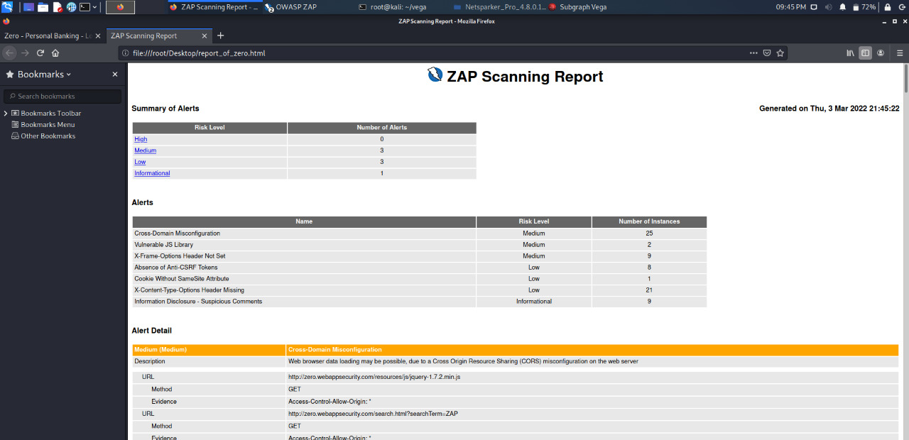

Slide 10
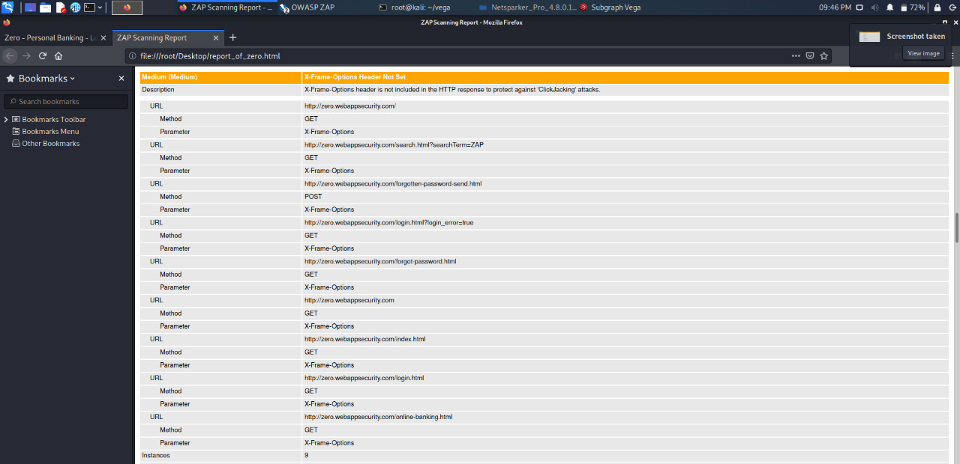

Slide 11
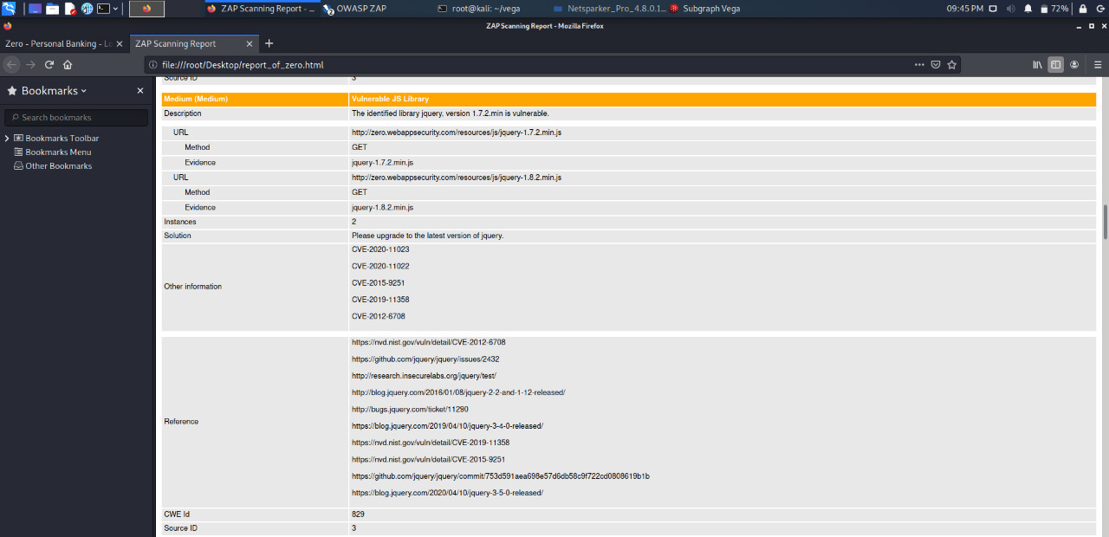

Slide 12
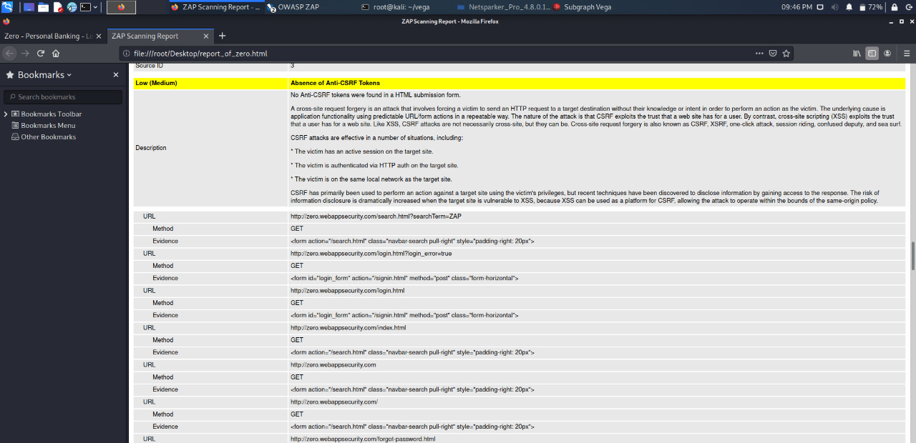

Slide 13
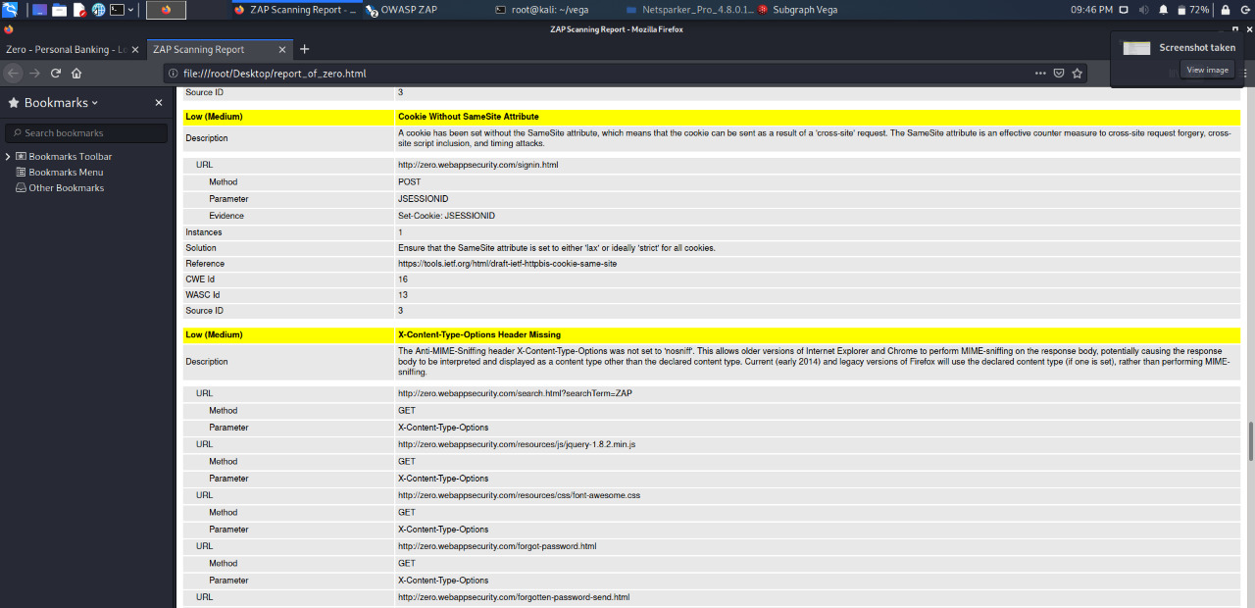

Slide 14
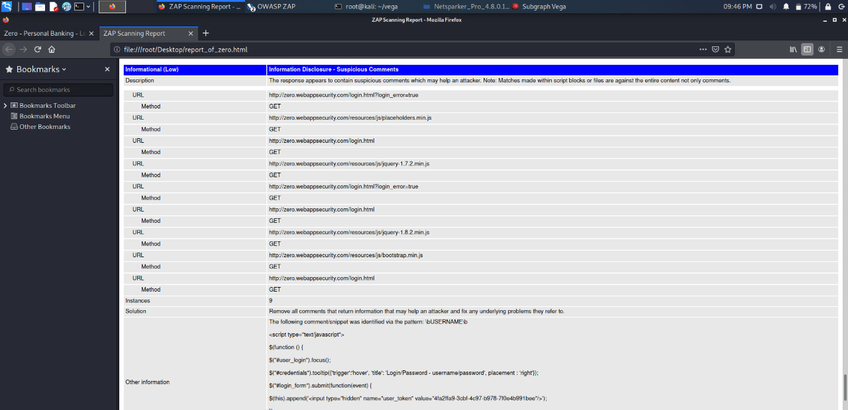

Slide 15
Outcome
In the report we can see, they are divided into 4 parts
Low:- vulnerability with low risk
Medium:- vulnerability with medium risk
Critical:- vulnerability with high risks, easy for black hat hacker to hack
Informational:- a vulnerability which leaks critical information of a website

