Slide 1
TRAIN HARD. FLOW SLOW. BREATHE DEEP.
PANCHKULA • BECSE (AIML) • PROJECT-BASED EVALUATION I
PULSE
Fitness Club — Website Development
A responsive, multi-page HTML / CSS / JS website for a gym, indoor games, yoga, pilates and meditation club.

Slide 2
CONTENTS
WHAT WE'LL COVER
01
Project Objective & Scope
02
Tech Stack & File Structure
Why PULSE exists and what the site needed to deliver
HTML / CSS / JS kept in separate, commented files
03
Design System
04
Responsive Strategy
Colour tokens, typography and the signature heartbeat motif
Mobile-first CSS, from phone to laptop
05
Key Interactive Features
06
Rubric Mapping & Next Steps
Theme toggle, mobile nav, zero-JS FAQ accordion
How the site targets Evaluation 1 criteria, and what's next
PULSE FITNESS CLUB — PROJECT EVALUATION I
2

Slide 3
THE BRIEF
OBJECTIVE & SCOPE
Build a website for PULSE, a fitness club in Panchkula offering a gym floor, three indoor courts, and a studio for yoga, pilates and meditation — one club, every kind of workout.
KEPT FOR EVALUATION 1
✓
Full visual design, layout & responsiveness
✓
Semantic HTML5 structure
M
Multi-page site
9 linked pages, not a single scrolling page — tabs lead to real pages
✓
Minimal JS: theme toggle, nav, form check, FAQ
P
Phone-first layout
✓
Clean GitHub structure & commit history
Designed for phone first, then scaled up to tablet and laptop
D
Day / Night mode
SAVED FOR EVALUATION 2
A theme toggle that persists across the whole site
→
BMI / calorie calculators
F
Separate files
→
Schedule filtering & booking
HTML, CSS and JS kept in their own files — commented throughout
→
localStorage-backed data
PULSE FITNESS CLUB — PROJECT EVALUATION I
3

Slide 4
UNDER THE HOOD
TECH STACK
Three languages, three files, one clear job each.
HTML5
CSS3
JS (ES5+)
Structure
Design & Layout
Minimal Behaviour
9 semantic pages — header, nav, main, section, article, footer used throughout.
One shared stylesheet: design tokens, mobile-first layout, all animations.
One shared script: theme toggle, mobile nav, contact-form check. Nothing else.
WHY SEPARATE FILES?
Structure, style and behaviour stay independent — easier to read, easier to grade, and easier to extend with heavier JS in Evaluation 2 without touching markup or design.
PULSE FITNESS CLUB — PROJECT EVALUATION I
4

Slide 5
INFORMATION ARCHITECTURE
SITE STRUCTURE — 9 PAGES
Every nav tab now leads to a real page — fixing the single-page anchor problem from the first draft.
index.html
Home
about.html
gym.html
yoga.html
meditation.html
About, Trainers, FAQ
The Gym Floor
Yoga & Pilates
Meditation Room
facilities.html
schedule.html
membership.html
contact.html
Facilities & Gallery
Class Schedule
Membership Plans
Contact & Map
PULSE FITNESS CLUB — PROJECT EVALUATION I
5

Slide 6
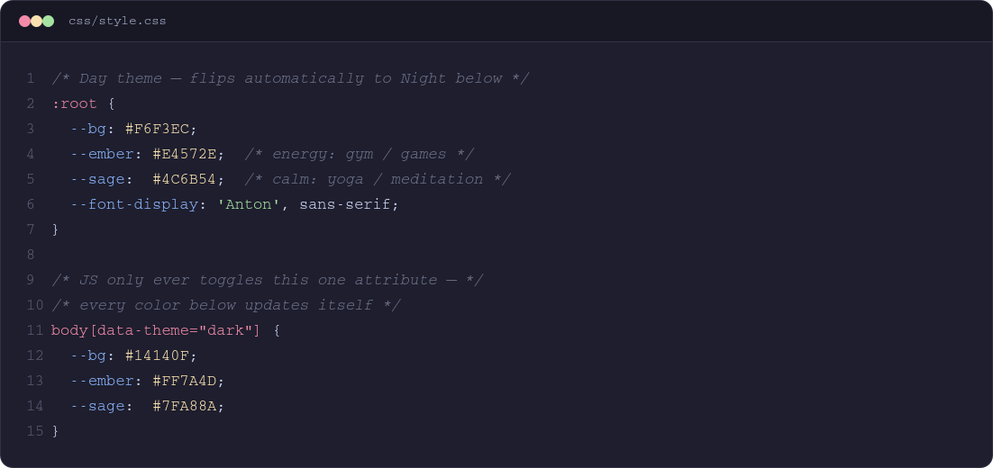
DESIGN SYSTEM
COLOUR TOKENS, DAY & NIGHT
Every colour on the site is a CSS variable. Flipping one attribute on <body> swaps the whole palette — no per-element logic needed.
Ember
Energy — gym, games
Sage
Calm — yoga, meditation
Cream
Day background
Ink
Night background
PULSE FITNESS CLUB — PROJECT EVALUATION I
6

Slide 7
DESIGN SYSTEM
TYPOGRAPHY & THE PULSE MOTIF
PULSE
THE HEARTBEAT DIVIDER
A recurring SVG line — spikes into a heartbeat, settles into a calm wave. It sits between energetic and calm sections on every page, visually connecting the gym side of PULSE to the studio side.
Anton — display headings
Train hard. Flow slow. Breathe deep.
Work Sans — all body copy, 3 weights
06:30 AM — SLOT-CALM
JetBrains Mono — stats, labels, tags
Reused on: Home · Gym
Only 3 font families, used consistently across all 9 pages — no per-page font drift.
Pure inline SVG, styled with a CSS variable — no image asset, no JS.
PULSE FITNESS CLUB — PROJECT EVALUATION I
7

Slide 8
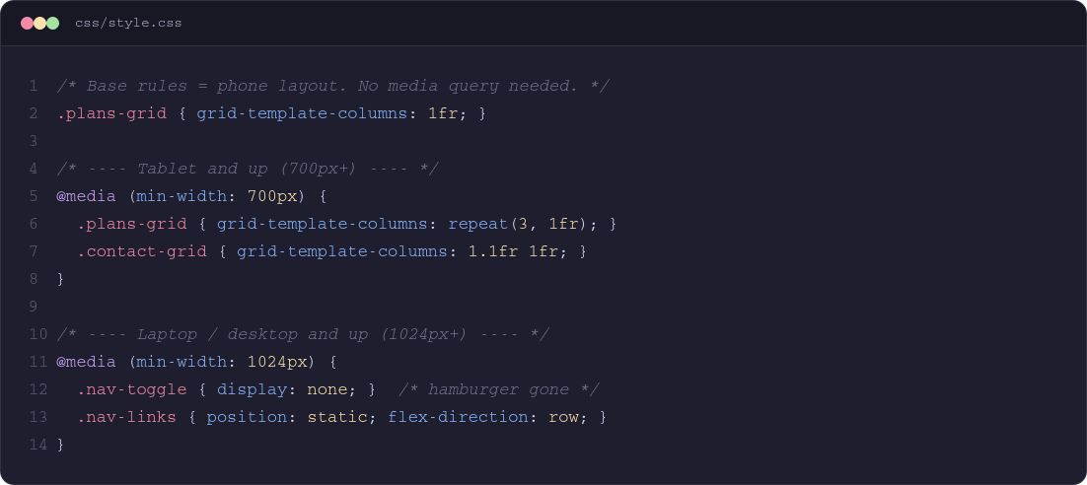
LAYOUT STRATEGY
MOBILE-FIRST, RESPONSIVE CSS
Every base CSS rule targets a phone screen. Two media queries then widen the layout — nothing is designed desktop-first and shrunk down.
1
Phone
2
Tablet
3
Laptop
< 700px
700px +
1024px +
Single column, centered text, hamburger menu
2-column grids, left-aligned copy
3-column grids, full horizontal nav bar
PULSE FITNESS CLUB — PROJECT EVALUATION I
8

Slide 9
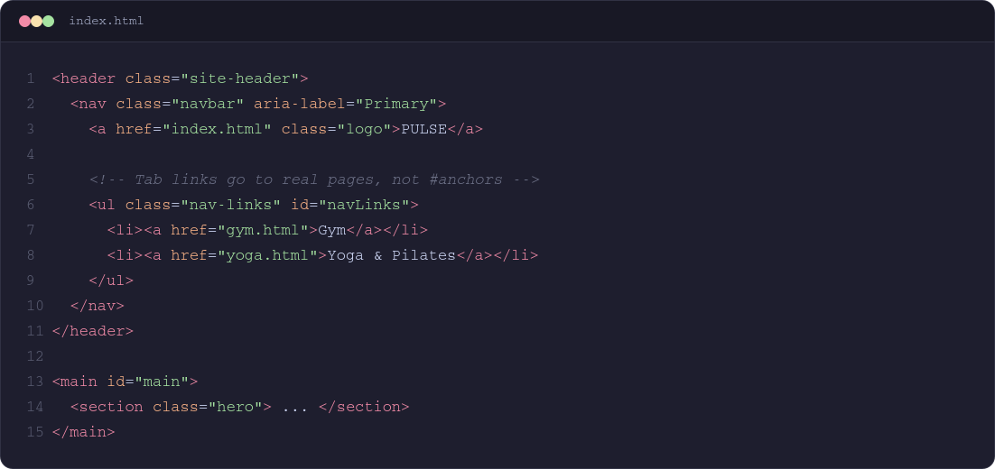
MARKUP QUALITY
SEMANTIC HTML5 & ACCESSIBILITY
<header> <nav> <main>
Real landmark elements, not endless <div>s — screen readers and graders can both navigate the page structure.
aria-label, aria-expanded
Navigation and the hamburger button carry ARIA attributes that update as the menu opens and closes.
Skip link + focus states
A hidden "skip to content" link, and every interactive element gets a visible focus outline.
Alt text on every image
Descriptive alt attributes throughout — gallery, trainers, hero — nothing left blank.
PULSE FITNESS CLUB — PROJECT EVALUATION I
9

Slide 10
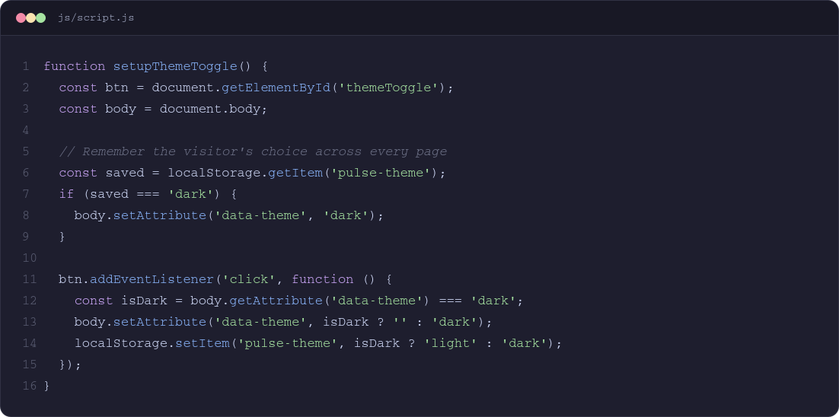
INTERACTIVE FEATURE 01
DAY / NIGHT THEME TOGGLE
One button, one attribute, every colour on the page. The choice is saved with localStorage so it holds across all 9 pages.
HOW IT WORKS
1
Click toggles data-theme on <body>
2
CSS variables re-resolve instantly
3
Choice saved to localStorage
4
Every other page reads it on load
PULSE FITNESS CLUB — PROJECT EVALUATION I
10

Slide 11
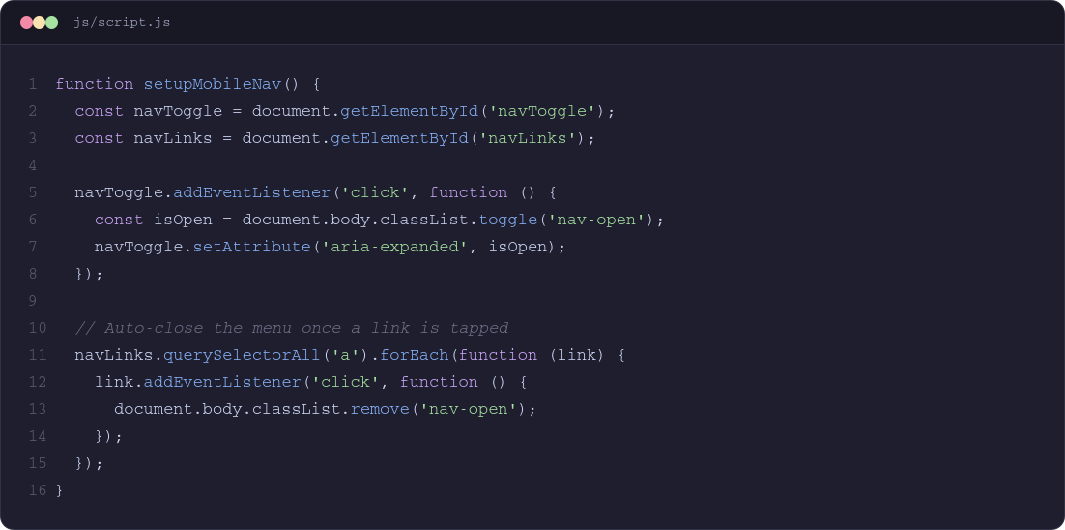
INTERACTIVE FEATURE 02
MOBILE HAMBURGER MENU
Below 1024px the nav bar collapses into a hamburger icon. Above it, CSS alone switches back to a full horizontal bar.
WHAT THE JS DOES
•
Toggles a .nav-open class on <body>
•
CSS handles the slide + fade animation
•
Auto-closes when a link is tapped
•
Updates aria-expanded for screen readers
PULSE FITNESS CLUB — PROJECT EVALUATION I
11

Slide 12
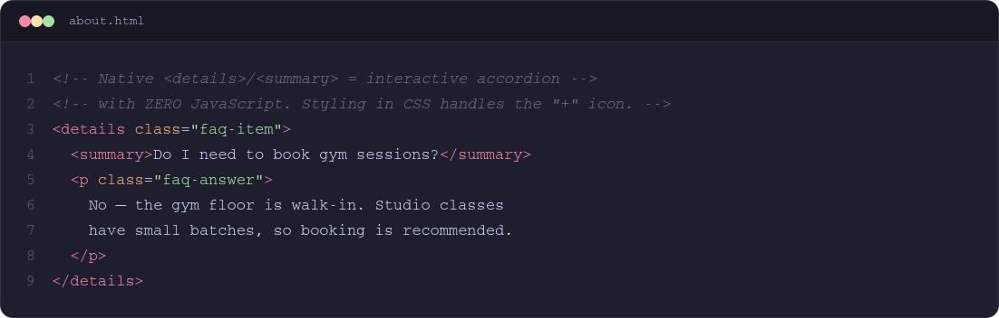
INTERACTIVE FEATURE 03
FAQ ACCORDION — ZERO JAVASCRIPT
The <details> / <summary> tags give a fully interactive, animated accordion using nothing but native HTML and CSS.
WHY THIS MATTERS
Interactivity doesn't always need JavaScript. This keeps the JS budget for Evaluation 1 spent only on the theme toggle, nav, and form — while the FAQ still feels alive and animated.
PULSE FITNESS CLUB — PROJECT EVALUATION I
12

Slide 13
PAGE-BY-PAGE
WHAT'S ON EACH PAGE
H
Home
A
About
G
Gym
Hero with CTA, stats strip, about teaser, Why Choose PULSE, facilities preview
Vision, trainer cards, star-rated testimonials, FAQ accordion
Free weights, machines, cardio deck & functional zone — hover-zoom cards
Y
Yoga & Pilates
Z
Meditation
F
Facilities
Large imagery, benefit pills: Flexibility, Core Strength, Posture
Deliberately calmer visual tone — contrast to the energetic gym pages
Full grid + indoor games detail + CSS-only masonry gallery
S
Schedule
$
Membership
C
Contact
Colour-coded energy / calm timetable, ready for Eval 2 filtering
3 plans; All Access called out as the featured, best-value option
Form, opening hours, embedded map — all pointing to Panchkula
PULSE FITNESS CLUB — PROJECT EVALUATION I
13

Slide 14
EVALUATION ALIGNMENT
MAPPED TO THE RUBRIC
1
Understanding & Communication
Full concept explained across Home + About; consistent Ember / Sage / heartbeat identity communicates the brand instantly.
2
Clarity & Organisation
9 clearly-named pages, semantic HTML, one design-token stylesheet — logical, easy to follow structure.
3
Engagement & Software Practices
Theme toggle, mobile nav, zero-JS FAQ, hover animations, and a clean, commented GitHub-ready file structure.
PULSE FITNESS CLUB — PROJECT EVALUATION I
14

Slide 15
REPOSITORY
FILE STRUCTURE & GITHUB
pulse-fitness/
├── index.html
├── about.html
├── gym.html
├── yoga.html
├── meditation.html
├── facilities.html
├── schedule.html
├── membership.html
├── contact.html
├── css/
│ └── style.css
└── js/
└── script.js
✓
One shared CSS / JS file
Every page links the same style.css and script.js — a single source of truth.
✓
Meaningful file names
gym.html, yoga.html, contact.html — no page1.html, no vague names.
✓
Inline comments throughout
Every major CSS block and JS function is commented with what it does and why.
✓
Regular, meaningful commits
Structure → design tokens → pages → interactivity, committed in logical stages.
PULSE FITNESS CLUB — PROJECT EVALUATION I
15

Slide 16
WHAT'S NEXT
ROADMAP — EVALUATION 2
Evaluation 1 is deliberately HTML/CSS-heavy. These are the features planned once heavier JavaScript is in scope.
#
R
L
BMI & Calorie Calculators
Workout Generator
Live Schedule Filtering
T
S
X
Class Booking System
localStorage-backed Data
React / useState / useEffect
PULSE FITNESS CLUB — PROJECT EVALUATION I
16

Slide 17
PULSE FITNESS CLUB · PANCHKULA · BECSE (AIML), 3RD SEMESTER
THANK YOU
Questions welcome — including a live walkthrough of the responsive layout and the theme toggle.

