Slide 1
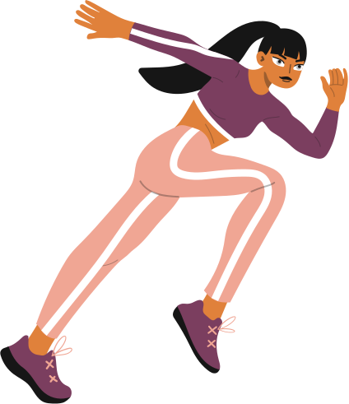

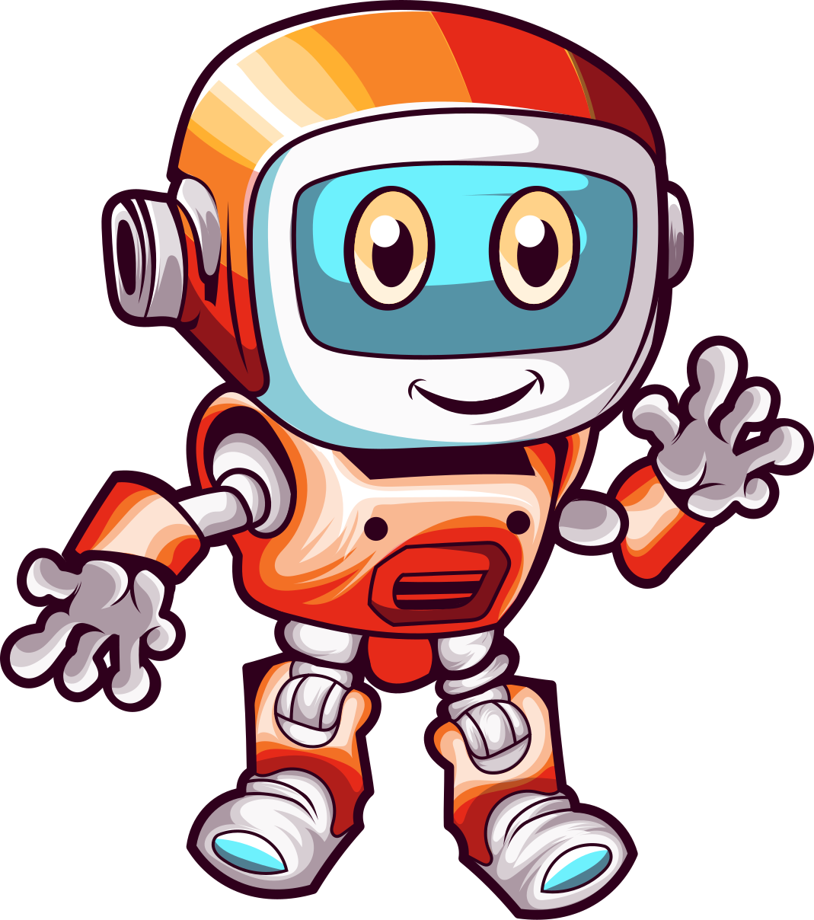
Fit AI - your pythonic way to wellness
Team Name: Health Tech Pioneers
Saptarshi Mukherjee (220150019)
Ishan Chandra Gupta (220150034)
Soumya Savarn (220150031)
Design template credits: Sir Aqui

Slide 2
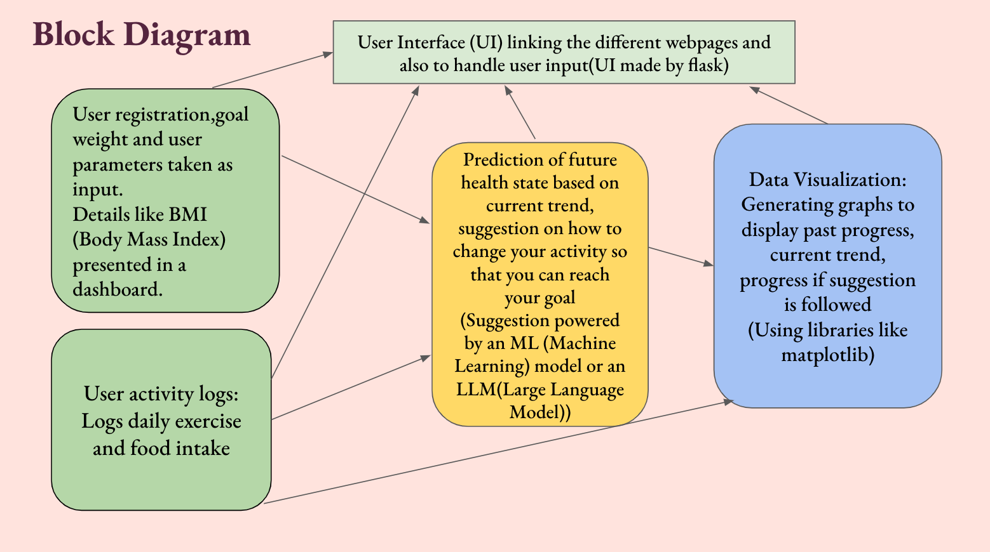
References:
1. Flask
2. Data Visualisation
FIT AI

Slide 3
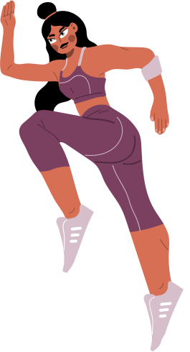

Loop of learning
Start
Feedback
Improvise
Outcome
With a very simple UI anyone can start with registering his daily logs of activity and health status
Ask for a feedback whenever needed and model will give you a suggestion depending upon your current state
Adjusts output based on target and current trend. Both User and machine will become aware of the future and a continuous loop of learning will start
Predictive capability will set the foundation for a more informed, motivated, and health-conscious society

