Slide 1
LBSN2GNN: Hypergraph Embedding Using Graph Neural Network for Location Based Social Network
Project Proposal Presentation :
CSE 5717: Big Data Analytics
Group 4: Chinmaey Sharad Shende, Soumyashree Sahoo
Presenter: Soumyashree Sahoo

Slide 2
Introduction:
Location-based social networks (LBSNs)
User’s mobility and social interactions
Two major approaches used for correlation between user’s mobility and social interactions:
1. Friendship prediction
2. Location prediction

Slide 3
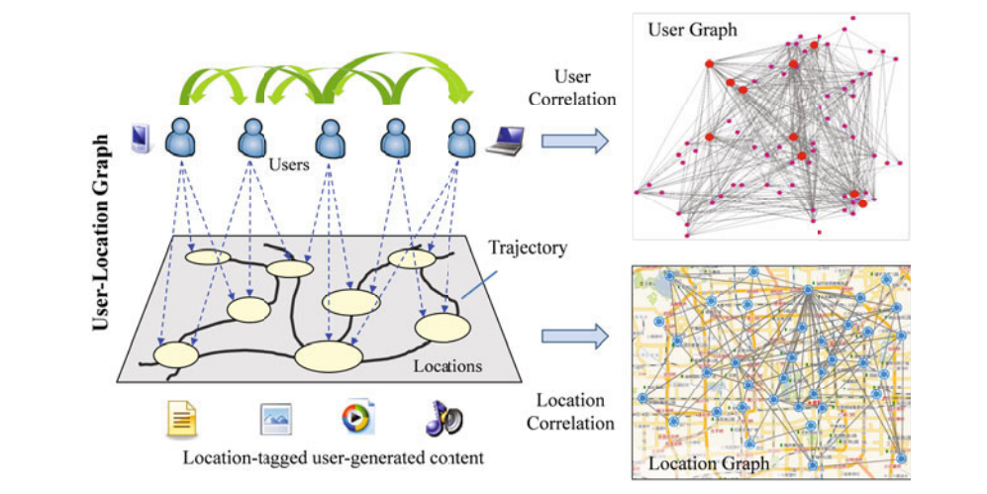
LBSN: Location Based Social Networks

Slide 4
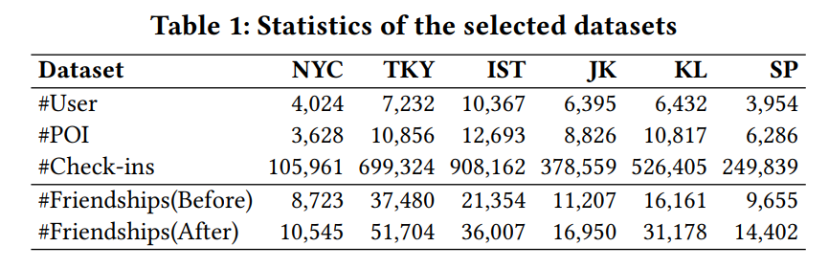
Background:
Proposed approach: LBSN2Vec (Revisiting User Mobility and Social Relationships in LBSNs: A Hypergraph Embedding Approach)
LBSN2Vec designs hyper-graph embedding approach that involves 3 stages.
Data collection
LBSN2Vec
Evaluation of dataset

Slide 5
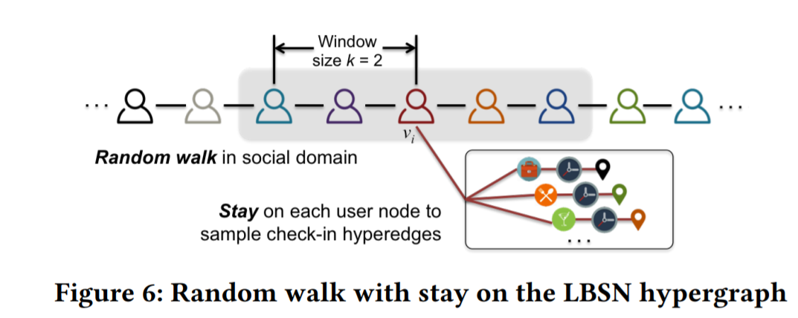
Graph Embeddings:
Factorization based approach
Graph sampling approach

Slide 6
Related Work:
LBSN2VEC++
Hin2Vec
GNN-FiLM
Hypergraph Convolution and Hypergraph Attention
Hypergraph neural networks
[2] Dingqi Yang, Bingqing Qu, Jie Yang, and Philippe Cudr´e-Mauroux ”LBSN2Vec++: Heterogeneous Hypergraph Embedding for Location-Based Social Networks”
[3] Marc Brockschmidt ”GNN-FiLM: Graph Neural Networks with Featurewise Linear Modulation.”
[4] Song Baia, Feihu Zhanga, Philip H.S. Torra ”Hypergraph Convolution and Hypergraph Attention”
[5] Y. Feng, H. You, Z. Zhang, R. Ji, and Y. Gao, “Hypergraph neural networks,” AAAI 2019, 2018.
[6] Tao-yang Fu et. al. ”HIN2Vec: Explore Meta-paths in Heterogeneous Information Networks for Representation Learning”

Slide 7
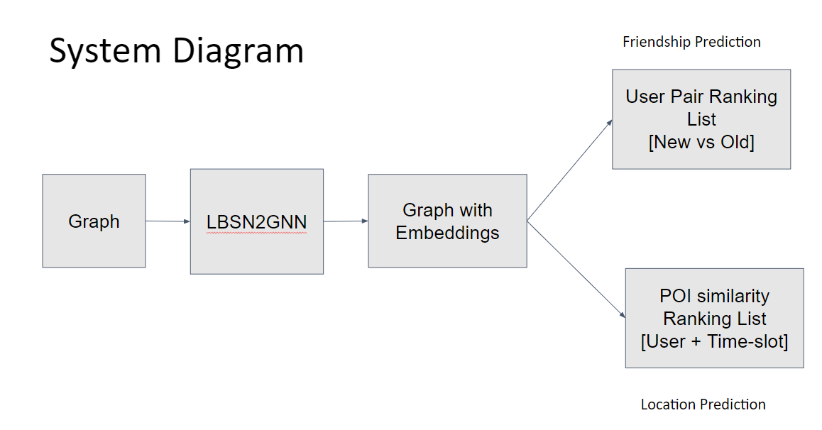

Slide 8
Empirical Data Analysis:
Dataset collection:
Dataset of Foursquare is used which contains global-scale check-ins over about two years.
Dataset of Foursquare is used which contains two snapshots of the corresponding user social network collected before and after the check- in data collection period.

Slide 9
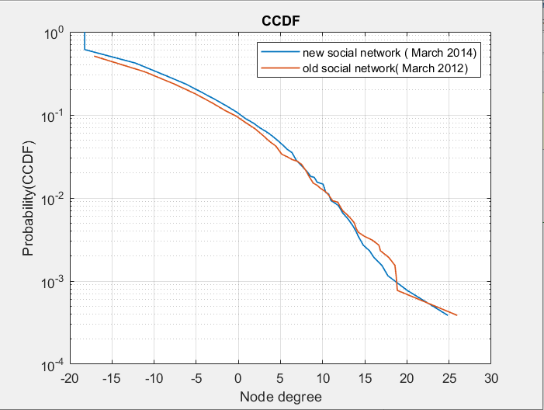
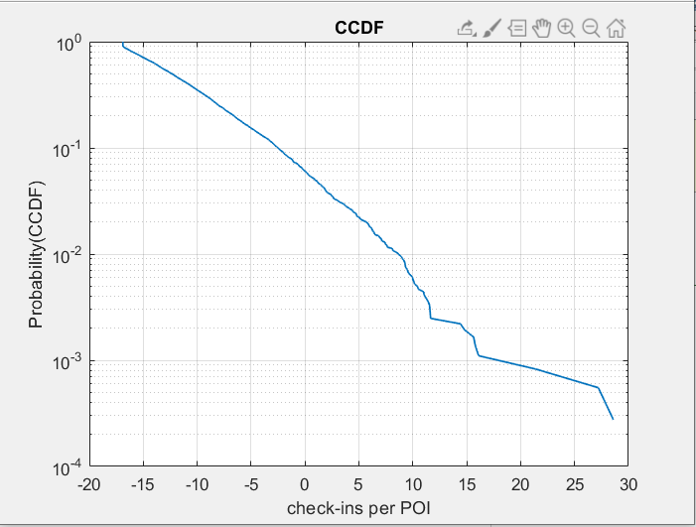
Dataset Analysis:
[7] Source code LBSN2VEC https://github.com/eXascaleInfolab/LBSN2Vec

Slide 10
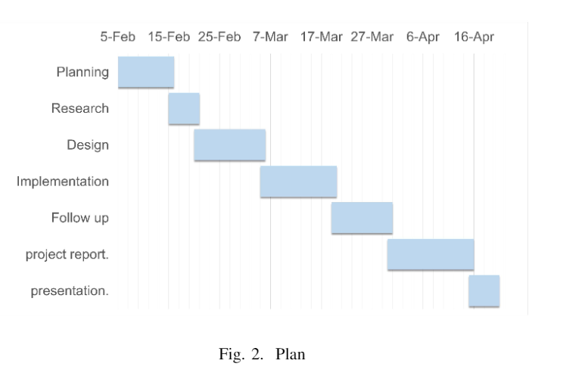
Responsible Contents:
1) Introduction + background: Soumya
2) Related work (or survey): Chinmaey and Soumya
3) Proposed directions of technical components: Chinmaey
4) Dataset preparation + plan of experimental studies: Soumya
5) References: Soumya

Slide 11
THANK YOU!

