Slide 1
LBSN2GNN
Project Proposal Presentation :
CSE 5717: Big Data Analytics
Group 4: Chinmaey Sharad Shende, Soumyashree Sahoo
Notes:
Revisiting User Mobility and Social Relationships in LBSNs: A Hypergraph Embedding Approach : Main Paper

Slide 2
Introduction:
Location-based social networks (LBSNs)
User’s mobility and social interactions
Two major approaches used for correlation between user’s mobility and social interactions:
1. Friendship prediction
2. Location prediction
Notes:
As Location based social networks( Facebook/Twitter) have recently gained much attention. These social networking sites accumulates vast knowledge, it enables impact of mobility and social relationships in between users and also can help with friendship and location prediction functionalities.
Friendship prediction : emphasizes on recommending social relationships that are likely to be established in future
Location prediction : predicts to which POI a user will go to at a given context( at a certain time).
These approaches often requires tedious effort from experts and to overcome this limitation, automatic feature learning in terms of application of networks or graphs embeddings.
System diagram:-
The figure presents LBSN data in form of a hypergraph, that has four key data domains,i.e., spatial (locations check-ins),temporal( time of check-in),semantic(categorization of venue/locations) and social(friendship nodes/users). This graph contains edges(black dotted line- friendships) between two users in the social network, hyperedges( check-ins) linking four nodes, representing user’s presence at a POI at a specific time along with the semantic information representing user’s activity at location.
Existing graph embedding techniques can’t fully grasp the complex structure of LBSNs. Against this background, human mobility and social relationships were revisited in LBSNs and we want to incorporate complex structure of GNN(graph neural network) for efficient correlation of user’s mobility and social interaction.
Our new approach:
New approach LBSN2GNN: GNN supports learning the node embeddings effectively. However it would be interesting to use the GNN to learn embeddings with Hypergraphs. Using GNN we will attempt find correlation between friendship and mobility pattern taking user check-ins data and social network snapshot data. As GNN does not specify it’s application over hypergraphs we need to understand issues with Hypergraph implementation using Neural network. Also we need to understand existing neural network based implementation HIN2Vec to compare the performance.

Slide 3
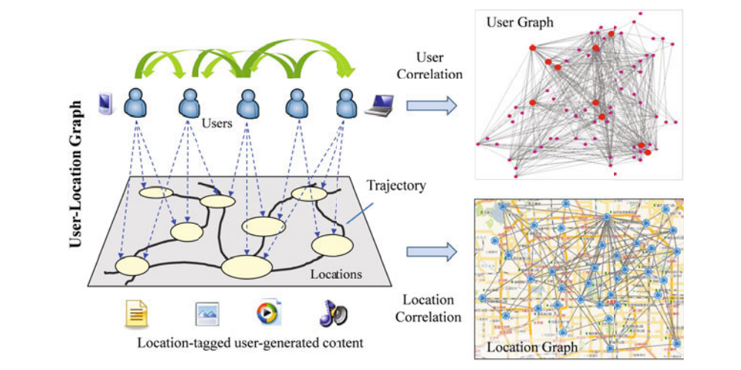
LBSN: Location Based Social Networks
LBSN:
Notes:
Location-based Social Networks (LSNs) allow users to see where their friends are, to search location-tagged content within their social graph, and to meet others nearby. These services allow users to easily share thoughts, activities, photos, and other information with friends to strengthen their connections.
In research philosophy of LBSN- User and location are two major subjects closely associated with each other. Users visit some locations in physical world leaving their location traces and generating location-tagged media content. If we sequentially connect these locations in terms of time, a trajectory will be formulated for each user. Based on these trajectories, we can build three graphs: a location-location graph, a user-location graph, and a user-user graph.
In the location-location graph (demonstrated in the bottom-right of Fig), a node (a point on the graph) is a location and a directed edge (a line on the graph) between two locations indicates that some users have consecutively traversed these two locations during a trip. The weight associated with an edge represents the correlation between the two locations connected by the edge.
In the user-location graph (depicted in the left part of Fig), there are two types of nodes: users and locations. An edge starting from a user and ending at a location indicates that the user has visited this location, and the weight of the edge can indicate the number of visits.
In the user-user graph (shown in the top-right of Fig), a node is a user and an edge between two nodes consists of two folds. One is the original connection between two users in an existing social network like Twitter. The other is the new interdependency derived from their locations, example: if two users have visited the same location or similar places in the real world over certain number of visits.

Slide 4
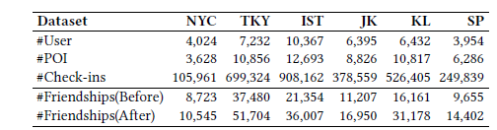
Background:
Proposed approach: LBSN2Vec
LBSN2Vec designs hyper-graph embedding approach that involves 3 stages.
Data collection
LBSN2Vec
Evaluation of dataset
Notes:
The proposed approach in paper is called LBSN2Vec which we want to follow as a baseline for our improvement.
LBSN2Vec designs hyper-graph embedding approach that involves 3 stages:-
Data Collection:- Large scale data collected over long-time period and analysis is done to reveal correlations between user check-ins and corresponding social network. The publicly available LBSN datasets from Foursquare[12] are collected, which contain user check-in data over a period and one snapshot of corresponding user social network before and at the end of two-years.
2) LBSN2Vec :- LBSN2Vec, is a proposed hypergraph embedding approach, that efficiently learn node embeddings of friendship edges and check-in hyperedges in a LBSN hypergraph. LBSC2Vec, uses social network, check-in data on LBSNs, location and temporal information of check-ins , and address the impact of mobility patterns and social relationships on each other.
3) Evaluation of dataset :- After thorough evaluation on dataset, it’s proved that LBSN2Vec outperforms state-of-the-art graph embedding techniques on both friendship and location prediction tasks. The improvement achieved in friendship prediction and location prediction is 32.95 percent and 25.32 percent, respectively.
Dataset:
Dataset is shown in slide , investigates the friendship and location prediction , which includes six cities.
Table here, summarizes the statistics of the selected datasets.

Slide 5
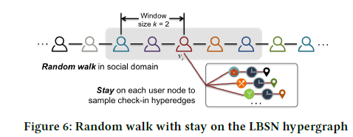
Graph Embeddings:
Factorization based approach
Graph sampling approach
Notes:
Graph embeddings method includes transformation of property graphs to a vector or a set of vectors. Embedding should capture the graph topology, vertex-to-vertex relationship, and other relevant information about graphs, subgraphs, and vertices.
Existing graph embedding approaches focus on preserving pairwise node proximity in a classical graph, which can be further classified into two categories according to the embedding learning process.
Two categories of the embedding learning process:-
Factorization based approach:- The factorization-based approach , measure pairwise node proximity as a matrix using a certain network proximity metric, such as common neighbor , and then factorize this proximity matrix using matrix factorization techniques to learn the node embeddings.
2. Graph sampling approach: - Graph-sampling approaches, sample node pairs (directly or via random walks) from a graph, and then design specific models to learn node embeddings from the sampled node pairs.
Here Random walk plays a major role in graph embeddings.
Random walk: To produce embeddings, the random walk starts in a selected node in LBSN and then we move to the random neighbor from a current node for a defined number of steps.
As shown in Figure , our random-walk with-stay scheme performs classical random walk only on user nodes based on their friendships in social domain, while for each encountered user node, it stays on the user node to sample a set of hyperedges (check-ins) from the corresponding user. In the node embedding learning process, when iterating over each user node in a random walk sequence, we not only learn from two user nodes appearing with a context window of length k(here context window refer to temporal data associated with nodes), but also stay on the corresponding user node to learn from its check-in hyperedges. In other words, the node embedding learning process alternates between these two types of edges (i.e., friendships and check-ins).
In LBSN2VEC, embedding is modeled to preserve the n-wise node proximity by maximizing the similarity between the nodes of a hypergraph and their best fit line under cosine similarity. Specifically, here the embedding model learns from hyperedges linking either 2 or 4 nodes.

Slide 6
Related Work:
LBSN2VEC++
Hin2Vec
GNN-FiLM
Hypergraph Convolution and Hypergraph Attention
Hypergraph neural networks
[2] Dingqi Yang, Bingqing Qu, Jie Yang, and Philippe Cudr´e-Mauroux ”LBSN2Vec++: Heterogeneous Hypergraph Embedding for Location-Based Social Networks”
[3] Marc Brockschmidt ”GNN-FiLM: Graph Neural Networks with Featurewise Linear Modulation.”
[4] Song Baia, Feihu Zhanga, Philip H.S. Torra ”Hypergraph Convolution and Hypergraph Attention”
[5] Y. Feng, H. You, Z. Zhang, R. Ji, and Y. Gao, “Hypergraph neural networks,” AAAI 2019, 2018.
[6] Tao-yang Fu et. al. ”HIN2Vec: Explore Meta-paths in Heterogeneous Information Networks for Representation Learning”
Notes:
Related to LBSN:
1. LBSN2VEC++ : -
Is an improvement on proposed approach LBSN2VEC. LBSN2VEC++ learn node embeddings from both sampled friendship homogeneous edges and check-in heterogeneous hyperedges by not only capturing the n-wise node proximity encoded by the hyperedges, but also considering the embedding space transformation between node domains to fully grasp the structural characteristics of the LBSN heterogeneous hypergraph. LBSN2VEC++ additionally preserves triple-wise proximity of activity node, the transformed user and POI nodes. [Reference - 2]
2. Hin2Vec : -
HIN2Vec neural network model, designed to capture the rich semantics embedded in (heterogeneous information networks) HINs by exploiting different types of relationships among nodes. Given a set of relationships specified in forms of metapaths in an HIN, HIN2Vec carries out multiple prediction training tasks jointly based on a target set of relationships to learn latent vectors of nodes and meta-paths in the HIN. Based on comparison with proposed LBSN2VEC++, this new approach can provide guidance to understand the issues in handling the Hypergraphs with GNN. [Reference - 6]
3. GNN-FiLM :-
In GNN-FiLM , the representation of the target node of an edge is used to compute a transformation that can be applied to all incoming messages, allowing
feature wise modulation of the passed information. In GNN-FiLM, the representation of the target node of an edge is used to compute a transformation that can be applied to all incoming messages, allowing feature wise modulation of the passed information. It receives a graph as an input and uses neural network-based technique to learn and update node embeddings. [Reference - 3]
4. Hypergraph Convolution and Hypergraph Attention:-
To efficiently learn deep embeddings on the highorder graph-structured data, this paper proposes two end-to-end trainable operators to the family of graph neural networks, i.e., hypergraph convolution and hypergraph attention. This paper could provide directions to possible techniques to handle hypergraphs with GNN. [Reference - 4]
5. Hypergraph neural networks:-
A hyperedge convolution operation is designed to handle the data correlation during representation learning. In this way, traditional hypergraph learning procedure can be conducted using hyperedge convolution operations efficiently. HGNN can learn the hidden layer representation considering the high-order data structure, which is a general framework considering the complex data correlations. [Reference - 5]

Slide 7
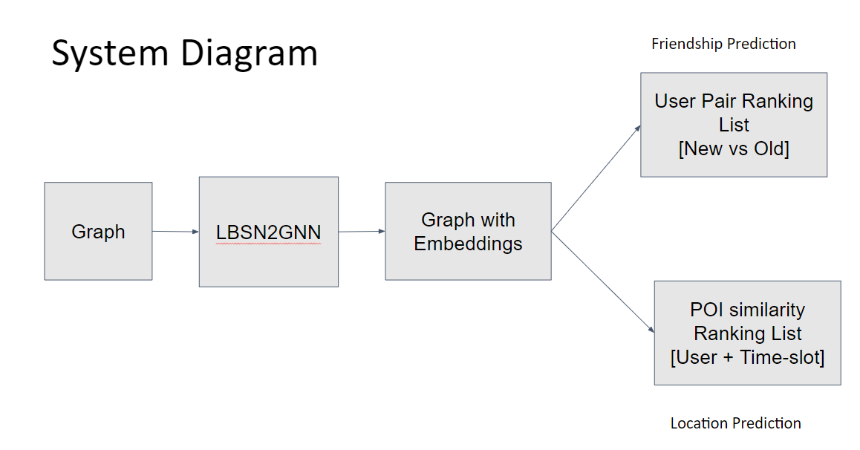
Notes:
Hypergraph of the user, POI and check-ins is input to the LBSN2GNN and is designed to compute the node embeddings of the graph. Here node embeddings are used for prediction. The cosine similarity between the pair of non-friend nodes in network before the study period is compared with the values after the study to obtain the most optimal minimum cosine distance that can be used to select the pair for potential friendship. The sum of two cosine distances related to POI is used to calculate the reference value for location prediction.
1. cosine distance between pair of location and users
2. cosine distance between pair of location and time slot.
Our new approach:
New approach LBSN2GNN: GNN supports learning the node embeddings effectively. However it would be interesting to use the GNN to learn embeddings with Hypergraphs. Using GNN we will attempt find correlation between friendship and mobility pattern taking user check-ins data and social network snapshot data. As GNN does not specify it’s application over hypergraphs we need to understand issues with Hypergraph implementation using Neural network. Also we need to understand existing neural network based implementation HIN2Vec to compare the performance.

Slide 8
Empirical Data Analysis:
Dataset collection:
Dataset of Foursquare is used which contains global-scale check-ins over about two years.
Dataset of Foursquare is used which contains two snapshots of the corresponding user social network collected before and after the check- in data collection period.
Notes:
Dataset of Foursquare is used which contains global-scale check-ins over about two years (from Apr. 2012 to Jan. 2014).
Dataset of Foursquare is used which contains two snapshots of the corresponding user social network collected before (in Mar. 2012) and after (in May 2014) the check-in data collection period.
Foursquare : Social networking service : (helping people to discover a great restaurant, an interesting coffee shop or the best places to visit. )

Slide 9
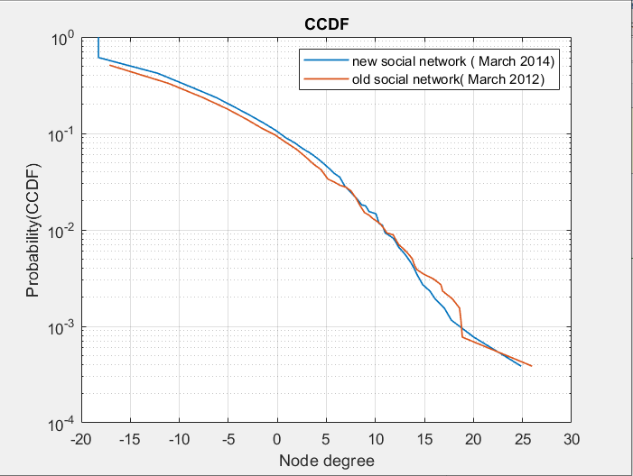
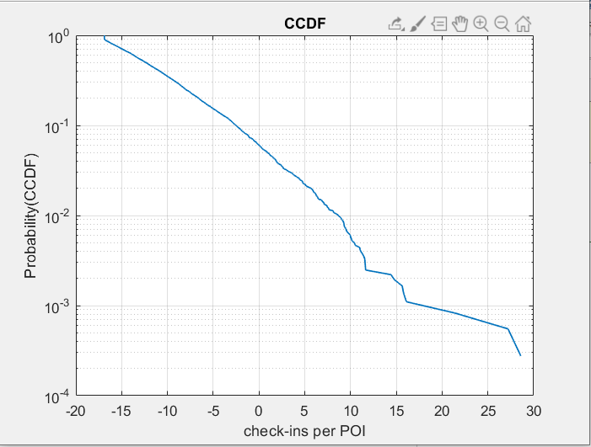
Dataset Analysis:
[7] Source code LBSN2VEC https://github.com/eXascaleInfolab/LBSN2Vec
Notes:
Plot detail:-
(In probability theory and statistics, the cumulative distribution function (CDF) of a real-valued random variable {X}, evaluated at {x}, is the probability that {X} will take a value less than or equal to {x}.
To summarize, the dataset contains 22,809,624( more than 22 million) check-ins from 114,324(114 thousand plus) users on 3,820,891(more than 3 million) POIs, and two snapshots of the corresponding user social network before (363,704 friendships) and after (607,333 friendships) the check-in data collection period. Fig 1(check-ins per user) shows CCDF plot for user check-in data.
Figure detail: ( tried to recreate the plot provided in paper)
To understand distribution of check-in data of each user in given dataset, a complementary cumulative distribution plot is made. Here we tried finding out number of check-in information per user by referring total number of venue indexes of each user. Venue index refer to semantic /location information of a certain user. Additionally, we also tried to recreate plots to study node degrees for old social network and new social network. 3Rd plots shows CCDF plot for check-ins per POI / check-in location snapshot.
We can observe that the user social network significantly expanded over the two years.
plot detail:- here a check-in value of 8.619(x-axis) corresponds to a probability of 0.009(y-axis). This means, Check-in value per user reaches 8.619 only 0.009 percent of time.

Slide 10
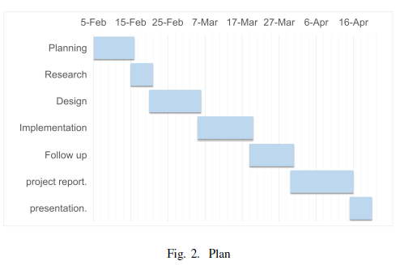
Responsible Contents:
1) Introduction + background: Soumya
2) Related work (or survey): Chinmaey and Soumya
3) Proposed directions of technical components: Chinmaey
4) Dataset preparation + plan of experimental studies:
Soumya
5) References: Soumya
Notes:
This slide shows the Ganntt chart of out task progress to be made and distribution of tasks between myself and Chinmaey.

