Slide 1
Covid-19 Prediction Using Machine Learning Methods
Final Project Presentation :
CSE 5095: Machine Learning for Time Series
Data Analysis
SOUMYASHREE SAHOO

Slide 2
Objective:
A novel methodology that combines disease estimates from mechanistic models and digital traces, via interpretable machine learning methodologies, to reliably predict and forecast COVID-19 activity worldwide.
Notes:
This paper analyses COVID-19 data at worldwide basis by gathering data from several authentic sources. Various data visualization techniques are used to study world-wide confirmed cases, total deaths, total recovery numbers.
This paper aims to comprehensively review role of Machine Learning models as one significant method in the arena of predicting and forecasting of COVID-19 pandemic.
Time series forecasting techniques such as Polynomial Regression and Support Vector Regression are deployed to perform prediction using relevant confirmed cases, deaths, and recoveries in terms of global data.

Slide 3
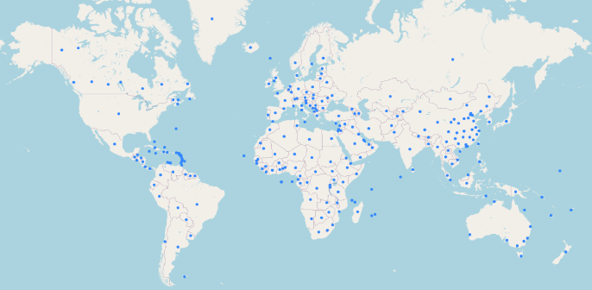
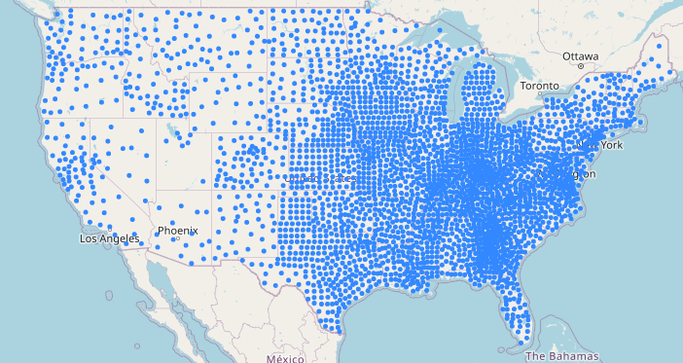
Introduction:
COVID-19 outbreak
Infected over 50,882,608 individuals and caused over 1,264,147 deaths
Confirmed cases globally and in United States
Notes:
The ongoing coronavirus disease (COVID-19) outbreak, which has infected over 50 million individuals and caused over 1.5 million deaths.
There has been many studies, focused on forecasting of COVID-19 confirmed cases using various forecasting models and focused on the forecast of COVID-19 outbreak and early response. These prediction systems can be very helpful in decision making to handle the present scenario to guide early interventions to manage these diseases very effectively.
Figure 1 and 2 are the snapshots of the visual representation of confirmed cases across world and United States. This clearly presents how the COVID-19 pandemic has been spreading over countries throughout time. The blue dots show the location data corresponding daily confirmed cases in global map and United States map.

Slide 4
Related Work:
A survey on “Forecasting Models for Coronavirus Disease (COVID-19): A Survey of the State-of-the-Art” is published in “National Center for Biotechnology Information” on 10.1007/s42979-020-00209-9.
Covid-19 Pandemic Data Analysis and Forecasting using Machine Learning Algorithms. SOHINI Sengupta, Sareeta Mugde, Garima Sharma doi: https://doi.org/10.1101/2020.06.25.20140004
Notes:
1. A survey on “Forecasting Models for Coronavirus Disease (COVID-19): introduces categorization of forecasting techniques into stochastic theory mathematical models and data science/machine learning techniques. This study discusses various challenges and provides a set of recommendations for the people who are currently fighting the global COVID-19 pandemic. The literature survey of the paper is based on broadly four categories like the size of dataset, source of dataset and techniques applied for forecasting like mathematical/analytical or machine learning/ data science.
2. SOHINI , Sareeta and Garima[2]: have analyzed COVID19 data initially at a global level and then drilled down to the scenario obtained in India. They have used Time Series Forecasting techniques including Machine Learning models like LR,SVR, Polynomial Regression and Deep Learning Forecasting Model like LSTMs are deployed to study the probable hike in cases and in near future. Here they have used root mean square method to for identifying best fitting model.
Referring these I have chosen my dataset and models in my study and analysis.

Slide 5
Methods and Materials:
Input sources:-
dataset is retrieved from the official repository of John Hopkins University
total confirmed cases b) total deaths c) total recovered cases d) daily forecasts of COVID-19 activity.
Methods to be used for prediction:
Linear regression model
Polynomial Regression Prediction model
Support vector regression model
Notes:
The dataset is retrieved from the official repository of John Hopkins University. The data consists of daily case reports and daily time series summary tables.
In this study, I have selected time-series data in CSV format having three data frames for confirmed, death, and recovered cases of COVID-19 with six characteristics. For example, province/state, country/region, last update, confirmed, death, and recovered cases.
My method uses the following sources as inputs: a) total confirmed cases b) total deaths c) total recovered cases d) daily forecasts of COVID-19 activity. The machine learning methodology uses Polynomial Regression, Linear regression model and Support vector machine model across worldwide to efficiently predict COVID prediction for future 7 days.

Slide 6
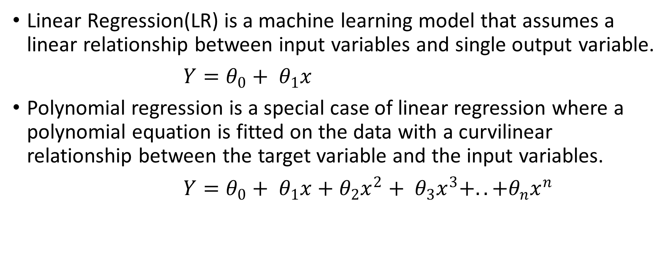
Models Overview:
Linear Regression(LR) is a machine learning model that assumes a linear relationship between input variables and single output variable.
$Y=θ_{0}+ θ_{1}x$
Polynomial regression is a special case of linear regression where a polynomial equation is fitted on the data with a curvilinear relationship between the target variable and the input variables.
$Y=θ_{0}+ θ_{1}x+θ_{2}x^{2}+ θ_{3}x^{3}+..+θ_{n}x^{n}$
Notes:
Linear Regression: If the goal is prediction, forecasting or error reduction, the LR model can be used to fit a predictive model to observed dataset of values of the response and explanatory variables. LR shows the connection between two variables by fitting a straight condition to based information. One variable is viewed as an independent and the other is viewed as a dependent. An LR1 line has a condition of the structure:
$Y=θ_{0}+ θ_{1}x$
Here x is the independent and Y is the dependent variable. $θ_{0}$ is the bias and $θ_{1}$ is the weight in the regression equation.
If asked: I have used LinearRegression() of sklearn.linear_model library.
Polynomial: In a curvilinear relationship, the value of the target variable changes in a non-uniform manner with respect to the predictor.
The linear equation can be used to represent linear relationship, but in polynomial regression, we have a polynomial equation of degree n represented as:
$$Y=θ_{0}+ θ_{1}x+θ_{2}x^{2}+ θ_{3}x^{3}+..+θ_{n}x^{n}$$
Here x is the independent and Y is the dependent variable. $θ_{0}$ is the bias. $θ_{1}$,$θ_{2}$,….,$θ_{n}$ are the weights in the polynomial regression equation. The number of higher order terms increases with increasing values of n, by making equation more complicated.
If asked: Here I have considered a degree of 10.

Slide 7
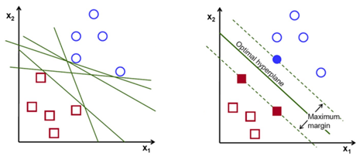
Support Vector Regression:
SVR technique is basically dependent on kernel functions, which allows for the construction of a non-linear model without changing the explanatory variables, which helps in better interpretation of the resultant model.
Notes:
Support vector machines (SVM) is a supervised learning algorithm, which is used for classification and regression problems. SVR is based on the same principles as SVM for classification ,to find a hyperplane in a d-dimensional space that uniquely classifies the data points. SVR technique is basically dependent on kernel functions, which allows for the construction of a non-linear model without changing the explanatory variables, which helps in better interpretation of the resultant model. In these algorithms, a hyperplane is found that separates the different features. The produced model by SVM does not depend on the training points that lie outside the margin but instead depends on a subset of the training data as the cost function.
A hyperplane is a function that classifies the points in a higher dimension or other words hyperplanes are the boundaries that help in the classification of the data points. If the margin for any hyperplane is maximum, then that hyperplane is the optimal hyperplane. The points which are closest to hyperplane are called support vector points and the distance of the vectors from the hyperplane are called the margins
If asked: SVR(shrinking=True, kernel='poly’, gamma=0.01, epsilon=1,degree=5, C=0.1)

Slide 8
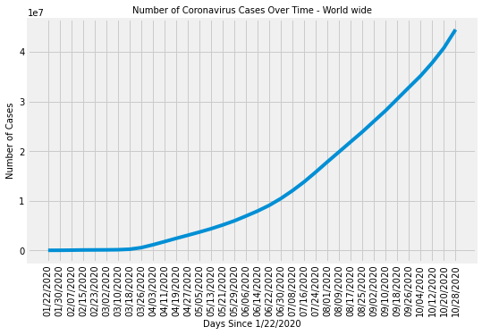
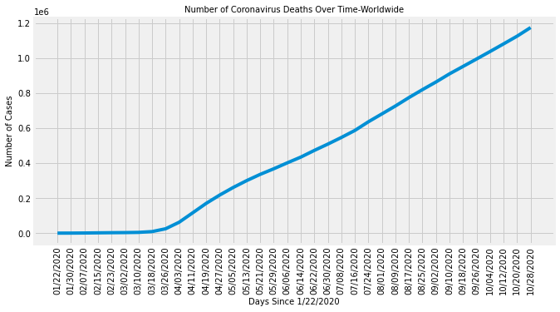
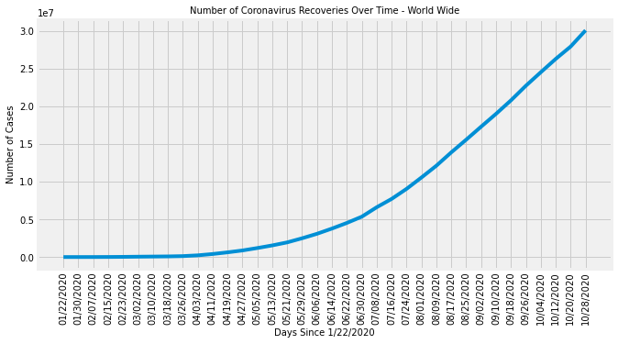
Experimental Results:
Fig 4 Number of COVID cases, deaths, and recoveries over time
Notes:
Figure-4 provided the visualization of dataset in terms of total number of cases, total number of deaths and total number of recoveries over time. In illustration it can be understood that there has been significant rise of infection count along with time. Number of death cases was diminished a little after May but gradually increasing afterwards. Along with these recoveries also have steadily growing.

Slide 9
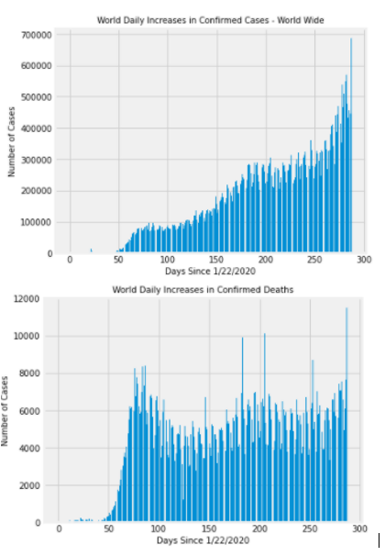
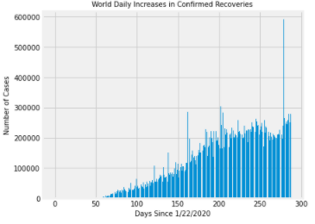
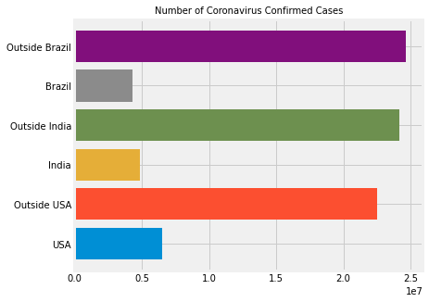
Experiments:
Fig 5 Daily increase of COVID cases, deaths, and recoveries over time
Notes:
According to Figure 5, there has been considerable increase of daily increase of confirmed cases and deaths worldwide. The infections have been increasing since September while slowing down the recoveries.
USA has been tremendously impacted in terms of number of confirmed cases and number of death counts. Recovery analysis shows that India have a great recovery rate in comparison to Brazil and USA.

Slide 10
Dataset Preparation and Evaluation:
Preparation of dataset begins by splitting the data for training, validation, and testing purpose. Pandas dataframe is used for storing confirmed, deaths and recovered csv files in form of dataframe.
World confirmed ,deaths and recovered cumulative case counts for each day are collected and reshaped.
Future days for prediction are determined based on incrementing order of days in terms of study dates.
Evaluating the model’s accuracy is an essential part of the process in creating models to describe how well the model is performing in its predictions.(r2 score)
Notes:
One index column is separately created for keeping track of dates starting Jan 22nd. Days since Jan 22nd , which is the start date is used for creating a set of values in form of NumPy array and then reshaped for prediction purpose.
As the r2 score is closely related to the mean square error(MSE) and it clearly presents variance in the prediction that is predictable from the given dataset, hence it is considered as the major evaluation metrics for prediction. Other metrics such as MAE(Mean absolute error) and RMSE(root mean square errors) are also found out.
To get accuracy of results I have used data up to August 2020. It corresponds only phase 1 of Covid-19.

Slide 11
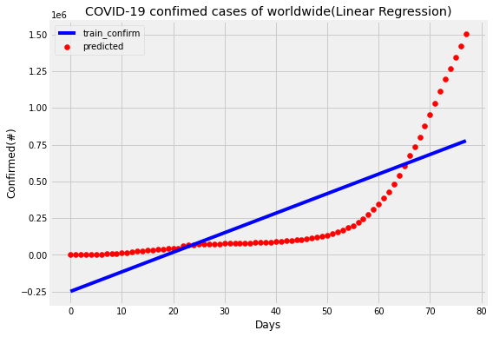
R2 score = 0.61
Notes:
To fit the linear regression model two parameters are selected considering dates and number of confirmed cases from the training, validation, and testing sets. In the verge of applying Linear regression model by thinking the continuous structure of data, a visualization is shown in Figure 6. After applying the linear regression, it can be seen that the predicted line does not fit with the independent variables. Which means that the line is unable to capture the patterns in the dataset and it may lead to under fitting situation.
The r2 score of the model is predicted as 0.61. R2 score is 61%. It means that 61% of variance is covered by the model. Now, to overcome the under-fitting problem, I must increase the complexity of the model. Here, I have used Polynomial linear regression technique because it best fit for the prediction of how diseases spread across the territory or the world.
R2 score: The coefficient of determination, denoted R² or r² and pronounced "R squared", is the proportion of the variance in the dependent variable that is predictable from the independent variable(s). It is a statistic used in the context of statistical models whose main purpose is either the prediction of future outcomes or the testing of hypotheses, on the basis of other related information. It provides a measure of how well observed outcomes are replicated by the model, based on the proportion of total variation of outcomes explained by the model.

Slide 12
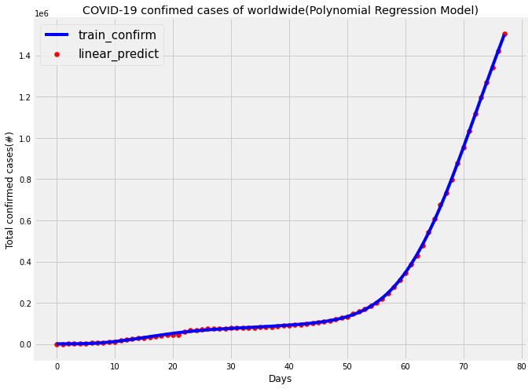
R2 score = 0.91
Notes:
Polynomial regression is a form of linear regression in which the relationship between predictive values and study data is modelled as an nth degree polynomial. In our problem, a degree of 10 is considered. I tried to find out relationships to hypothesize the result to be curvilinear. Study data is transformed in terms of polynomial value and then model is fitted using transformed independent values and to be predicted values. In the same process I try to predict cases using polynomial converted future dates.
Figure 7 shows how the polynomial line connects all points and predicts all values almost covering all data. While trying to validate the model with few data points, the confirmed cases of the data is predicted as in Table 1.
the r2 score of the model is predicted as 0.91. R2 score is 91%. It means that 91% of variance is covered by the model and can be considered to have achieved considerable accuracy and more correlated in comparison to linear regression model.

Slide 13
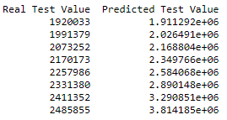
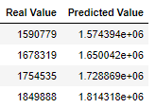
Table 1 Predicted Confirmed cases values using validation data Table 2 Predicted Confirmed cases values using test data
Notes:
Prediction using validation and testing data illustrates increasing confirmed cases values.

Slide 14
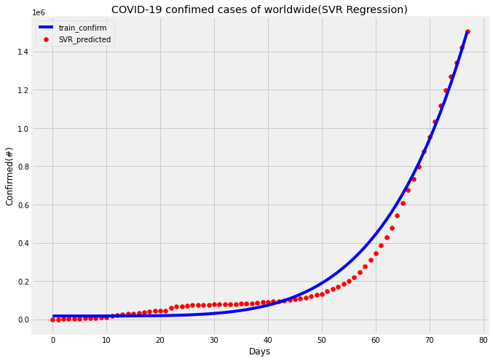
R2 score = 0.98
Notes:
The support vector regression model is linear model for prediction problems and can solve both linear and nonlinear problems. The algorithm creates a line or hyperplane which separates data into classes. Perfecting this model to our problem, the original data is to be applied to the model to predict the future cases. The generalized equation for hyperplane could be represented as $y = wX + b$, where w is the weights and b is the intercept at X=0.
SVR(shrinking=True, kernel='poly', gamma=0.01, epsilon=1,degree=5, C=0.1)
SVR model is fitted using dates index values and confirmed cases training dataset for prediction. The scatter plot function and line plot are used from matplotlib to show prediction using actual data and predicted data. In Figure 8, it’s clear that most of the prediction using SVR regression model aren’t correctly correlated with actual dataset.
After applying the SVR regression, the predicted line does not fit with the independent variables. It means that the line is unable to capture the patterns in the data. This may be an example of under-fitting. For confirmation, the r2 score of the model is predicted as 0.98. It means that 98% of variance is covered by the model and can be considered for predicting future forecast values.

Slide 15
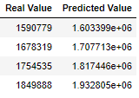
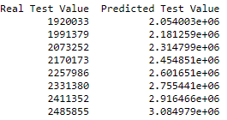
Table 1 Predicted Confirmed cases values using validation data Table 2 Predicted Confirmed cases values using test data
Notes:
To understand cumulative effect of prediction on number of confirmed cases, the accurate model is applied on validation and test data and values are shown in Table 1 and 2.
Prediction using validation and test data presents increasing trend of cases throughout time.

Slide 16
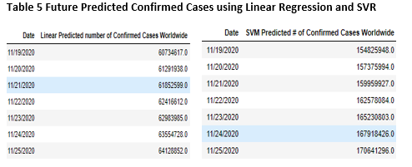
Notes:
To find out current prediction with date starting November 11th, future confirmed cases are predicted for next 7 days using models created so far. This helps to visualize the cumulative cases increasing trend in future 7 days. Table 5 shows predicted case counts using LR and SVR.

Slide 17
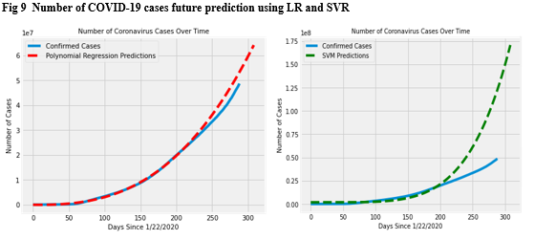
Notes:
To better understand behavior of linear and support vector models that is being created, future forecasting of COIVD-19 cases is done. In Figure 9 the increasing trend of confirmed cases can be visualized. Results show that model performed better in determining future cases by Polynomial regression model than Support Vector Regression. In Polynomial Regression model, increasing trend is more consistent with prediction line using actual non future data.

Slide 18
Conclusion
Machine Learning models help in the decision-making process based on the past data with the data analytics and data mining perspectives.
The Coronavirus data is huge in size and gathering information and retrieving interesting pattern out of the cumulative data is a challenging task. With the current data about confirmed , recovered and death across worldwide for over time durations helps in predicting and forecasting in near future.
The accuracy of model could be increased by introducing other factors such as age of person, environmental aspects, gender, and underlying health conditions to prevent the propagation of COVID-19.
According to latest reports, it is very clear that to handle this situation is by social distancing or quarantine and isolation.
By noticing the predicted values and matching with cases from John Hopkins University data we can conclude that the Polynomial Regression method is giving good prediction results than that of the LR and SVR method.
In future we can work with some deep learning methods for forecasting time series data for getting better predictions.
Notes:
The accuracy of model could be increased by introducing other factors such as age of person, environmental aspects, gender, and underlying health conditions to prevent the propagation of COVID-19.
In future we can work with some deep learning methods for forecasting time series data for getting better predictions.

Slide 19
References:
Forecasting Models for Coronavirus Disease (COVID-19): A Survey of the State-of-the-Art. SN COMPUT SCI. 2020; 1(4): 197. Published online 2020 Jun 11. doi: 10.1007/s42979-020-00209-9
Covid-19 Pandemic Data Analysis and Forecasting using Machine Learning Algorithms. SOHINI Sengupta, Sareeta Mugde, Garima Sharma doi: https://doi.org/10.1101/2020.06.25.20140004
Analysis, Prediction and Evaluation of COVID-19 Datasets using Machine Learning Algorithms, Volume 8. No. 5, May 2020 International Journal of Emerging Trends in Engineering Research Available Online at http://www.warse.org/IJETER/static/pdf/file/ijeter117852020.pdf https://doi.org/10.30534/ijeter/2020/117852020

